Slide 1
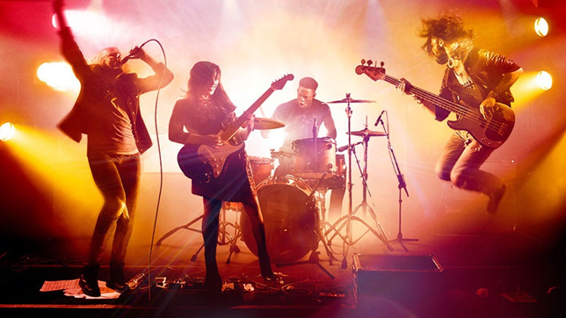
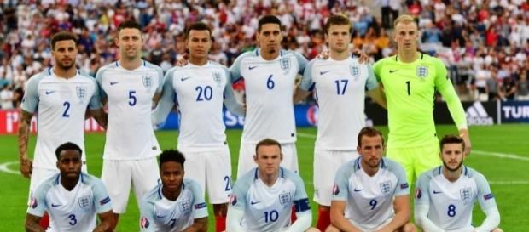
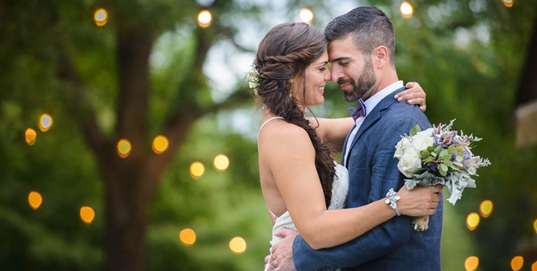

DQ: What makes a good team?
DRIFT: On your Post-It note, write down at least 3 things that you think make a strong team.
Article 28: Every child has a right to education.

Slide 2
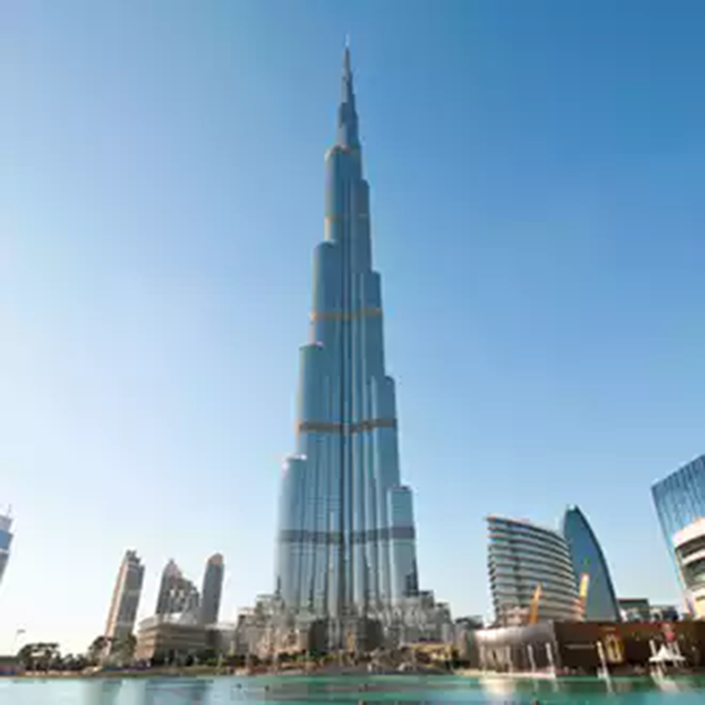
Your objective…
Today you will be working as a team
Your main objective of today is to build the tallest structure possible
To be able to create your structure, you will need to earn the materials required to build it
Build a paper structure, as tall as possible, using only paper and sellotape
As you make your shape credits, you can purchase paper and sellotape from Mrs Knifton
1 sheet of paper is 5 credits
A roll of sellotape is 10 credits

Slide 3
How you earn your money to buy materials…
Each group will be given paper, a ruler, pencil and scissors
Your task is to make as much money as possible!
(You can only make circles if you have your own compass)
2 credits
10 credits
4 credits
All sides must be equal and measure 5cm
All sides must be equal and measure 5cm
Circles must have a radius of 3 cm and a diameter of 6cm

Slide 4
Reflection…
Return to your Post-It note
How did you work successfully as a team?
Would you have done anything differently?
What areas of your team would need developing if you did this task again?

