Slide 1
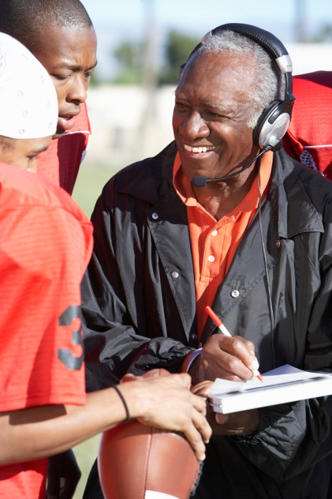

Bright Sparks
Writing: A Life Skill

Slide 2
Bright Sparks: Writing
Objectives:
To examine the importance of written communication skills

Slide 3
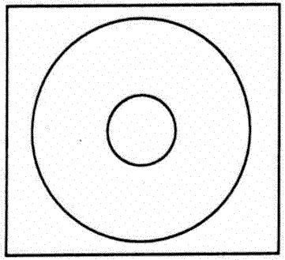
How can writing help me?
Circle map why effective writing is important
Writing
Notes:
3

Slide 4
How can writing help me?
communicate clearly
take and pass on messages
read and understand a wide range of texts
Write fluently, accurately, using accepted conventions of format, spelling, grammar and punctuation.
To help me in all walks of life
And there are more….
Notes:
4

Slide 5

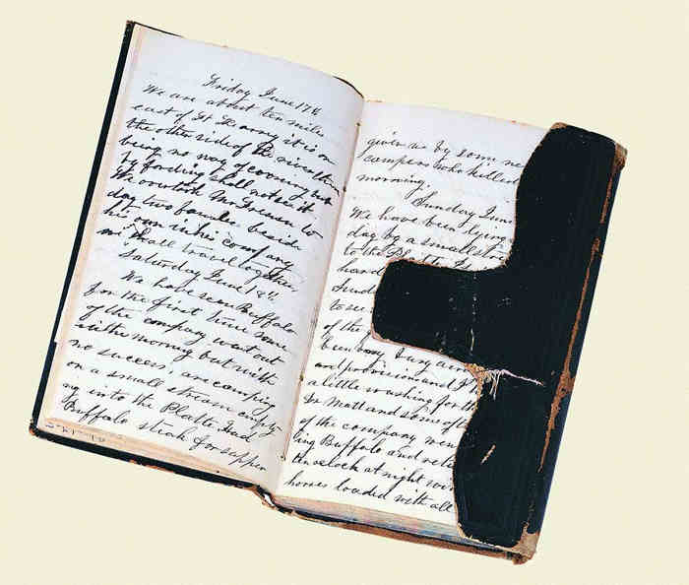
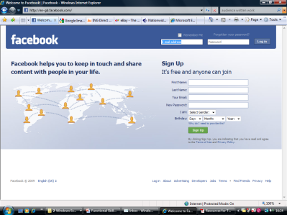
What do you write at the moment?
Make a list of the things you have to write now in life.
Put them into three categories like this:
What writing do you find difficult or try to avoid?
Why do you think this is the case?
What do you think you will need to write
in the future
in everyday life
in further study
in work.
Extension work: describe the job or career you are aiming for and think about what you will need to write in the future.
Work | Study | Personal Life
 |  | Diary
Notes:
5

Slide 6
My Writing
What do you write at the moment?
I write…
Write down as many ideas as you can. You could use some ideas from the following slide…

Slide 7


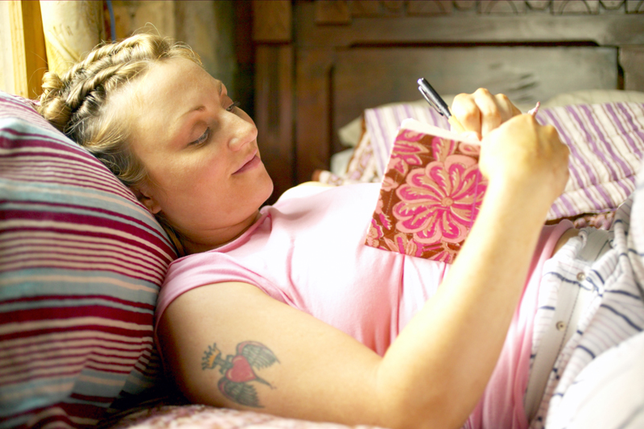
Notes:
7

Slide 8
My Writing
We all write different things for work and leisure…
Social networking
Writing music / songs
E mail
My writing
Diary Writing
School work
Website contribution

Slide 9
Audience
In everyday writing (and in later life) you will be required to write for a range of purposes and a variety of audiences.
In this lesson we will learn how the audience and purpose of a piece of writing will affect its layout, vocabulary and use of images.

Slide 10
What do we mean by Audience?
When you think of the word audience what images come to mind? How many examples of an audience can you think of?
Audience

Slide 11
How Audience
Affects Writing
Before you begin any piece of writing you should consider the audience you are writing for very carefully.
The audience for a piece of written work is the intended reader. The intended reader may be a group of parents, a Year 3 Pupil or the Prime Minister; whatever the audience you will need to adjust your writing appropriately.

Slide 12
The Audience Affect
Look at the texts shown on the following slides.
Who do you think they are written for?
Are they specifically targeted at male, female, young, old (etc) readers?
Would they appeal to a ‘specialist’ readership?
How did you decide?

Slide 13
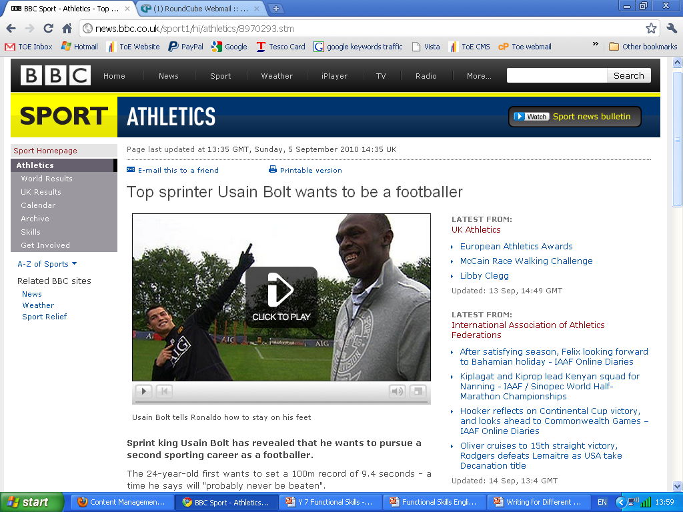

Slide 14

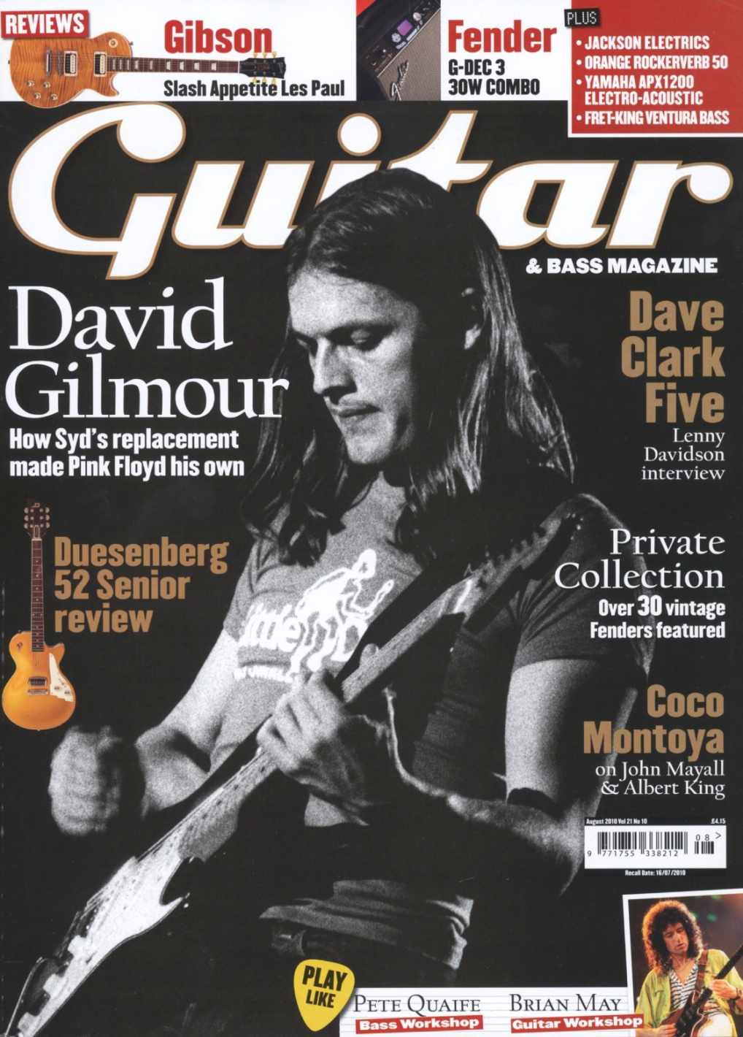

Slide 15
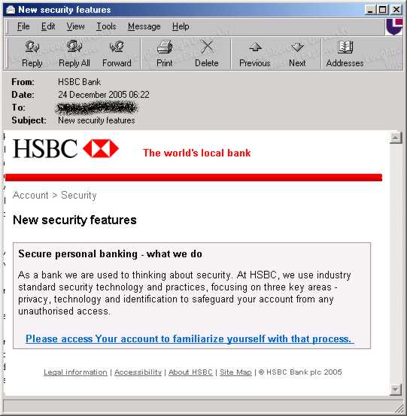

Slide 16
Writing for a Range of Audiences
Study the four texts. Look at the language, page layout and the use of images before completing the table below.
Text Title | Audience | Evidence
Notes:
Provide each pair with a variety of texts covering a range of ages, genders and specialist readerships.

Slide 17
Feedback to the rest of the group. Discuss what you have written and how you came to a decision about the intended audience of each text.
How does the audience affect a piece of writing?

Slide 18
Check your understanding
Before you begin any piece of writing always be sure of your audience and their needs.
Think about:
Who are the reader(s)? (eg customer, manager, teacher, public, friend)
Why are they reading this?
Do they already know somethings about the subject?
How old are they?
Are they male, female or both?
What is their literacy level?
Notes:
18

