Slide 1
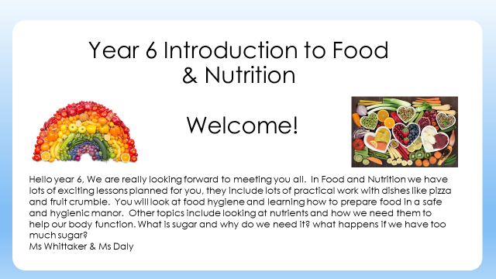
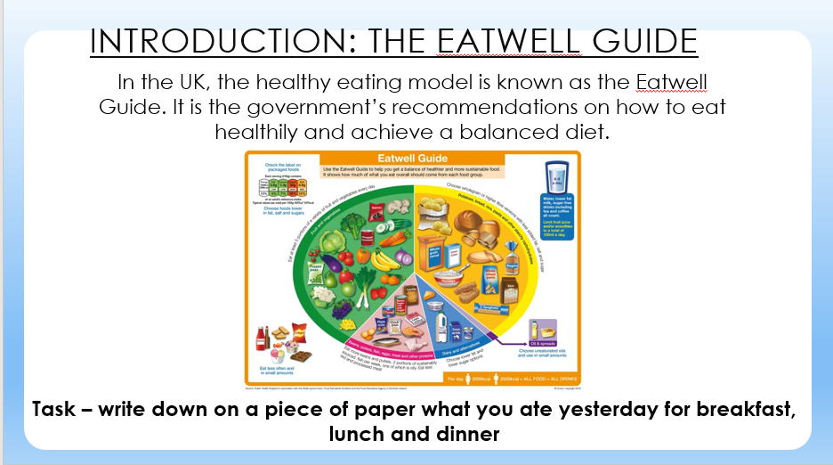
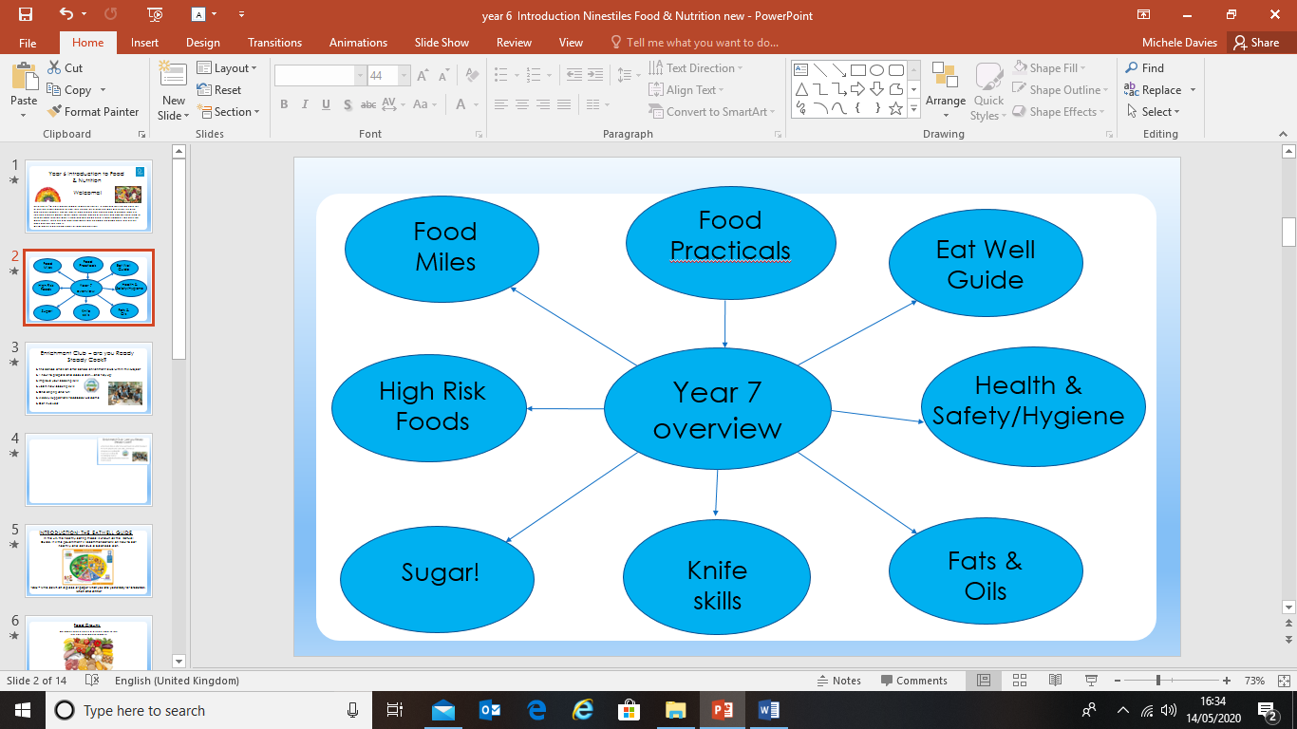
Notes:
Teacher’s Notes: Adapt this lesson by setting up a control bag (not touched) the same as above, then set up a ‘class bag’. For this, take the slice of bread out of the packet and ask the class to pass it around so that every member of the class has touched the bread. Mist with water, seal as above and label as ‘Touched’ and add the class name/code. Hang these up in your room to see which class grows the most mould (and need to wash their hands more thoroughly)!

Slide 2


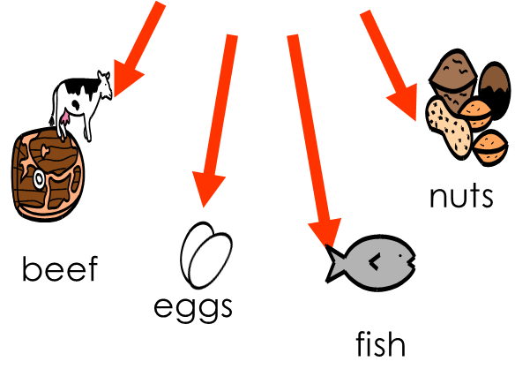

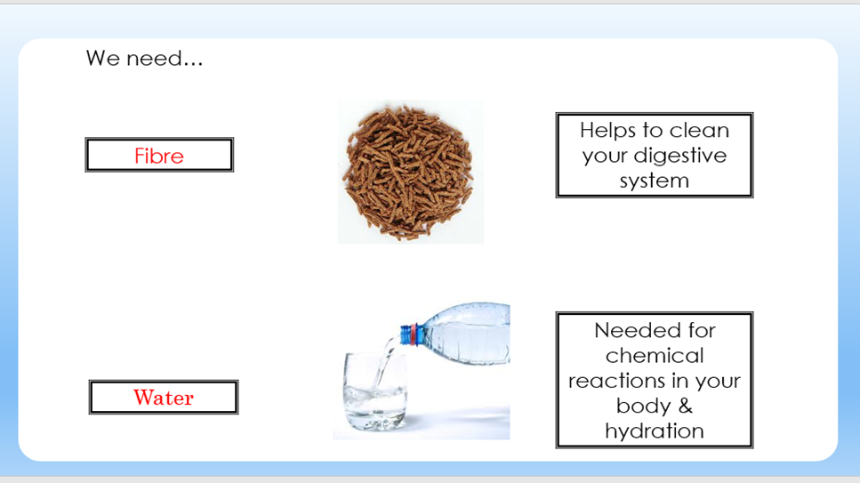
Carbohydrates are in starchy and sugary foods.
Meat & Fish contain protein.
Vitamins & Minerals are found in fruit & vegetables
Proteins help your body grow and repair itself.
Carbohydrates give you energy.
They help your bodies to work properly.
These foods contain carbohydrates.
These are really good for us.
rice
nuts
potato
cereal
pasta
beef
eggs
fish
Notes:
Teacher’s Notes: Adapt this lesson by setting up a control bag (not touched) the same as above, then set up a ‘class bag’. For this, take the slice of bread out of the packet and ask the class to pass it around so that every member of the class has touched the bread. Mist with water, seal as above and label as ‘Touched’ and add the class name/code. Hang these up in your room to see which class grows the most mould (and need to wash their hands more thoroughly)!

Slide 3
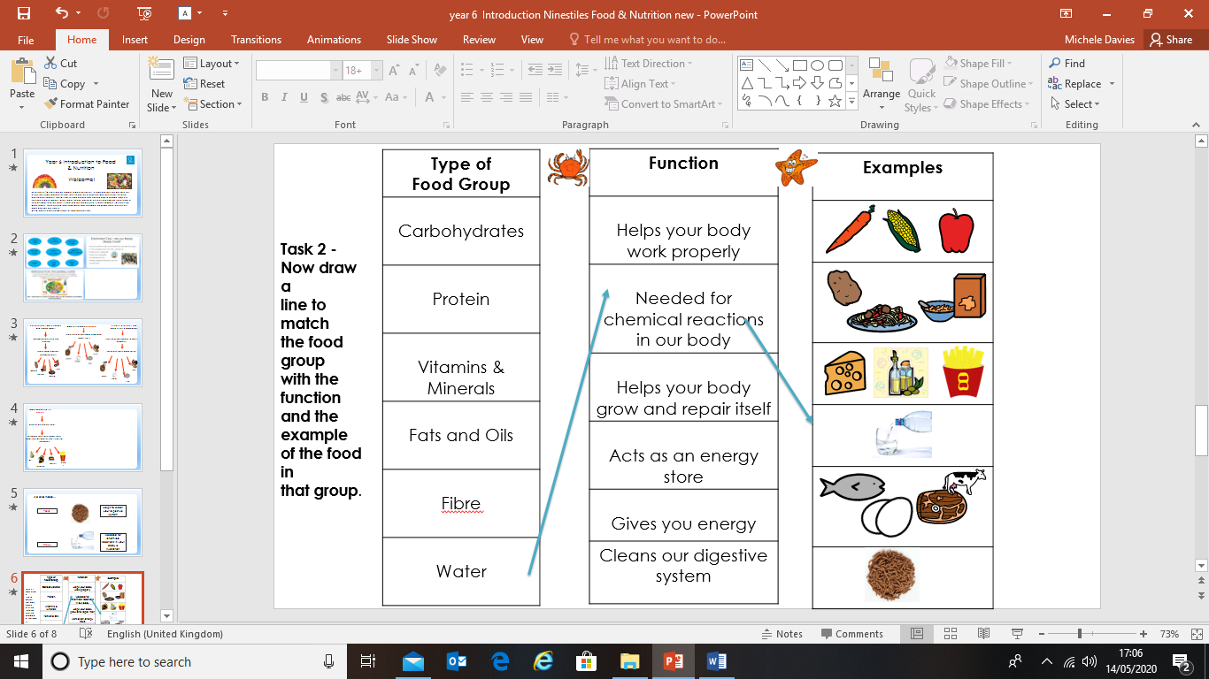


Foods containing fats and oils
Used as an energy store.
Although they taste good these foods can be bad for you if you eat too many!
Oil
butter
chips
cheese
Notes:
Teacher’s Notes: Adapt this lesson by setting up a control bag (not touched) the same as above, then set up a ‘class bag’. For this, take the slice of bread out of the packet and ask the class to pass it around so that every member of the class has touched the bread. Mist with water, seal as above and label as ‘Touched’ and add the class name/code. Hang these up in your room to see which class grows the most mould (and need to wash their hands more thoroughly)!

Slide 4
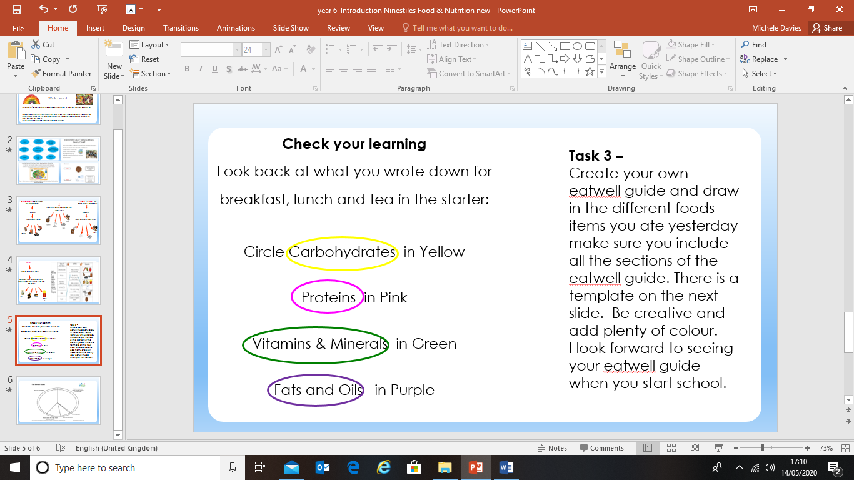
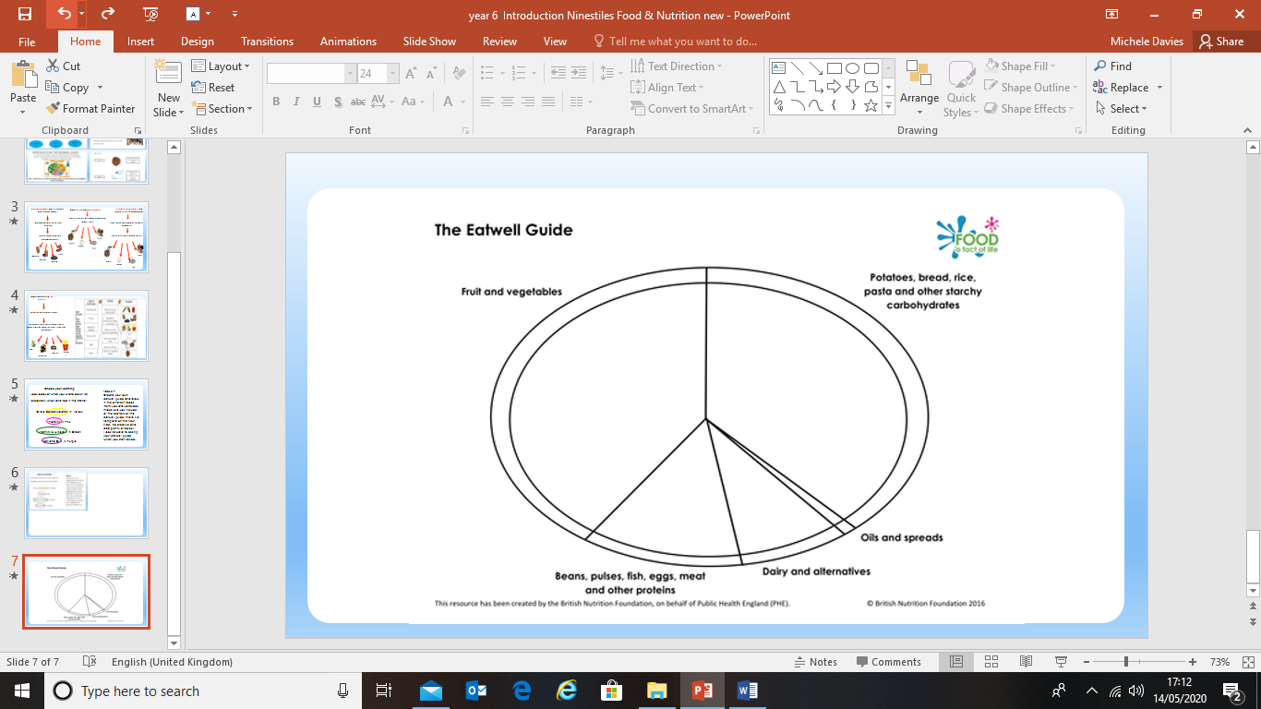
Re-create the eatwell guide and bring it with you to your food and nutrition lesson. We really looking forward to seeing your work.
Notes:
Teacher’s Notes: Adapt this lesson by setting up a control bag (not touched) the same as above, then set up a ‘class bag’. For this, take the slice of bread out of the packet and ask the class to pass it around so that every member of the class has touched the bread. Mist with water, seal as above and label as ‘Touched’ and add the class name/code. Hang these up in your room to see which class grows the most mould (and need to wash their hands more thoroughly)!

