Slide 1
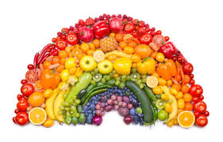
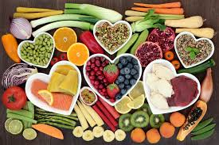
Year 6 Introduction to Food & Nutrition
Welcome!
Hello year 6, We are really looking forward to meeting you all. In Food and Nutrition we have lots of exciting lessons planned for you, they include lots of practical work with dishes like pizza and fruit crumble. You will look at food hygiene and learning how to prepare food in a safe and hygienic manor. Other topics include looking at nutrients and how we need them to help our body function. What is sugar and why do we need it? what happens if we have too much sugar?
Ms Whittaker & Ms Daly
Notes:
Teacher’s Notes: Adapt this lesson by setting up a control bag (not touched) the same as above, then set up a ‘class bag’. For this, take the slice of bread out of the packet and ask the class to pass it around so that every member of the class has touched the bread. Mist with water, seal as above and label as ‘Touched’ and add the class name/code. Hang these up in your room to see which class grows the most mould (and need to wash their hands more thoroughly)!

Slide 2
Food Practicals
Eat Well Guide
High Risk Foods
Year 7 overview
Health & Safety/Hygiene
Sugar!
Knife skills
Fats & Oils
Notes:
Teacher’s Notes: Adapt this lesson by setting up a control bag (not touched) the same as above, then set up a ‘class bag’. For this, take the slice of bread out of the packet and ask the class to pass it around so that every member of the class has touched the bread. Mist with water, seal as above and label as ‘Touched’ and add the class name/code. Hang these up in your room to see which class grows the most mould (and need to wash their hands more thoroughly)!

Slide 3
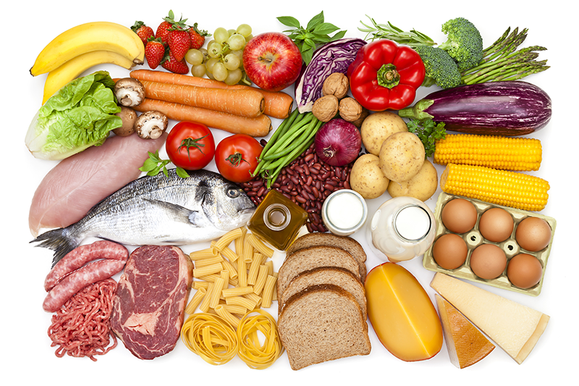
Food Groups
Our bodies need a variety of different foods so that they can keep working properly.
Let’s look at the sort of foods we should be eating and why they are good for us.
Notes:
Teacher’s Notes: Adapt this lesson by setting up a control bag (not touched) the same as above, then set up a ‘class bag’. For this, take the slice of bread out of the packet and ask the class to pass it around so that every member of the class has touched the bread. Mist with water, seal as above and label as ‘Touched’ and add the class name/code. Hang these up in your room to see which class grows the most mould (and need to wash their hands more thoroughly)!

Slide 4
Carbohydrates are in starchy and sugary foods.
Carbohydrates give you energy.
These foods contain carbohydrates.
potato
rice
cereal
pasta
Notes:
Teacher’s Notes: Adapt this lesson by setting up a control bag (not touched) the same as above, then set up a ‘class bag’. For this, take the slice of bread out of the packet and ask the class to pass it around so that every member of the class has touched the bread. Mist with water, seal as above and label as ‘Touched’ and add the class name/code. Hang these up in your room to see which class grows the most mould (and need to wash their hands more thoroughly)!

Slide 5
Meat & Fish contain protein.
Proteins help your body grow and repair itself.
Here are some good ways of getting protein.
nuts
beef
eggs
fish
Notes:
Teacher’s Notes: Adapt this lesson by setting up a control bag (not touched) the same as above, then set up a ‘class bag’. For this, take the slice of bread out of the packet and ask the class to pass it around so that every member of the class has touched the bread. Mist with water, seal as above and label as ‘Touched’ and add the class name/code. Hang these up in your room to see which class grows the most mould (and need to wash their hands more thoroughly)!

Slide 6
Vitamins & Minerals are found in fruit & vegetables
They help your bodies to work properly.
These are really good for us.
carrot
grapes
apple
corn
Notes:
Teacher’s Notes: Adapt this lesson by setting up a control bag (not touched) the same as above, then set up a ‘class bag’. For this, take the slice of bread out of the packet and ask the class to pass it around so that every member of the class has touched the bread. Mist with water, seal as above and label as ‘Touched’ and add the class name/code. Hang these up in your room to see which class grows the most mould (and need to wash their hands more thoroughly)!

Slide 7


Foods containing fats and oils
Used as an energy store.
Although they taste good these foods can be bad for you if you eat too many!
Oil
butter
chips
cheese
Notes:
Teacher’s Notes: Adapt this lesson by setting up a control bag (not touched) the same as above, then set up a ‘class bag’. For this, take the slice of bread out of the packet and ask the class to pass it around so that every member of the class has touched the bread. Mist with water, seal as above and label as ‘Touched’ and add the class name/code. Hang these up in your room to see which class grows the most mould (and need to wash their hands more thoroughly)!

Slide 8
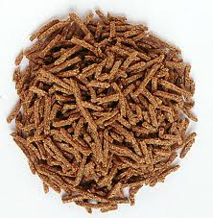
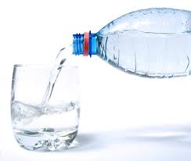
We also need…
Helps to clean your digestive system
Fibre
Needed for chemical reactions in your body & hydration
Water
Notes:
Teacher’s Notes: Adapt this lesson by setting up a control bag (not touched) the same as above, then set up a ‘class bag’. For this, take the slice of bread out of the packet and ask the class to pass it around so that every member of the class has touched the bread. Mist with water, seal as above and label as ‘Touched’ and add the class name/code. Hang these up in your room to see which class grows the most mould (and need to wash their hands more thoroughly)!

Slide 9
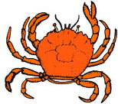


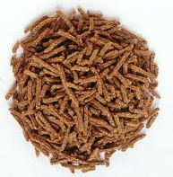
Type of Food Group
Carbohydrates
Protein
Vitamins & Minerals
Fats and Oils
Fibre
Water
Function
Helps your body work properly
Needed for chemical reactions in our body
Helps your body grow and repair itself
Acts as an energy store
Gives you energy
Cleans our digestive system
Examples
Task 1-Now draw a
line to match
the food group
with the function
and the example
of the food in
that group.

Slide 10
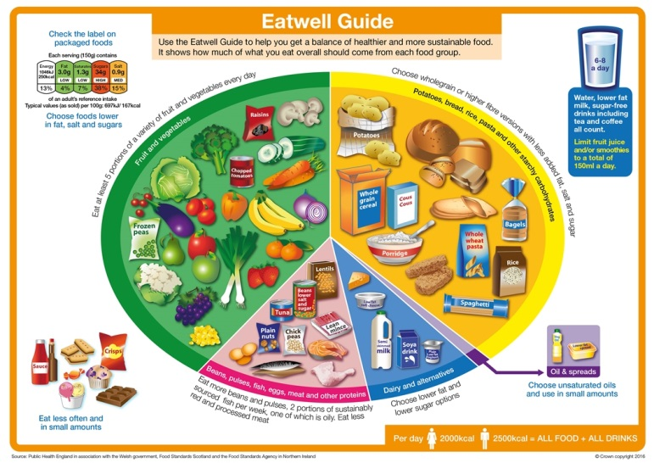
INTRODUCTION: THE EatWell Guide
In the UK, the healthy eating model is known as the Eatwell Guide. It is the government’s recommendations on how to eat healthily and achieve a balanced diet.
Task 2 – write down on a piece of paper what you ate yesterday for breakfast, lunch and dinner.
Notes:
Teacher’s Notes: Adapt this lesson by setting up a control bag (not touched) the same as above, then set up a ‘class bag’. For this, take the slice of bread out of the packet and ask the class to pass it around so that every member of the class has touched the bread. Mist with water, seal as above and label as ‘Touched’ and add the class name/code. Hang these up in your room to see which class grows the most mould (and need to wash their hands more thoroughly)!

Slide 11
Check your learning
Look back at what you wrote down for breakfast, lunch and tea in the starter:
Circle Carbohydrates in Yellow
Proteins in Pink
Vitamins & Minerals in Green
Fats and Oils in Purple
Task 3 –
Create your own eatwell guide and draw in the different foods items you ate yesterday make sure you include all the sections of the eatwell guide. There is a template on the next slide. Be creative and add plenty of colour.
I look forward to seeing your eatwell guide when you start school.
Notes:
Teacher’s Notes: Adapt this lesson by setting up a control bag (not touched) the same as above, then set up a ‘class bag’. For this, take the slice of bread out of the packet and ask the class to pass it around so that every member of the class has touched the bread. Mist with water, seal as above and label as ‘Touched’ and add the class name/code. Hang these up in your room to see which class grows the most mould (and need to wash their hands more thoroughly)!

Slide 12
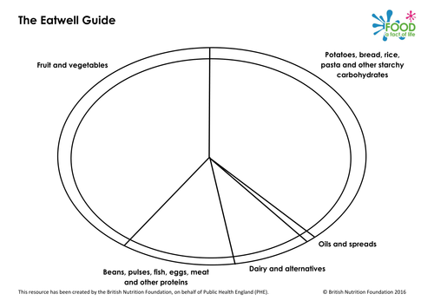
Notes:
Teacher’s Notes: Adapt this lesson by setting up a control bag (not touched) the same as above, then set up a ‘class bag’. For this, take the slice of bread out of the packet and ask the class to pass it around so that every member of the class has touched the bread. Mist with water, seal as above and label as ‘Touched’ and add the class name/code. Hang these up in your room to see which class grows the most mould (and need to wash their hands more thoroughly)!

