Slide 1
In you neatest handwriting copy the acrostic poem. Once you have completed it, you can draw a picture of the monkey.
Monkeys like to swing in trees
On the look out for bananas
Naughty, cheeky and very cute
Kind and caring to their friends
Ever so smart
You will smile when you see a monkey.

Slide 2
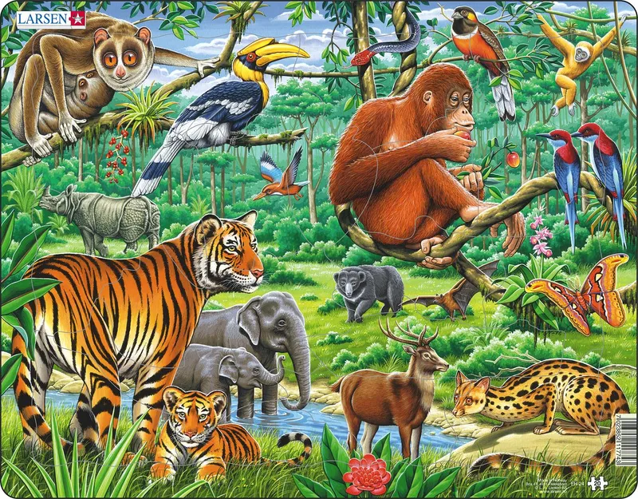





Choose a jungle animal that you would like to write your poem about.
Draw a picture of the animal.
Then create a mind map with adjectives to describe what your animal is like.
long, pointy whiskers
tiger
fierce
stripey

Slide 3
Children are to create an acrostic poem for the chosen animal. An acrostic poem is when each sentence starts with the letters in the word.
Tigers are strong and big.
In a pride they live.
Great big claws.
Everyday snoozing in the sun.
Roaring extremely loud.

Slide 4
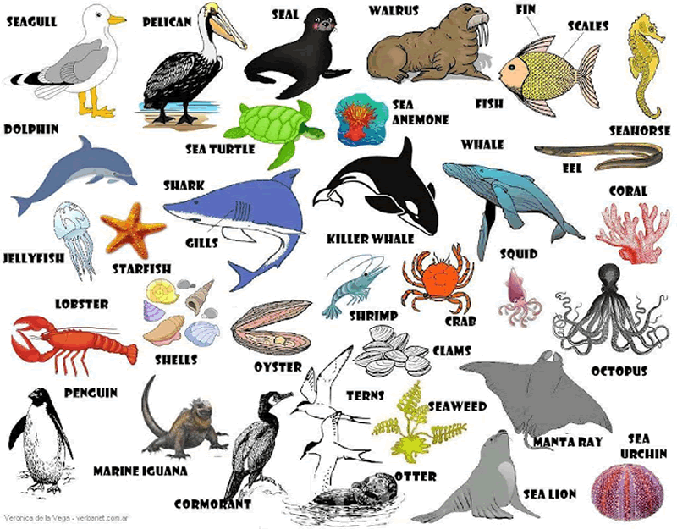





Choose a sea creature that you would like to write your poem.
Draw a picture of the animal.
Then create a mind map with adjectives to describe what your sea creature is like.
enourmous
shark
strong
sharp, razor teeth

Slide 5
Children are to create an acrostic poem for the chosen sea creature.
Sharp, razor teeth
Horrifying to see
Amazing and enormous
Really fast swimmers
Keep swimming away

