Slide 1
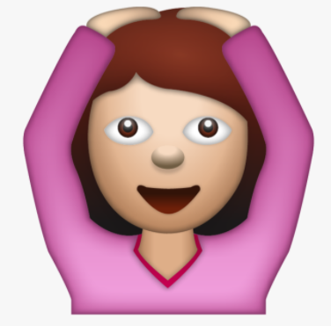

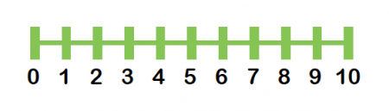



15
Here are examples of the different ways that you can complete addition number sentences.
21 + 7 = 28
15 + 3 = 18
7 + 3 = 10

Slide 2
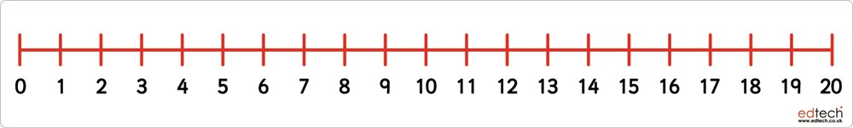
Children can choose to count on in their head, use a number line or draw the base ten to complete the questions.
Questions
5 + 4 =
12 + 5 =
11 + 7 =
12 + 5 =
21 + 6 =
25 + 3 =
32 + 4 =
40 + 7 =
41 + 9 =

Slide 3




15
Here are examples of the different ways that you can complete subtraction number sentences.
38 + 7 = 31
15 - 3 = 12
15 – 5 = 10

Slide 4
Children can choose to count on in their head, use a number line or draw the base ten to complete the questions.
Questions
9 - 4 =
15 – 3 =
17 – 2 =
25 – 3 =
29 – 7 =
33 – 1 =
38 – 7 =
49 – 9 =

Slide 5

12
Questions:
10 + 4 =
12 + 3 =
14 + 4 =
18 + 1 =
9 + 5 =
7 + 7 =
6 + 8 =
9 + 9 =
12 + 5 = 17
Put the biggest number in your head and then count on using your fingers.
Remember addition can be done in any order.
12 + 5 = 17 and 5 + 12 = 17

Slide 6
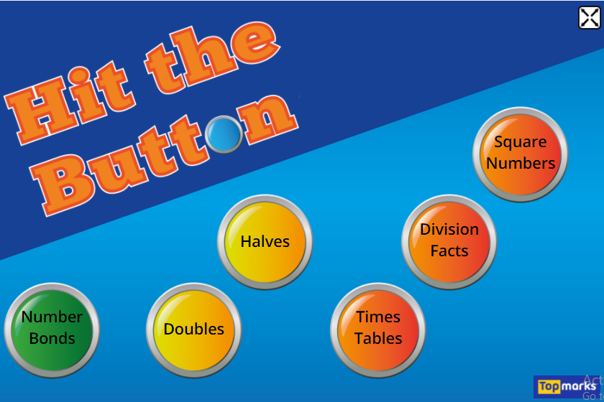
https://www.topmarks.co.uk/maths-games/hit-the-button
Use this game for quick fire maths. You are given 60 seconds to answer as many questions as you can. Play multiple times to see if you can beat your score.
Practise your number bonds to 10 and 20 and your addition.

