Slide 1
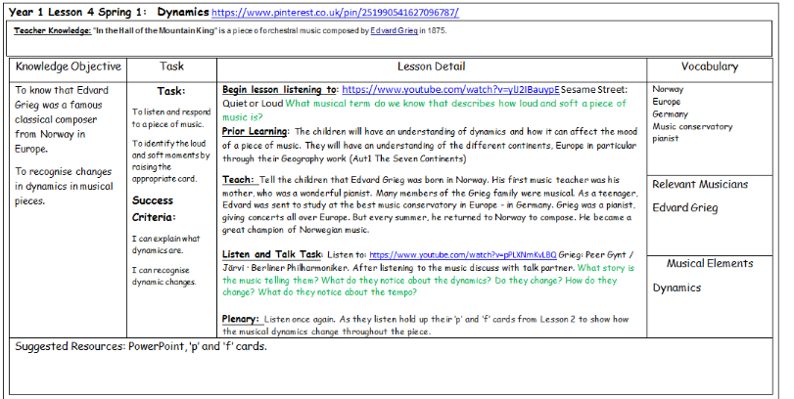
Lesson 4 - Dynamics

Slide 2
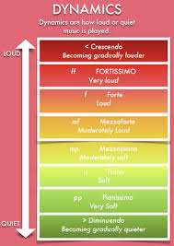

Year 1
Spring 1
Lesson 4
Dynamics

Slide 3


Let’s Listen
In the Hall of the Mountain King by Edvard Grieg
Listen to:
https://www.youtube.com/watch?v=pPLXNmKvLBO
How does the music make you feel? Why?
What are the dynamics for the of the piece like? What term do we know that describes how loud or soft a piece of music is?

Slide 4
Prior Learning
We know that dynamics is the volume of the music.
We know that dynamics can affect the mood of a piece of music.
In our Geography work we have during the Autumn Term we studied the seven continents of the world.
We know where the continent of Europe is on a map of the world.

Slide 5
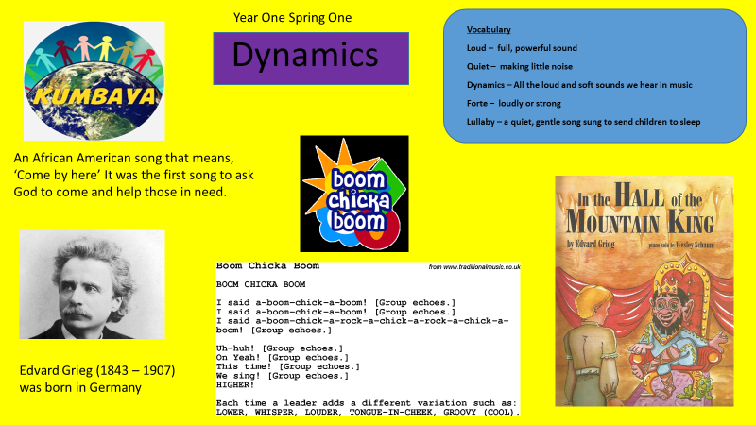
Our Knowledge Organiser

Slide 6
Key Vocabulary
ForteLoud
Quiet
Piano
Soft
Lullaby
Italian
Norway
Europe
Music Conservatory
pianist
Dynamics
Germany

Slide 7
L.O: To know that Edvard Grieg was a famous classical composer from Norway in Europe. To recognise changes in musical pieces.
Success Criteria: I can explain what dynamics are. I can recognize dynamic changes.
Here are today’s key words:
Quiet Loud Norway
Piano (soft) Europe
Forte (loud)
Music Conservatory
Italian Lullaby
Dynamics pianist

Slide 8
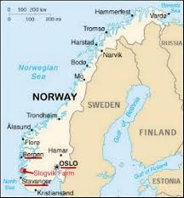
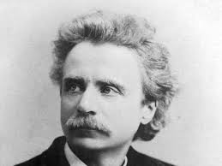
Teach
Edvard Grieg was born in Norway.
His first music teacher was his mother.
His mother was a wonderful pianist.
Many of the Grieg family were musical.
As a teenager, Edvard was sent to study
at the best music conservatory in Europe-#
In the country of Germany.
Grieg was a pianist, giving concerts all over Europe. Every summer he returned to Norway to compose. He became a great champion of Norwegian music.

Slide 9
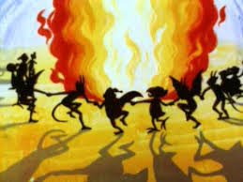
Talk Task
Listen to:
Edvard Grieg’s In the Hall of the Mountain King from the Peer Gynt Suit
https;//www.youtube.com/watch?v=pPLXNmKvLBO
With your talk partner discuss:
What story is the music telling you?
What do you notice about the dynamics?
Do the dynamics change? How?
What do you notice about the tempo of the music?
Does the music make you feel like
something is about to happen?

Slide 10
And finally…
Listen!
Listen to ‘In the Hall of the Mountain King’ again.
.

