Slide 1
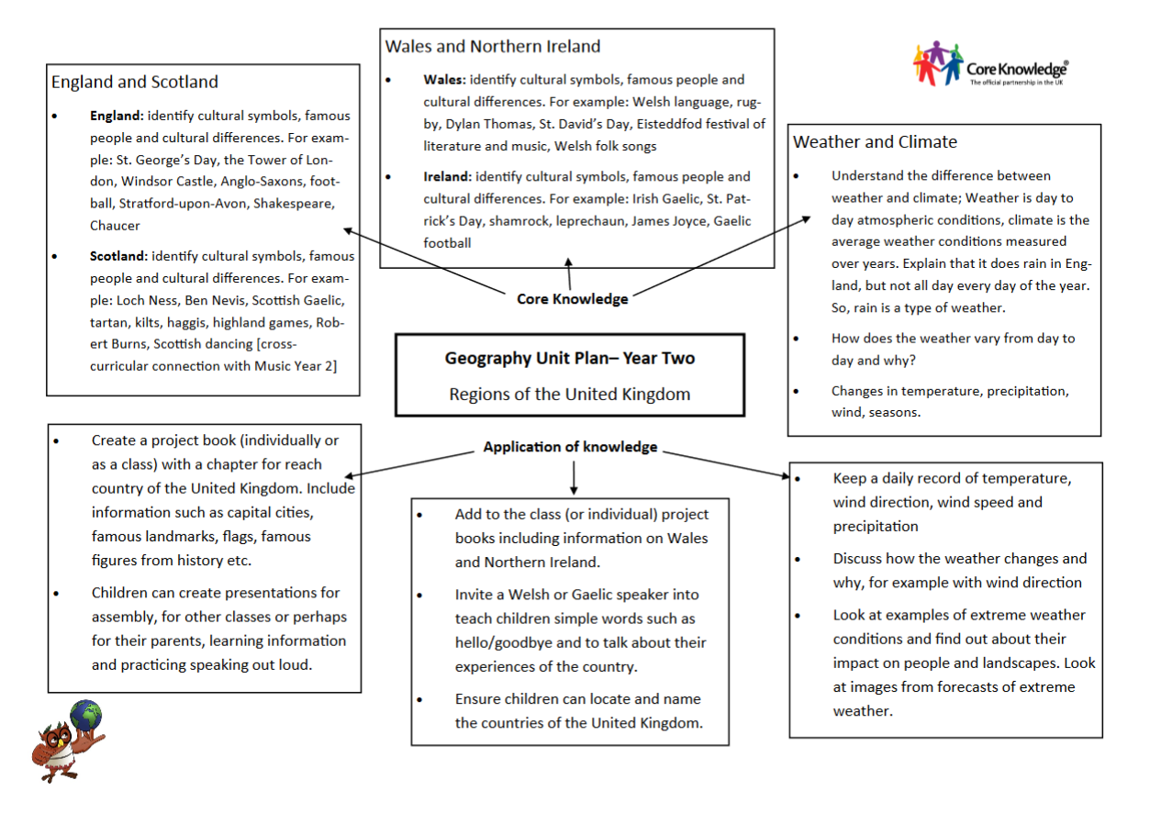
Year 1

Slide 2
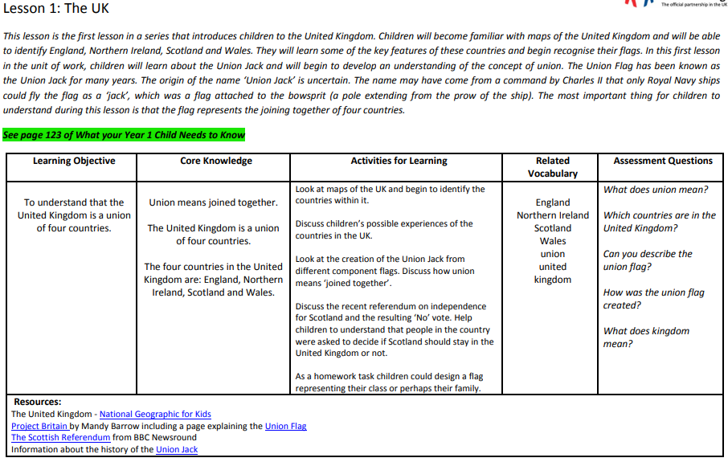

Slide 3

LO: To know that the United Kingdom is a union of four countries

Slide 4
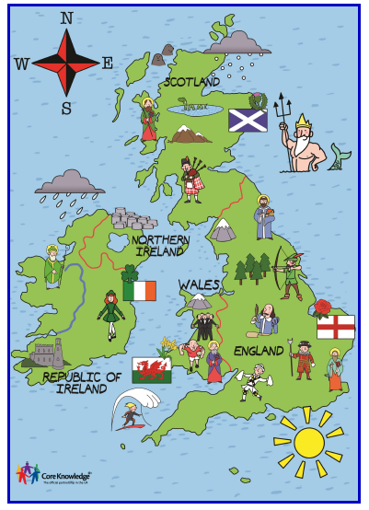
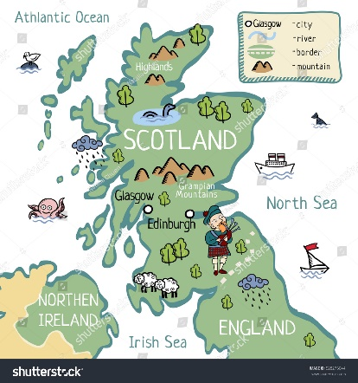
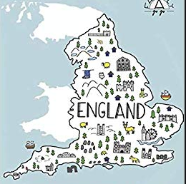
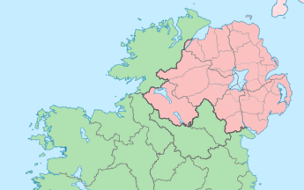
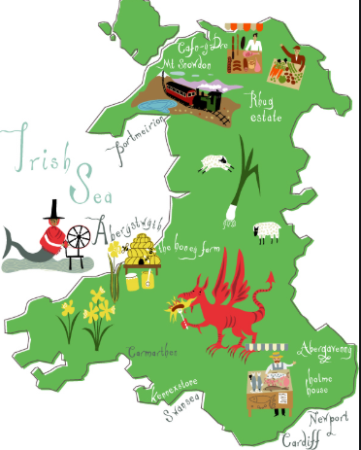
Scotland
England
Northern Ireland
Wales

Slide 5
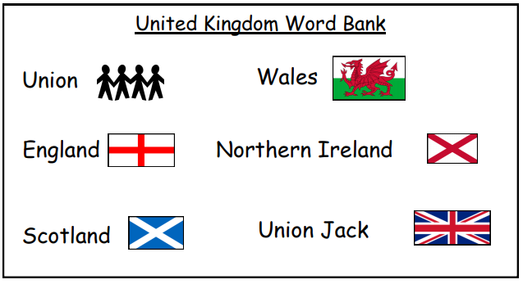
Key Vocabulary
Let’s look at the words we will learn today.

Slide 6

The Union Jack

Slide 7
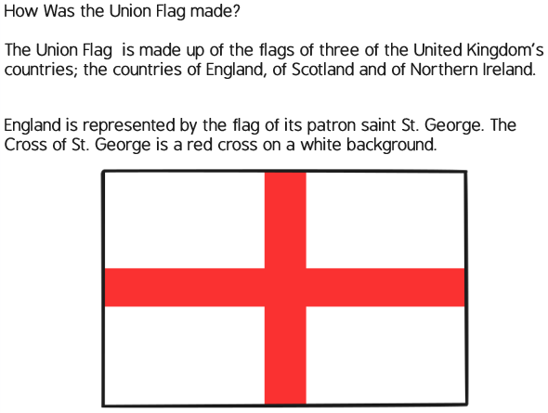
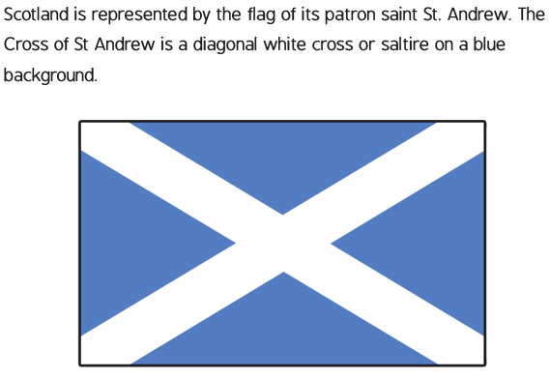



+ =

Slide 8
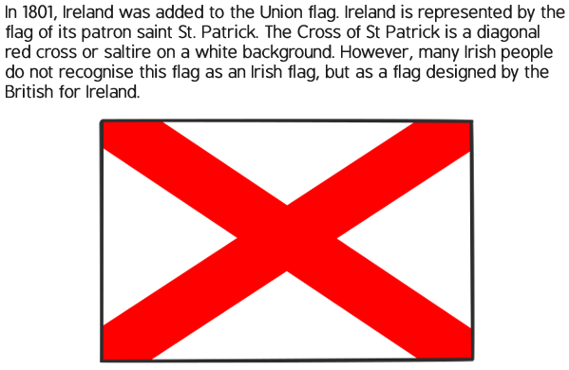


+ =

Slide 9
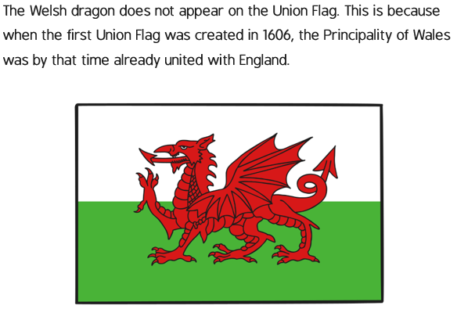
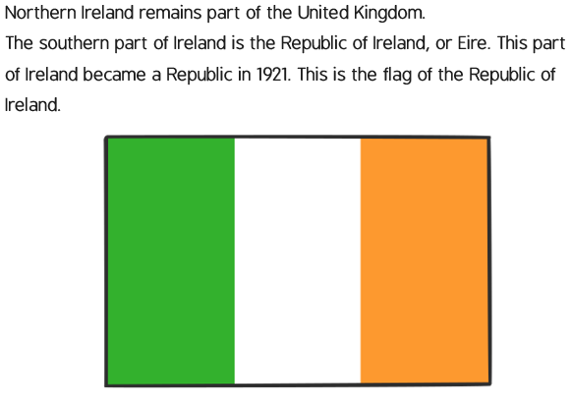
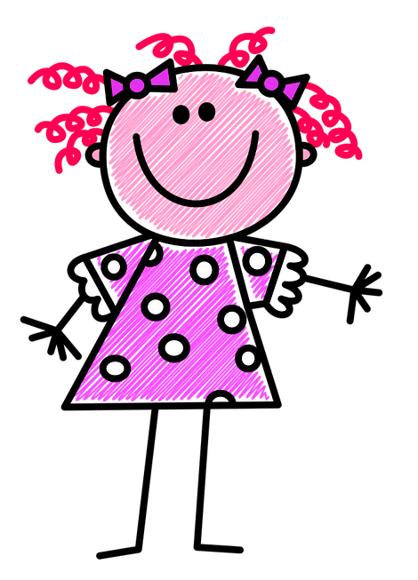
But they are still parts of the United Kingdom!

Slide 10
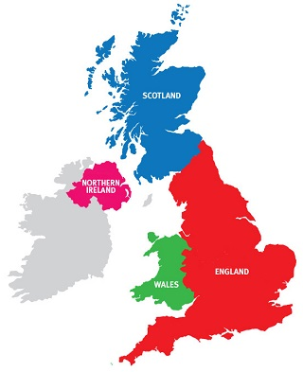
Talk Task
Have you been to a different country in the UK?
Which country would you like to go to? Why?

Slide 11
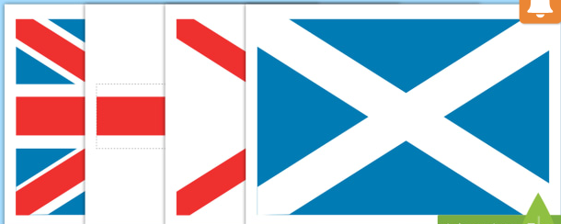
Task:
Can you make the Union Jack using the flags from different countries?
Notes:
If not, could colour in a small union jack instead

Slide 12
Task
All:
Will put make a Union Jack flag using the flags of different countries in the UK. Can you name which countries are used?
Most:
Will design their own flag for the UK. Can you tell me why this is a good flag for the UK?
Some:
Will design their own flag for the UK. Can you explain each symbol used in the flag and why you chose it?

Slide 13

What have we found out today?
Can you tell me something about the UK?
Can you describe the Union Jack?
Do you know anyone else who lives in the
UK?

