Slide 1
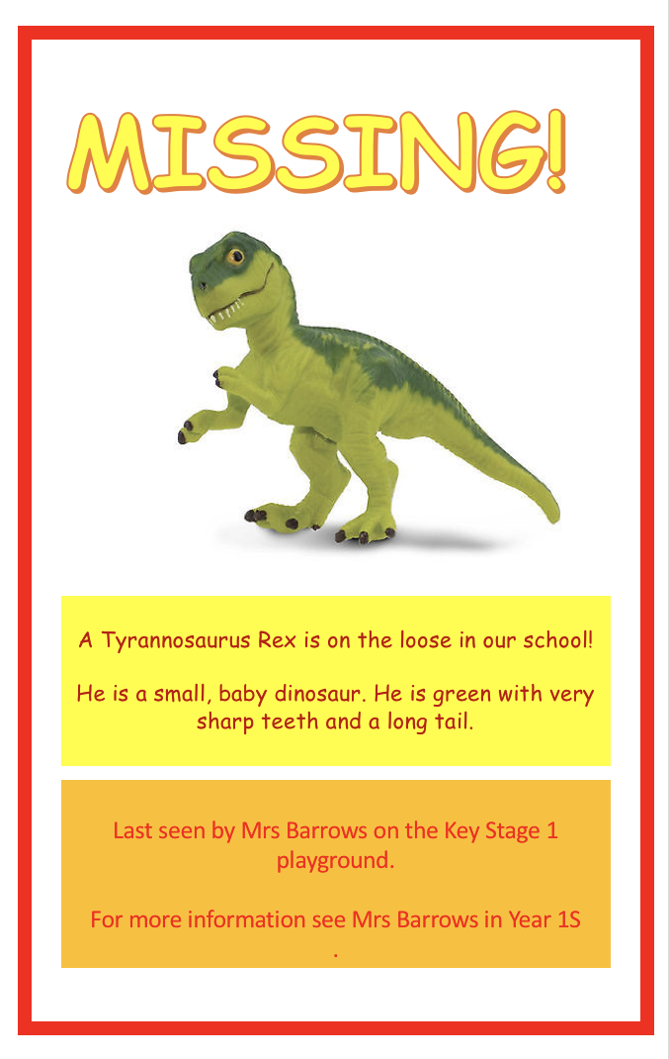
LO: to use my sounds.
Create your own missing poster for the baby dinosaur that has escaped from our classroom.

Slide 2
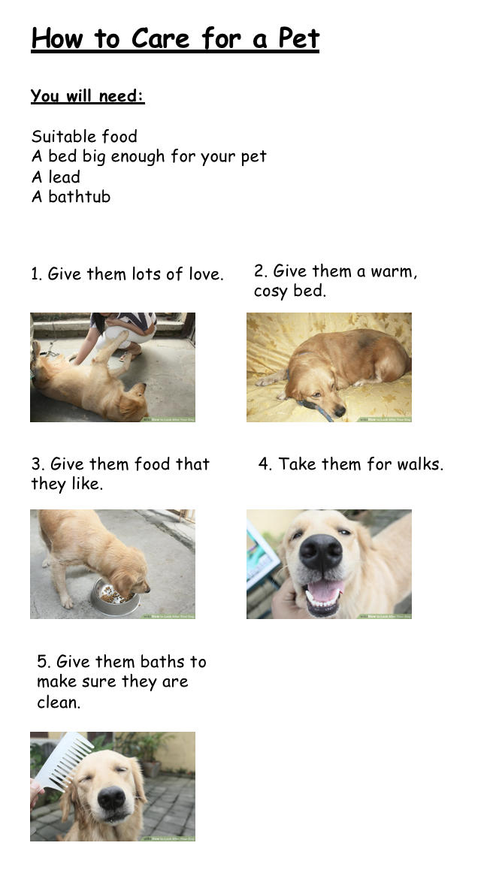
LO: to use capital letters and full stops.
Create your own set of instructions for how to look after a baby dinosaur.
(similar to a dog)

Slide 3
LO: to research.
The word dinosaur comes from the Greek language and means ‘terrible lizard’. The word was coined by English paleontologist Richard Owen in 1842 and was meant to refer to Dinosaurs impressive size rather than their scary appearance. Dinosaurs ruled the Earth for over 160 million years, from the Triassic period around 230 million years ago through the Jurassic period and until the end of the Cretaceous period around 65 million years ago. The time period from 250 million years ago until around 65 million years ago is known as the Mesozoic Era. It is often referred to as the Age of the Dinosaurs because most dinosaurs developed and became extinct during this time.

Slide 4
It is believed that dinosaurs lived on Earth until around 65 million years ago when a mass extinction occurred. Scientists believe that the event leading to the extinction may have been a massive asteroid impact or huge volcanic activity. Events such as these could have blocked out sunlight and significantly changed the Earth’s ecology
The first dinosaur to be formally named was the Megalosaurus, back in 1824. A person who studies dinosaurs is known as a paleontologist. Rather than being carnivores (meat eaters), the largest dinosaurs such as the Brachiosaurus and Apatosaurus were actually herbivores (plant eaters). To help fight meat eaters such as the Allosaurus or Spinosaurus, many plant eaters had natural weapons at their disposal. Examples of this include the spikes on the tail of the Stegosaurus and the three horns attached to the front of the Triceratops’s head shield.
Pterodactyls are not dinosaurs, they were flying reptiles that lived during the age of dinosaurs but by definition they do not fall into the same category. The same goes for water based reptiles such as Plesiosaurs.

Slide 5
Let's find out some more information about specific dinosaurs.
https://www.bbc.co.uk/cbeebies/curations/dinosaur-facts

Slide 6
LO: to write simple sentences.
Using all of the information that you found out yesterday. Write facts about dinosaurs.

Slide 7
LO: to form my letters correctly.
I want to be a great big dinosaur. That is what I really want to be. For if I were a great big dinosaur. Everyone would run away from me.

