Slide 1
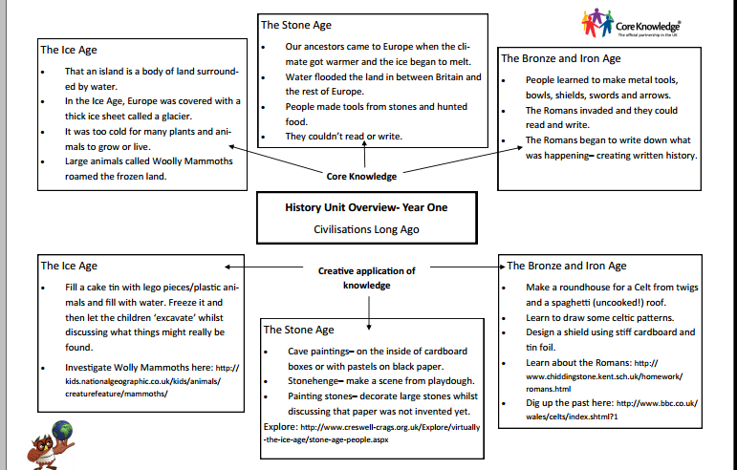

Slide 2
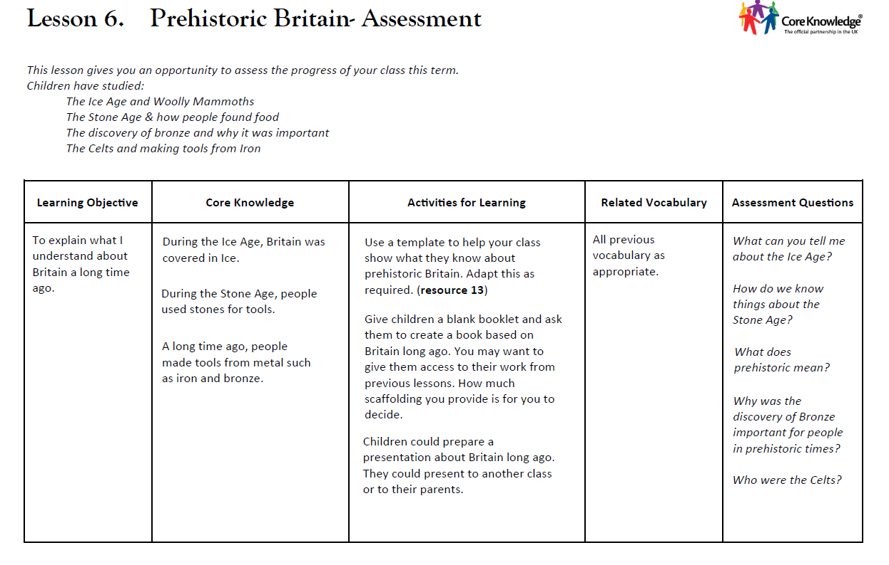

Slide 3
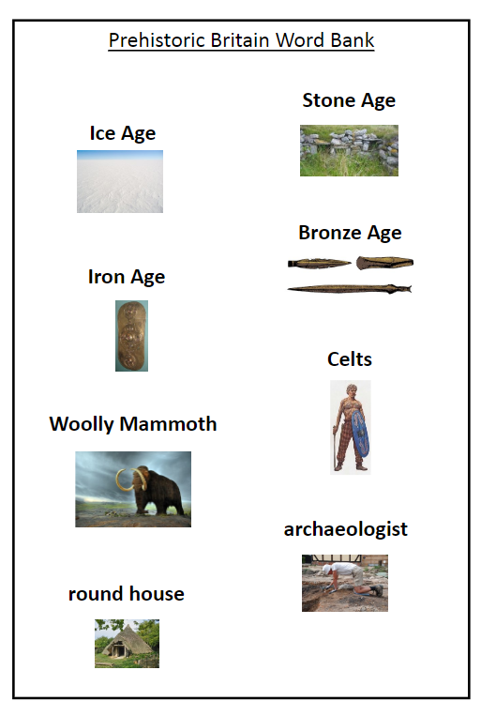
Prior Knowledge
What can we remember?

Slide 4
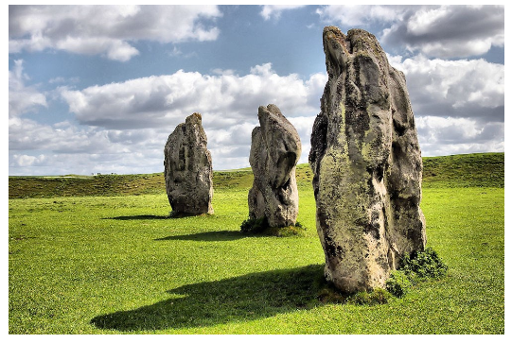
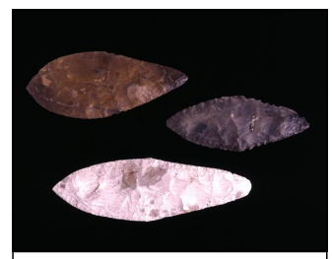
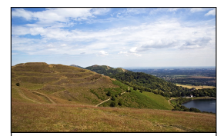
How do we learn about the past?

Slide 5
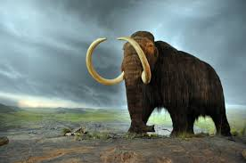
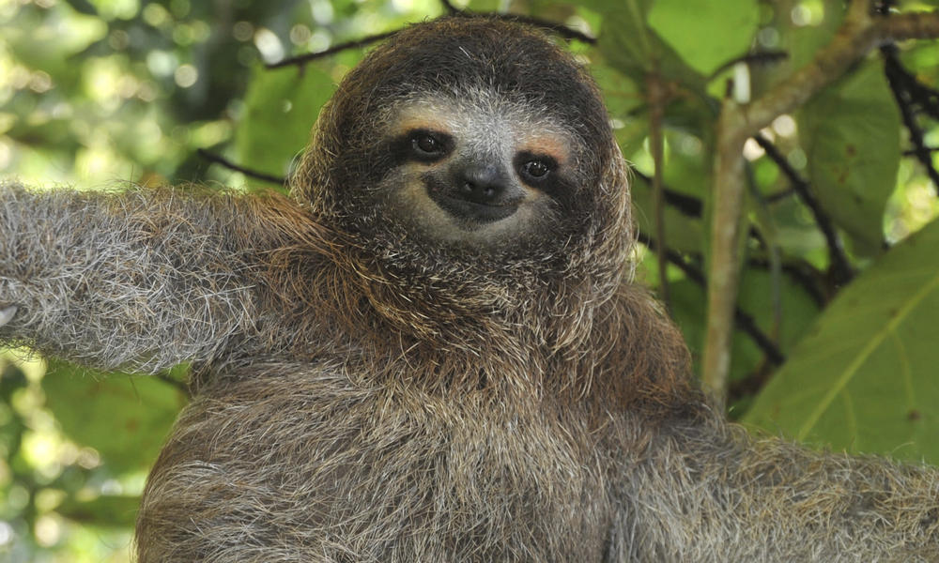
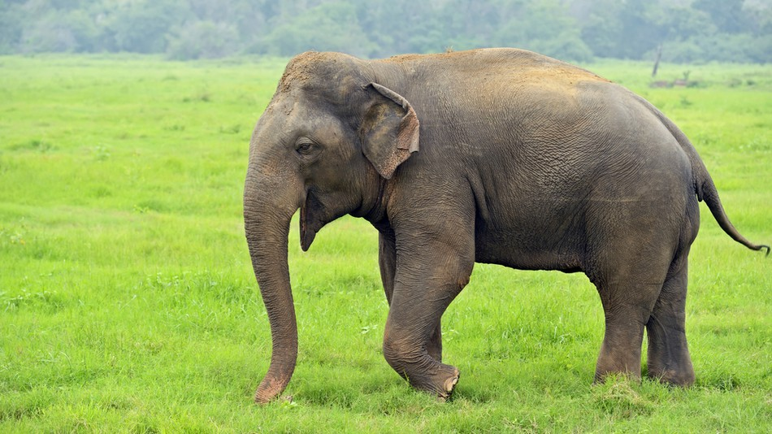
Which one is woolly mammoth?
A
C
B

Slide 6
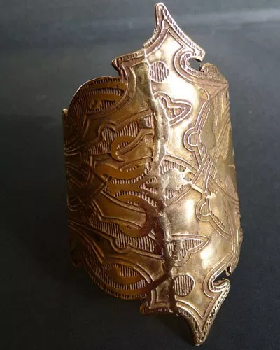
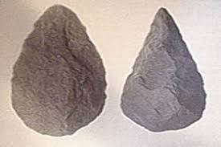
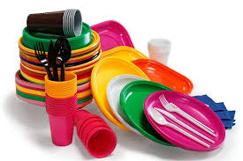
What material Stone Age people use?
A
C
B

Slide 7
Which one was the first?
A
C
B

Slide 8
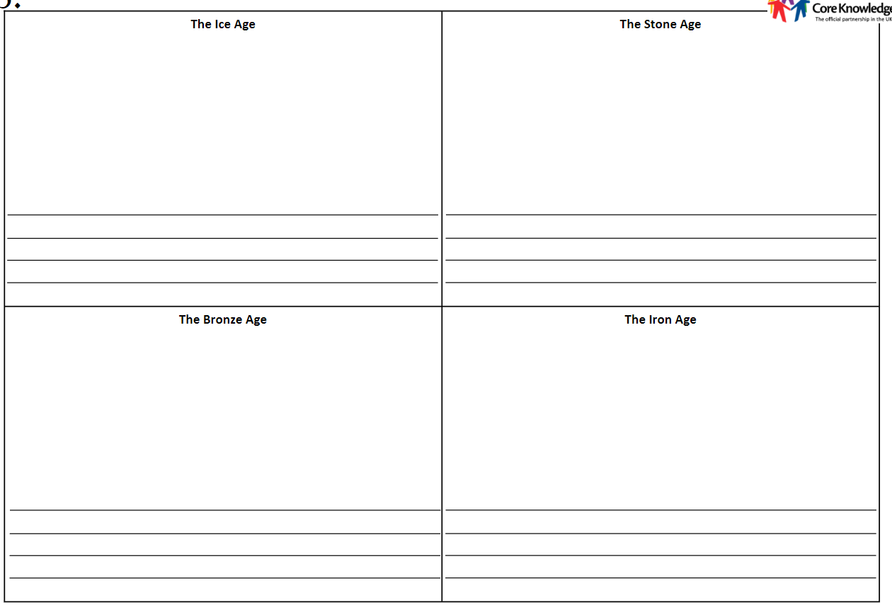
Today's Task...

Slide 9
Plenary...
What can you tell me about the Ice Age?
How do we know about The Stone Age?
What does prehistoric mean?
Why was the discovery of Bronze important for people in prehistoric times?
Who were the Celts?

