Slide 1

Advent Day
What could you promise to do during Advent?

Slide 2
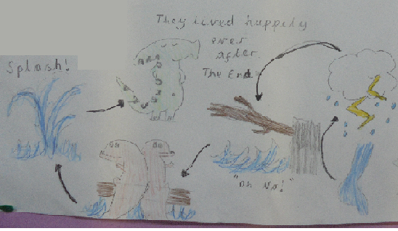
LO: To sequence sentences.
The end of the story is from when there is a storm until the end of the story.

Slide 3
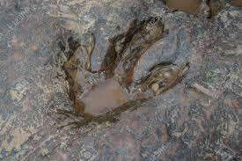
LO: to use question marks.
What questions could you ask?
?

Slide 4
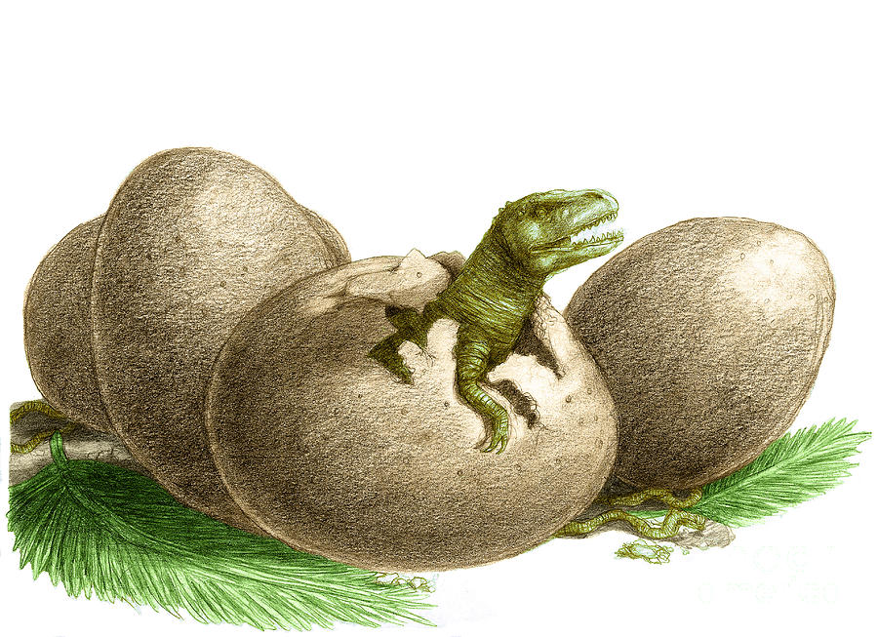
LO: to use question marks.
What questions could you ask?
?

Slide 5
LO: To use the correct punctuation.
Do you need a . or a ? The egg cracked Why did it crack Who helped him to escape I think he has ran away

