Slide 1
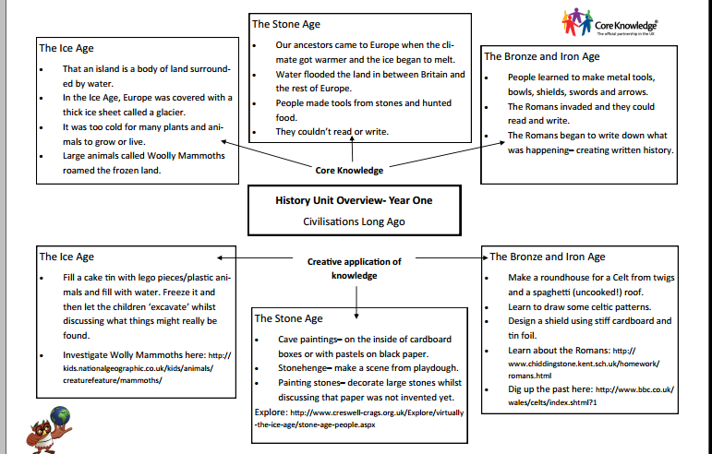

Slide 2
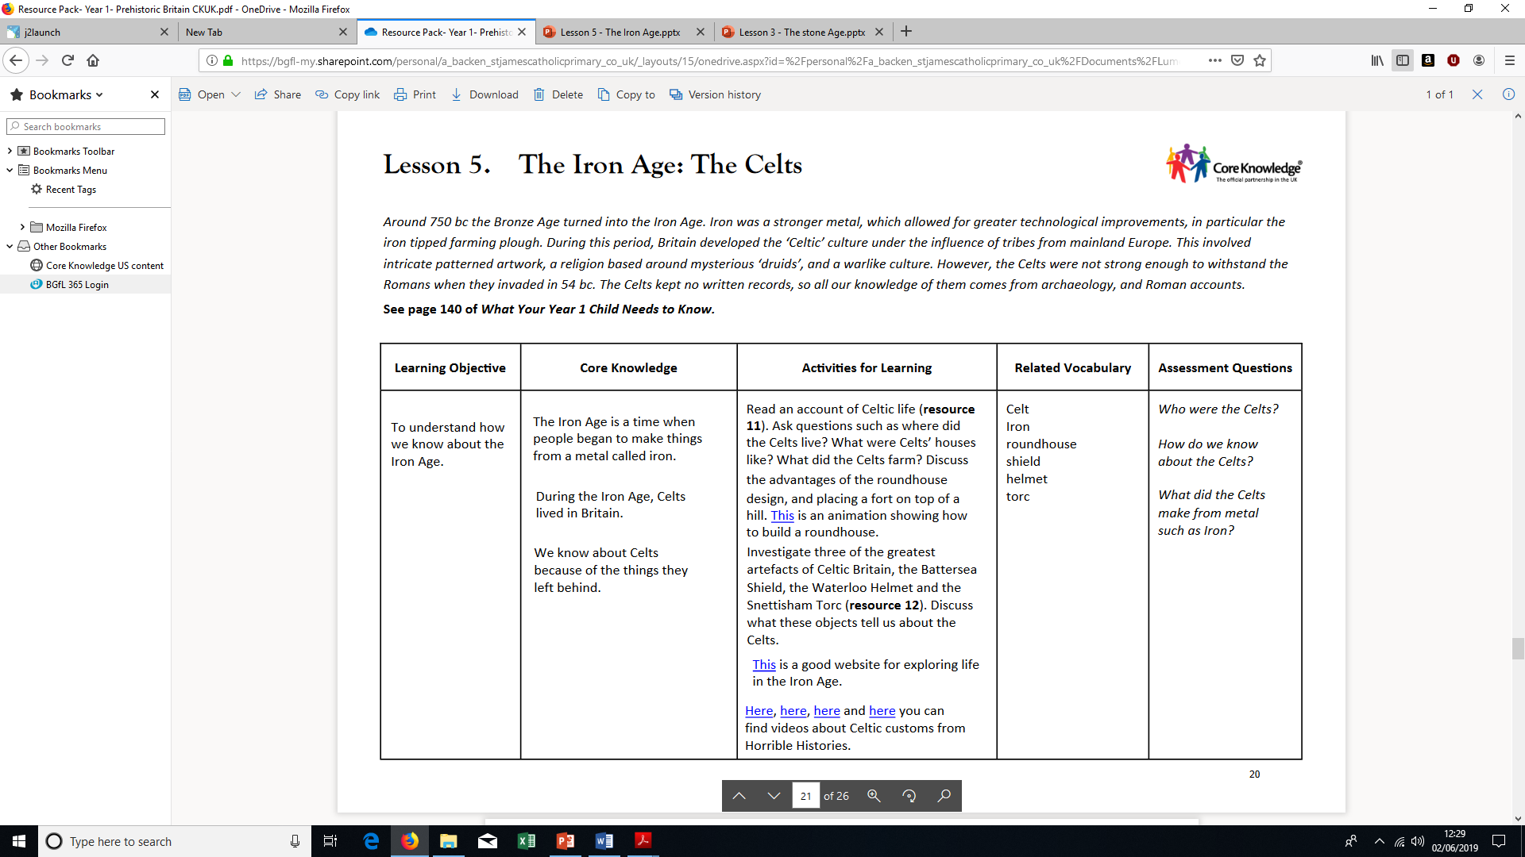

Slide 3
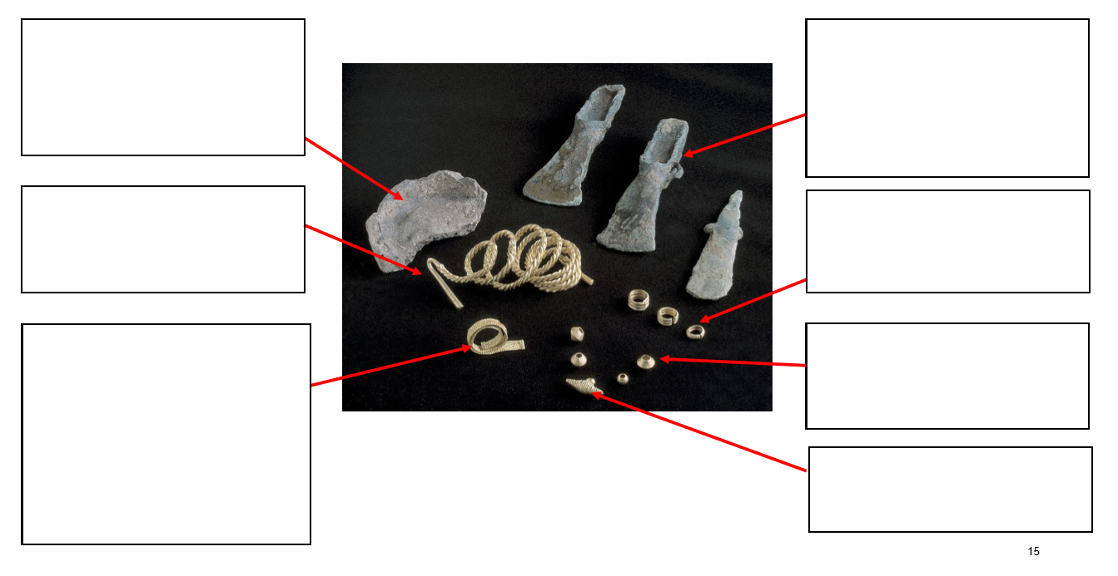
Prior Knowledge
What can we remember about the Bronze Age?

Slide 4
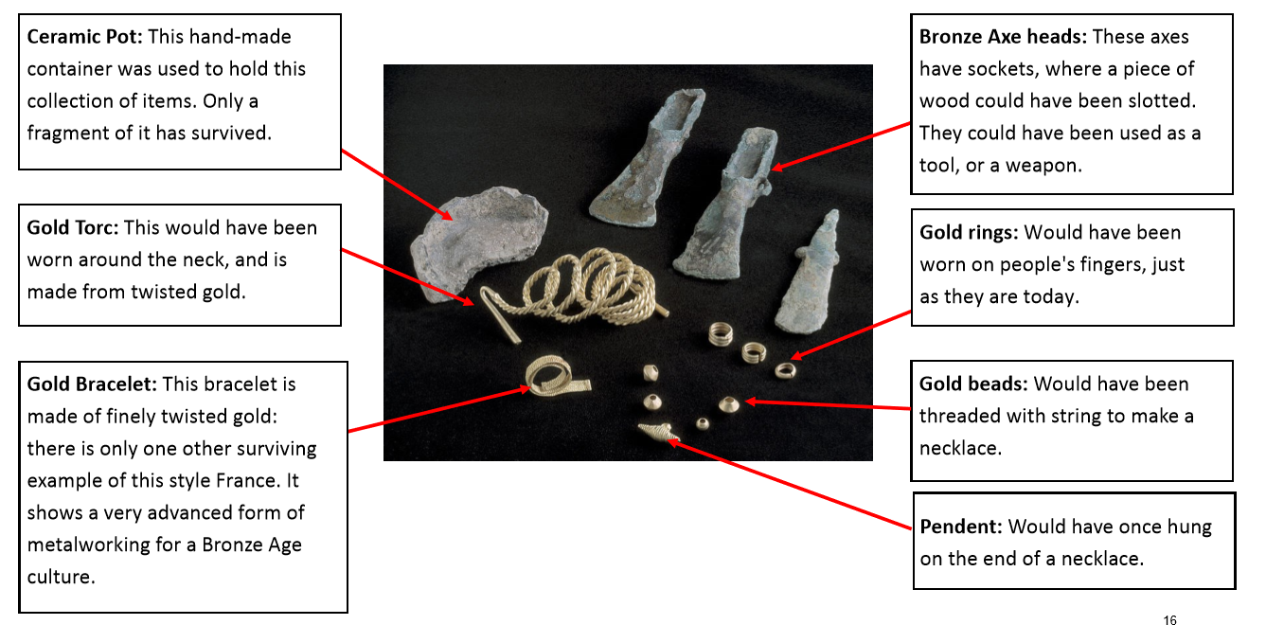
Prior Knowledge
.
The Burton Hoard.

Slide 5
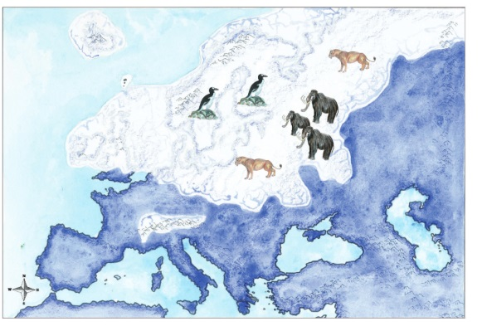
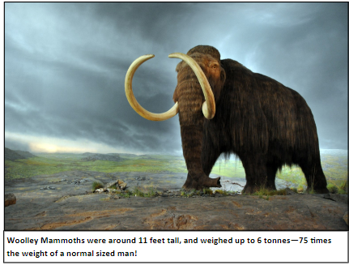
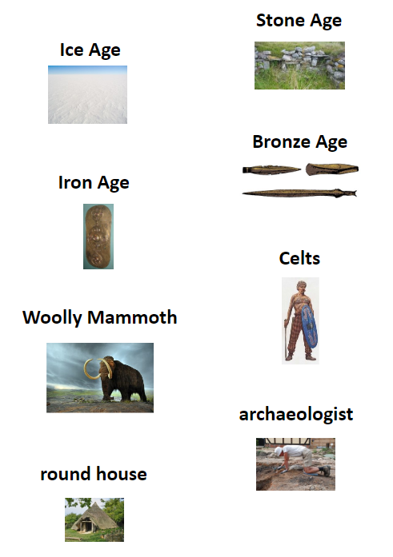
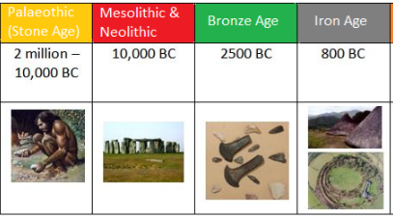
Year 1 Knowledge Organiser- Prehistoric Britain ( History)
Key Vocabulary | Definitions
Prehistoric | Human existence before written records
Ice Age | When Great Britain was covered in sheets of ice
Stone Age | When humans made tool out of stone, wood and bone
Bronze Age | When people discovered how to make bronze and metal for tools and weapons
Woolly Mammoth | An extinct animal that lived in the Ice Age
Archaeologist | A person who studies human history though discovering artefacts
Celts | A tribe who came from mainland Europe that lived in Great Britain around 750 BC
Round house | A house Celts lived in made from wood , straw and soil

Slide 6
LO: To understand how we know about The Iron Age.
Success Criteria:​
The Iron Age is a time when people began to make things from a metal called Iron.
During The Iron Age, Celts lived in Britain.
We know about Celts because of the things they left behind.
Celt​
Shield
Iron​​
Roundhouse​​
Torc​​
Warrior
Helmet ​​

Slide 7

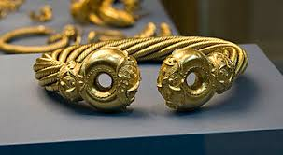
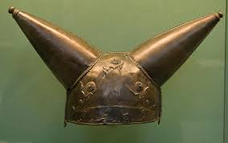
What do these artefacts tell us about Celtic people?

Slide 8
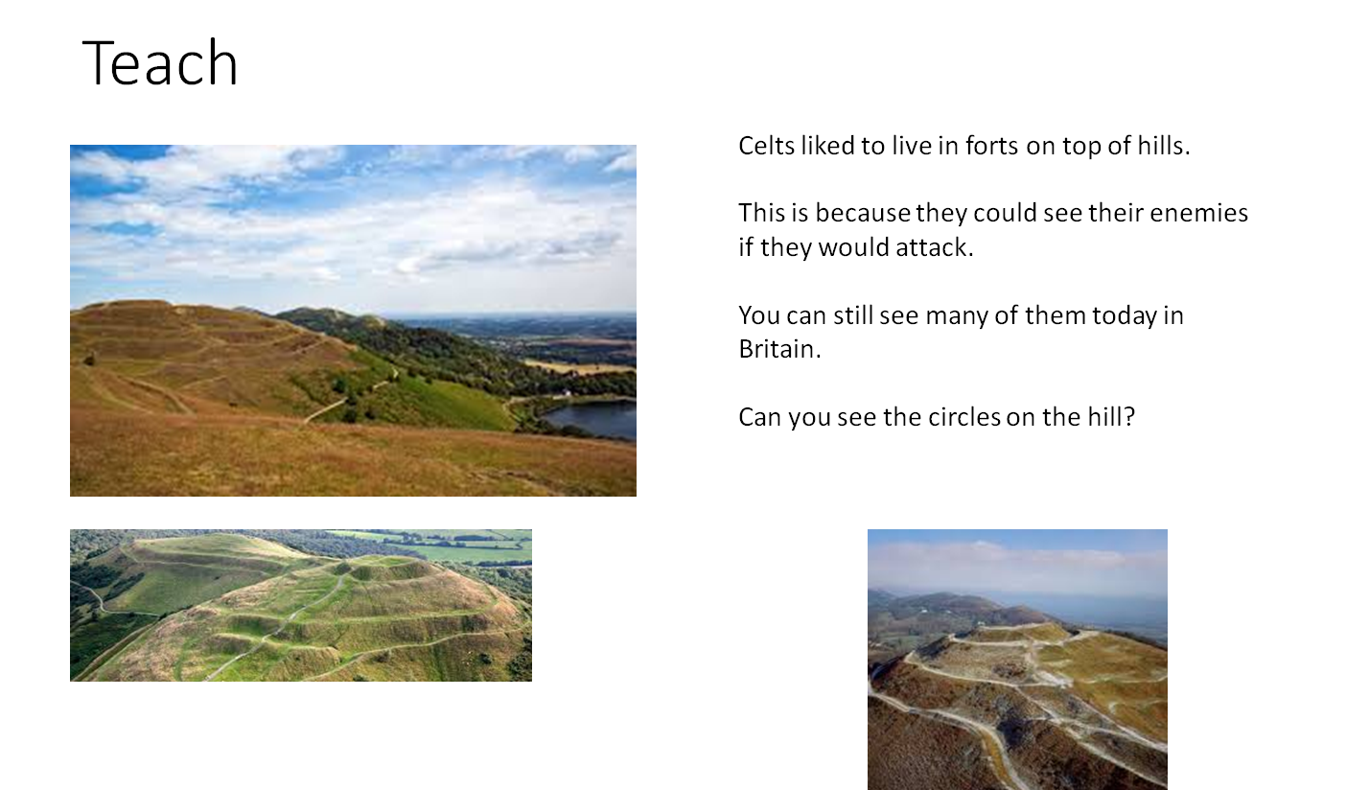
Teaching Slide
LO: To understand what we know about The Iron Age.

Slide 9
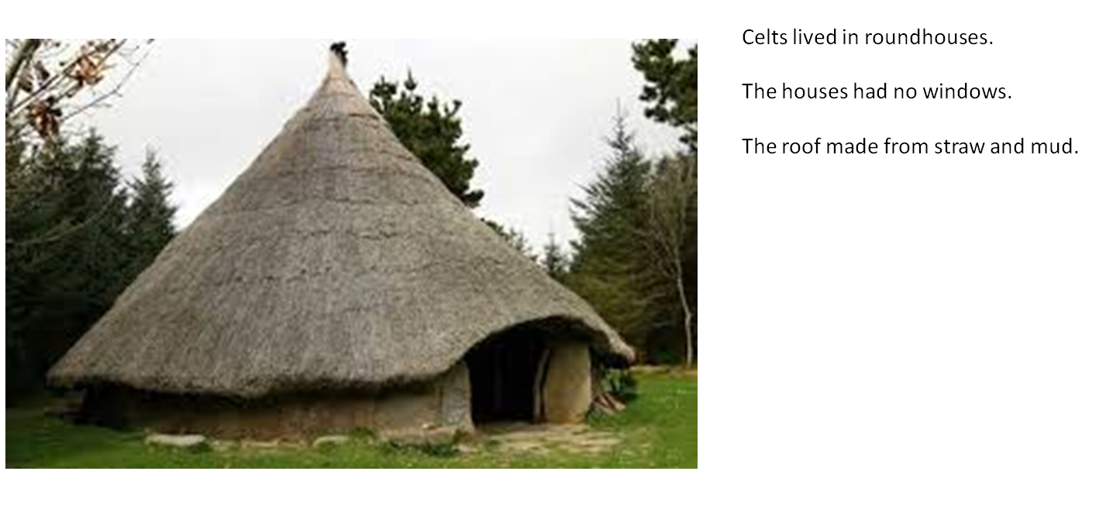
Teaching Slide
LO: To understand what we know about The Iron Age.

Slide 10
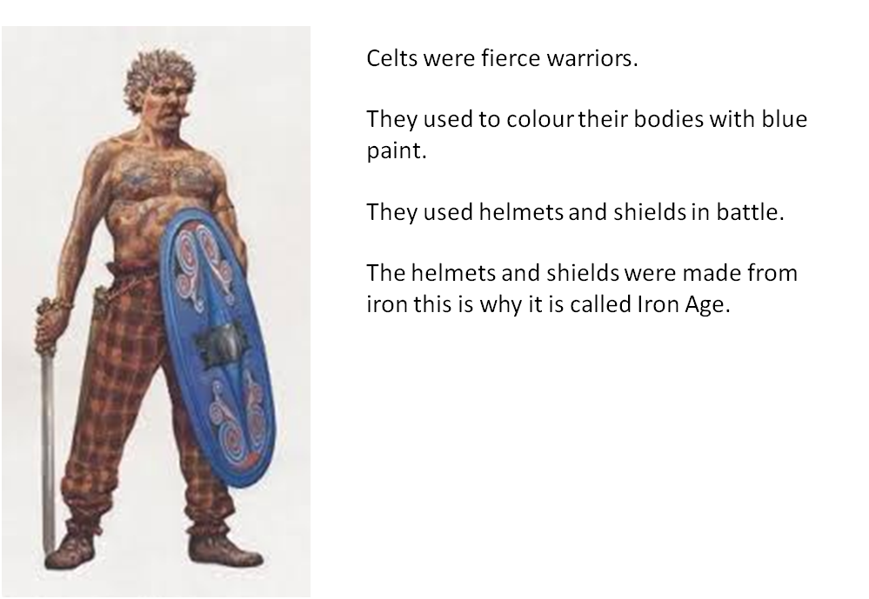
Teaching Slide
LO: To understand what we know about The Iron Age.

Slide 11
Talk task!
Who were the Celts?
What were their houses like?
Where did they live?
What did they mine?

Slide 12
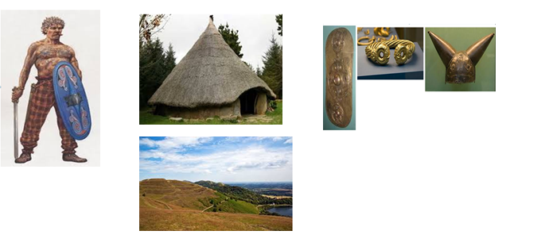
Today's Task...
Can you identify these Celt artefacts and explain what these objects were used for in the past?

Slide 13
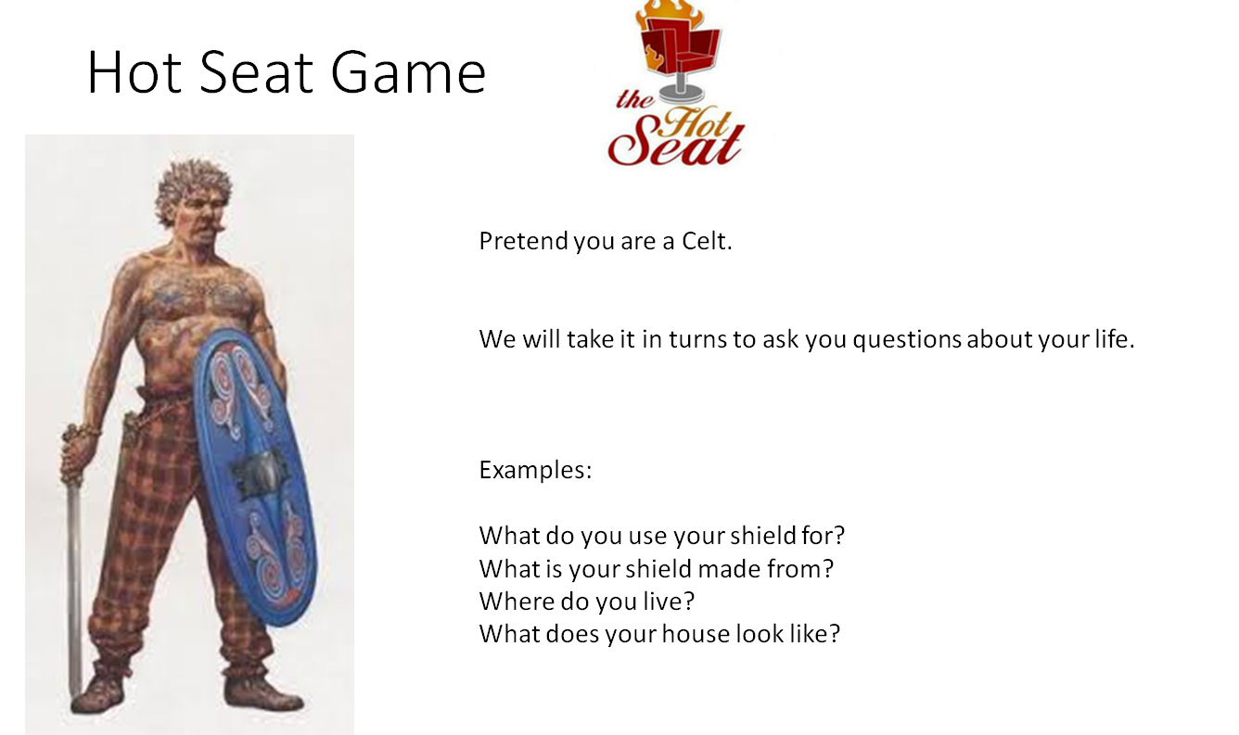
Plenary...

