Slide 1
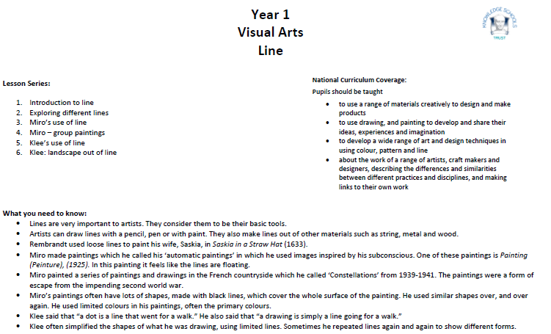
Unit overview

Slide 2
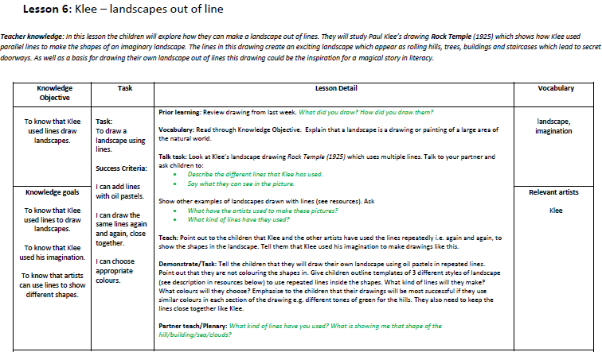
Lesson Plan

Slide 3
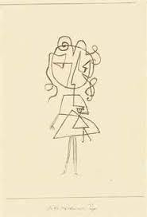
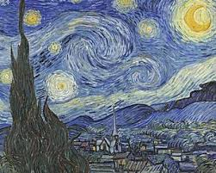
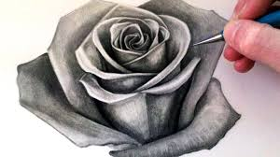
Prior learning (quiz)
Who is Klee?
a. artist b. teacher c. singer d. doctor
2. What tools do you need to draw straight lines?
a. a hammer and a pencil
b. a ruler and a sharp pencil
c. a number line and a crayon
3. Which is the Klee’s drawing?
a. b. c.

Slide 4
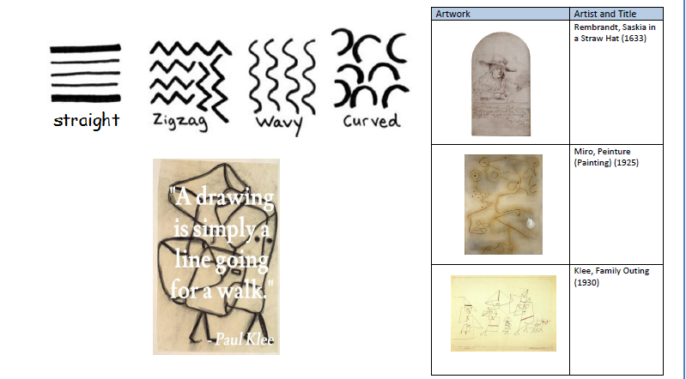
Knowledge Organiser

Slide 5
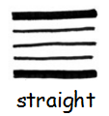
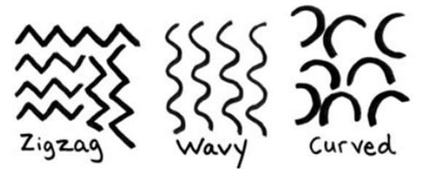
Key Vocabulary
Landscape
Landscape is a drawing or painting of a large area of the natural world.

Slide 6
Learning Objectives and Success criteria
LO : To know that Klee used lines draw landscapes.
Success Criteria
I can add lines with oil pastels.
I can draw the same lines again and again, close together.
I can choose appropriate colours

Slide 7
Teaching
Klee and the other artists have used the lines repeatedly i.e. again and again, to show the shapes in the landscape.
Klee used his imagination to make drawings like this.

Slide 8
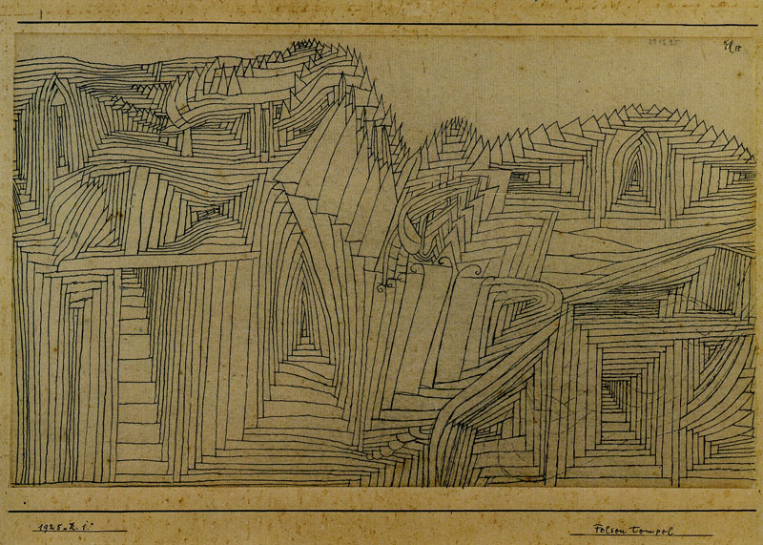

Slide 9
Talk Task
Look at Klee’s landscape drawing Rock Temple (1925) which uses multiple lines.
Q. Describe the different lines that Klee has used.
Q. Say what they can see in the picture.
Show other examples of landscapes drawn with lines
Q. What have the artists used to make these pictures?
Q. What kind of lines have they used?
Notes:
Suggested resources: For information about Klee’s drawing Rock Temple see http://www.artic.edu/aic/collections/artwork/198872 outline templates for 3 landscapes for children to add lines to – seascape with clouds, landscape with trees/hills, landscape with buildings of various heights, oil pastels.

Slide 10
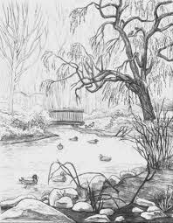

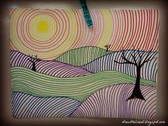

Slide 11
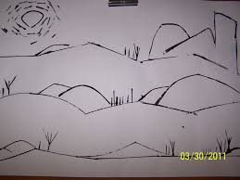
Task
To draw a landscape using lines.
Notes:
The children will draw their own landscape using oil pastels in repeated lines.
Point out that they are not colouring the shapes in.

Slide 12
Plenary
Q. What kind of lines have you used?
Q. What is showing me that shape of the hill/building/sea/clouds?

