Slide 1
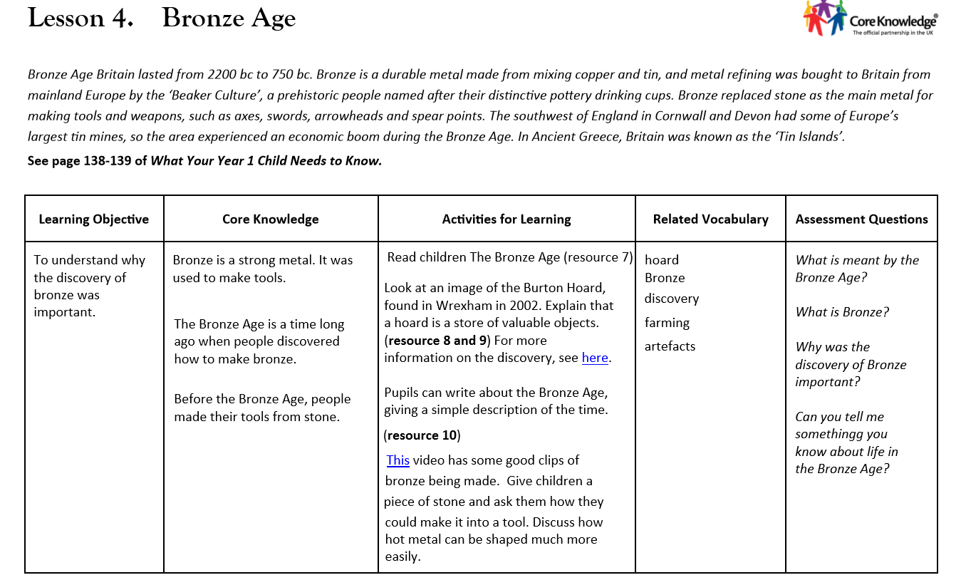

Slide 2
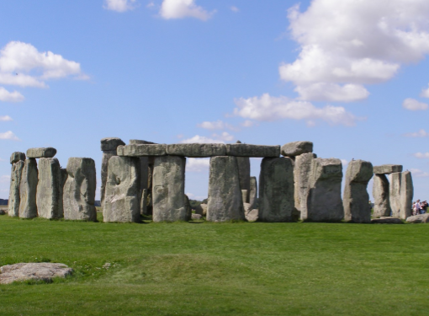
Prior learning:

Slide 3
Key vocabulary to learn and use:
hoard
Bronze
discovery
farming
artefacts
archeologist

Slide 4
LO: To understand why the discovery of bronze was important.

Slide 5
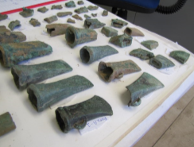
We are learning about the Bronze Age
Bronze is a very hard metal, made from 2 other metals: tin and copper. It was used to make tools.

Slide 6
What is an Archeologist?

Slide 7
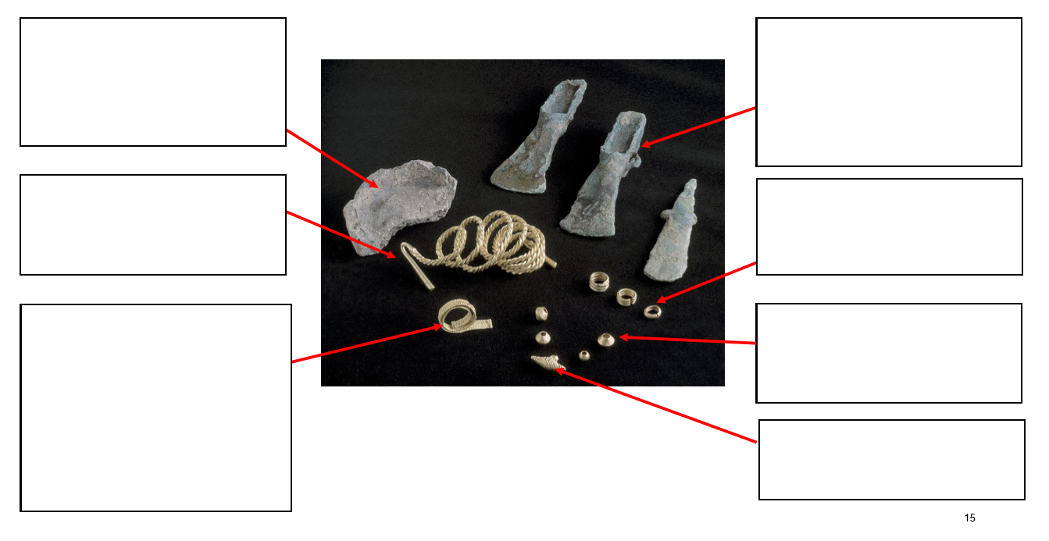
The Burton Hoard.
What do you think these items are?

Slide 8
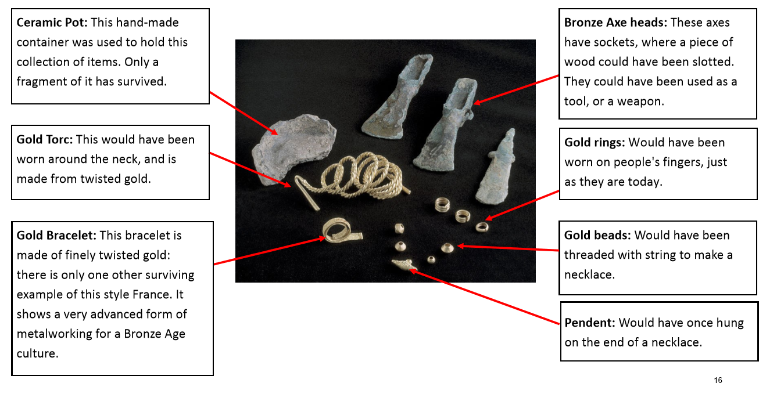
The Burton Hoard.

Slide 9
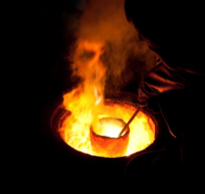
Why was the discovery of Bronze important?

Slide 10

Convince me
Living in the Bronze Age is better than living in the Stone Age.

Slide 11
Key vocabulary learnt?
hoard
Bronze
discovery
farming
Artefacts
archeologist

