Slide 1
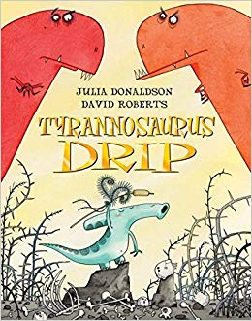
LO: To use capital letters and full stops.
What is your favourite part of the story? Why do you like it?

Slide 2
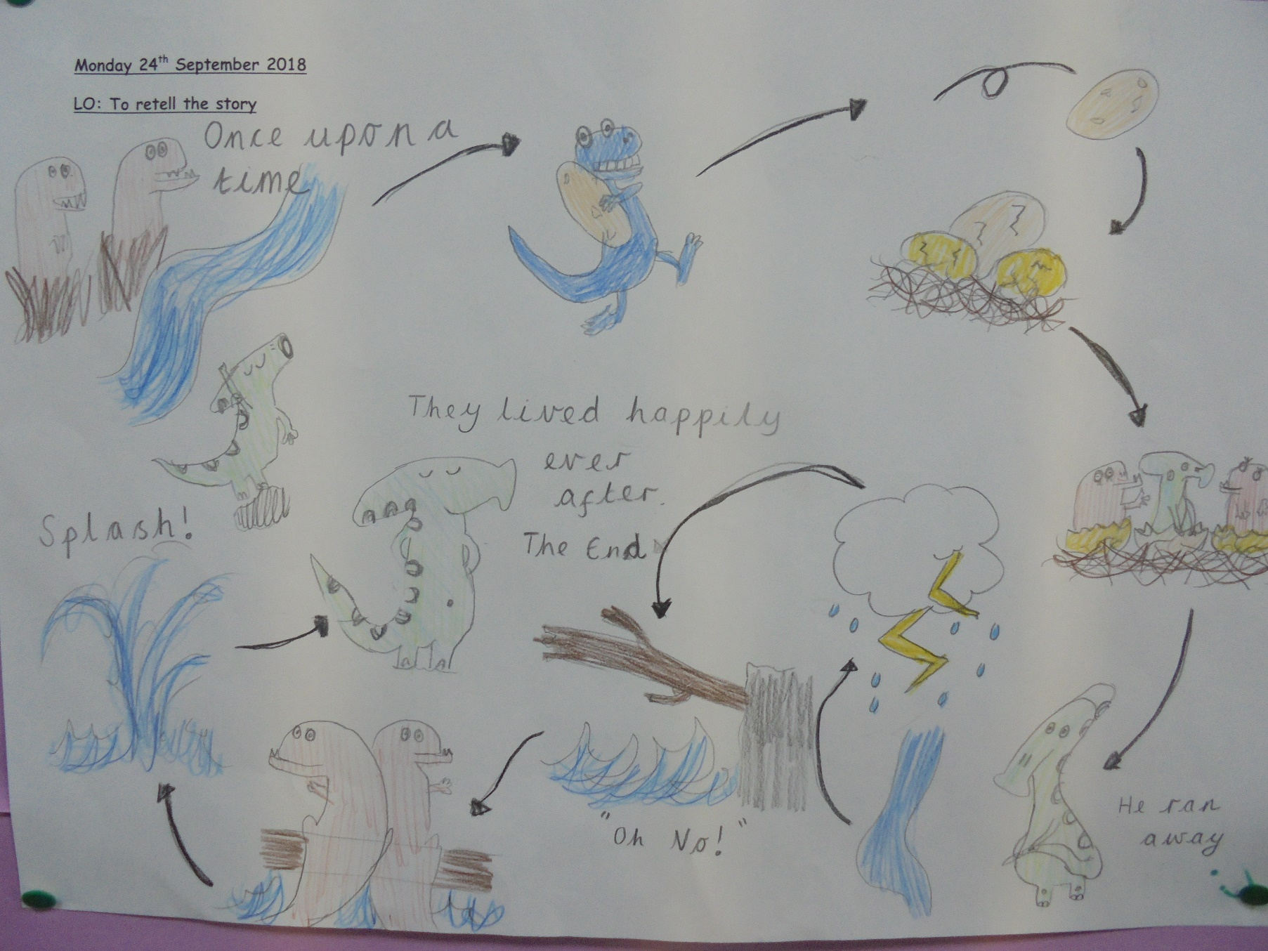
LO: To retell the story.
Example of a story map.

Slide 3
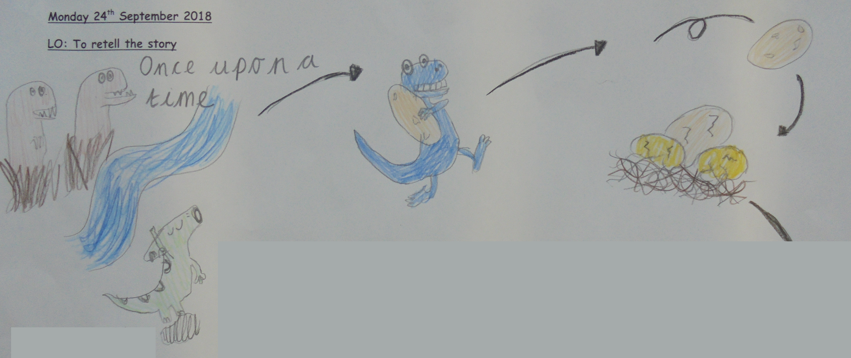
LO: To sequence sentences.
The beginning of the story is up until the egg lands in the T-Rex nest.

Slide 4
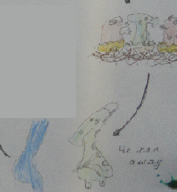
LO: To sequence sentences.
The middle of the story is from when the eggs hatch and Drip runs away to the river.

Slide 5
LO: To use capital letters and full stops.
drip was sad and ran away comp was a sneaky dinosaur the dinosaurs fell into the river the trees are tall and green

