Slide 1
Line
Lesson 3: Miro’s use of line

Slide 2
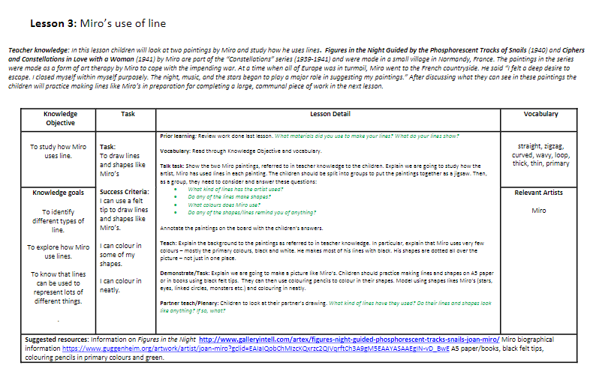
Teacher Plan

Slide 3
What do we already know?
Lines can be used for lots of different things, like pictures in stories!
There are different types of line
      Straight
      Wavy
      Zigzag
      Curved
      Thin
      Thick

Slide 4
What do we already know?
What material did we use to make our lines?
What do your lines show?

Slide 5
Vocabulary
straight
curved
wavy
thin
primary
zigzag
loop
thick

Slide 6
Today we are going to...
LO: To study how Miro uses line
Success Criteria:
I can use felt tip to draw lines and make shapes like Miro’s
I can colour in some of my shapes
I can colour in neatly

Slide 7
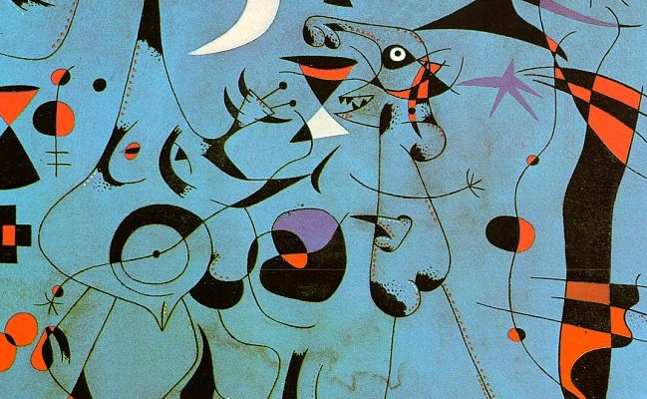
Figures in the Night Guided by the Phosphorescent Tracks of Snails (1940)

Slide 8
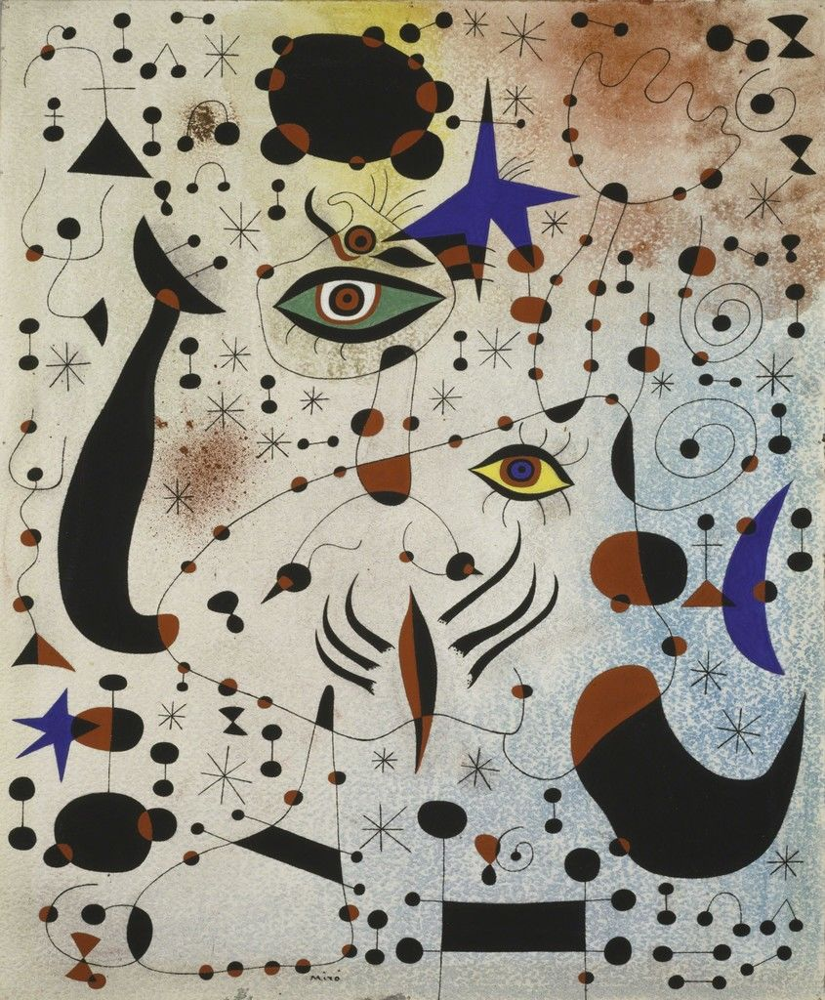
Ciphers and Constellations in Love with a Woman (1941)

Slide 9
Talk Task
What kind of lines has Miro used?
Do any of the lines make shapes?
What colours does Miro use?
Do any of the shapes or lines remind you of anything?

Slide 10
Talk Task
Talk about these questions with your group...
Can you put the jigsaw together?
We are going to write some of your ideas down and talk about them!

Slide 11
Teach
Miro created his paintings in a small village in France during the war
He liked looking at the stars and sky when he painted
Miro does not use many colours in his paintings
He likes to use primary colours and black and white
His shapes are all over his picture – not just in one place

Slide 12
Task
We are going to make a piece of art just like Miro’s
We are going to practise drawing lines like Miro
You can draw your picture in black felt tip / pencil first then colour it in after

Slide 13
Plenary
Look at your partners drawing
What kind of lines have they used?
Do their shapes look like anything? What do they look like?
Well done for making your very own Miro picture!

Slide 14


