Slide 1
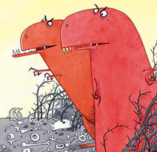
LO: To think of adjectives.
An adjective is a describing word.
Think of adjectives to describe the Tyrannosauruses.
Make a mind map.

Slide 2
LO: To use adjectives.
Using your adjectives from yesterday.
Write sentences to describe the tyrannosauruses.

Slide 3
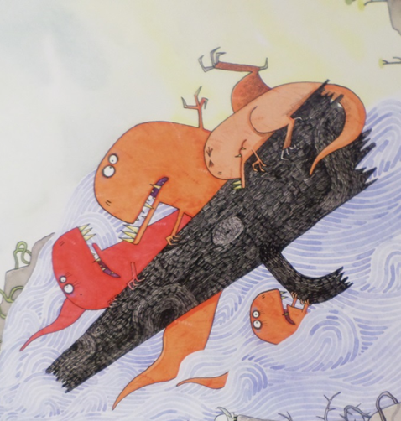
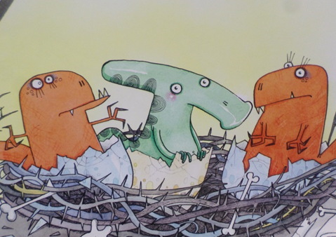
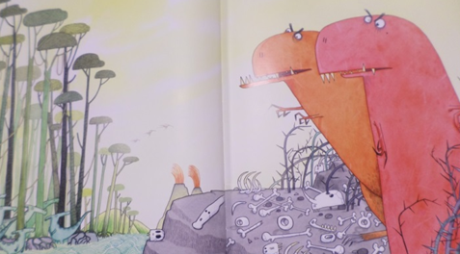
LO: To think of adjectives.
An adjective is a describing word.
Think of adjectives to describe how the Tyrannosauruses were feeling at different parts of the story.

Slide 4
LO: To use adjectives.
Using your adjectives from yesterday.
Write sentences to describe how the Tyrannosauruses felt at different times in the story.

Slide 5
Handwriting
Oh I want to be a great, big dinosaur.
That is what I really want to be!
For if I were a great, big dinosaur.
Everyone would run away from me!

