Slide 1
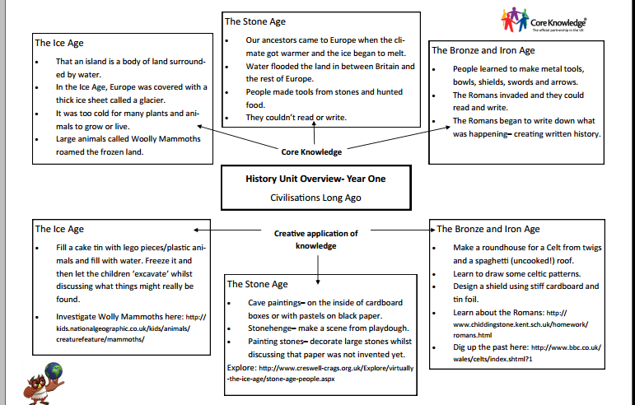

Slide 2
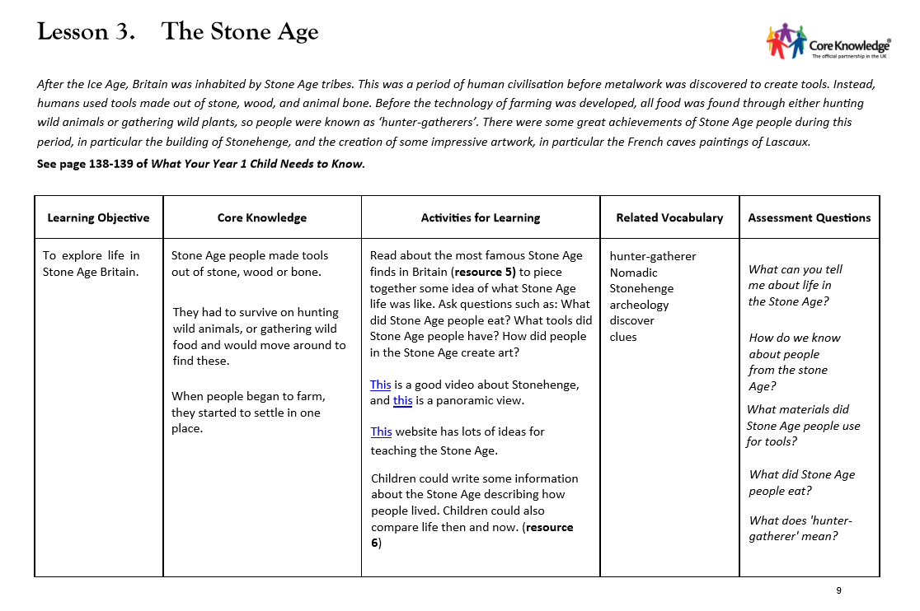

Slide 3
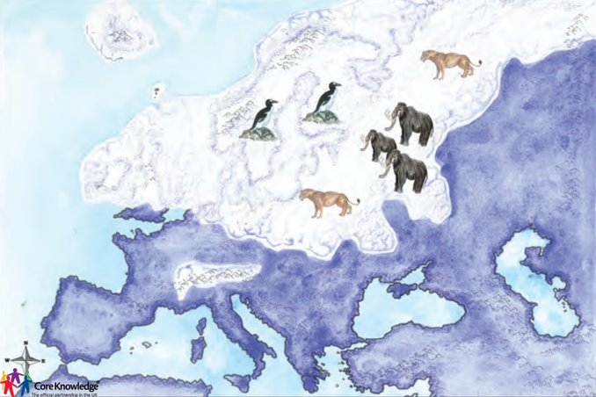
Prior Knowledge
What can you tell me about this picture?
​
​

Slide 4
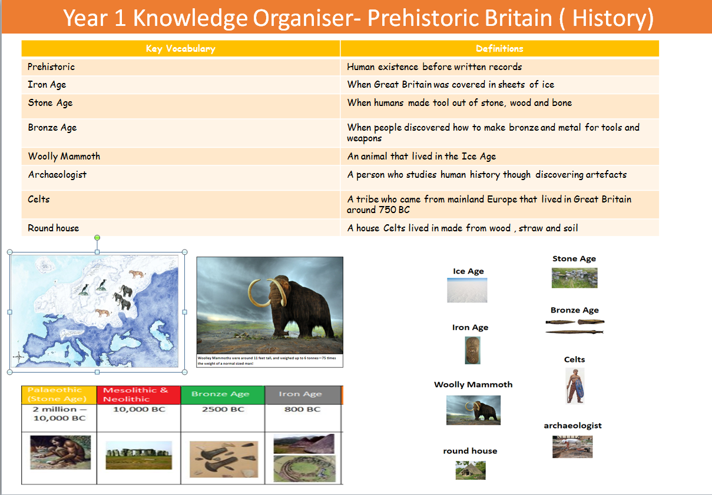

Slide 5
LO: explore life in Stone Age Britain.​
Success Criteria:​
During the Stone age people made tools out of wood, stone or bone.
They had to survive on hunting wild animals or gathering wild food and would move aroudn to find these.
When people began to farm they settled in one place.
Prehistoric​
Stone Age​
discover​​
hunter gatherer
Past​​
nomadic
archeology
​​
clues

Slide 6

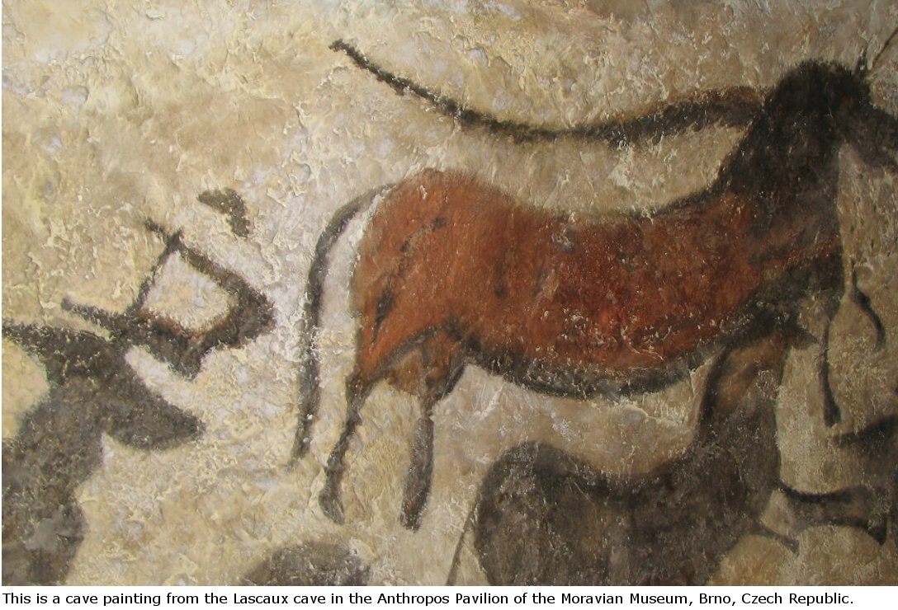
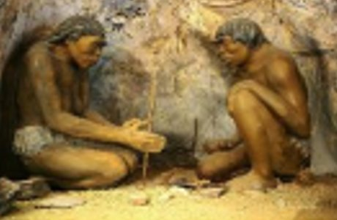
Teaching Slide
LO: To explore life in Stone Age Britain.
.
What do you think the Stone Age means? What did it look like?
How do you think people found food? How do we know about people from the Stone Age?

Slide 7
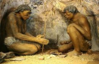
The Stone Age was over 12,000 years ago.
People made things out of stone, wood or bone.
They would move around to find food. They would hunt animals or gather wild food. ( fruit, berries.)
Eventually people started farming and stayed in one place.

Slide 8
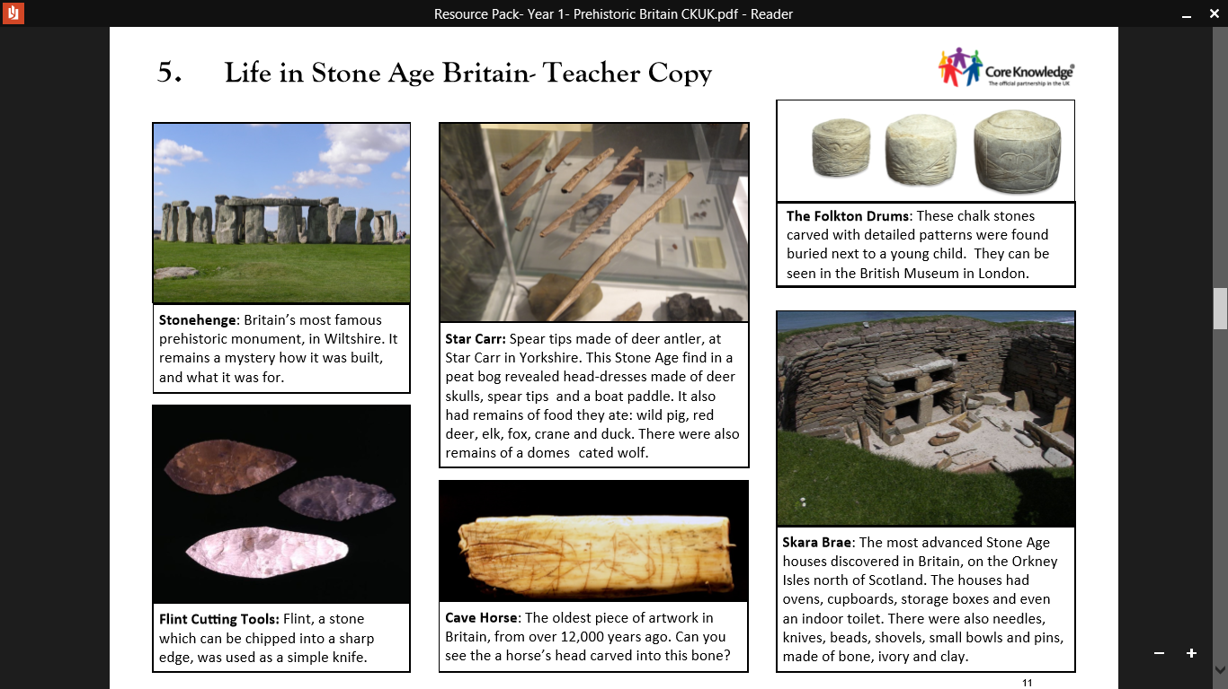
Talk task!
What do you think these objects are from the Stone Age?
What tools did they use?
How did they find food?
Can you tell me about their life?

Slide 9
Talk task!
What do you think these objects are from the Stone Age?

Slide 10
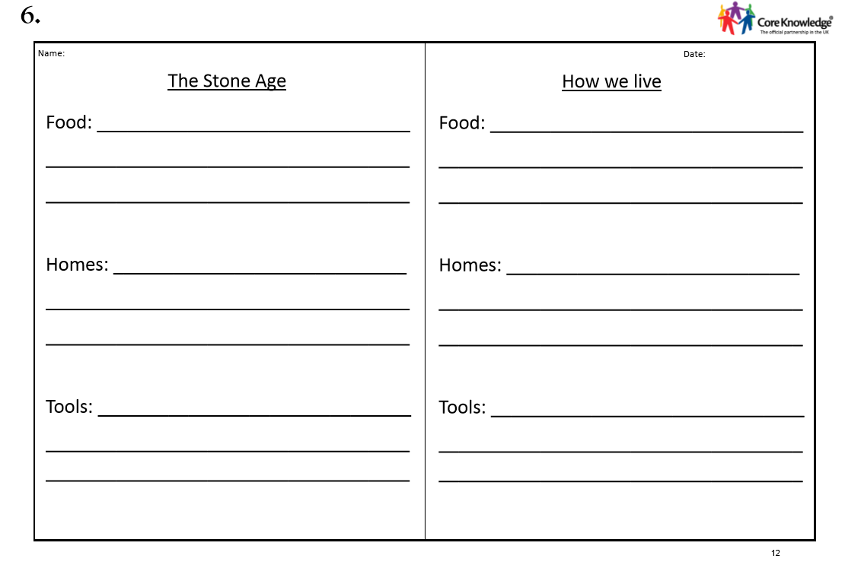
Today's Task...
Can you compare how people lived in the Stone Age with how
people live today?

Slide 11

Plenary... True or False?
People from the Stone Age ate pizza.
Thumbs up or Thumbs down!

Slide 12
Plenary... True or False?
People from the Stone Age hunted animals for food.
Thumbs up or Thumbs down!

Slide 13
Plenary... True or False?
We know about people from the Stone Age through pictures on cameras.
Thumbs up or Thumbs down!

Slide 14
Plenary... True or False?
They made tools and objects from stone, bone and wood.
Thumbs up or Thumbs down!

