Slide 1
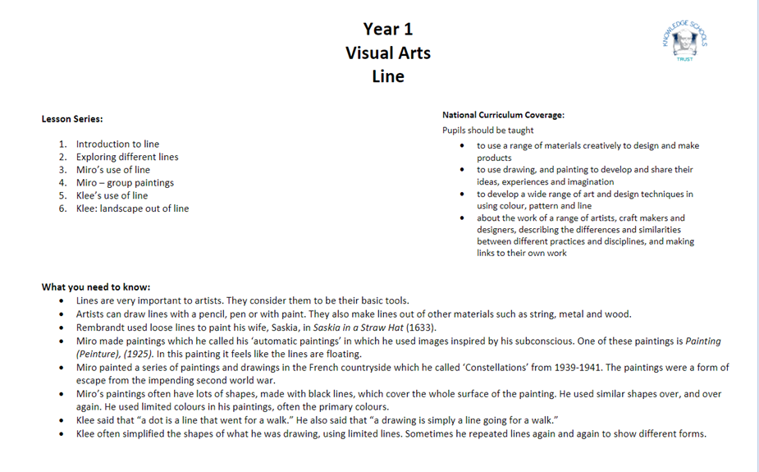

Slide 2
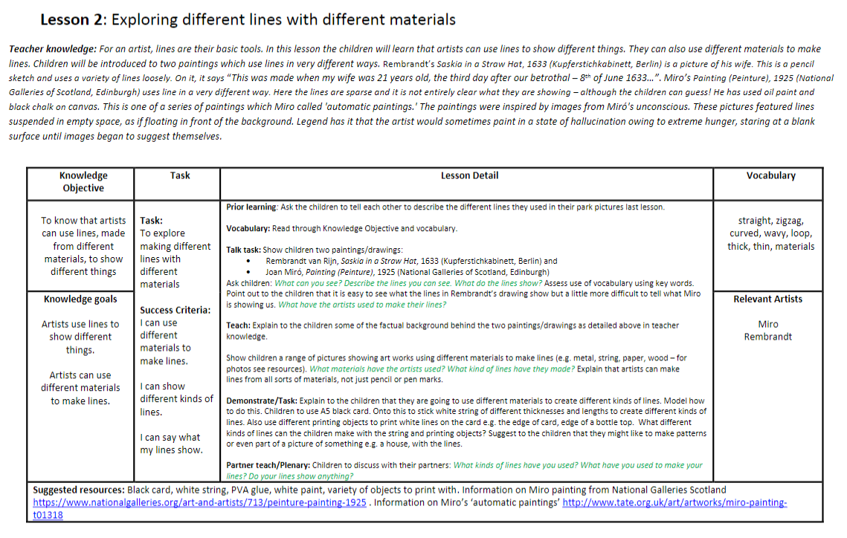

Slide 3
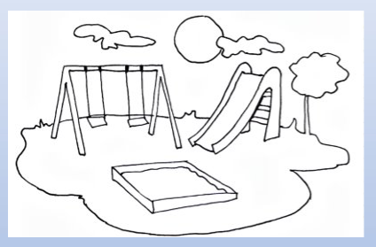
Prior Knowledge
What do you know about line? What can you make a line with?
What type of lines did you use in your park pictures last week?

Slide 4
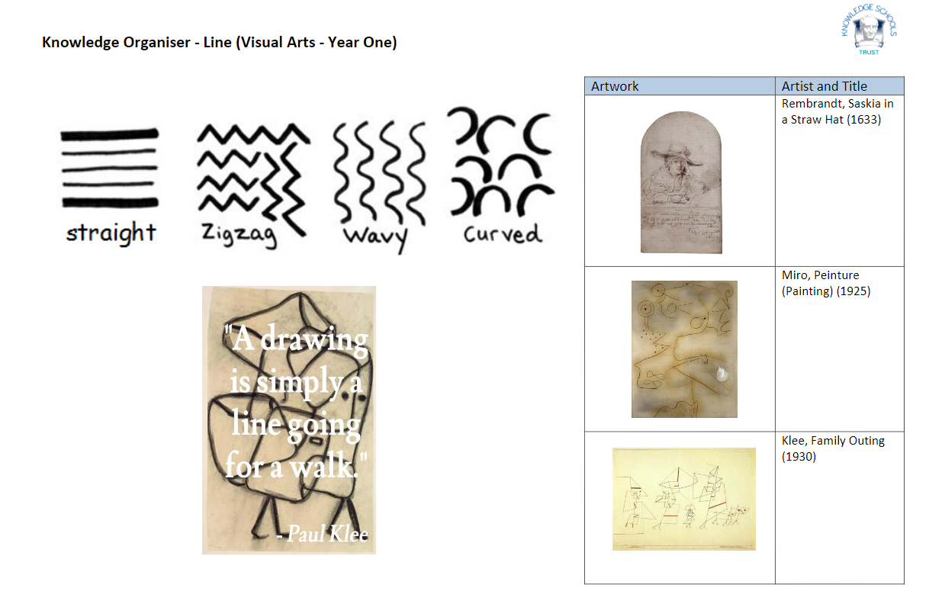

Slide 5
Key Vocabulary
line
straight​
materials
zigzag
curved
wavy
thick
loop
thin​​

Slide 6
LO: To know that artists can use lines, made from different materials, to show different things.
Success Criteria:
I know artists use lines to show different things and artists can use different materials to make lines.
I can explore and use different materials to make lines.
I can draw different kinds of lines and say what my lines show.
straight​
line
materials
zigzag
curved
wavy
thick
loop
thin​​

Slide 7
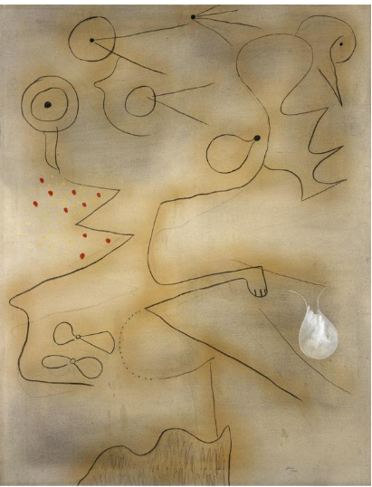
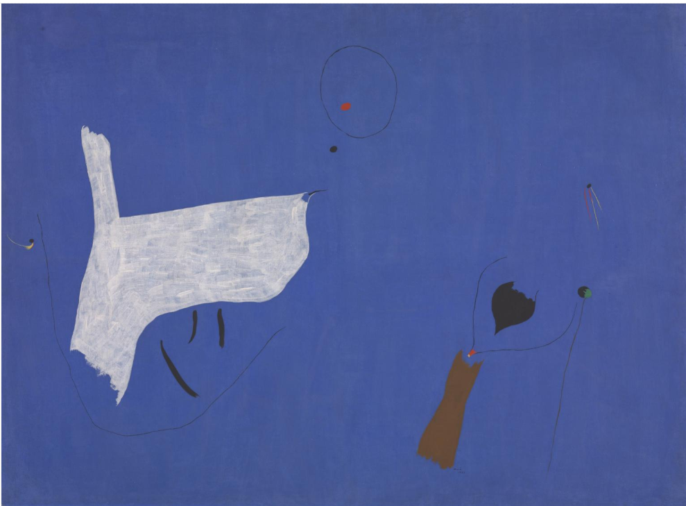
Talk Task
LO: To know that artists can make lines, from different materials, using different things.
What can you see? What do the lines show?
What have the artists used to make their lines?

Slide 8
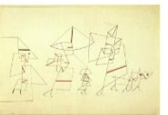
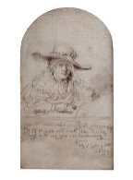
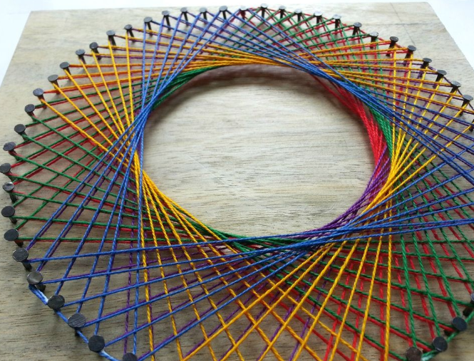
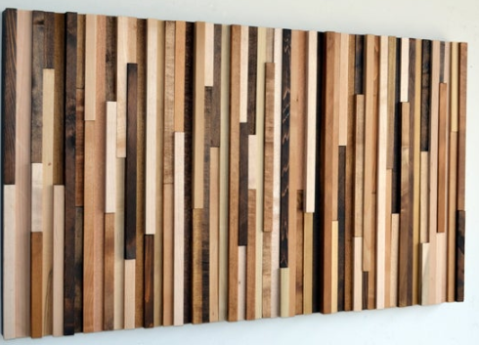
Teaching Slide
LO: To know that artists can make lines, from different materials, using different things.
What lines have the artists made?
What materials have the artists used? How are they different?

Slide 9
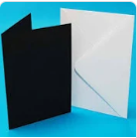
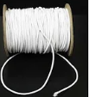
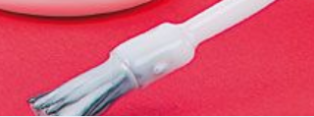

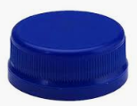
Today's Task...
You are going to be making your own picture using different lines and resources ( glue, paint, string, bottle caps, card etc.)
​
You must include both thick, thin, straight and curved lines.
Challenge! Can you make patterns or part of a picture with your lines e.g a house?

Slide 10
Plenary... Sharing Knowledge Talk Task!
​
Turn to your partner and show your picture...
​
What kind of lines have you made and used?
What did you use to make your lines?
Do your lines and picture show anything?

