Slide 1
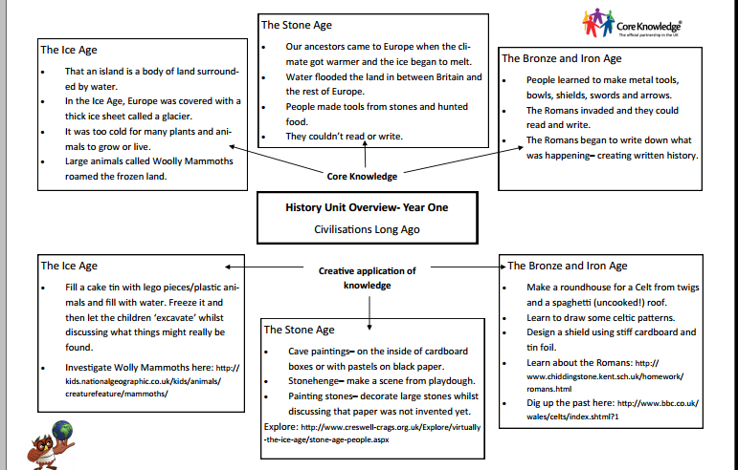

Slide 2
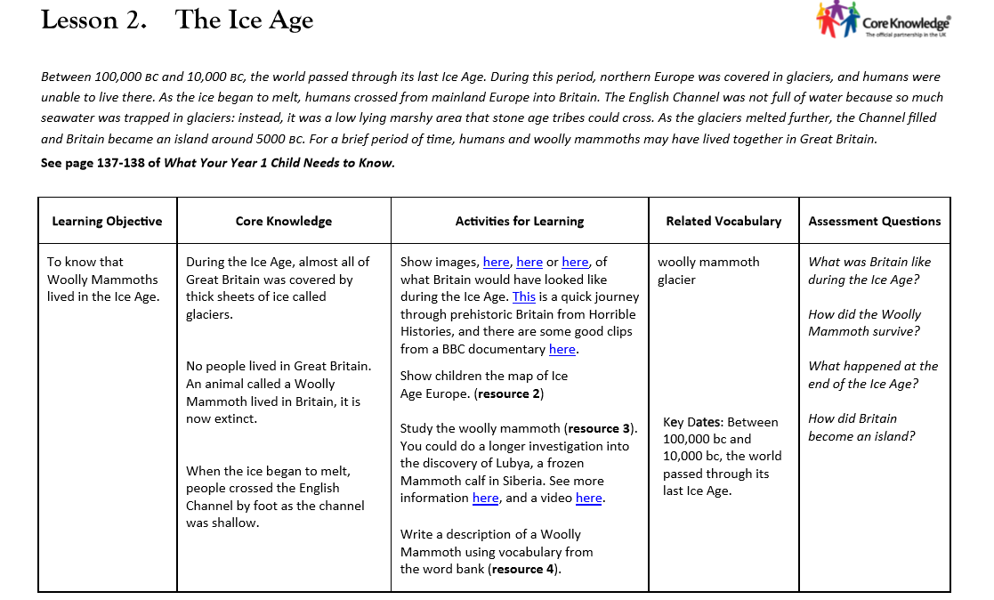

Slide 3
Prior Knowledge
What do these words mean?
Archeology​
Prehistoric​
Past​
​
Artefact

Slide 4
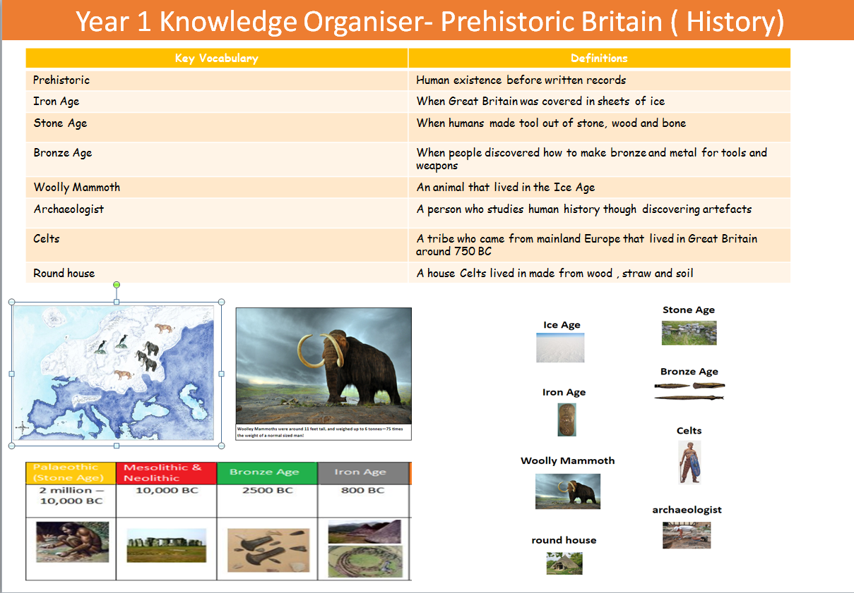

Slide 5
Key Vocabulary
Prehistoric​
Ice​
Source​​
Ice Age
Past​​
wooly mammoth​
extinct
​​
glacier​​

Slide 6
LO: To know that woolly mammoths lived in the Ice Age.
Success Criteria:
During the Ice Age, almost all of Great Britian was covered by thick sheets of ice called glaciers.
No people lived in Great Britain at this time.An animal called a woolly mammoth lived in Britian, it is now extinct.
When the ice began to melt, people crossed The English Channel by foot as the channel was shallow.
Prehistoric​
Source​​
Ice Age
Past​​
wooly mammoth​
extinct
​​
glacier​​

Slide 7

Teaching Slide
LO: To know that woolly mammoths lived in the Ice Age.
.
What do you know about the Ice Age? What do you think it means? What did it look like?
What do you think a woolly mammoth is?

Slide 8
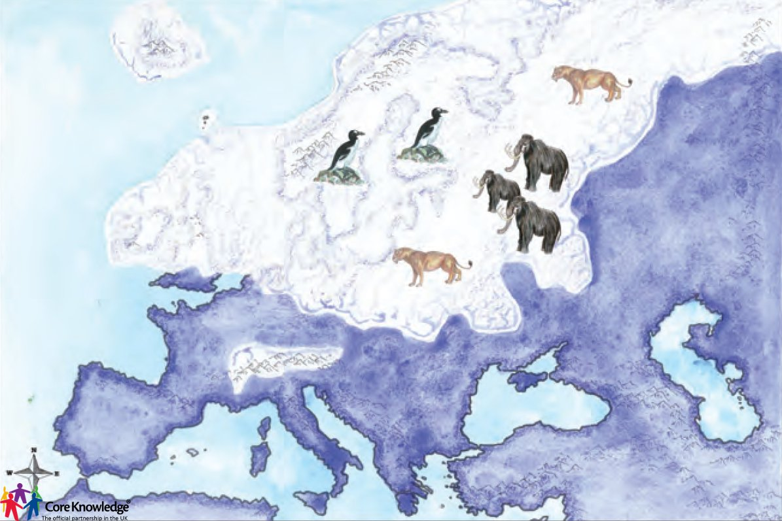
During the Ice Age almost all of Great Britain was covered by big sheets of ice.
No people lived in Great Britain.
What do you think might have lived there?

Slide 9
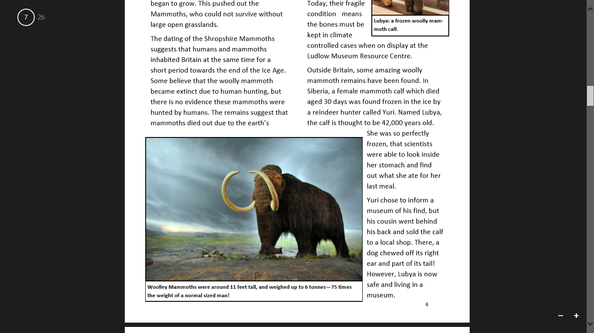
Talk task!
An animal called a woolly mammoth lived here.​
​
Can you describe the woolly mammoth?

Slide 10
They lived nearly 13,000 years ago.
They were up to 11 feet tall and weighed 6 tonnes. ( 75 times heavier than us!)
They have big tusks and a large trunk.
They are covered in wool to keep them warm.
They ate plants, tree and grass. ( vegetarian.)

Slide 11
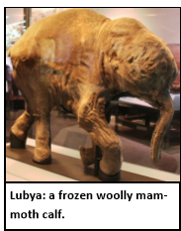
They become extinct ( died) because the world got warmer.
There was not enough food for them to eat.
We do not see them today as they can only live in very cold weather.
We still have their bones today to look at and learn from.

Slide 12
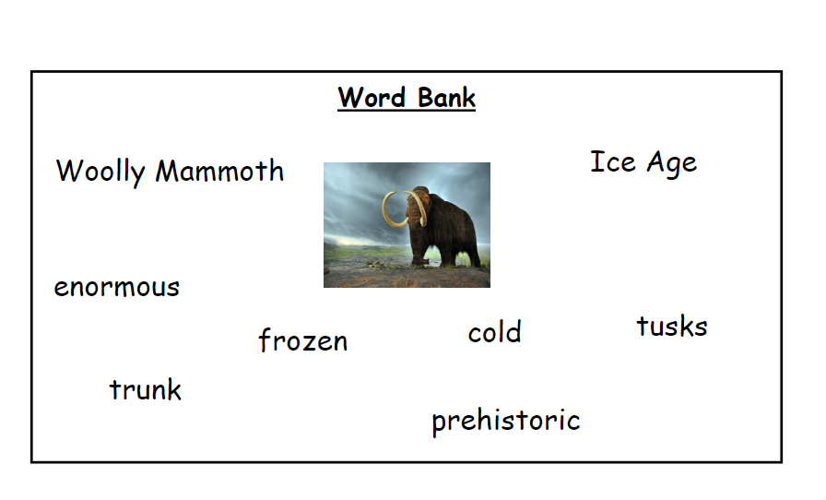
Today's Task...
You are going to write a description of a woolly mammoth!
​
Use your vocabulary word bank to help you!​

Slide 13
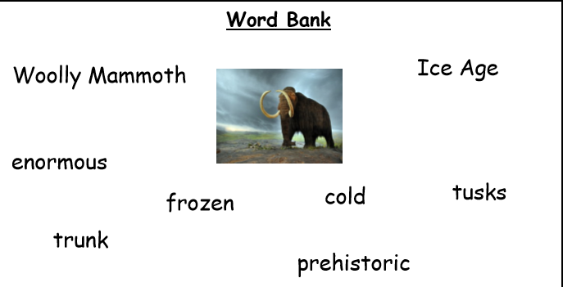
Plenary...
Who would like to read their description to the class?
What do we like about it?
What is your favourite thing about a woolly mammoth?

Slide 14

Plenary... Questions on your whiteboards!
Tell me 3 things you know about a woolly mammoth!

Slide 15
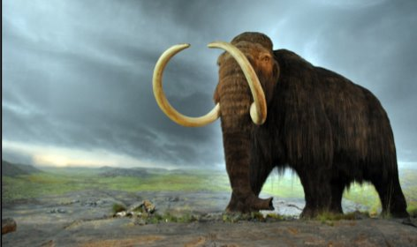
Plenary... Questions on your whiteboards!
Tell me 3 things you know about a woolly mammoth!

Slide 16
Plenary... Quickfire Questions!
What was Britain like during the Ice Age?
How did the Woolly Mammoth survive?
What happened at the end of the Ice Age? How did Britain become an island?

Slide 17
Quickfire Questions!
How was Britain like during the Ice Age?
How did the Woolly Mammoth survive?
What happened at the end of the Ice Age? How did Britain become an island?

