Slide 1
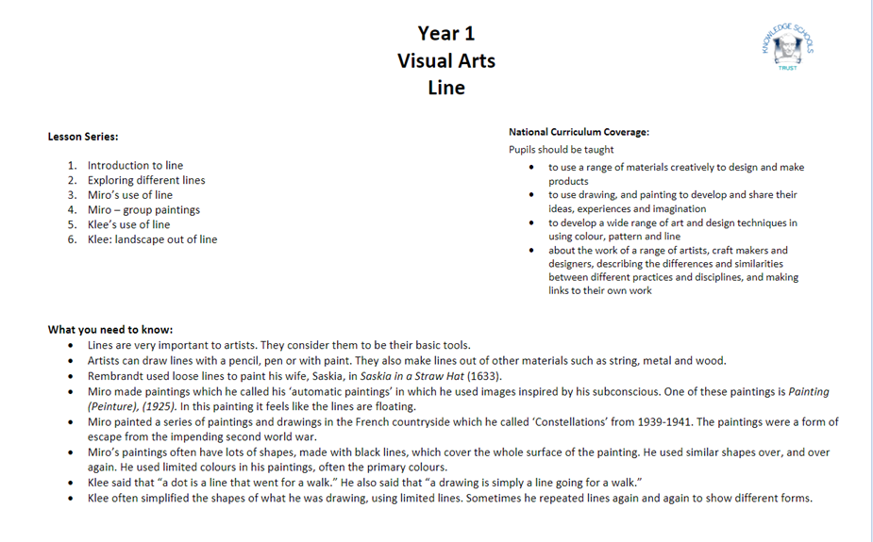

Slide 2
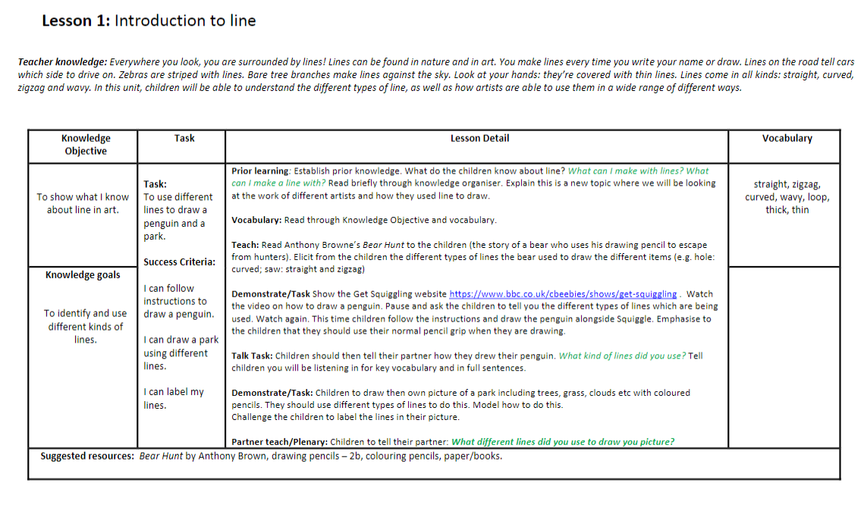

Slide 3
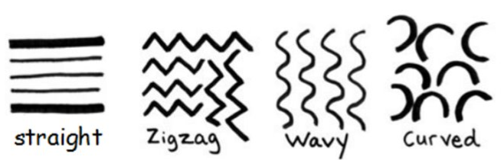
Prior Knowledge
What do you know about lines?
What can you make a line with?

Slide 4
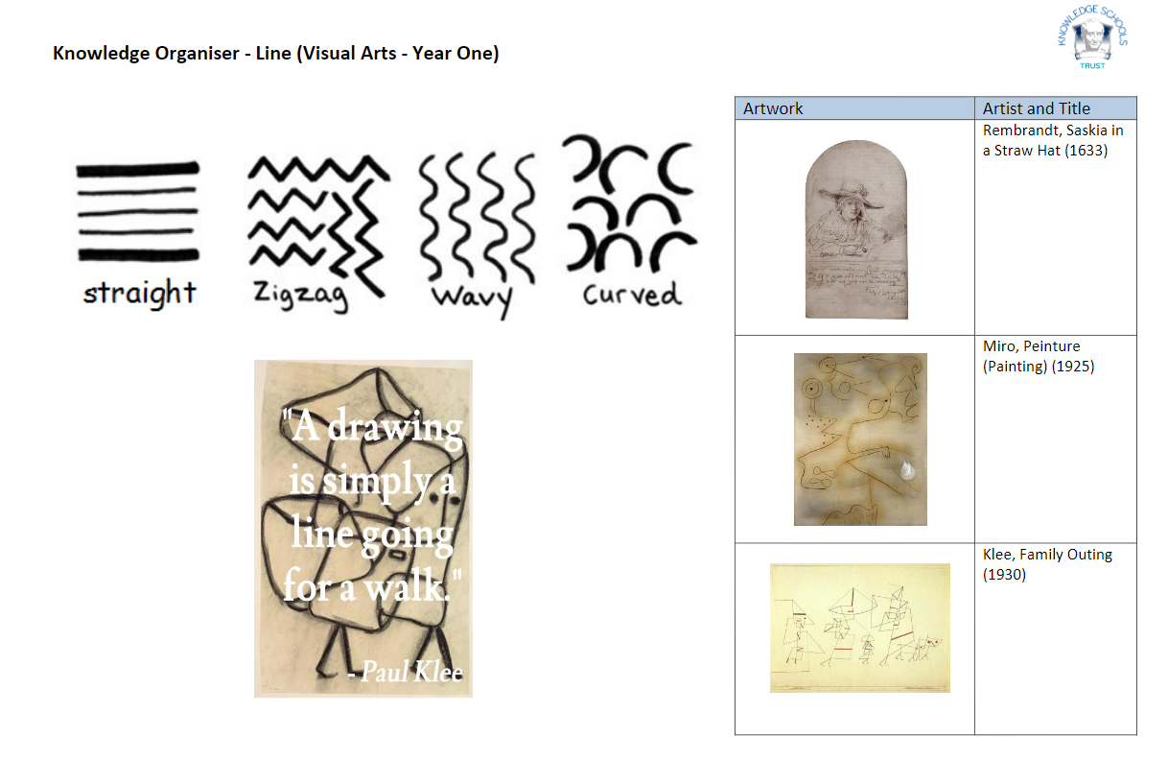

Slide 5
Key Vocabulary
straight​
line
zigzag
curved
wavy
thick
thin​​

Slide 6
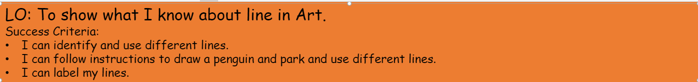
straight​
line
zigzag
curved
wavy
thick
thin​​

Slide 7

Teaching Slide
LO: To show what I know about line in Art.
What lines did we find in our story we read?
https://www.youtube.com/watch?v=-u3oys6THpY
What different types of lines did Bear use?

Slide 8

Teaching Slide
LO: To show what I know about line in Art.
Let's watch this video on how to draw a penguin!
Which types of lines are being used?
Can we now draw our own penguin
on our white boards following the instructions?
https://www.bbc.co.uk/cbeebies/shows/get-squiggling
( Also On One Drive in Art Lines Folder- Get Squiggling Penguin.)
.

Slide 9

Talk Task!
Tell your partner...
How did you draw your partner?
What kind of lines did you use?
Don't forget your key vocabulary and to use full sentences!

Slide 10
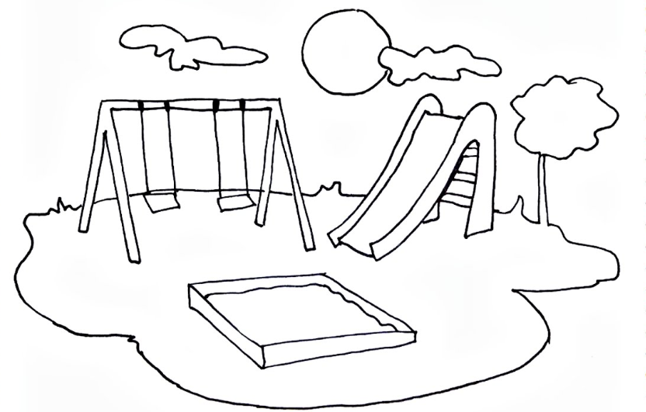
Today's Task...
You are going to be draw your own picture of a park using the lines we have learnt about.​
​
You must include a tree, grass, clouds, and use different lines.
Challenge! Can you label the different types of line you use?​

Slide 11
Plenary... Sharing Knowledge Talk Task!
​
Turn to your partner and show your picture...
​
What different lines did you use to draw it?

