Slide 1
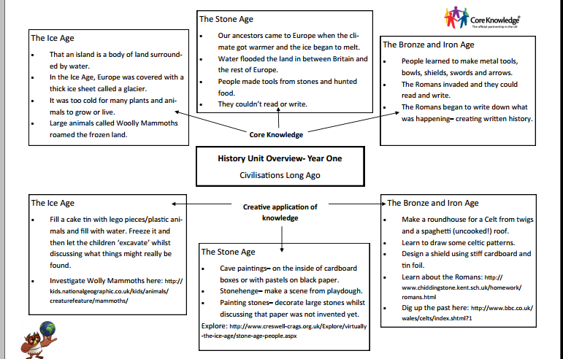

Slide 2
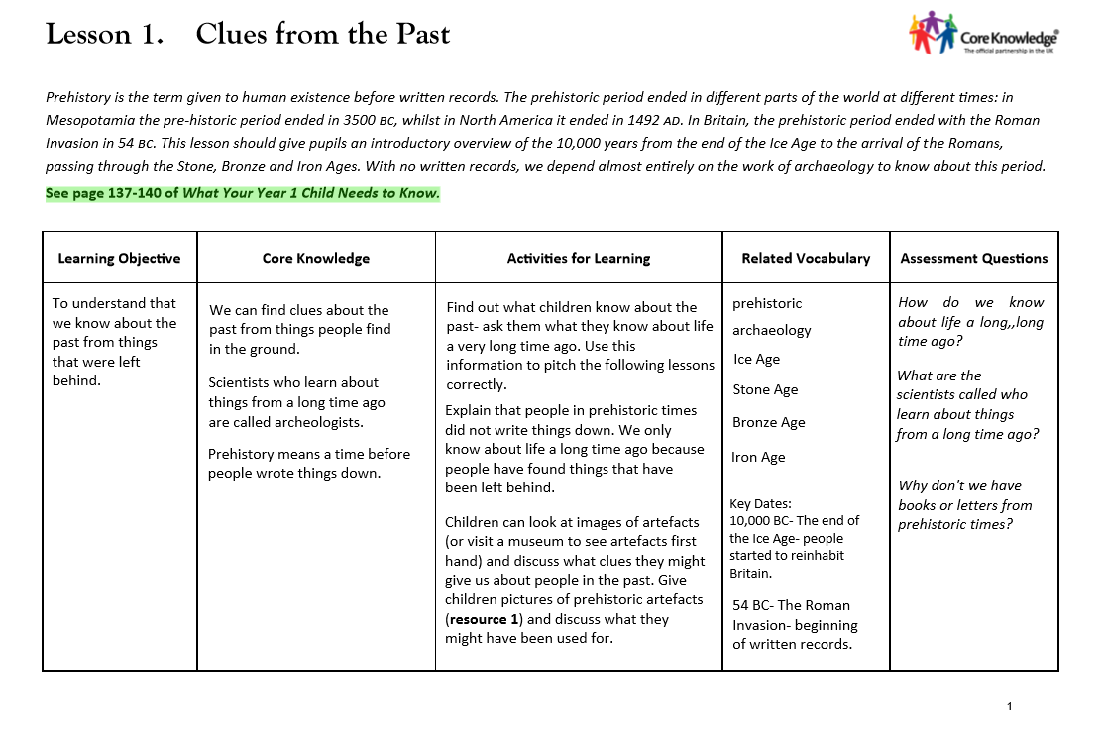

Slide 3
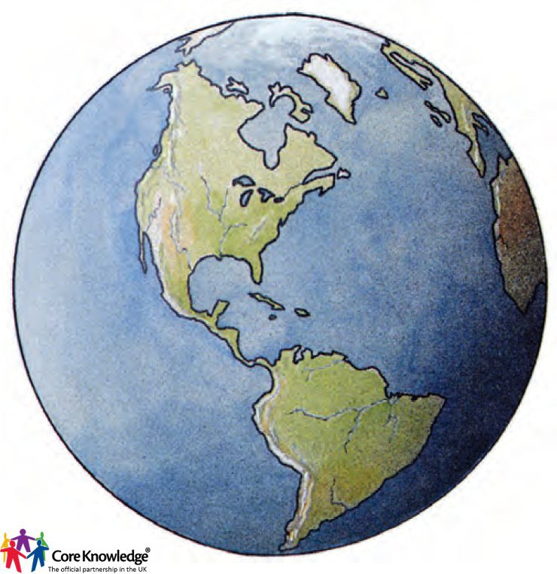
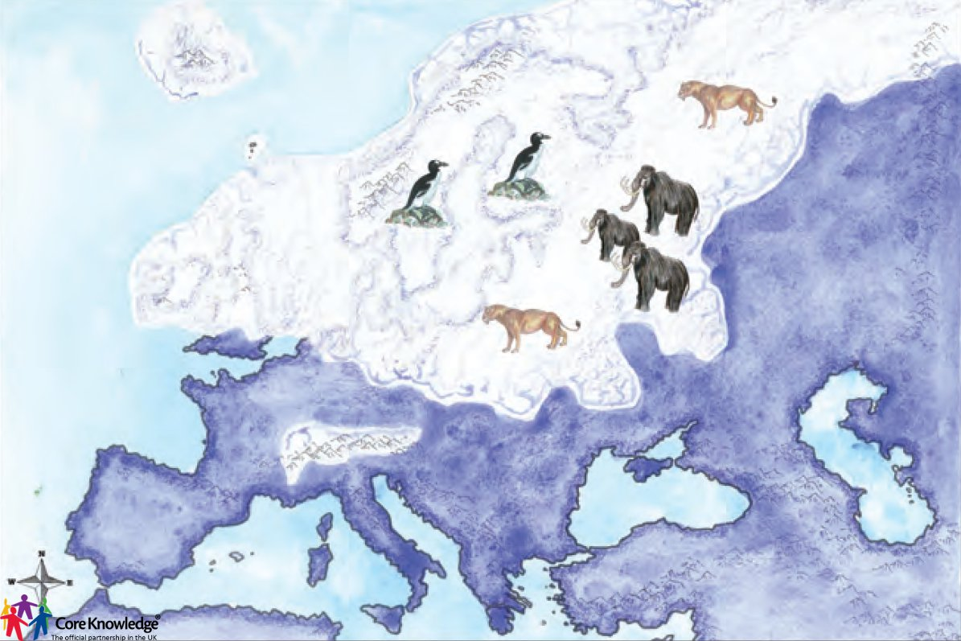
Prior Knowledge
In Reception we learnt about Understanding the World…
In Reception we learnt about the coldest place on Earth…

Slide 4
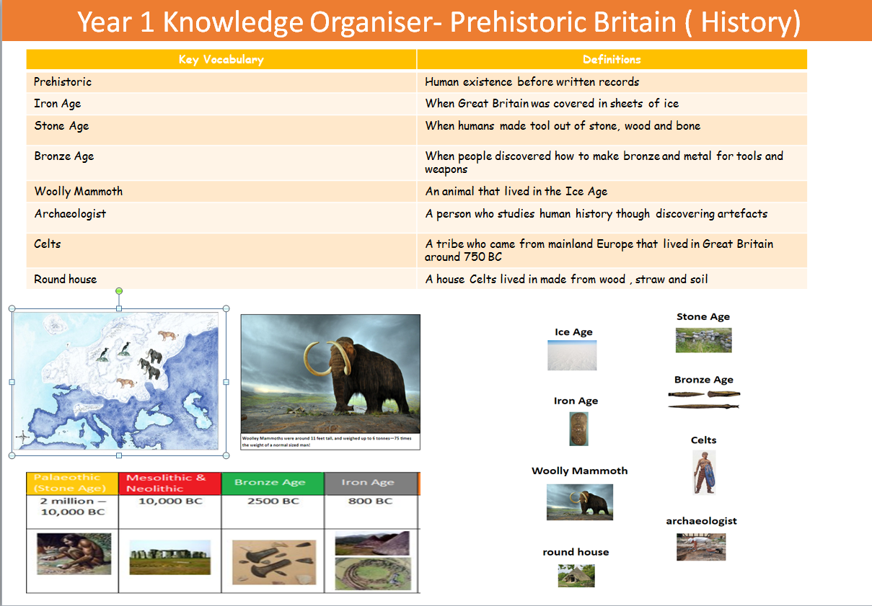

Slide 5
LO: To understand that we know about that the past from things that are left behind.
Success Criteria:
We can find clues about the past from things that were left in the ground.
Scientists who learn about things from a long time ago are called archaeologists.
Prehistory means a time before people wrote things down.
Iron Age​
Prehistoric​
Source​​
Ice Age
Past​​
Archeology​​
Bronze Age​
​​
Artefact​​

Slide 6

Teaching Slide
LO: To understand that we know about that the past from things that are left behind.
.
What do you know about the past? What does it mean?
Can you tell me about something that has happened in the past?
Do you know anything that happened before you were born?

Slide 7
Teaching Slide
LO: To understand that we know about that the past from things that are left behind.
.
What do you know about the past? What does it mean?
Can you tell me about something that has happened in the past?
Do you know anything that happened before you were born?

Slide 8
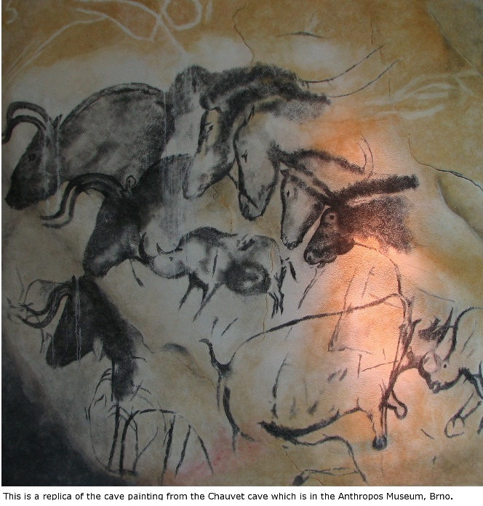
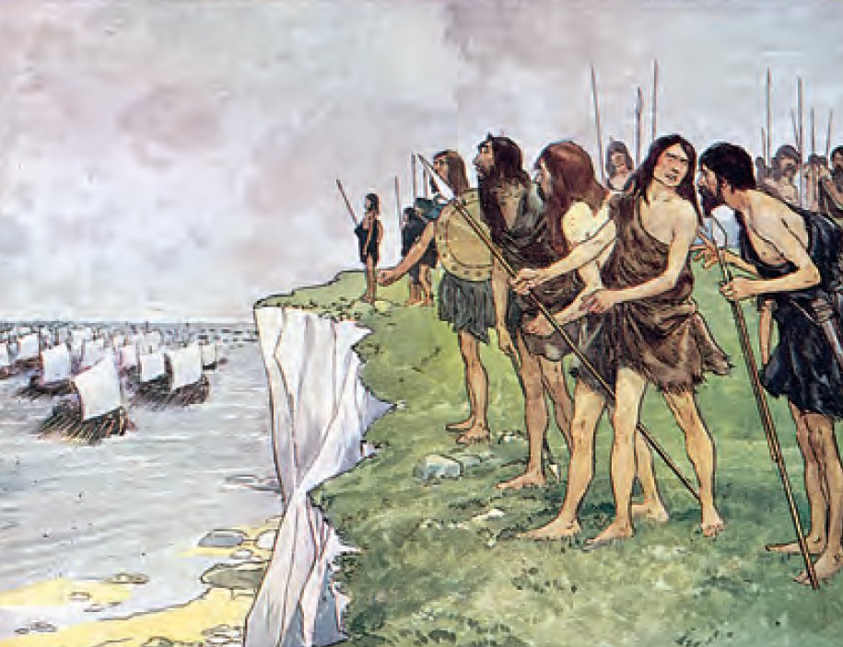
The past is something that has already happened or may have happened a long time ago.
Prehistoric is a time in the past that happened when people did not write things down.
How do you think we know what happened?

Slide 9
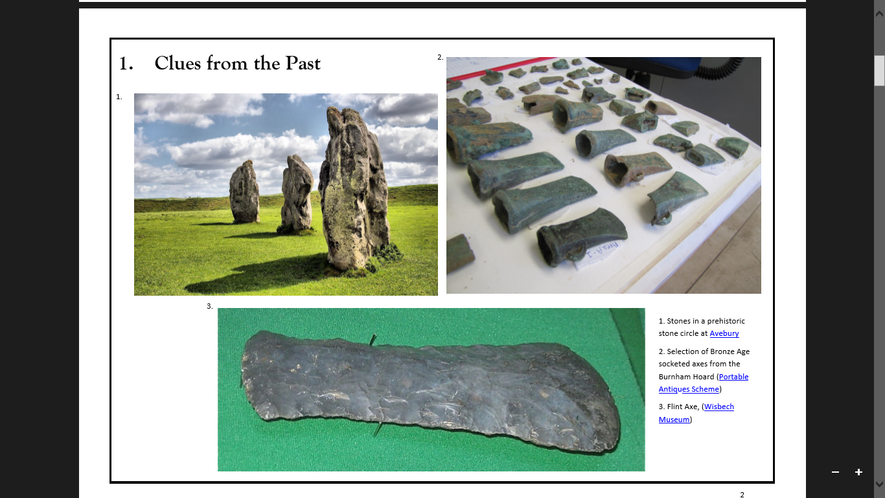
We know about things from a long time ago because people have found things that have been left behind. We didn’t have books, photos letters!
People that find these things are special scientists called archaeologists. They look at special objects or artefacts to find out about History.

Slide 10
Talk task!
What do you think this artefact is? ​
​
What could it have been used for?​

Slide 11
Today's Task...
You are going to be archaeologists!​
​
As tables can you discuss and write down what you think the different artefacts are from Prehistoric Britian?​

Slide 12
You are going to be archaeologists!
As tables can you now match up the words with the artefacts?
Stone
Stonehenge
Sword
Axe

Slide 13
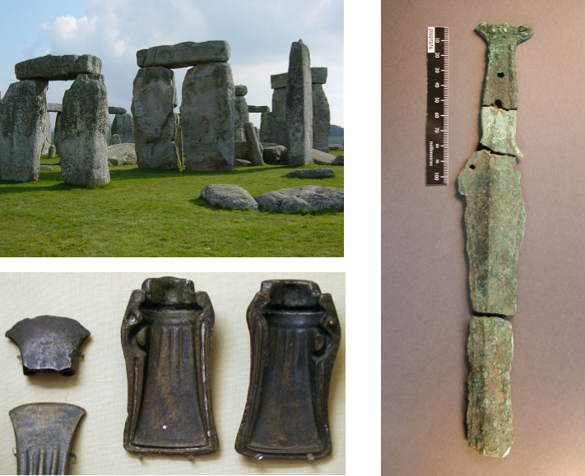
What did we find out about the artefacts?
Can we match up the words and pictures?
StoneHenge
Sword
Hoard ( treasure)

Slide 14
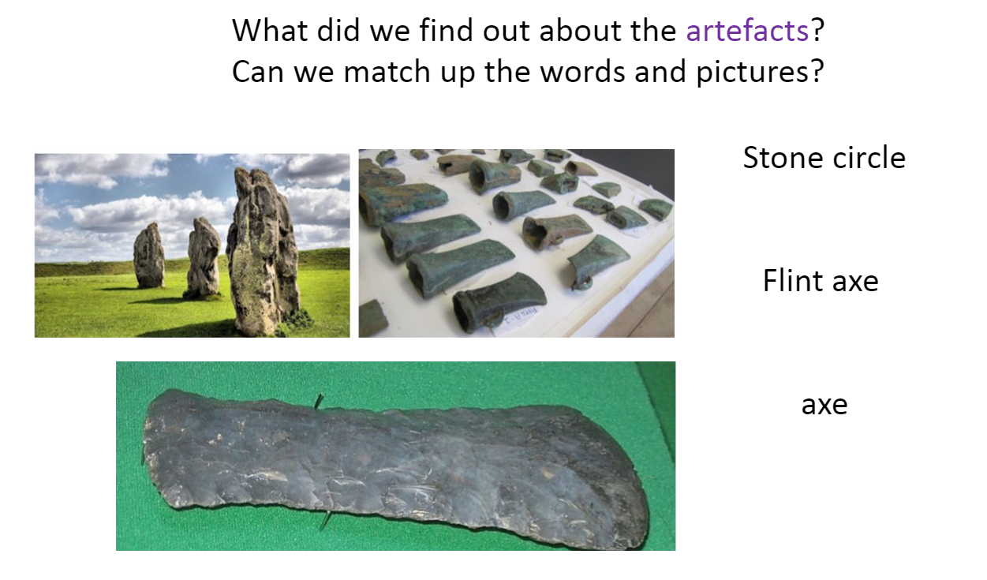
Plenary...

Slide 15

Plenary... True or False?
Things were not written down in prehistoric times.
Thumbs up or Thumbs down!

Slide 16
Plenary... Quickfire Questions!
How do we know about life from a long time ago?​
​
​
What are the scientists called who find out things from a long time ago?​
​
​
Why don’t we have books or letters from prehistoric times?

Slide 17
Quickfire Questions!
How do we know about life from a long time ago?
What are the scientists called who find out things from a long time ago?
Why don’t we have books or letters from prehistoric times?

