Slide 1
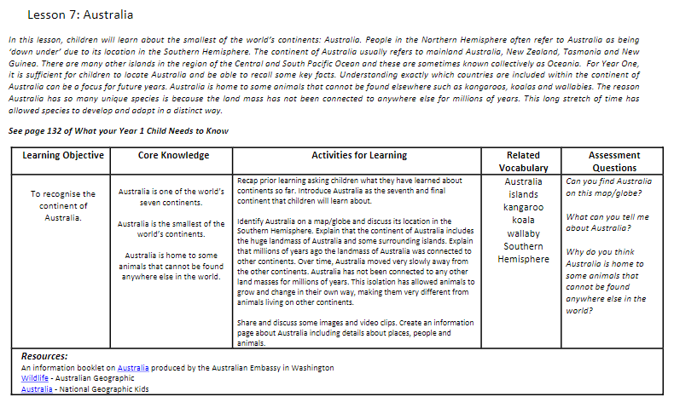

Slide 2

What do you already know about Australia?

Slide 3
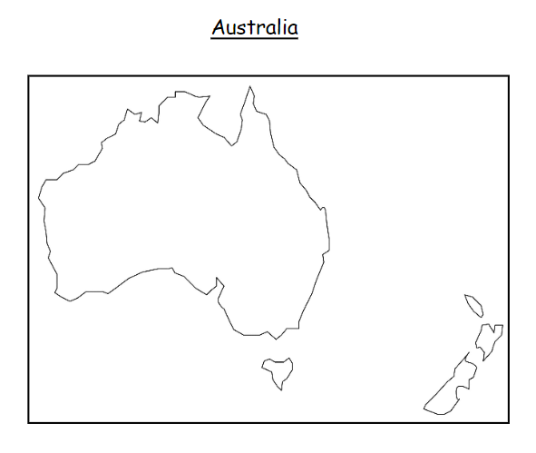
LO: To recognise the continent of Australia.
Key vocabulary to learn and use:
Australia
Islands
Kangaroo
Koala
Wallaby
Southern Hemisphere

Slide 4
We are learning about the continent of
Australia!

Slide 5
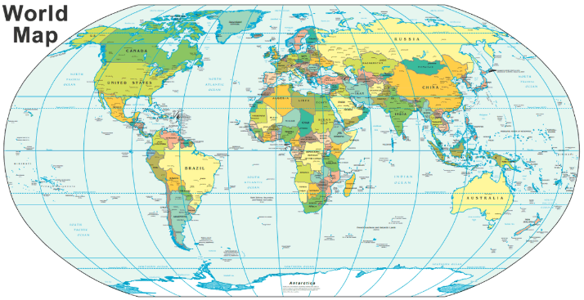
Can you find it on a map?
Lets look on the board and in our Atlases

Slide 6
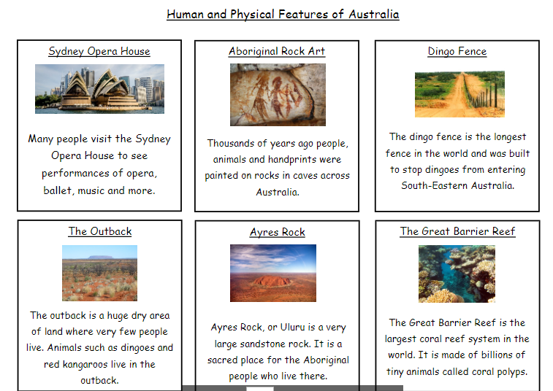
Australia has lots of physical features.

Slide 7
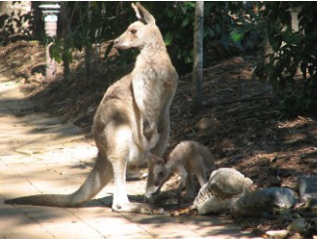
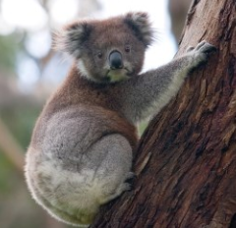
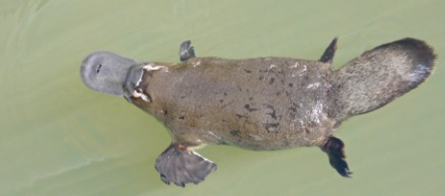
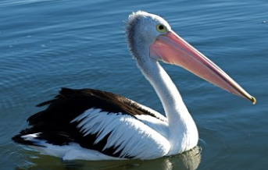
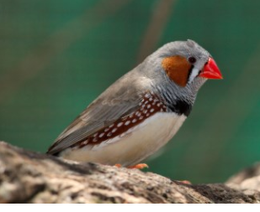
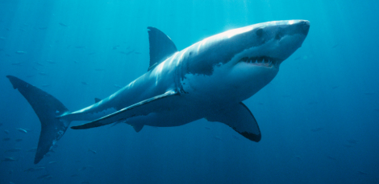
Here are some of the amazing animals you might see.

Slide 8
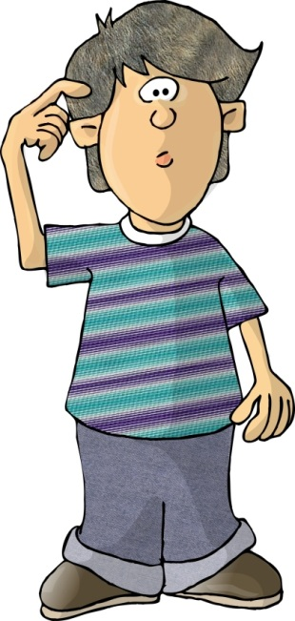
What can you tell me about the continent of Australia?
What do you know about its animals?
Name a human or physical feature?
Do any other continents share these features?

Slide 9
Key vocabulary to learn and use:
Australia
Islands
Kangaroo
Koala
Wallaby
Southern Hemisphere

