Slide 1


Slide 2

What is Confirmation?
A sacrament of initiation in the Catholic Church.
Strengthens our bond with God.
We receive the gifts of the Holy Spirit.

Slide 3
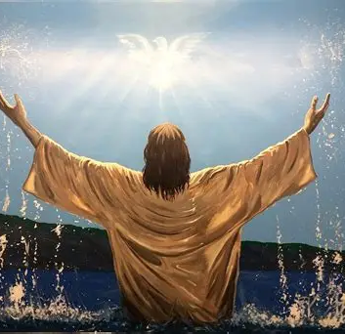
Baptism – The First Step
Entry into the Christian family.
Cleansing of original sin.
Beginning of our faith journey.

Slide 4
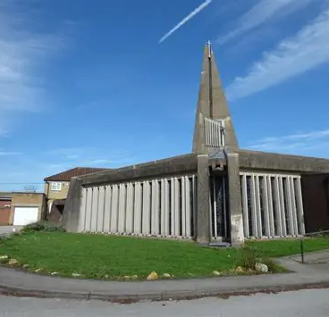
Learning About Faith
Attending Mass
Reading the Bible
Praying regularly
Living like Jesus

Slide 5

Preparing for Confirmation
Classes and discussions
Choosing a sponsor
Reflecting on your faith
Understanding the gifts of the Holy Spirit

Slide 6
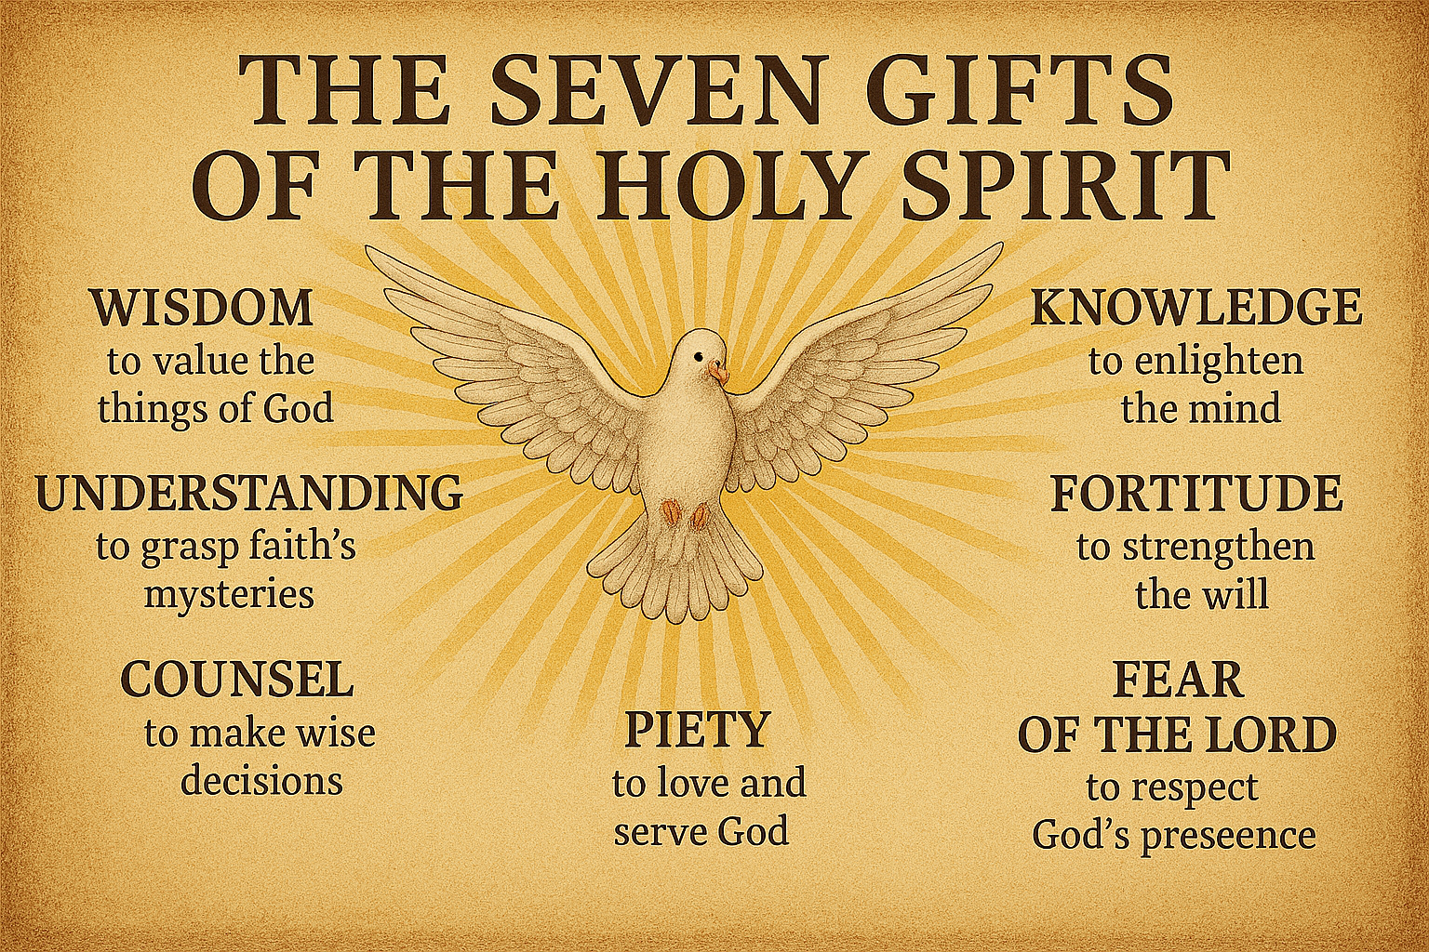
The Holy Spirit

Slide 7
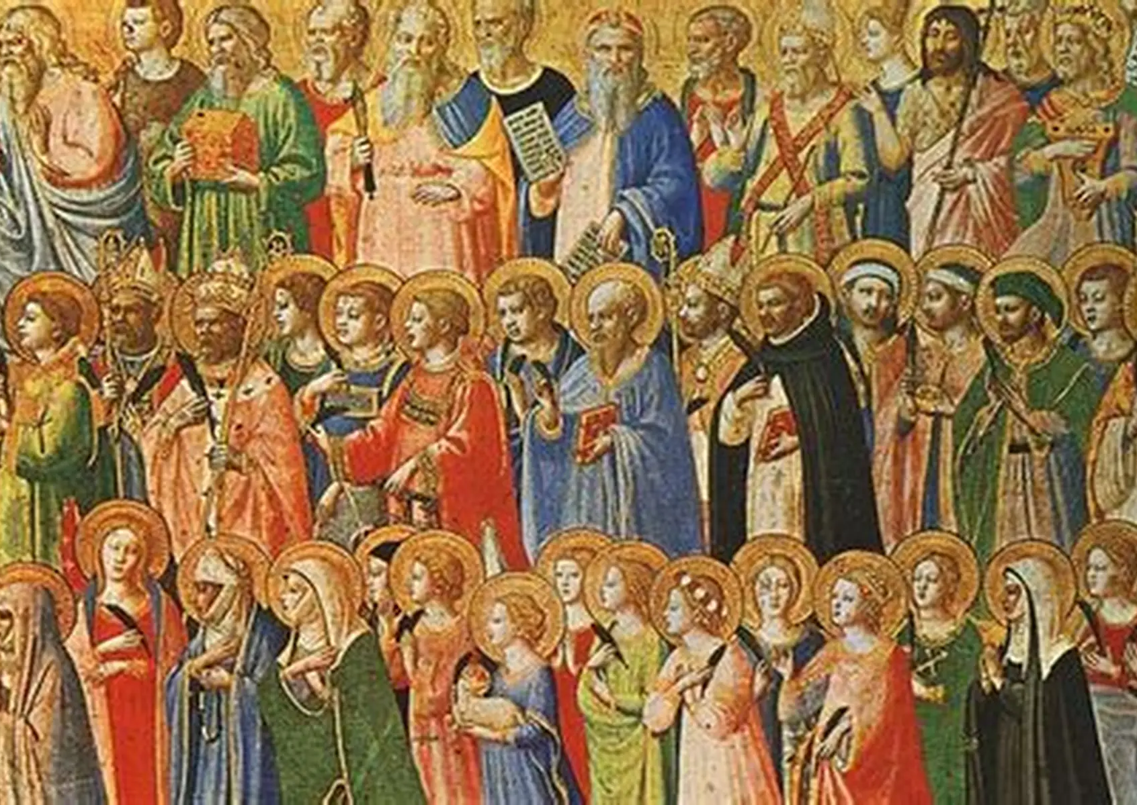
Choosing a Saint
Saints as role models
Why do we choose this Confirmation name?

Slide 8

Living as a Confirmed Christian
Being a witness to Christ
Serving others
Growing in faith
Staying active in the Church

