Slide 1
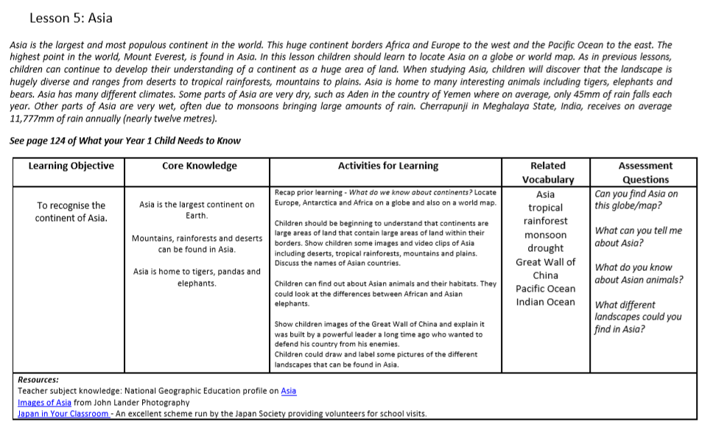

Slide 2
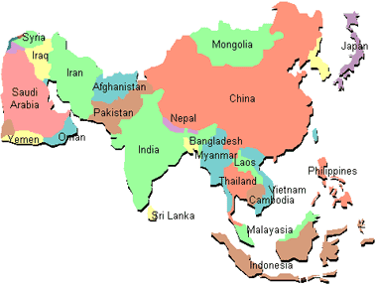
What do you already know about Asia?

Slide 3
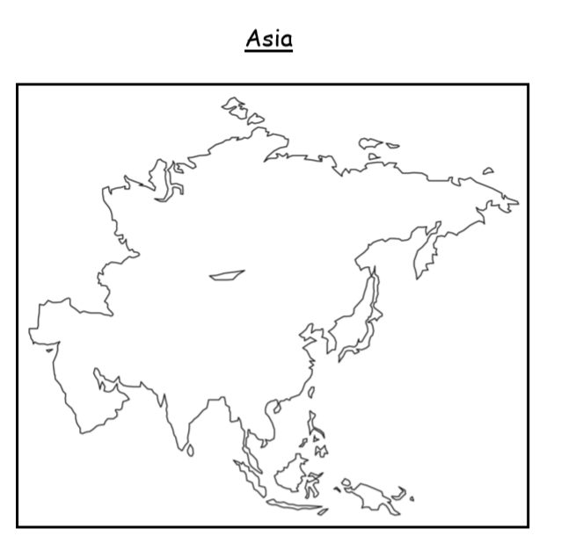
LO: To recognise the continent of Asia.
Key vocabulary to learn and use:
Asia
tropical
rainforest
monsoon
drought
Great wall of China
Pacific Ocean
Indian Ocean

Slide 4
We are learning about the continent of Asia
Asia is the largest continent in the world. Can you remember the second largest?

Slide 5
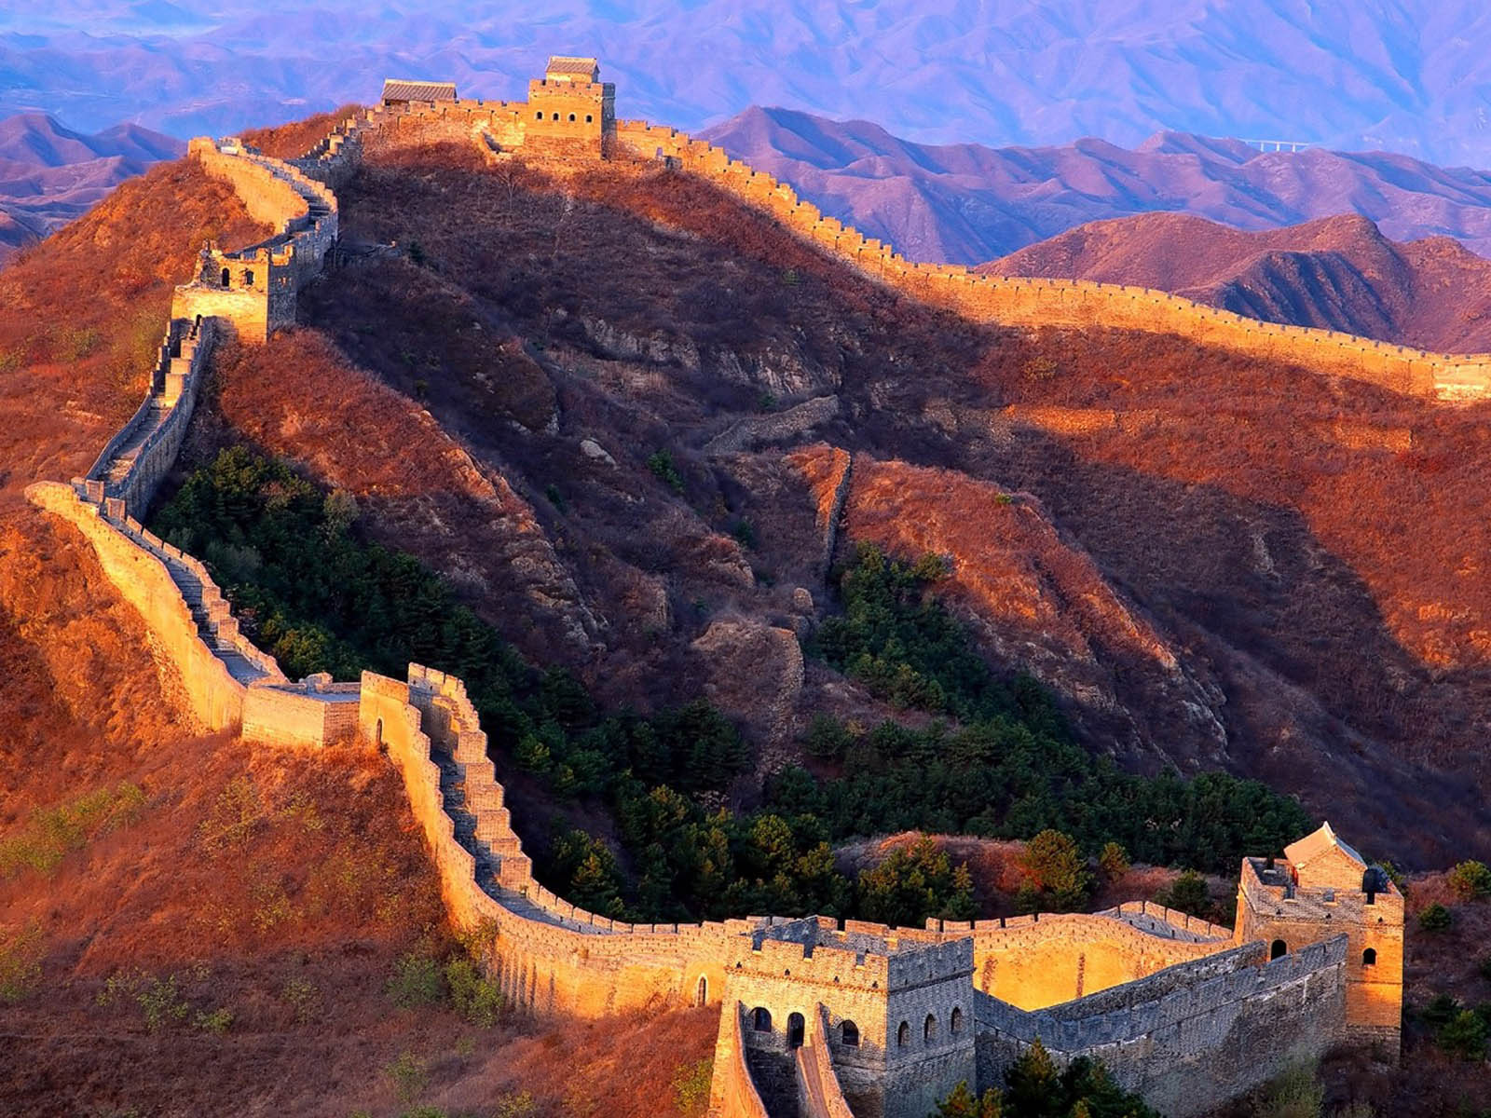
Great Wall of China
A wall the runs for miles and miles across the country of China. A powerful leader built this wall a long time ago to defend their country from enemies.

Slide 6
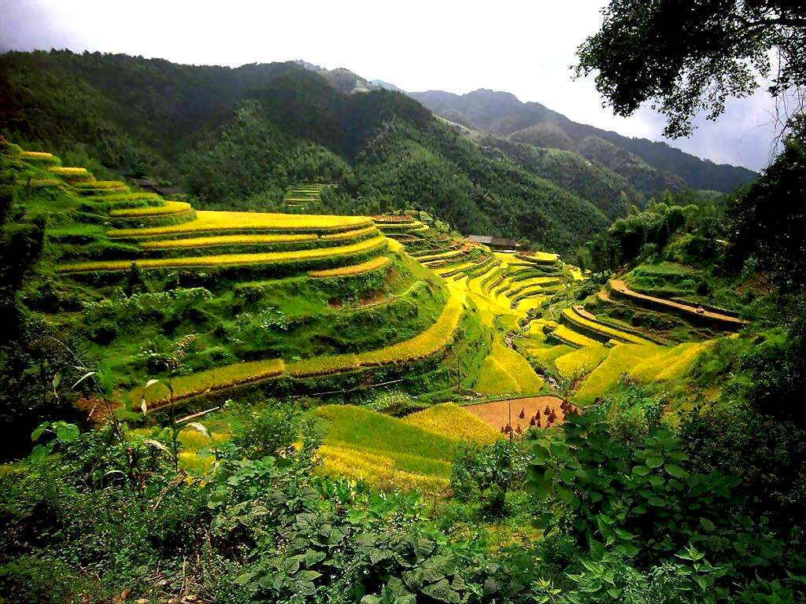
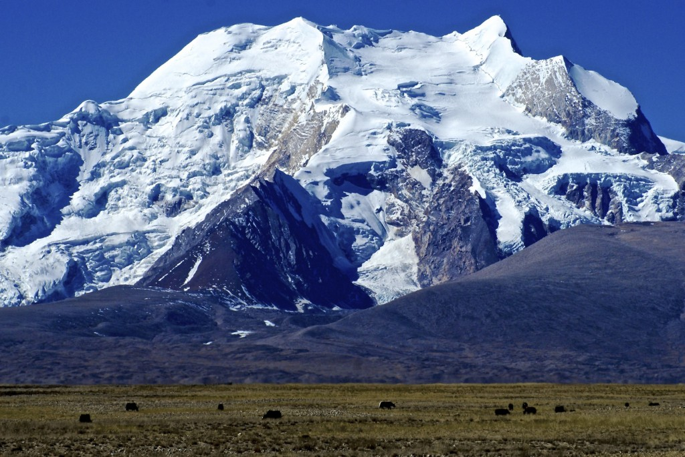
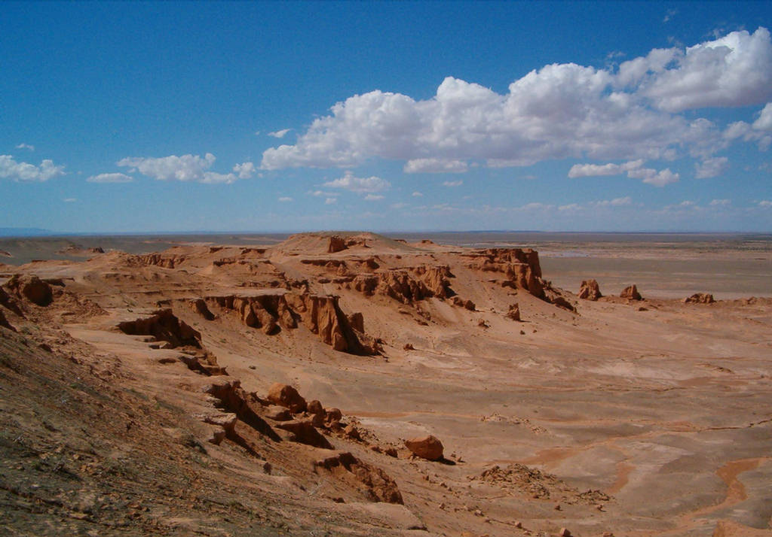
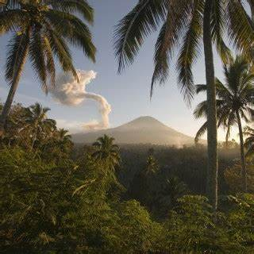
Asia is a large area of different types of land.
Rice terraces
mountains
rainforests
deserts

Slide 7
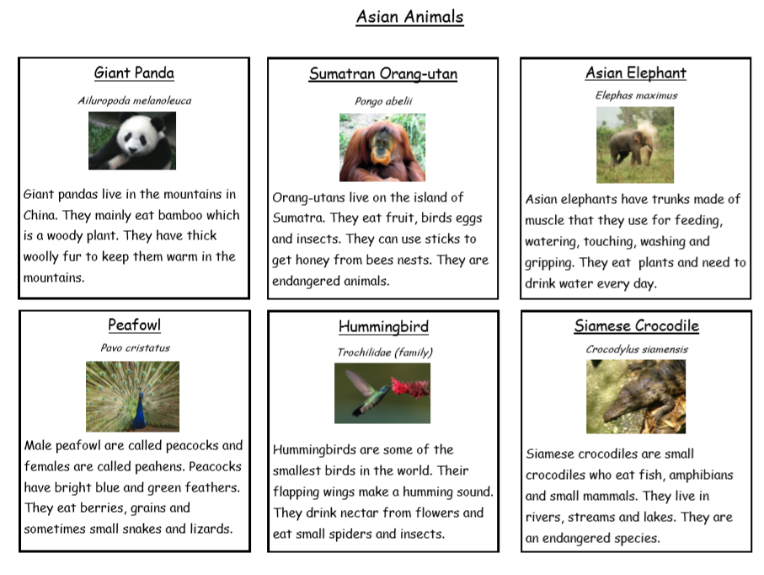
Here are some of the amazing animals you might see.

Slide 8
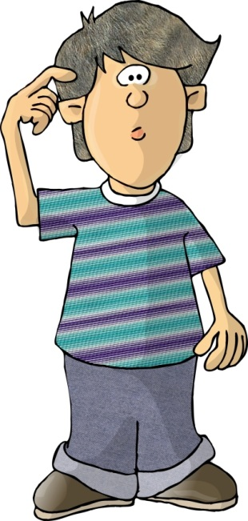
What can you tell me about Asia?
What do you know about Asian animals?
Why was the Great Wall of China built?

Slide 9
Key vocabulary to learn and use:
Asia
tropical
rainforest
monsoon
drought
Great wall of China
Pacific Ocean
Indian Ocean

