Slide 1
Mass is a very important celebration that takes place in Church.

Slide 2
What happens during the Mass? What do we do? What does Priest do?

Slide 3
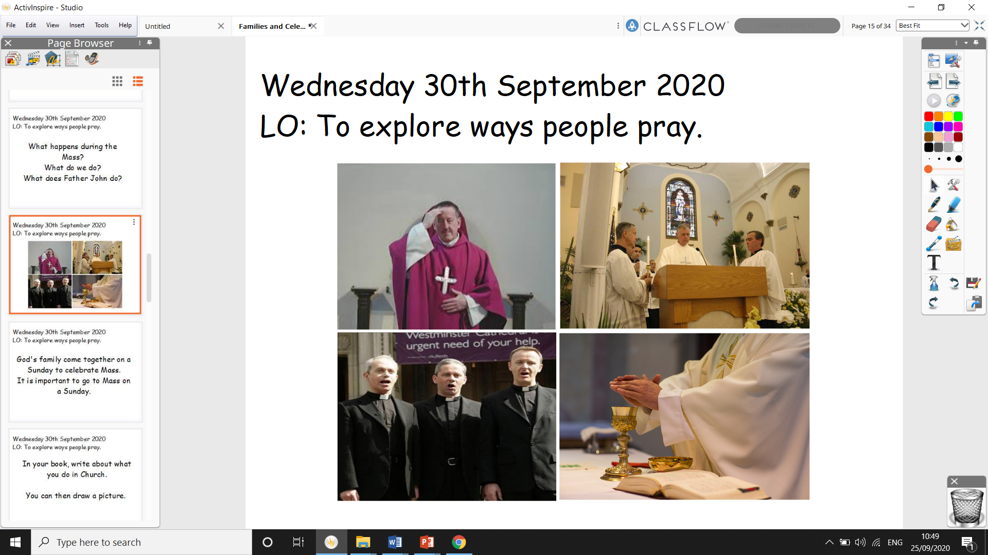

Slide 4
God's family come together on a Sunday to celebrate Mass.
It is important to go to Mass on a Sunday.

Slide 5
In your book, write about what you do in Church.
You can then draw a picture.

