Slide 1
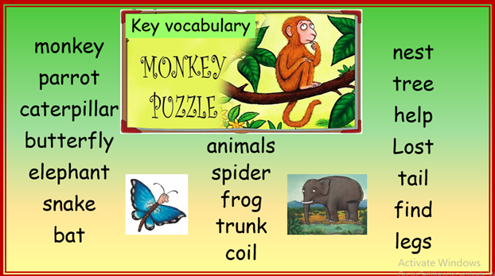

Slide 2
What is an adjective?
An adjective is a describing word.
E.g. green grass, long hair, scary witch

Slide 3
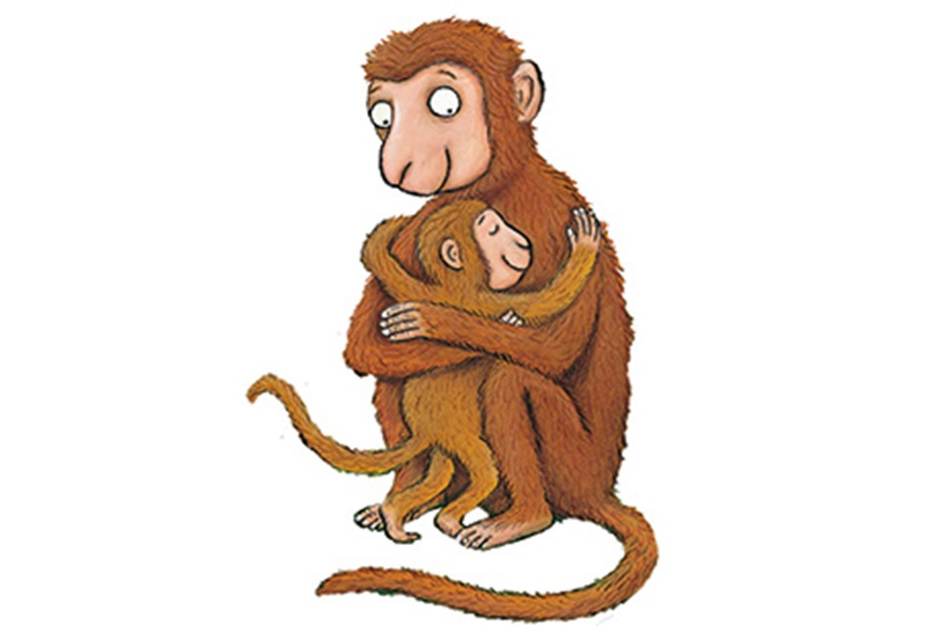
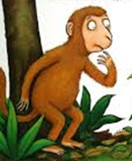
Baby Monkey pictures

