Slide 1
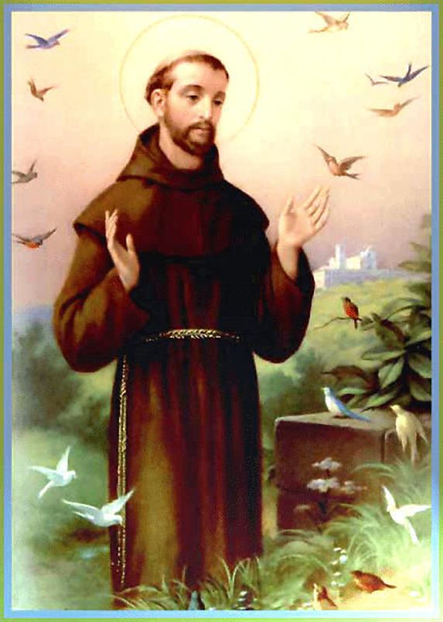
St Francis of Assisi
Who is this? What do you know about him?

Slide 2
St. Francis was born in Assisi in Italy. He was very rich and always had really nice clothes and didn’t care about how much money he was spending.

Slide 3
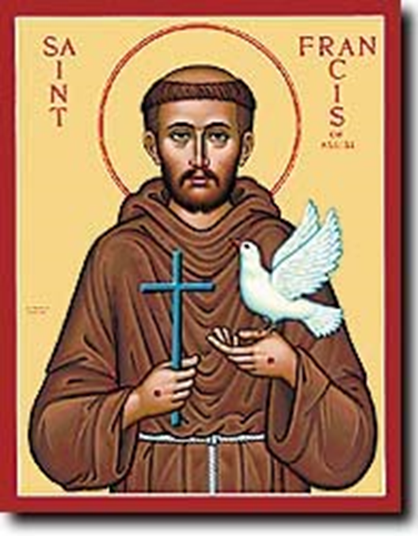
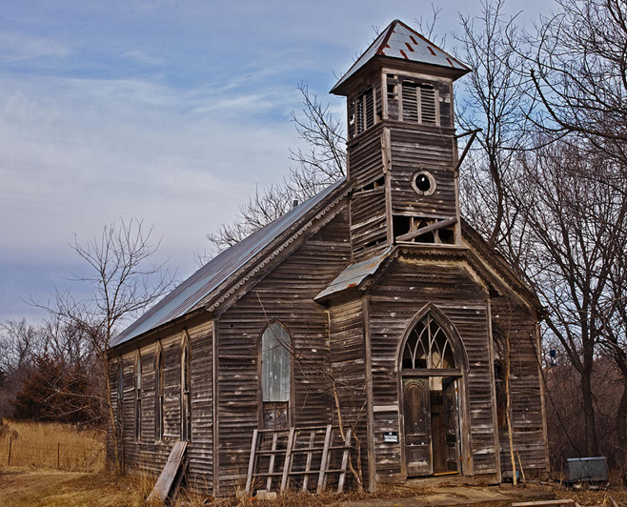
Over the next few years Francis began to see visions from God that changed his life. The first vision was when he was sick with a high fever. Francis heard God tell him to ‘repair my church, which is falling in ruins.’

Slide 4
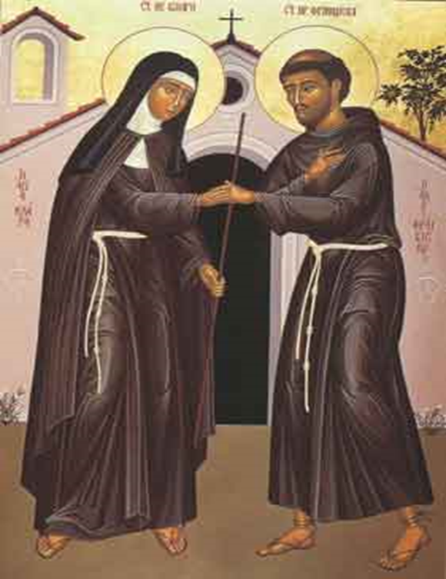
Francis gave all his money to the Church. Francis then left his father’s home and took a vow of poverty. As Francis lived his life of poverty and taught people about God, people began to follow him and also took a vow of poverty. He went to visit sick people in hospitals and helped as many people as he could by telling them about God.

Slide 5
St Francis helped many people in his lifetime. It was not easy for him to give up all of his possessions and money but he realised that some things in life are more important than others.

Slide 6
Write different ways that you can be more like St Francis. You can draw pictures afterwards. I can be more like St Francis by... E.g. be kind, look after animals, help others, tell people about God, make good choices.

