Slide 1
Welcome to St Thomas More
EYFS
Phonic / Reading meeting

Slide 2
Phonics
What is phonics ?
A systematic approach to learning the pure sounds of the alphabet and then applying those sounds to learn to read and spell.

Slide 3
Terminology
Phoneme
Grapheme
Diagraph
Trigraph
CVC
Segmenting
Blending
Tricky words
Notes:
Phoneme- The smallest unit of sound that is found within a word
Grapheme-The speeling of that small unit of sound
Diagraph – Two letters that make one sound
Trigraph – three letters that make one sound
CVC – stands for consonant , vowel , consonant
Segmenting – breaking up a word into its sounds
Blending – Putting the sounds together to read a word
Tricky words – Words that cannot be easily decoded

Slide 4
Little Wandle and Jolly Phonics
Validated by the DfE as being systematic synthetic Phonic programmes
Jolly phonics uses a catchy song and action to help children learn the initial pure phoneme sounds alongside the Little Wandle sound cards.

Slide 5
A typical lesson
Phonics is taught daily. Next week we will begin with around 5-minute sessions building up to 20-minute sessions by the end of the year.
Children revisit the sounds that they have previously learnt, listening to the jolly phonic song and looking at the Little Wandle cards.
Children will try and think of words that being with that initial sound.
Children develop their segmenting and blending skills reading CVC words.
Children practise writing the sounds that they are learning in their phonic books.

Slide 6
How to help at home
Each Friday in the children’s book bag you will find initially a set of sounds on paper inside a word book to practise with your child.
This will then subsequently change to a piece of paper which also shows the sounds that your child needs to learn.
Please practise the sounds in the word book little and often – every night for 5 minutes is so much better than once a week for half an hour
You will also find within the word book a list of tricky words. Tricky words are words that your child has to learn to read by sight - these initial tricky words include words such as I, no, go, into , he , she etc.
We will also send home a Sound Mat, which we always use in school whenever the children are writing to support them in their phonics knowledge.

Slide 7
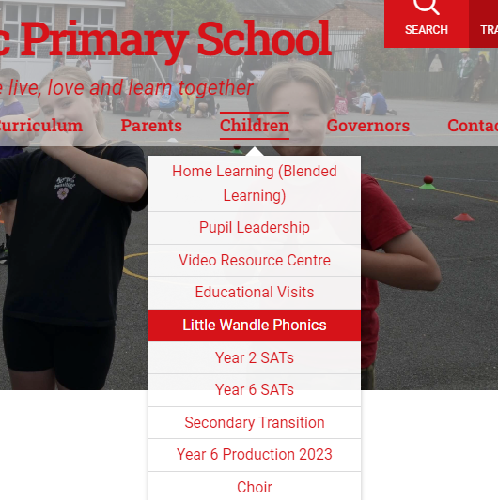
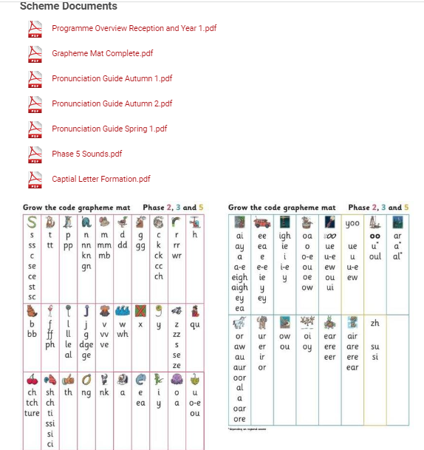
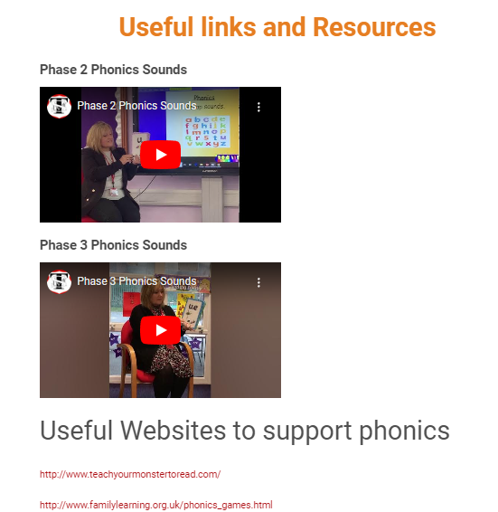
How to help at home
If you are unsure how to pronounce the sounds, have a look on our school website. You will find videos to help you pronounce the sounds correctly.
Go to the ‘Children’ tab, then click the ‘Little Wandle Phonics’ tab where you will find the videos, as well as information about the Little Wandle Phonics scheme.

Slide 8
Learning to read
Learning the sounds that we send home is the initial stage.
Then learning how to segment and blend.
Segmenting a word means that you are breaking down each sound in a word eg c..a…t
Blending is putting all the sounds back together again to read the word c..a…t…cat.
Children are encouraged to use their arm to segment and then sweep along their arm to blend the word beak together.
Once a child has learnt to segment and blend and knows their tricky words they will be given a reading book. This is a book that your child will read to you. Reading books are not given to any child until they have learnt to segment and blend as it is disheartening to give any child a book that they cannot read and may have a negative impact on their reading for life.

Slide 9
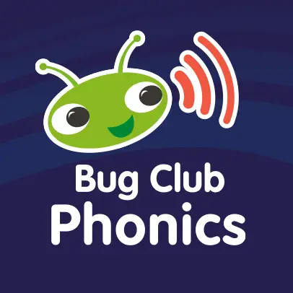
Phonic Bug
Your children have each been given an account on Bug Club where you can find digital books to read with your child. This can be used on a phone, tablet or laptop.
These are allocated by your child’s class teacher so will be books that match their developing phonic ability.
Let your class teach know if your child has read all of their books and more will be allocated.
These usernames and passwords will be sent home with your child’s reading record, book and word book on Friday 29th September.

Slide 10
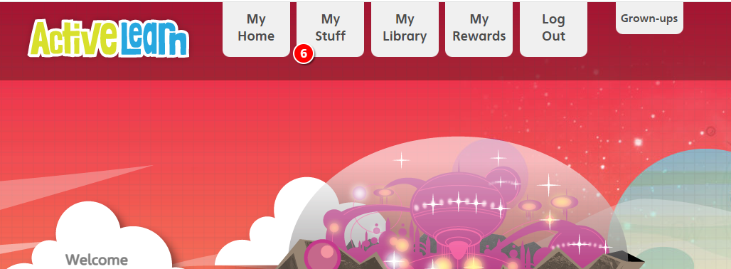
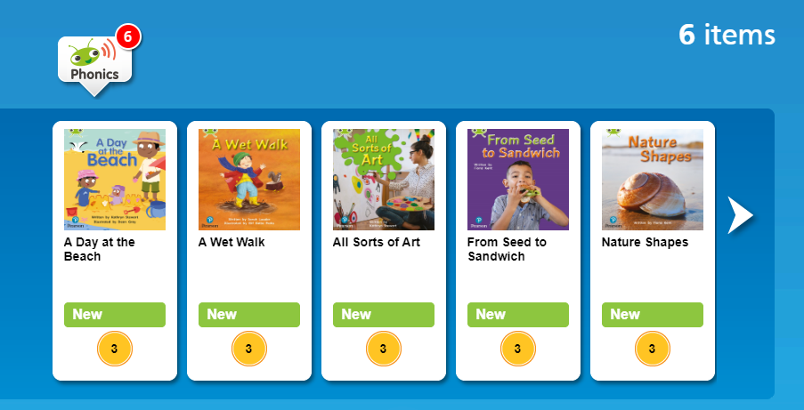

Slide 11
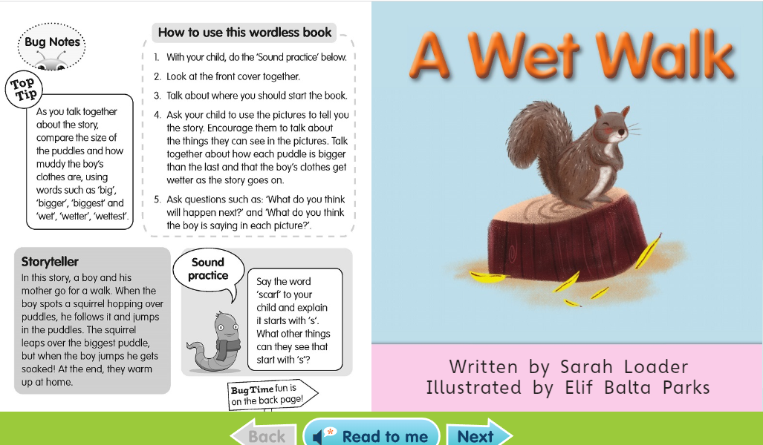

Slide 12
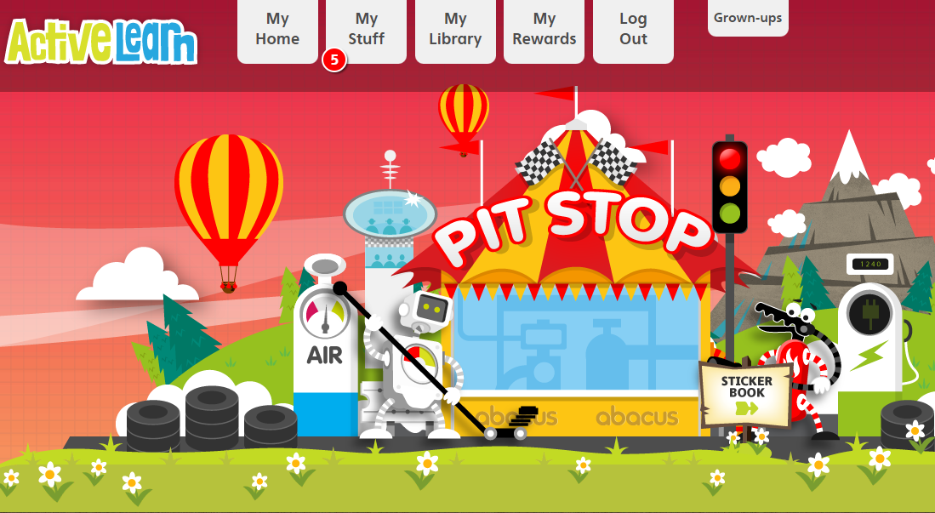

Slide 13
So, what happens if my child can’t segment and blend ?
Each child will take home their weekly sounds to learn.
Until they can segment and blend and have a reading book children will be given a discussion book .
Discussion books may or may not have words in but it is about looking at the pictures and talking to your child about what they see., relating back to your own child’s experiences and broadening their vocabulary

Slide 14
How often are books changed
All books whether they be discussion books or reading books are changed twice a week on Tuesdays and Fridays. New sounds will be given out once a week.
However, it is important that your child’s book bag is in school every day as staff will hear your child read and assess their sound knowledge regularly on other days and if the book bag isn’t in school, this can’t happen.
You will find a reading record book alongside your child’s discussion book or reading books. Please make a comment about how your child has read or enjoyed the book when you have shared it with them. Please also sign the comment box. If there is no comment or no signature from an adult staff will presume that the book has not been heard with the child and it won’t be changed on the allocated day, so please remember to sign the reading record book!

Slide 15
Friday 29th September 2023
On Friday 29th September, we will have completed the first week of our phonics lessons, so in your child’s book bag, this is what you will find:
A red or blue folder depending on which group your child is in.
A reading record book.
A sharing book.
A word book containing the phonics sounds that the children have learnt that week.
Tricky words
A sound mat.
Bug Club login details.

