Slide 1
WELCOME
St Thomas More Catholic
Primary School
Christ is the centre of our school community
where we live, love and learn together
Notes:
Mark

Slide 2
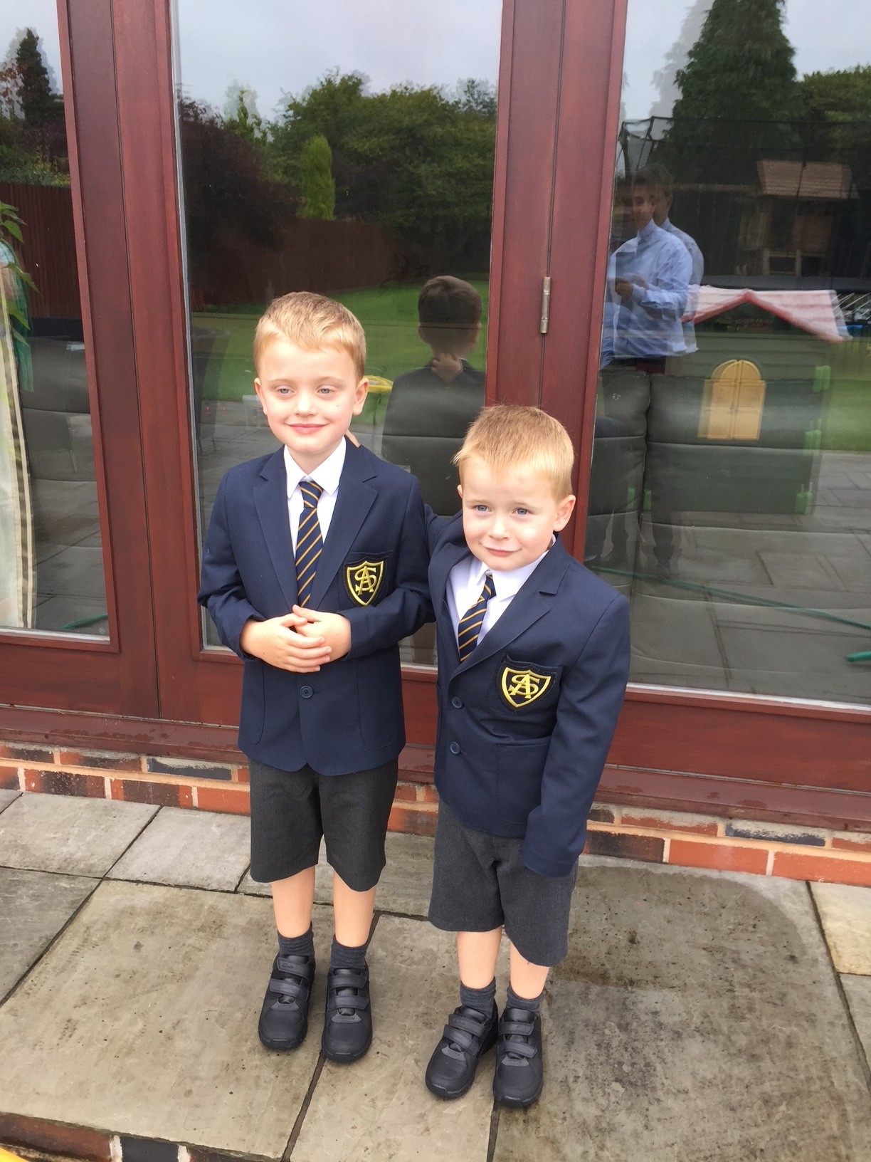

Slide 3
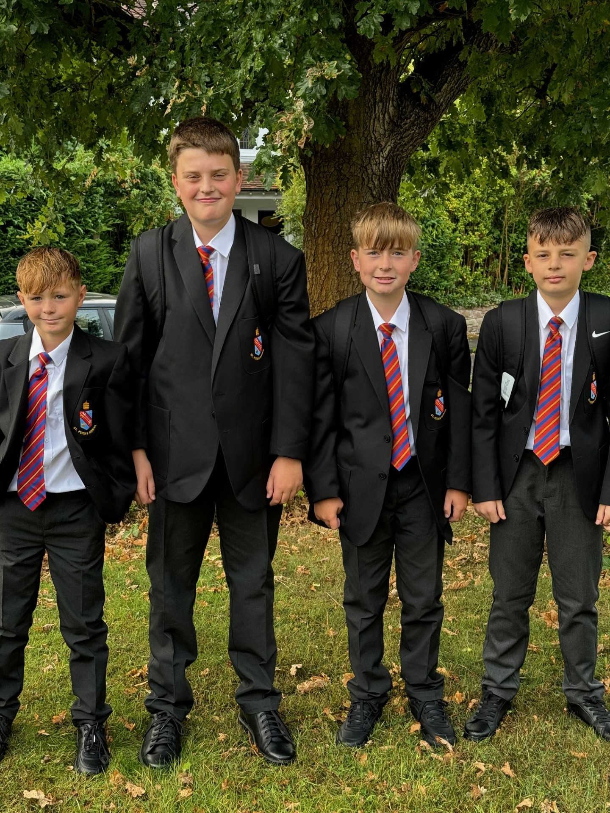

Slide 4
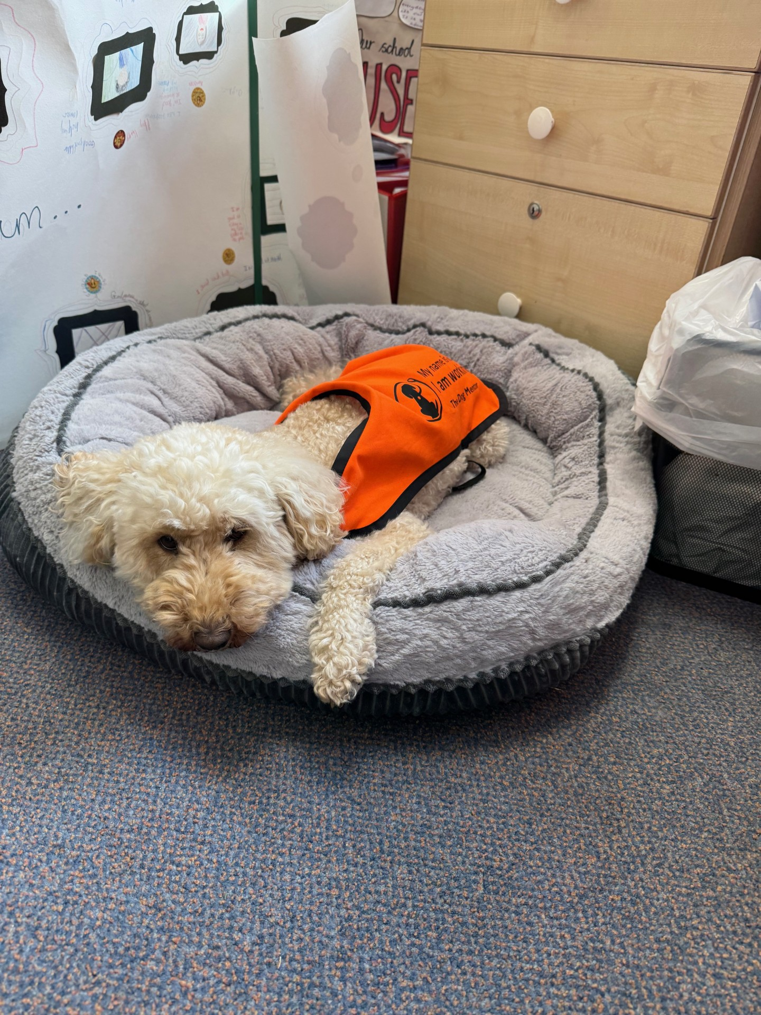

Slide 5

Notes:
Mark

Slide 6

Lumen Christi Schools
St Brigid’s
St Columba’s
St James
St Joseph’s
St Paul’s
St John Fisher
St Peter’s
St Thomas More
St Thomas Aquinas
Notes:
Mark

Slide 7

Lumen Christi Mission Statement
Working together with mutual trust, respect and love
to provide the highest quality of Catholic education to our communities.
Notes:
Mark

Slide 8
Birmingham diocese mission statement
Forming Christ-centred pilgrims of hope with kind hearts, questioning minds, a thirst for knowledge and a hunger for justice
Notes:
Mark

Slide 9

Lumen Christi Catholic Education in Birmingham Diocese
The Catholic Church is the second largest provider of education in the country.
There are 2230 Catholic schools in England educating almost 1 million children
There are 4 Catholic Universities with over 17,000 students.
Catholic Schools outperform State Schools.
Notes:
Father Christopher

Slide 10

Early Years
Foundation Stage

Slide 11
What they say
Ofsted January 2023
Children in the Reception class make a very strong start to their education. The way that children manage their behaviour during independent activities is impressive. They cooperate exceptionally well with each other and are inquisitive learners.

Slide 12
What they say
Diocesan Visit September 2025
EYFS provision in the school is outstanding and a high proportion of pupils leave reception with a Good Level of Development (GLD) and this offers the bedrock to flourish in Key Stage One.
Performance Area | School performance | Diocesan average | Local average
% achieving GLD | 75% | 69% | 72%

Slide 13

AREAS OF LEARNING AND DEVELOPMENT
PRIME AREAS
PERSONAL, SOCIAL AND EMOTIONAL DEVELOPMENT
PHYSICAL DEVELOPMENT
COMMUNICATION AND LANGUAGE
SPECIFIC AREAS
LITERACY
MATHEMATICS
UNDERSTANDING THE WORLD
EXPRESSIVE ARTS AND DESIGN
Notes:
Debbie – Our school aims to provide a high quality curriculum and a broad range of stimulating and challenging experiences, within a child- centred environment which encourages independence and self-motivation.
A wide variety of structured and unstructured learning activities are provided indoors and outdoors to cater for all areas of learning and development.
The Early Years Foundation Stage Statutory Framework sets the standards for Learning, Development and Care for children from birth to five. It includes detailed information on the 7 areas of learning and development and supporting children from birth through various stages of maturity and development.
Three prime areas underpin children’s learning:
Communication and language
Physical Development
Personal, Social and Emotional development
As children grow, they will be supported to develop skills in 4 specific areas.
Literacy
Mathematics
Understanding the World
Expressive Arts and Design.
Alongside the EYFS we use the non-statutory framework, Developmental Matters and Birth to 5 matters to provide a framework for planning the curriculum and for setting an appropriate sequenced curriculum to impact on the development and learning for every child throughout the year. This means that we put the child at the centre of our practice, with their connections within family, communities, culture and the natural world.

Slide 14
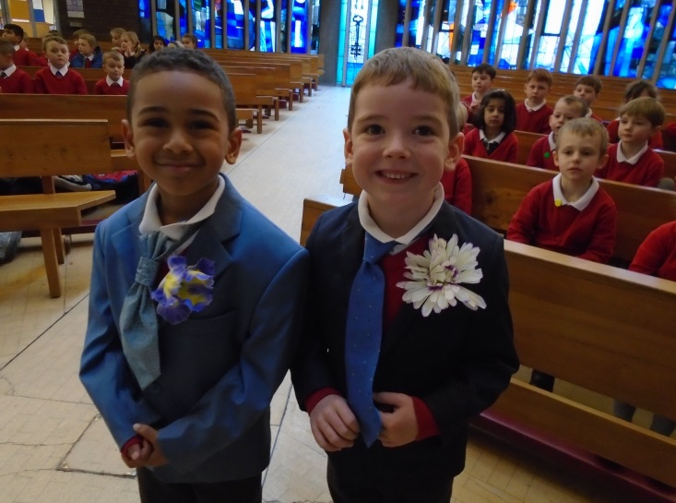
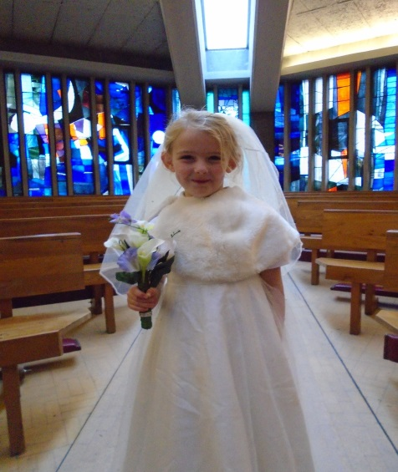
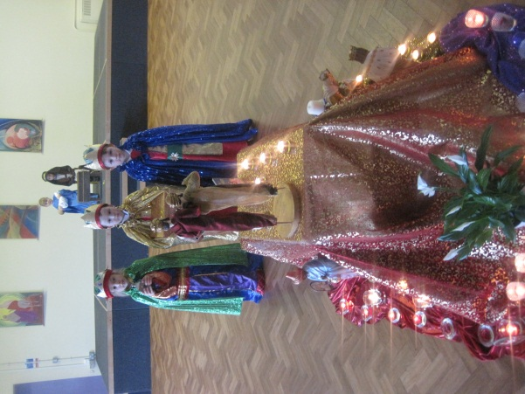
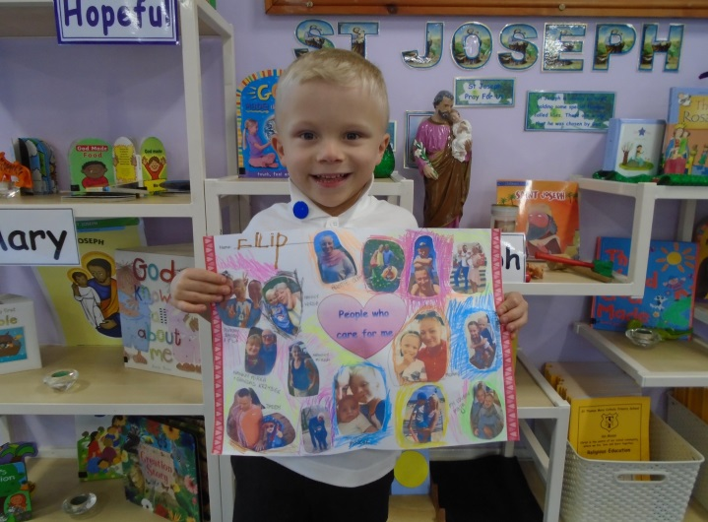
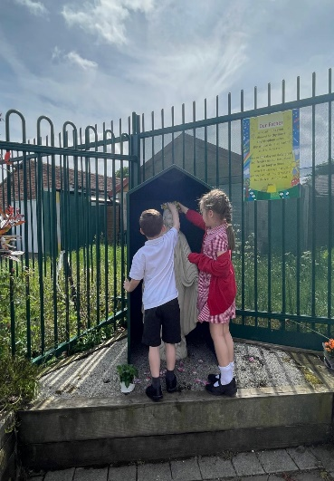
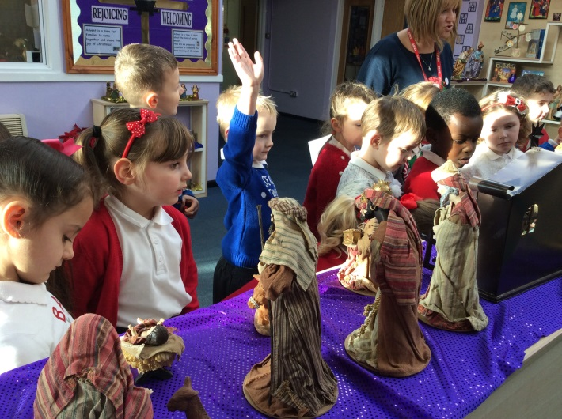
Religious Education
Notes:
Debbie Our school follows the curriculum strategy – Learning and Growing as the People of God - provided by the Archdiocese of Birmingham for teaching RE in a Catholic primary school. All children will have access to at least 10% of Religious Education ( not including assemblies, Mass or Hymn Practise) per week.
All children will receive class collective worship and will take an active role within this, eg: helping to plan and lead the service, help the class teacher to prepare the prayer focus with a liturgically coloured cloth and appropriate artefacts.
The lessons are very interactive and as you can see by the slide role play is used to support the children's religious education learning in a meaningful but fun way.

Slide 15

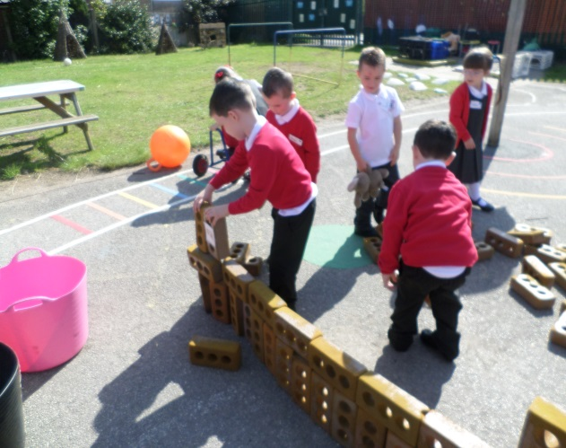
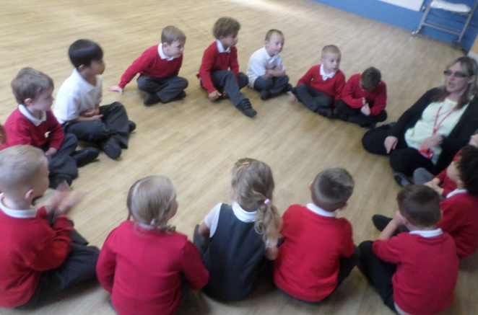
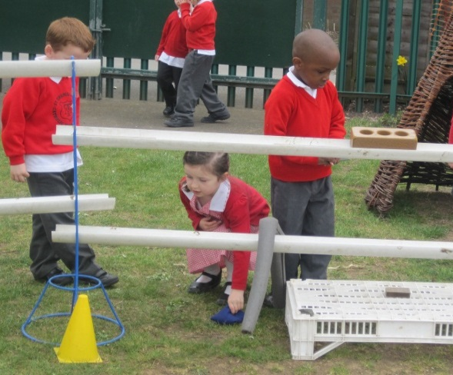
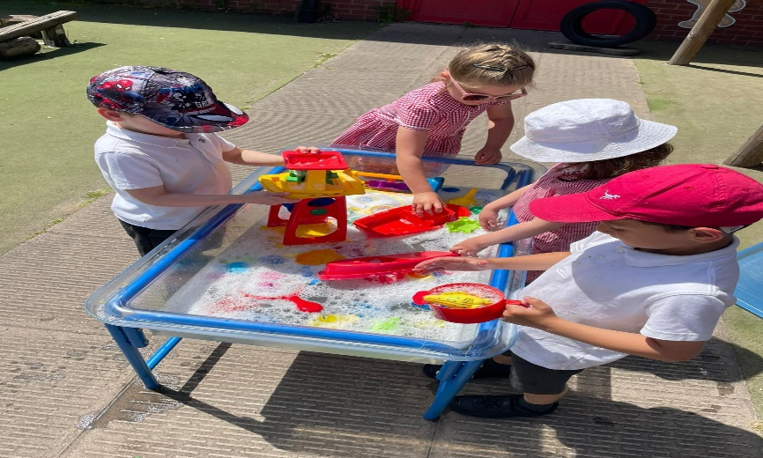
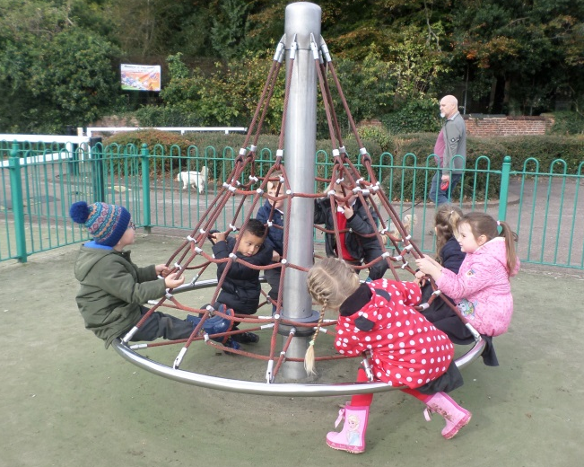
Personal, Social and
Emotional Development
Notes:
Rachel

Slide 16

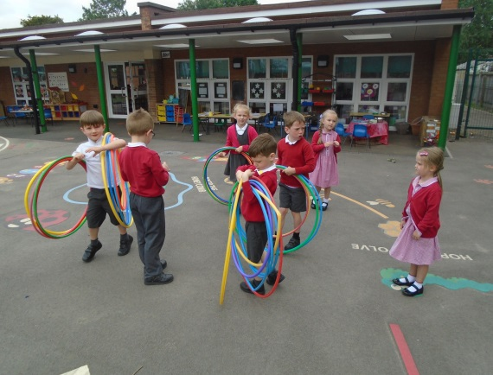
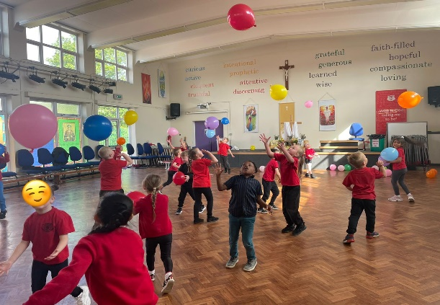
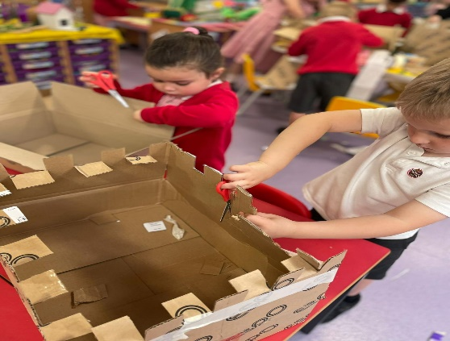
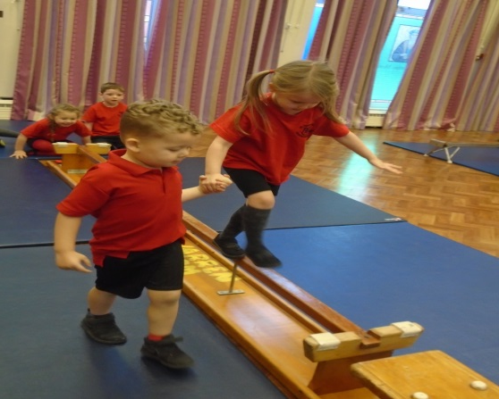
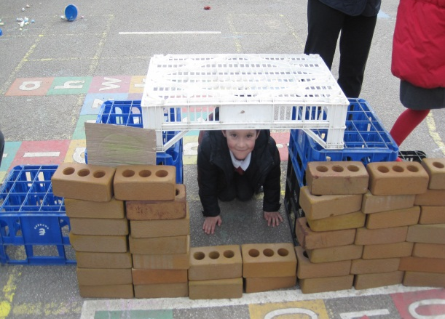
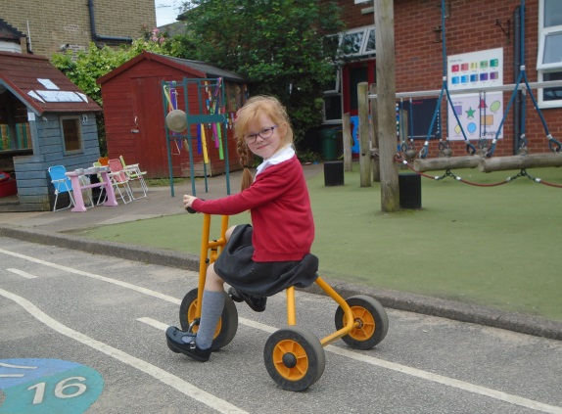
Physical Development
Notes:
Rachel

Slide 17
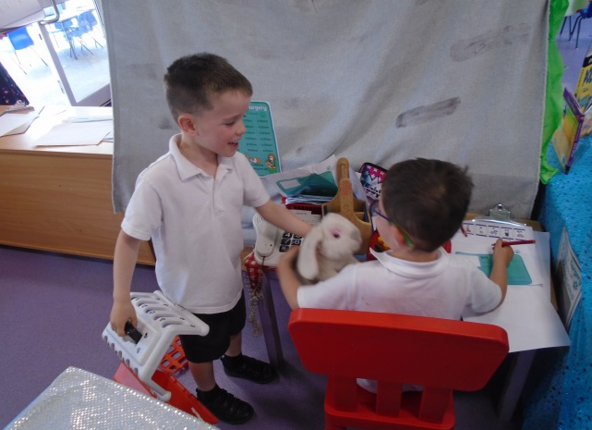
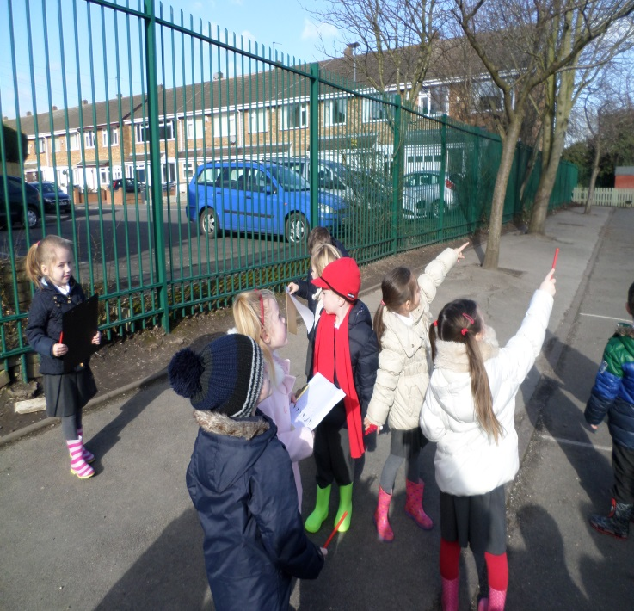
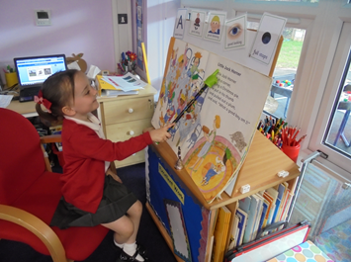
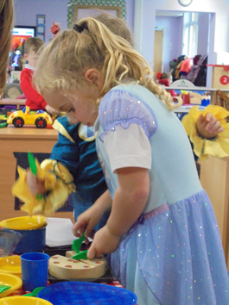
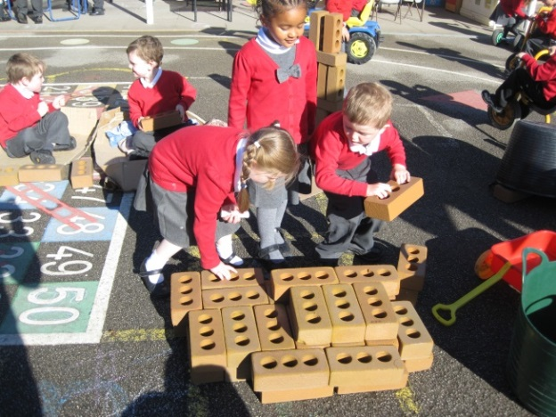
Communication and Language
Notes:
Rachel

Slide 18
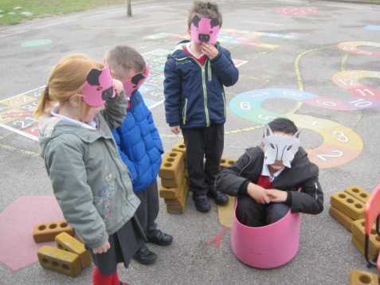
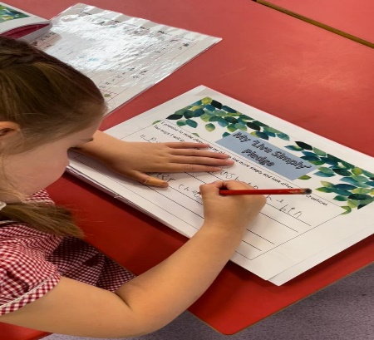
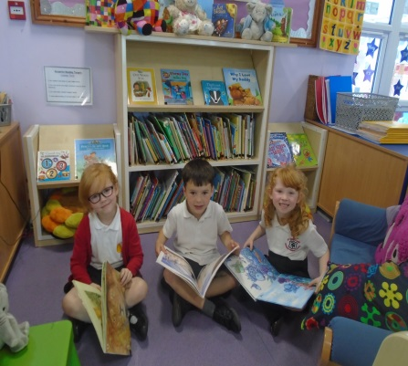
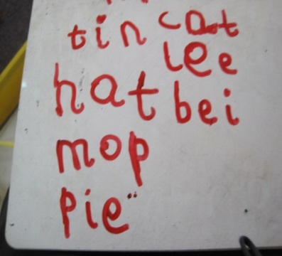
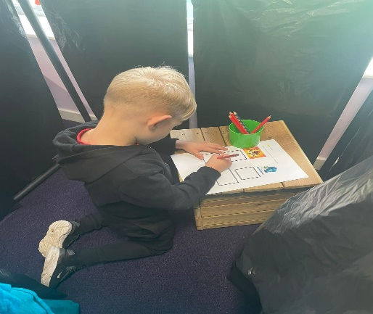
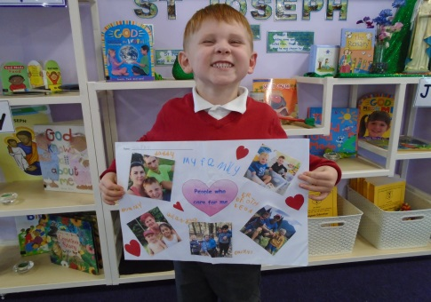
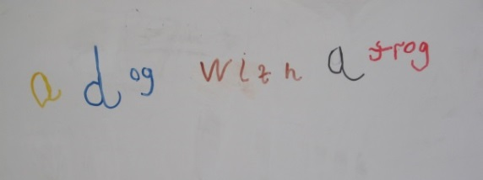
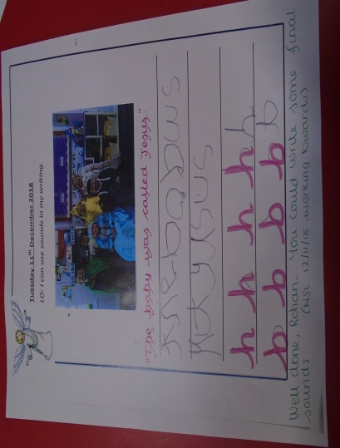
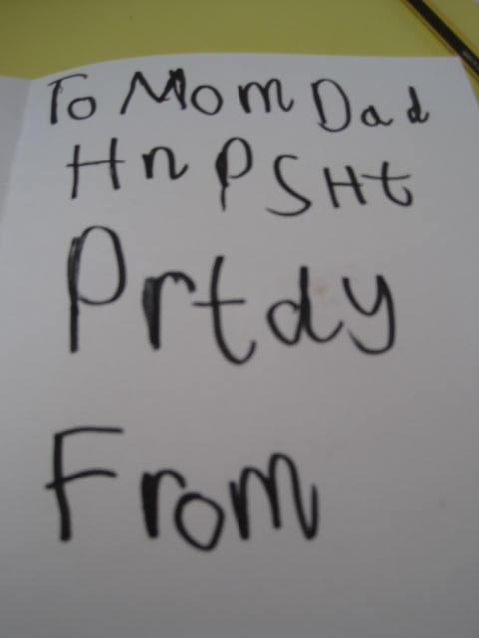
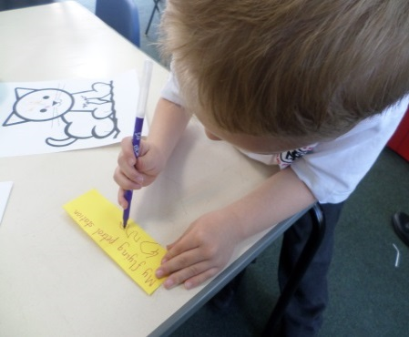
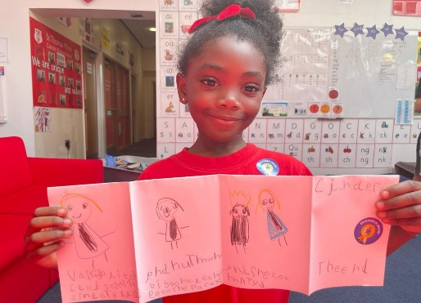
Literacy
Notes:
Debbie Reading and writing
Little Wandle Phonics Scheme . Discussion books while the children learn to segment, and blend sounds to make words . Then have a fully decodable reading book Opportunity to take home a class library book each week .
By the end of the year - use phonic knowledge to decode regular words and read
them aloud accurately with understanding
to read some common irregular words
They will then learn to apply this phonic knowledge to their writing
There will be a phonics meeting in the autumn term to help you support your childs learning at home
By the end of the year be able to write a simple sentence writing some words accurately whilst others are phonetically plausible .

Slide 19
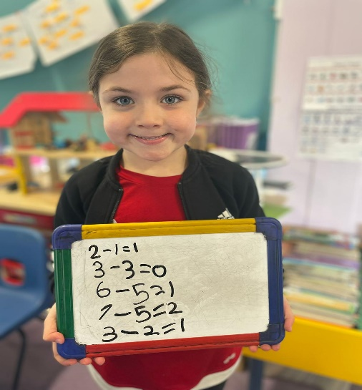
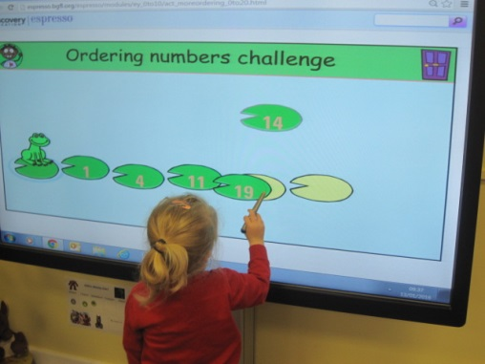
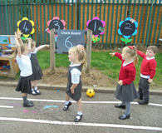
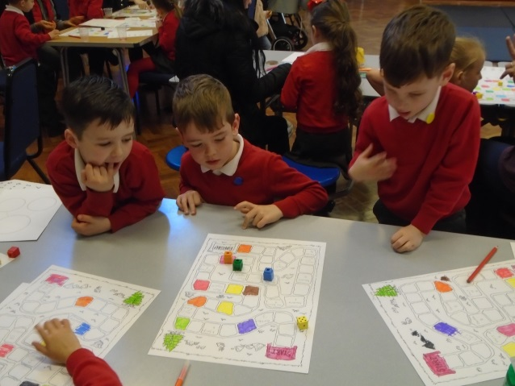
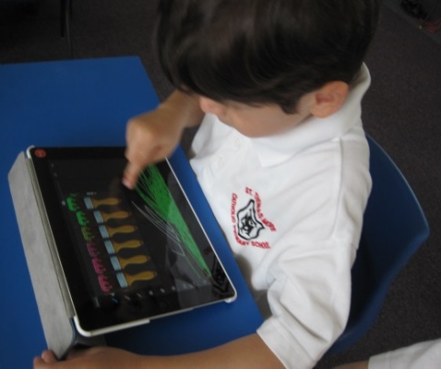
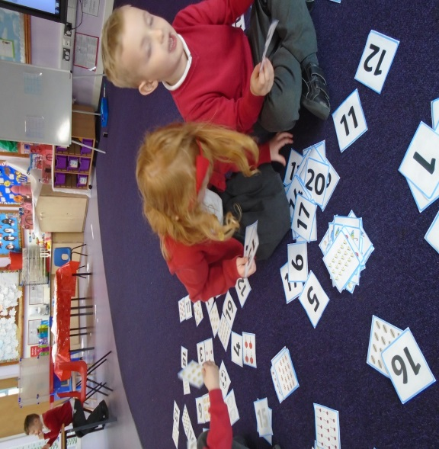
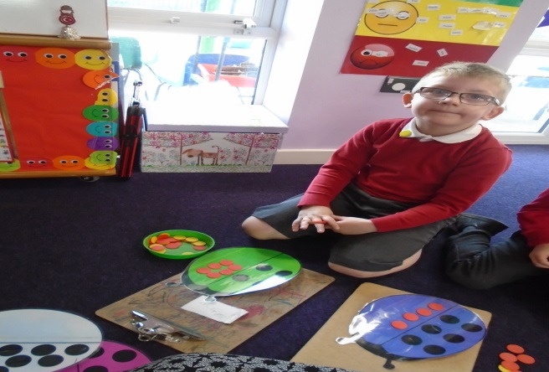
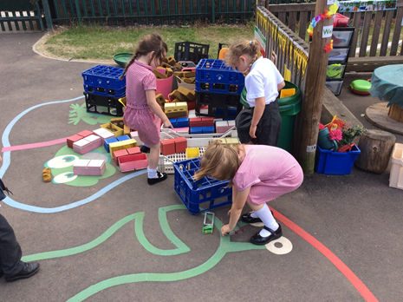
Mathematics
Notes:
Debbie
Use a maths mastery approach following guidelines and planning from the NCETM . Throughout the year we understand and learn the meaning of numbers from 0 to 10 using numberblocks , a range of practical resources to help the children really understand what an amount is . This moves on to also learning doubles halves, odd and even numbers, addition , subtraction and number bonds .

Slide 20

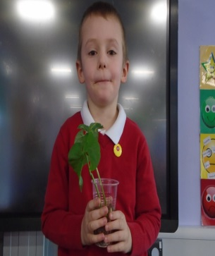
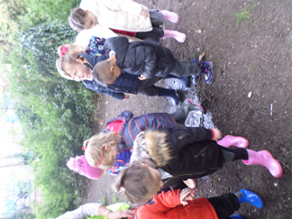
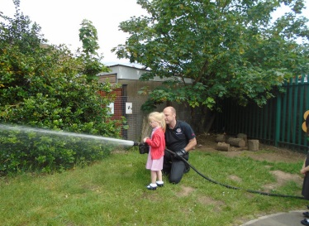
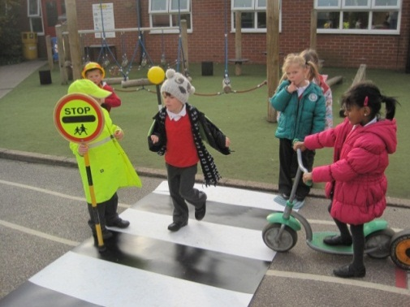
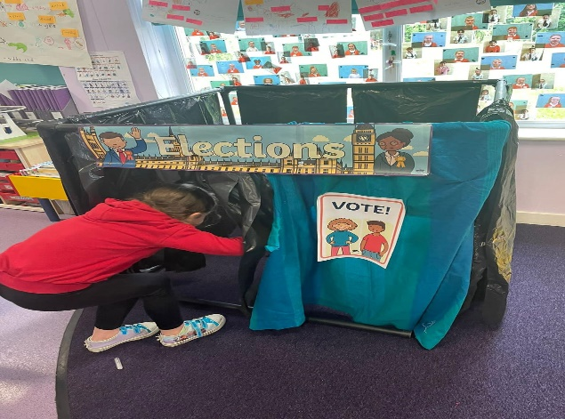
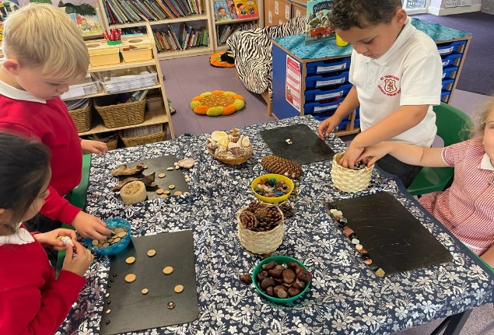




Understanding the World
Notes:
Rachel

Slide 21








Expressive Arts
and Design
Notes:
Rachel

Slide 22
Making Progress
Early Years Outcomes
Learning Journals
RE Book
Literacy Book
Mathematics Book
Half-Termly Assessments
Characteristics of Effective Learning
Learning Journal Celebrations
Parent Consultations
Termly Celebration Meetings
End of Year Report
Notes:
Rachel

Slide 23
What can you do to help?
Encourage your child to speak in full sentences
Help them to recognise their own name
To share books regularly
To practise putting their own coat on and taking it off
To become familiar when getting changed in and out of their school uniform (including shoes)
To have an awareness of numbers in the environment
Practise saying the number names in order
To have a go at writing their own name

Slide 24
The first few weeks
We will find out what the children
already know and can do
(a baseline assessment)
and use this information to help us develop an
individual learning programme
for each child.
We would value any contributions
you would like to make in helping us
get to know your child’s needs.
You will be invited to discuss
your child’s progress & adjustment
to school within the first term at parents evening.
Notes:
Debbie– getting to know your child , their likes , dislikes , ensuring that foundations are laid to down to make them feel happy and secure and ready to learn – baseline – speech and Language – Neli programme

Slide 25
Attendance & Punctuality
GREEN 97.5 – 100% attendance Excellent! Fantastic attendance
YELLOW 95 – 97.4% attendance Super Effort! You are trying hard to be in school
RED Less than 95% Danger Zone! You are missing a lot of learning time
Less than 90% Persistent Absence requiring formal intervention
Pupils who are away from school for whatever reasons, for 10% of their timetable, are regarded as Persistent Absences and the school have to involve other agencies. Being late adds up to lost learning too! If you are 5 minutes late everyday you will miss 3 school days in one year. If you are 15 minutes late everyday you will miss 10 school days in one year. If you are 30 minutes late everyday you will miss 19 school days in one year – the equivalent of nearly 100 hours of learning.

Slide 26
Behaviour
Saint Thomas More has a positive behaviour policy (available on our website) with a shared, whole-school, uniformed approach
Yellow forms record reflections on behaviour | Red forms record serious incidents where our three school rules are broken
God’s Gifts assemblies give opportunities to celebrate children’s successes
House points are awarded for demonstrations of resilience and respect

Slide 27
SEND
The term 'Special Educational Needs' is used to describe learning difficulties or disabilities that make it harder for children to learn than most children of the same age. Children with Special Educational Needs (SEN) are likely to need extra or different help from that given to other children their age.​
4 broad areas of need:​
communication and interaction​
cognition and learning​
social, emotional and mental health difficulties​
sensory and/or physical needs.
If you have a concern about your child, or if your child is already being supported by agencies, e.g, Health, Speech and Language service, please make staff aware or contact our school SENDCo, Mrs A Nicholls at a.nicholls@stm-lumenchristi.org.uk

Slide 28
Anti-Bullying
Saint Thomas More has an Anti-Bullying policy (located on our website)
Our school takes a ‘zero tolerance’ approach to bullying
Staff utilise ‘restorative justice’ to repair damaged relationships between pupils, taking the opinions and feelings of all parties into consideration when seeking a resolution

Slide 29
Safeguarding
Saint Thomas More has a number of staff trained as Safeguarding Leads:
Me McLoughlin,, Mrs Sullivan, Mrs Clarke-Pitcher, Mrs Nicholls and
Mr Poole
Staff are well trained to identify possible safeguarding issues with pupils and are knowledgeable in the steps to take, and the relevant staff to speak to, in the reporting of safeguarding concerns.
Lumen Christi works with the organisation Pathfinder to facilitate our Early Help offer, with family support workers engaging with families

Slide 30
Medicine and Allergies
If your child requires medicine during the school day, please take it to the office, where you will be asked to complete a form to give parental consent for a member of staff to administer it.
We are only able to administer prescribed medication in school.
Please ensure we have the most up-to-date medical and allergy information.
Notes:
Mrs Barrows is our senior First aider and Mrs McDougall is also a trained first aider . Green slips given out . Phone call home is your child bumps their head .

Slide 31
Breakfast Club
After School Club
Please contact the school office to register your interest.

Slide 32
Parent Pay
In September you will be contacted to set up an account with Parent Pay.
This system is used to pay for events, trips etc.
For more information please contact the school office.

Slide 33



School Meals
Information about school meals can be found in your Information Pack.
Notes:
All children in EYFS and KS1 are intitled to a free school meal . Menus can be found inside pack

Slide 34

School Uniform
Notes:
Debbie All items of clothing need to be labelled clearly with a permanent marker or an iron tag with child’s name. Children will also need to bring in a bag to keep ins school with a spare change of clothes in case of any toilet accidents .
All children will also need a pair of wellies to be kept in school for weekly forest school sessions . We have supplied to all in in one suits but ask that each child has a pair of wellies

Slide 35

Physical Development Uniform
Notes:
Debbie You will be notified what day PE for EYFS will be on . Children will need to come to school wearing their PE kit for the day.

Slide 36
Things We Need
To Know
An up to date contact telephone number and address (At least two contacts)
Who is collecting your child?
Any special diet your child follows for medical reasons particularly if it is not what your child may have (e.g. food, drink, plasters, soap etc)
Any medical conditions (e.g. asthma, eczema, speech or hearing difficulties)
If you change address or telephone number
If your home circumstances change, so that
we can be sensitive to your child’s needs
Notes:
Rachel

Slide 37

Start Dates
Wednesday 2nd September 2026
2. Monday 7th September 2026
You will be notified when your child will be starting school in your information Pack.
Any questions please come and chat to us
Notes:
Debbie

