Slide 1
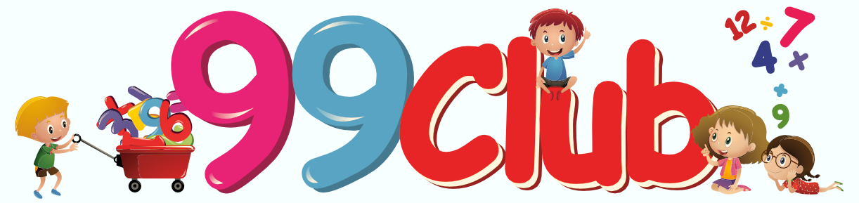
The ‘99’ Club!
St Thomas More’s Calculations
Challenge!
Who is going to be a maths masters?

Slide 2
Overview (How it works)
You will get at least 10 minutes a week to practice and show your skills.
If you can prove yourself on a level 3 times with no mistakes, you move up!
Clubs 11-44 have 4 minutes to complete.
Clubs 55-88 have 3 and a half minutes to complete.
Clubs 99-platinum have 3 minutes to complete.
Certificates will be awarded when you move up a level.

