Slide 1
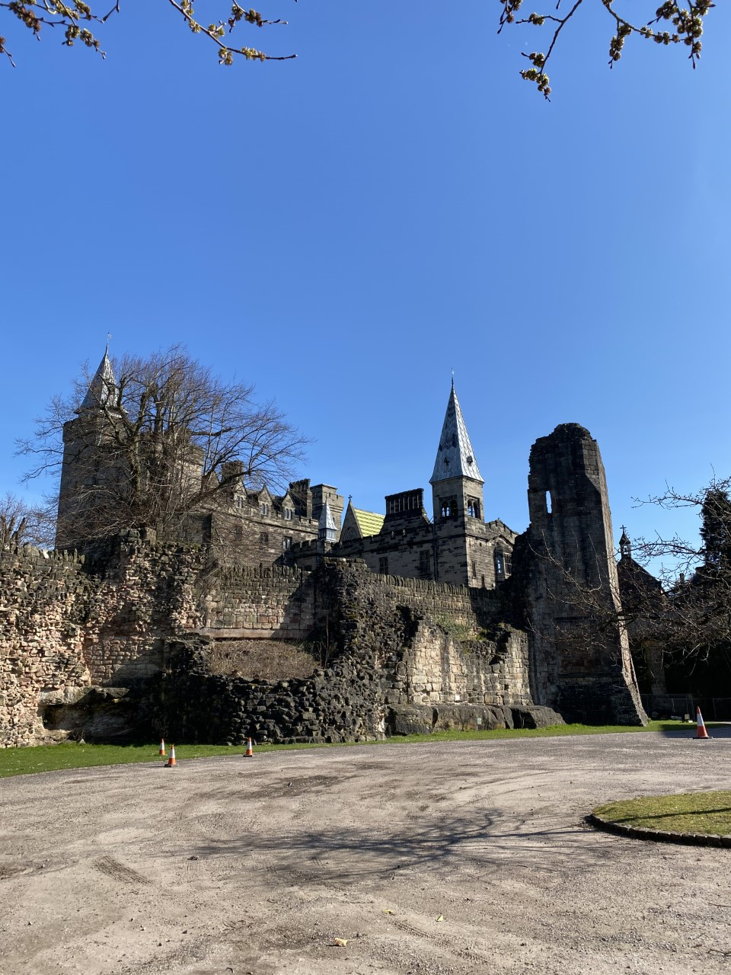
Alton Castle
7th-9th September 2022

Slide 2
Our Mission
Encountering Christ through creation, community and challenging activities...
It is our aim that every young person who visits Alton Castle will grow closer to God, encountering Christ in many different ways.
During our residential retreat we provide children with many opportunities to pray and reflect, including small group night prayer where young people are invited to pray openly each night, and the celebration of Mass on the second evening. These times of prayer, where our children can come together as a community, are truly special moments where they encounter Christ.

Slide 3
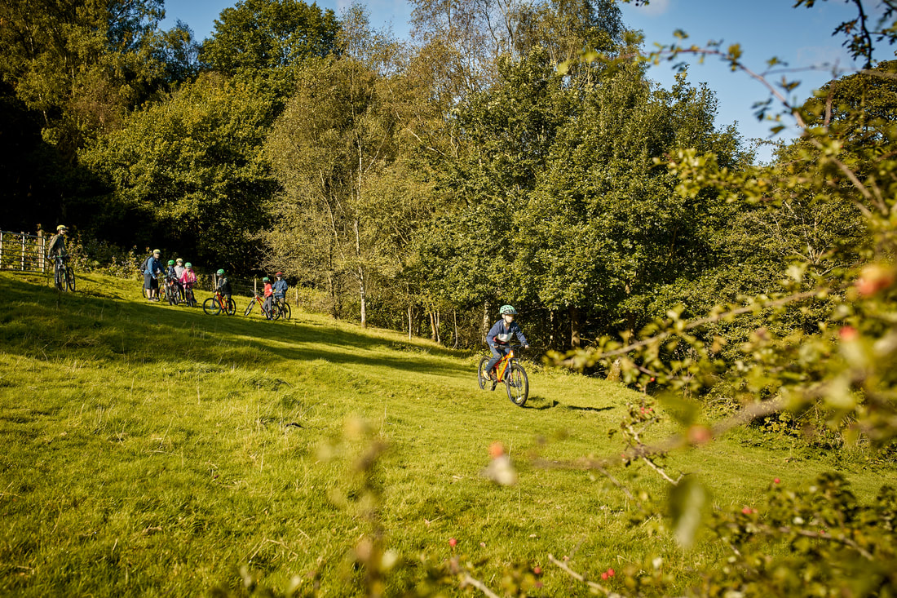
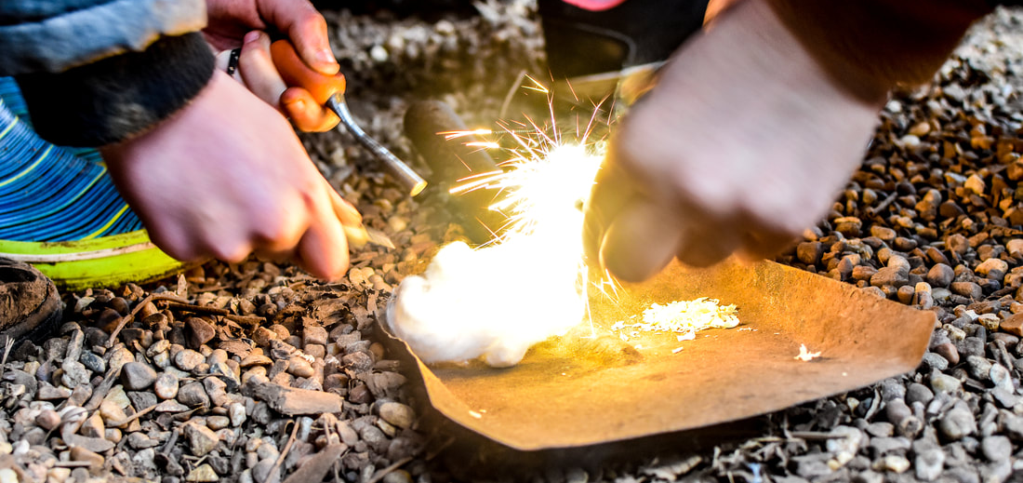
Our children will be encouraged to trust in each other, to work together, and to conquer challenges as the encounter Christ in each other and in the activities, they take part in.
Activities

Slide 4
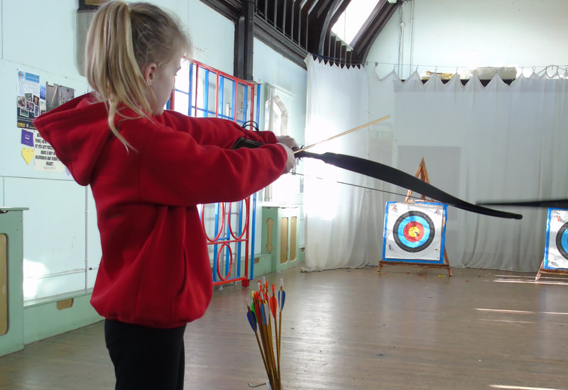
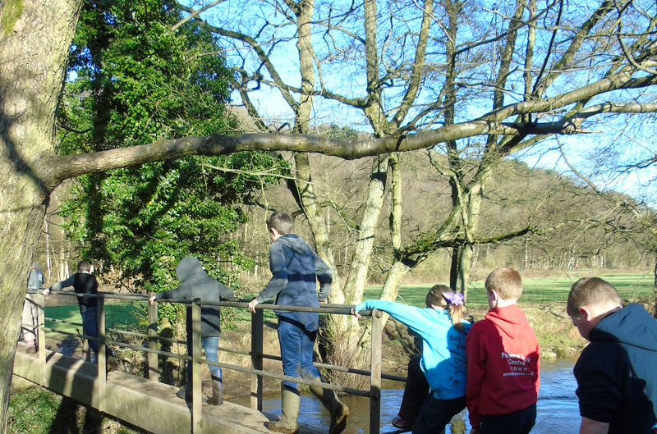
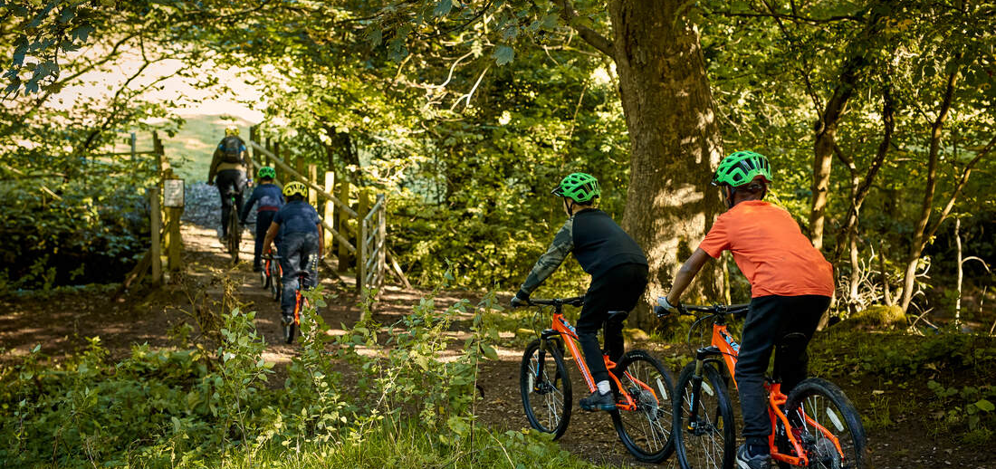
Activities

Slide 5
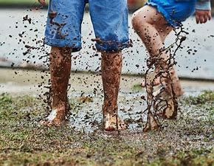
Kit List
Toothbrush & toothpaste
Hair brush (and bobbles if needed)
Shower gel
Shampoo
Underwear
Pyjamas
Joggers/leggings
T-shirts
Hoodie/jumper
Waterproof coat
Trainers for outdoor activities
Trainers/casual shoes for indoor use only
Walking boots/sturdy trainers for trek
All children need enough outfits for 3 days of activities plus spares.
Activities do continue in all weathers so spare outfits may be needed each day to change into for evening time.

Slide 6
Extras
Personal items
Children are allowed some money to buy some tuck or small token gifts. We suggest a limit of £5.
Children may wish to bring a small personal item such as a cuddly toy or favourite book. Please do not send any valuables.
If your child has any additional medical or dietary needs please speak to a member of staff.

