Slide 1
KS2 SATs Meeting
January 2025

Slide 2
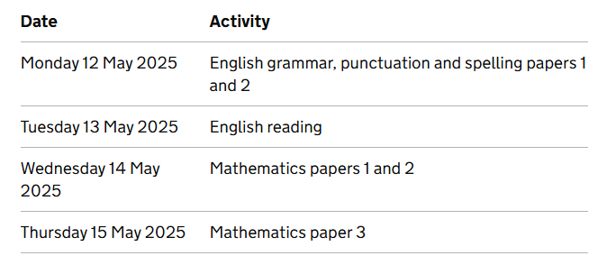
Dates of the Tests

Slide 3

Scaled Scores
A scaled score of more than 110 is judged to have exceeded the national standard.
A scaled score of 100 is judged to have met the ‘national standard’.
A scaled score of less than 100 is judged to have not yet met the ‘national standard’.

Slide 4
Spelling, Punctuation, and Grammar (SPaG)
The English grammar, punctuation and spelling test at two components:
Paper 1, the short-answer questions, consists of between 40 and 50 questions assessing grammar, punctuation and vocabulary, worth 50 marks
Paper 2, the spelling task worth 20 marks

Slide 5
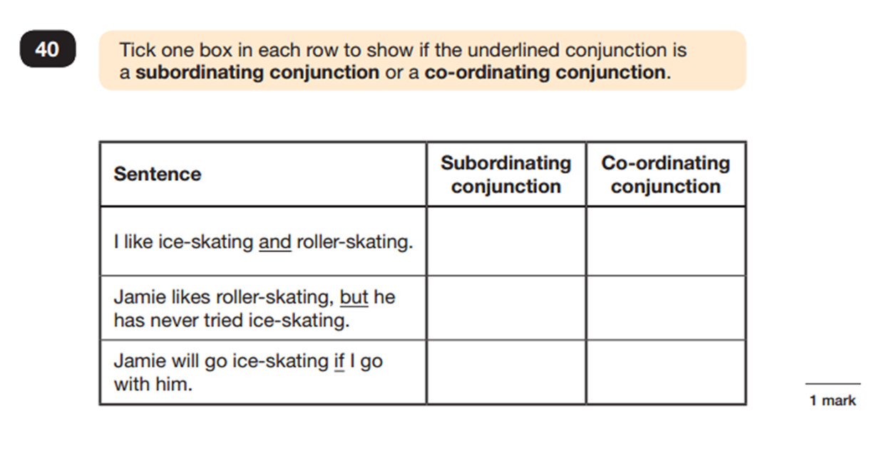
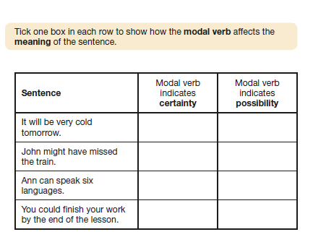

Slide 6
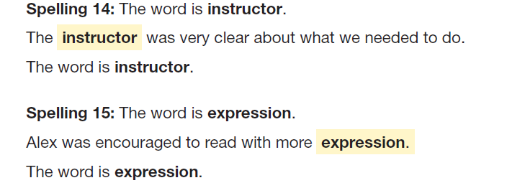
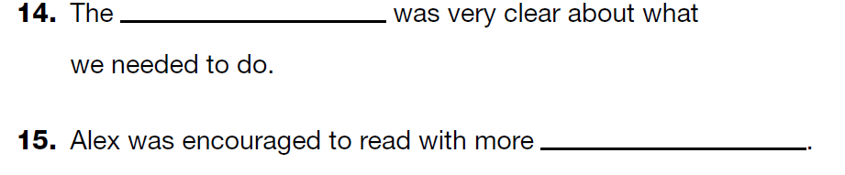
Spelling

Slide 7
Reading paper
Children will have a total of one hour to read the texts and complete the questions at their own pace.
The reading answer booklet will comprise approximately 35 to 40 questions (totalling 50 marks). Questions are worth 1, 2 or 3 marks.

Slide 9
The questions are:
shorter, closed response items (such as multiple choice and matching questions)
More than one sentence, open response items giving more than one idea.
Longer, open response items that require children to explain and comment on the texts to demonstrate a full understanding.

Slide 10
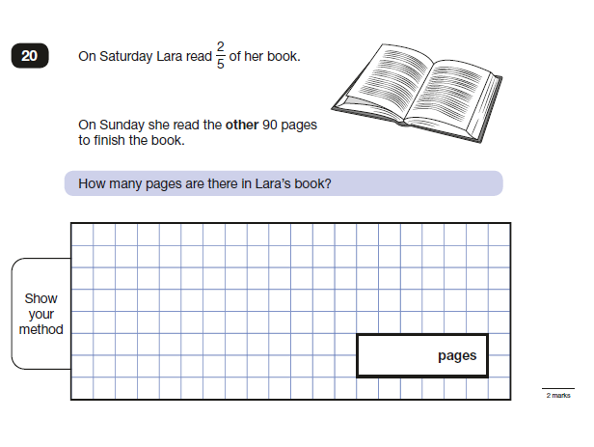
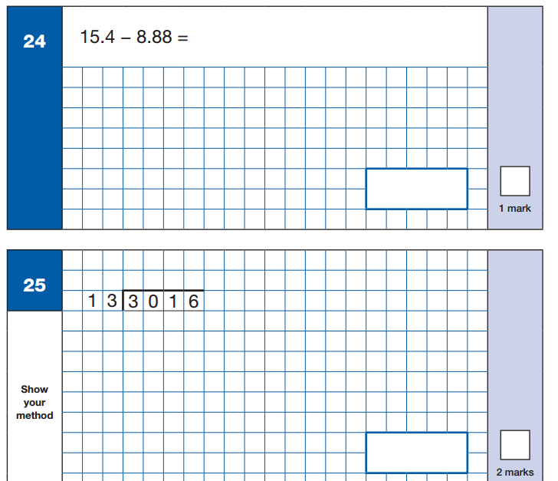
Structure of the Maths Tests
Arithmetic (30 mins)
2 Problem Solving Papers (40 mins)

Slide 11
How to prepare your child/ren
Keep revising spellings From Y3/Y4 Words to Y5/Y6 children have been working on the last two years.
Encouraging children to read EVERY night looking at as many high-quality children’s novels. Please ask and answer questions about these texts using inference skills.
Correct spoken language- WAS and WERE
Times Tables regular practice at home (Times Tables Rockstars)
Ensure that your child is getting enough sleep and have breakfast each
day and that they come to school with a healthy snack and water bottle.

Slide 12
SATs Boosters
These will be weekly sessions.
Focus on weaker areas of the curriculum.
Both re-teaching and answering questions.

Slide 13
Any Questions?

