Slide 1
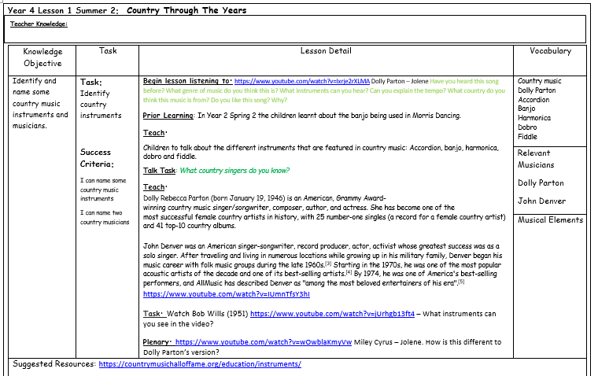
Lesson 2 – Country Roads

Slide 2
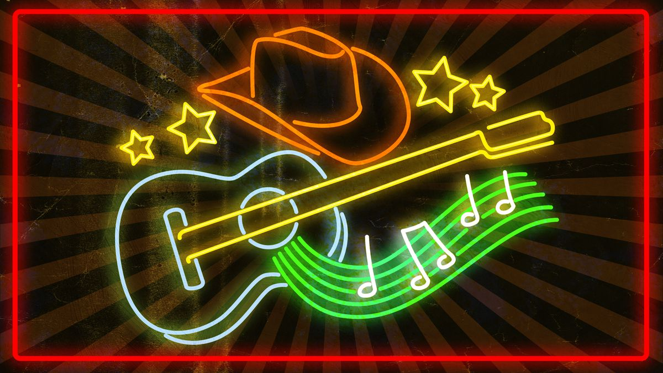
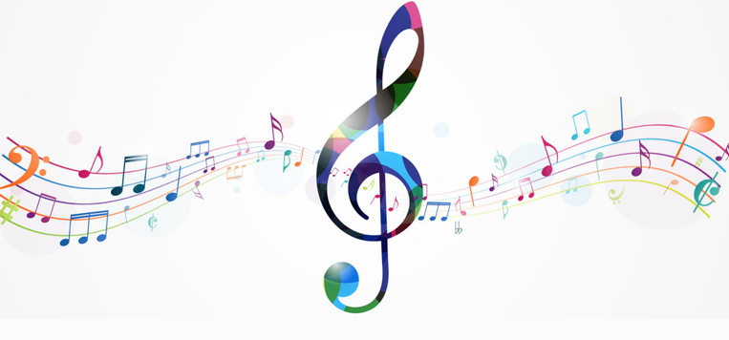
Year 4
Summer 2
Lesson 2
Country Roads

Slide 3
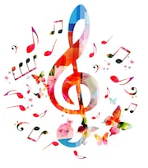
Let’s Listen
Dolly Parton - Jolene
Have you heard this song before?
What genre of music do you think this is?
What instruments can you hear?
What country do you think this is from?
What is the tempo?
Do you like this song? Why?
https://www.youtube.com/watch?v=Ixrje2rXLMA

Slide 4
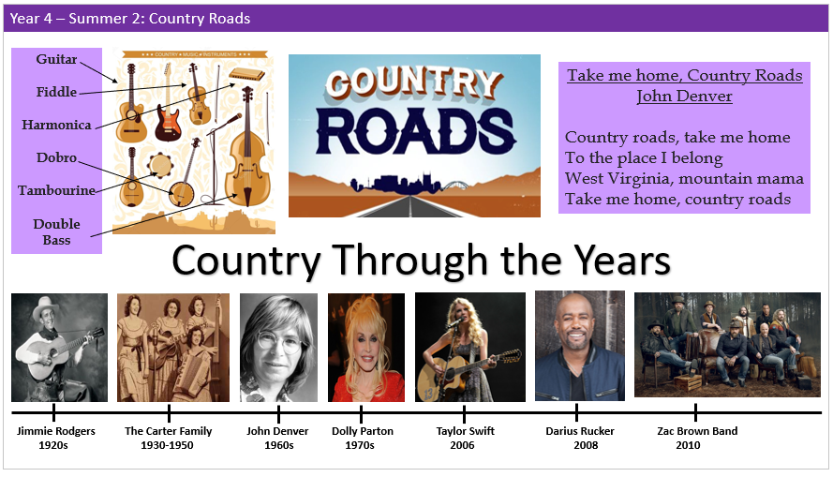
Our Knowledge Organiser

Slide 5
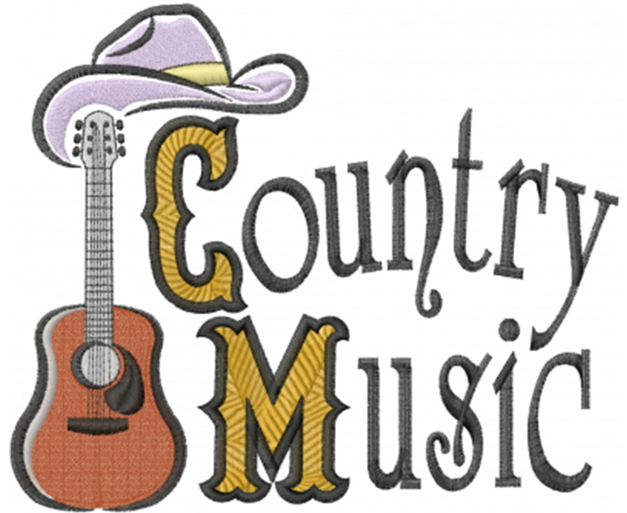
Key Vocabulary
Country music
Dolly Parton
Accordion
Banjo
Harmonica
Dobro
Fiddle

Slide 6
L.O: Identify and name some country music instruments
Success Criteria: I can name some country music instruments I can name two country musicians I can express how I feel about a piece of music
Here are today’s key words:
Country music
Dolly Parton
Accordion
Banjo
Harmonica
Dobro
Fiddle

Slide 7
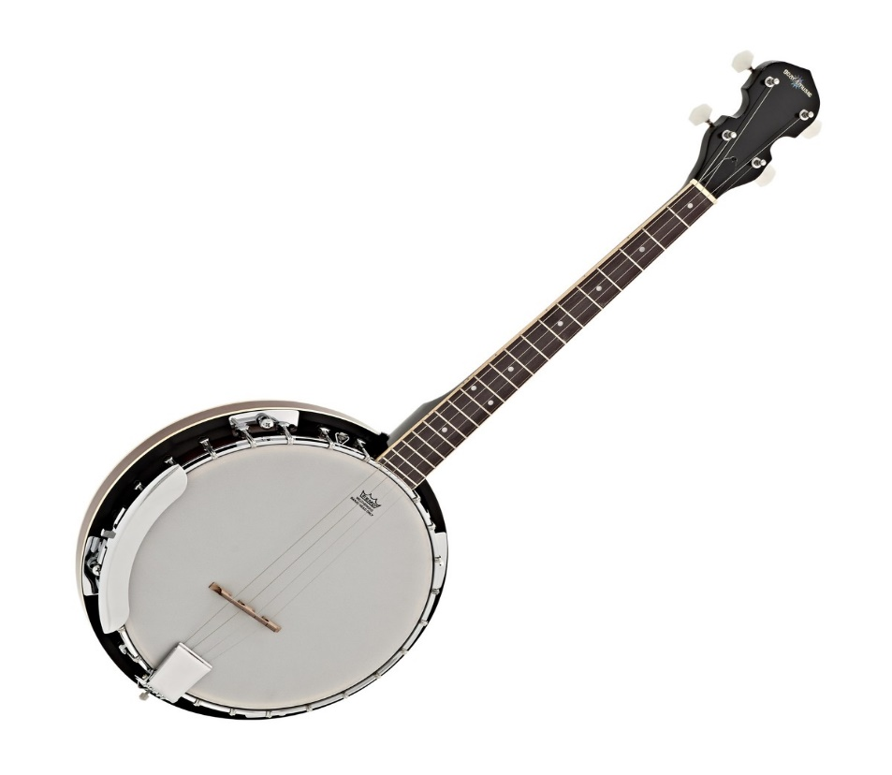
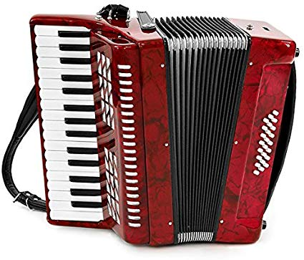
Teach
Banjo: Banjos are plucked or strummed stringed instruments whose distinctive tones stem from the strings being supported by a bridge that rests on a tightly stretched skin membrane.
Accordion: The accordion is worn like a vest and consists of right and left hand keyboards that are connected by a bellows. Notes are produced by the bellows pushing air through valves which are controlled by the keyboard.

Slide 8
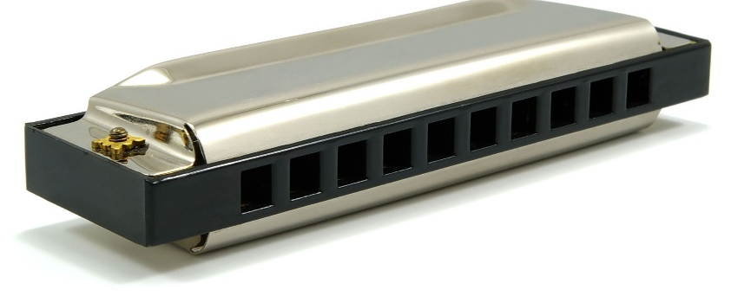
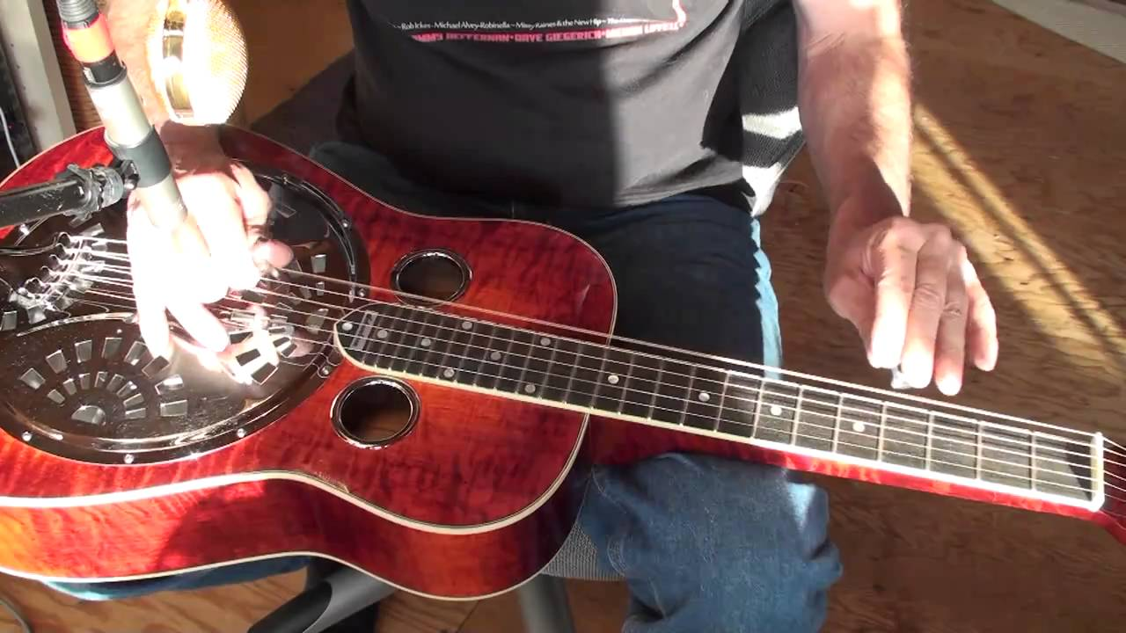
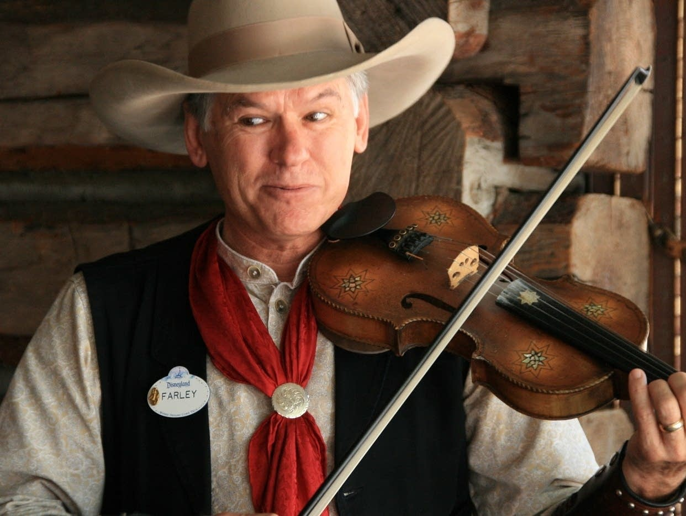
Teach
Harmonica: A small rectangular free-reed instrument having a row of free reeds set back in air holes and played and blowing into desired hole.
Dobro: A twangy cousin to the slide guitar, the Dobro is played face up with a series of finger picks and a metal bar which is used to fret strings.
Fiddle: The word fiddle means a violin when used in folk music. Many people also use it simply as a fun word for "violin". Someone who plays the fiddle is a "fiddler". The bow is sometimes called a "fiddling stick".

Slide 9
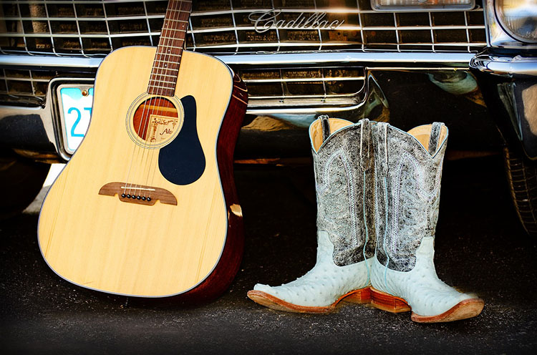
Talk Task
What country singers do you know?

Slide 10
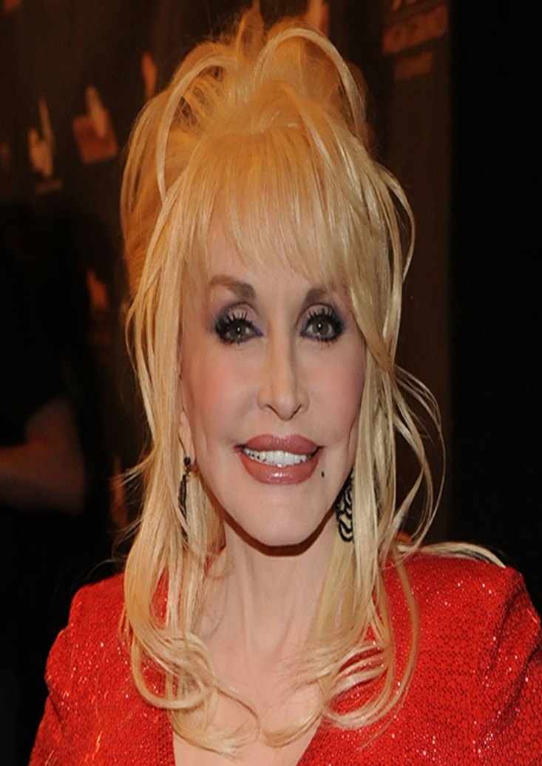
Teach
Dolly Parton (1946)
Dolly is an American, Grammy Award winning country music singer /songwriter, composer, author, and actress. She has become one of the most successful female country artists in history, with 25 number-one singles (a record for a female country artist) and 41 top-10 country albums.

Slide 11
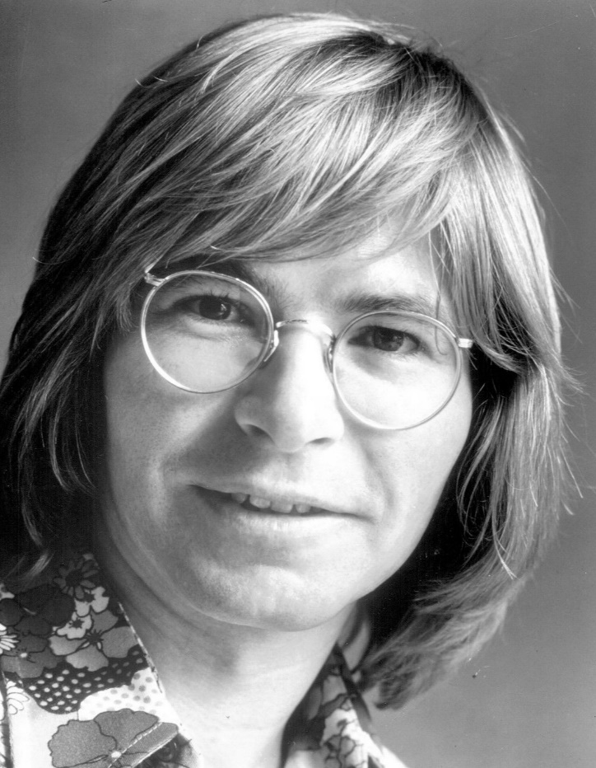
Teach
John Denver
John Denver was an American singer and songwriter. After travelling and living in different locations he began his music career with country music groups in the later 1960s.
He was one of the most popular acoustic artists of the decade and described as “among the most beloved entertainers of his era”.
https://www.youtube.com/watch?v=IUmnTfsY3hI

Slide 12
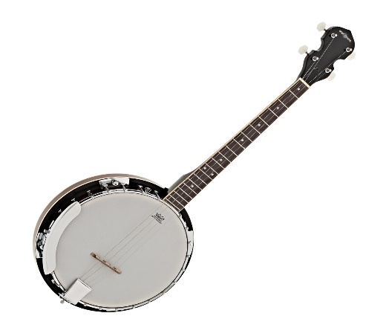
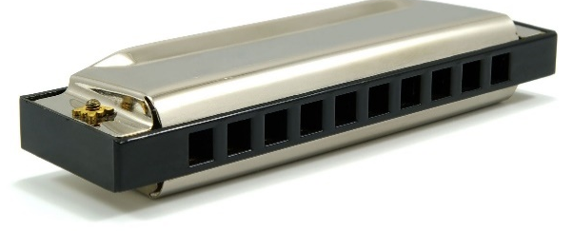
Task
Watch Bob Wills (1951)
https://www.youtube.com/watch?v=jUrhgb13ft4
What instruments can you see in the video?

Slide 13

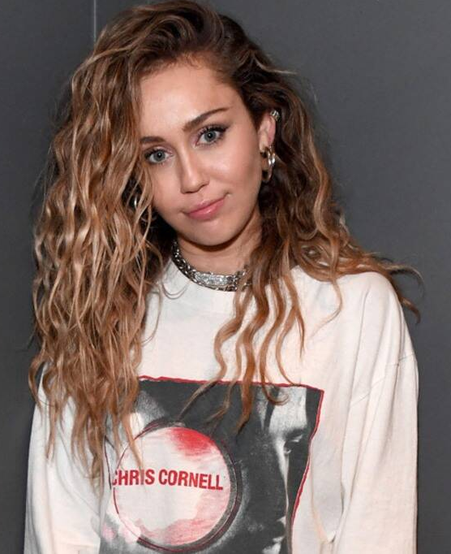
And finally…
Miley Cyrus – Jolene.
https://www.youtube.com/watch?v=wOwblaKmyVw
How is this different to Dolly Parton’s version?

