Slide 1
Week 15
OUTCOME: To write a poem using a strict syllable form

Slide 2
https://classroom.thenational.academy/lessons/to-investigate-homophones-cruk2t?activity=video&step=1
This week’s spellings are homophones.
accept
except
affect
effect
aloud
allowed
weather
whether
whose
who’s

Slide 3
LO: to know the form of haiku
Word of the day-syllable What does the word mean? Can you think of other words that have the suffix able?

Slide 4
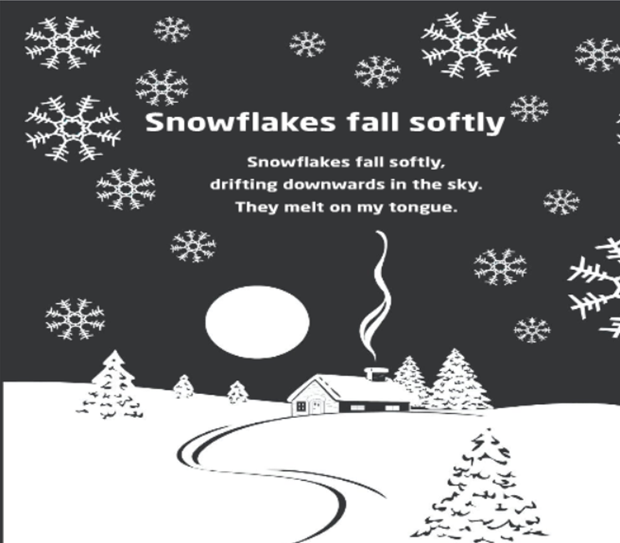
The Haiku
The haiku is a form of poetry it originates in Japan.
(A Japanese poem of 17 syllables, in three lines of five, seven and five. They traditionally evoke the natural world.)
Read the poem and count the syllables in each line.

Slide 5
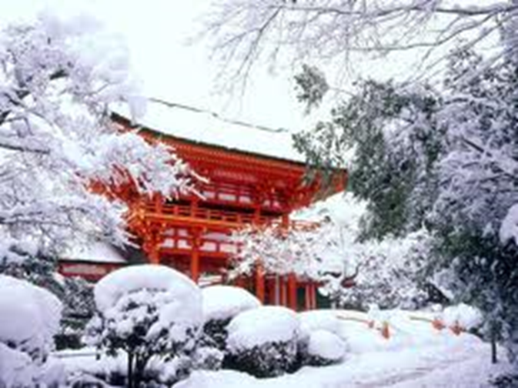
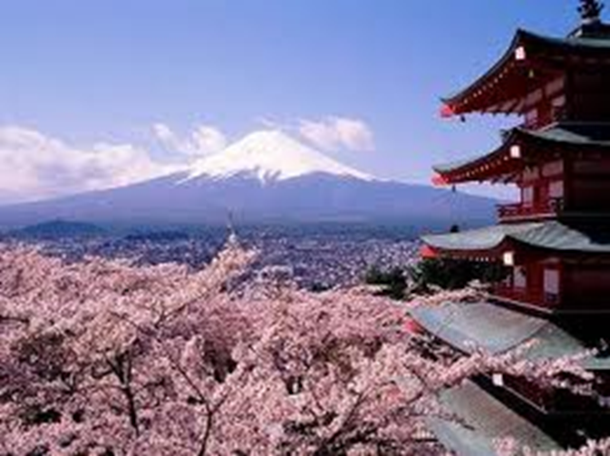
Samurai, Basho (1644-94)
The Seasons Haiku Poems
This snowy morning
That black crow I hate so much ....
But he's beautiful!
Spring morning marvel
lovely nameless little hill
on a sea of mist
Task: Write a haiku on the theme of Winter.

Slide 6
Day 2
Word of the day: anthology Sound of the day: -ology Investigate the suffix -ology What does the word mean?

Slide 7
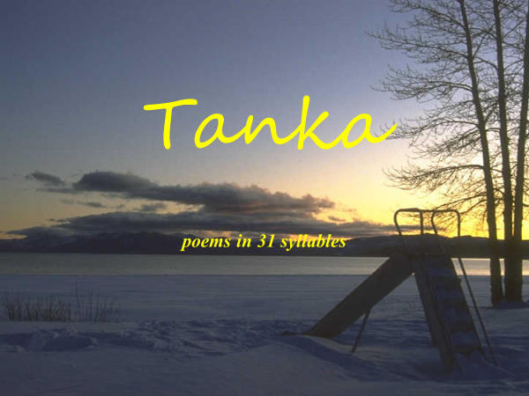

Slide 8
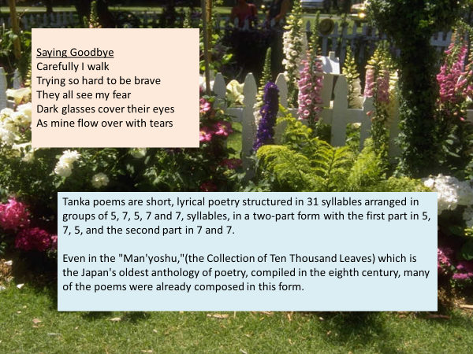

Slide 9
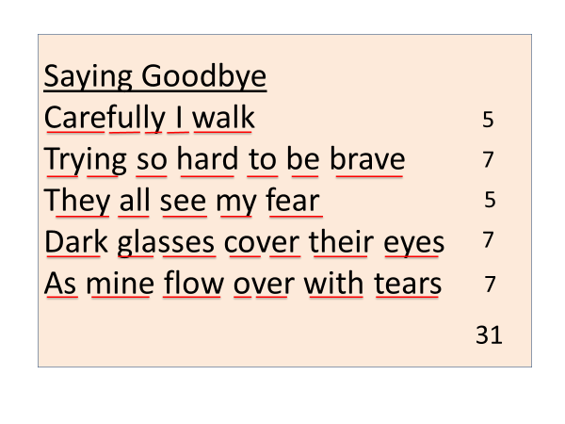

Slide 10
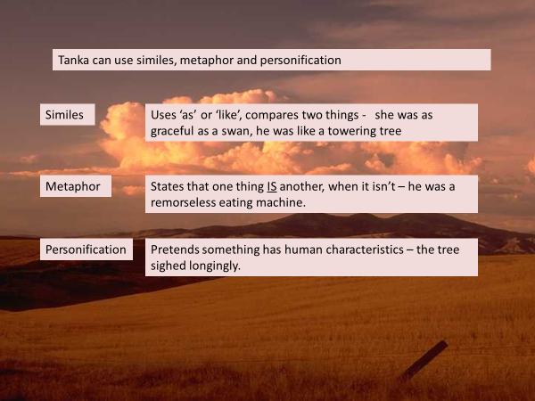

Slide 11
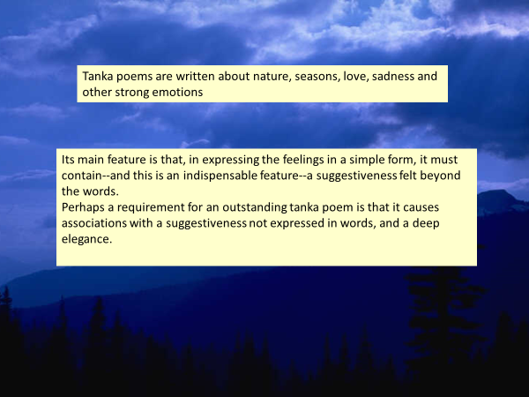
Write a tanka poem with a seasonal theme

Slide 12
Day 3
Word of the day -Word of the day- epiphany Sound of the day: ph What does the word mean? Can you write a sentence using the word of the day.

Slide 13
LO: to explore Tetractys poetry
Tetractys
The rules for writing a tetractys are as follows:
Line 1 is one syllable
Segment of speech usually consisting of a vowel with or without accompanying consonant sounds (e.g., a, I, out, too, cap, snap, check) . A syllabic consonant, like the final n sound in button and widen, also constitutes a syllable.
line 2 is two syllables;
line 3 is three syllables;
line 4 is four syllables;
and line 5, is ten syllables.
The fourth and fifth lines may rhyme.

Slide 14


Slide 15
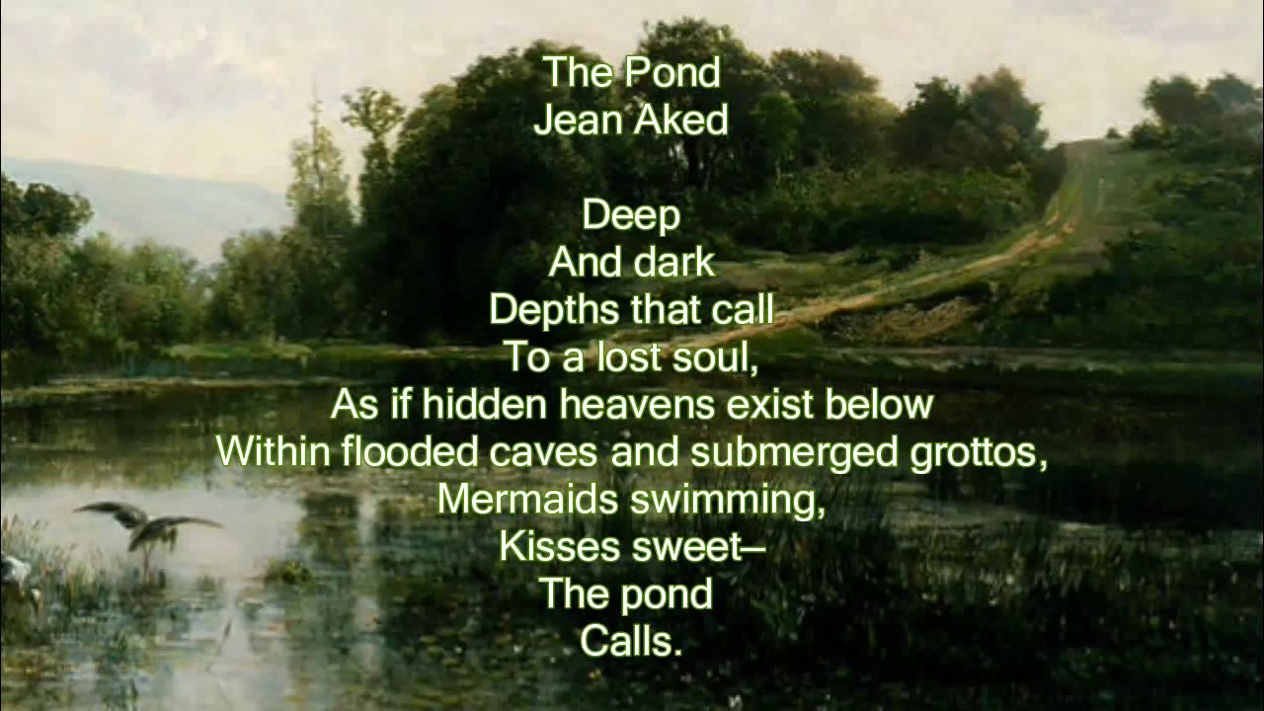

Slide 16
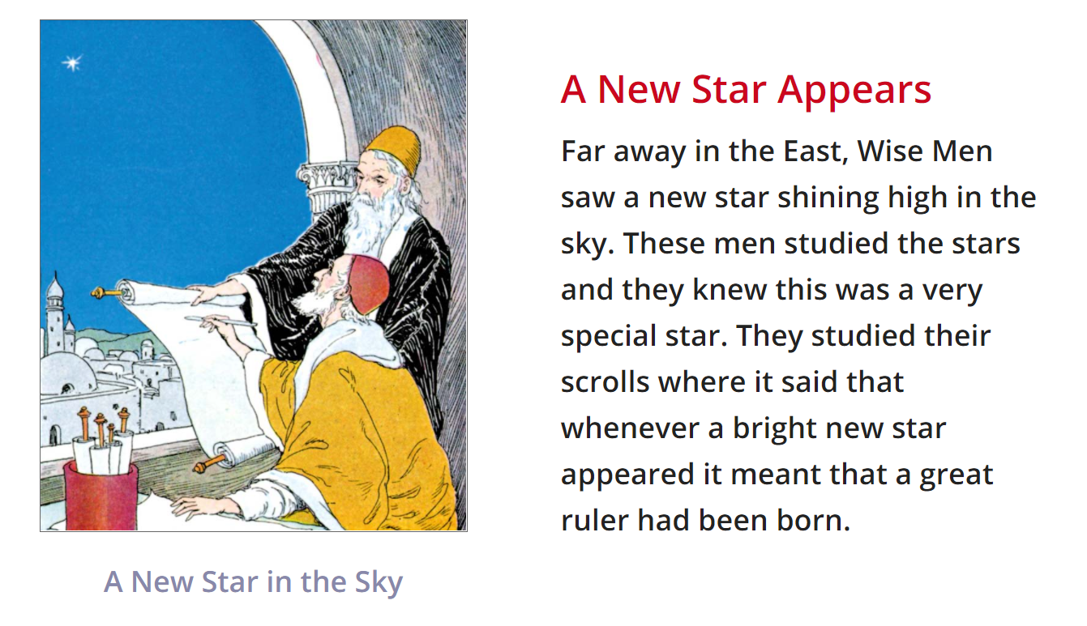

Slide 17
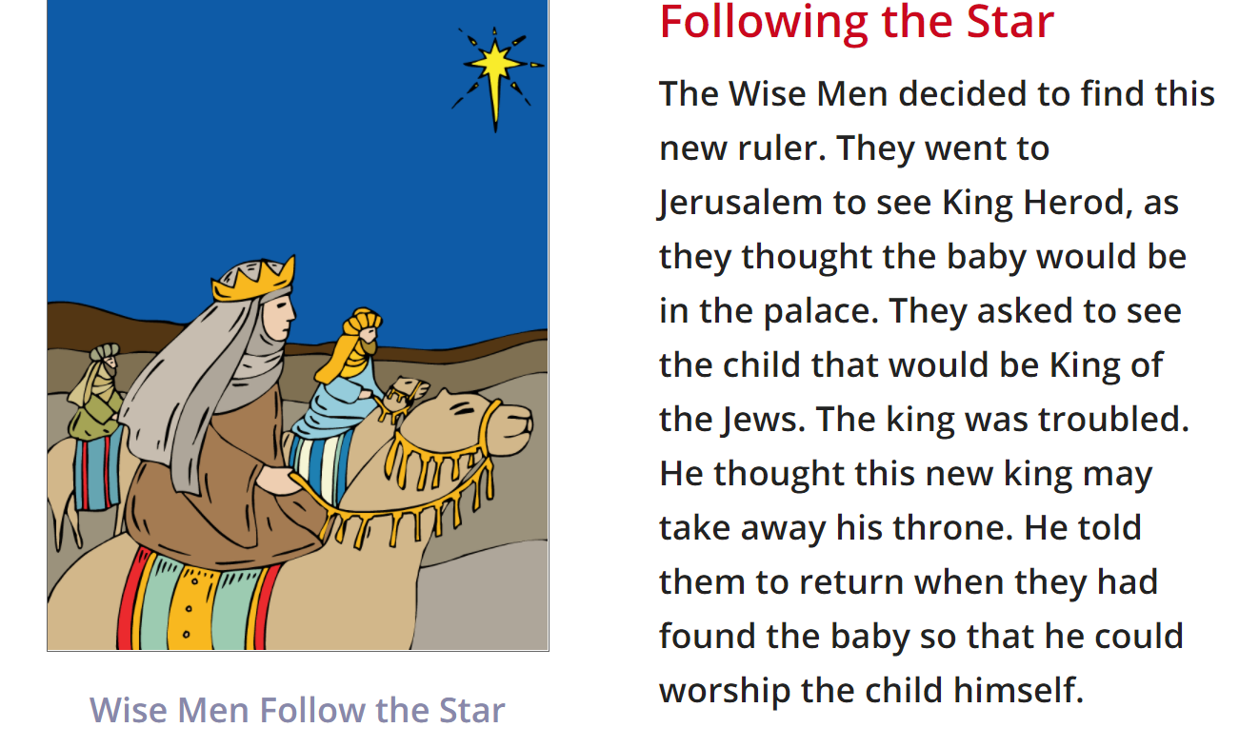

Slide 18
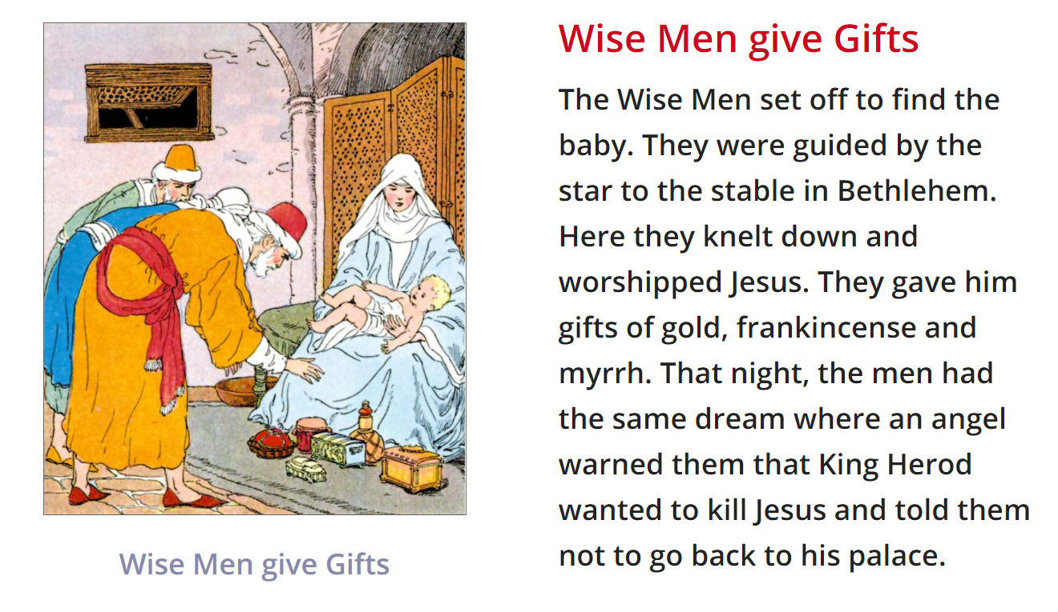
Mind map theme of the epiphany
Collect words/ phrases relating to the epiphany and then count the syllables.

Slide 19
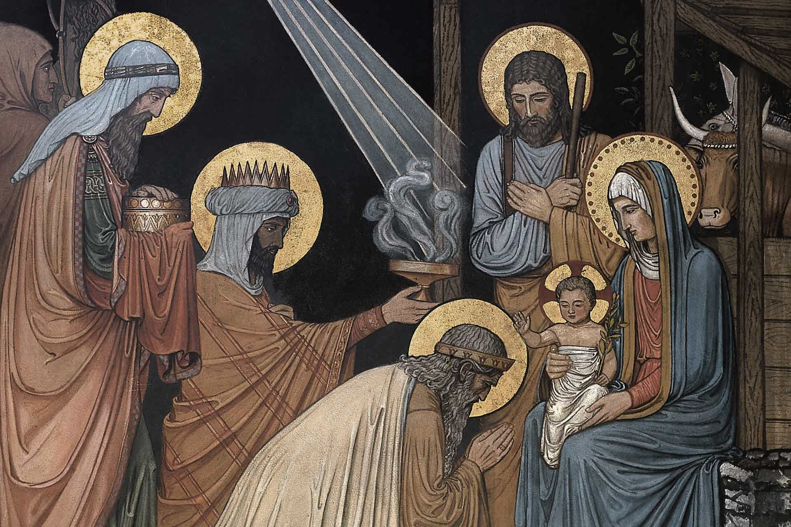
Shinning (2)
Bright(1)
Following
Sign
Troubled
Travelling
Epiphany

Slide 20
Day 4
Word of the day-hostile
What does this word mean? Can you think another word with a similar meaning? And the cities hostile and the towns unfriendly.

Slide 21
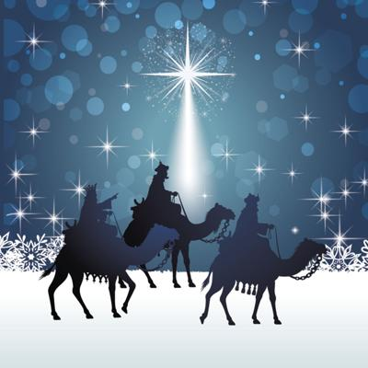
The Journey Of The Magi
A cold coming we had of it,
Just the worst time of the year
For a journey, and such a long journey:
The ways deep and the weather sharp,
The very dead of winter.'
And the camels galled, sore footed, refractory,
Lying down in the melting snow.
There were times we regretted
The summer palaces on slopes, the terraces,
And the silken girls bringing sherbet.
Then the camel men cursing and grumbling
and running away, and wanting their liquor and women,
And the night-fires going out, and the lack of shelters,
And the cities hostile and the towns unfriendly
And the villages dirty and charging high prices:
A hard time we had of it.
At the end we preferred to travel all night,
Sleeping in snatches,
With the voices singing in our ears, saying
That this was all folly.
All this was a long time ago, I remember,
And I would do it again, but set down
This set down
This: were we led all that way for
Birth or Death? There was a Birth, certainly
We had evidence and no doubt. I had seen birth and death,
But had thought they were different; this Birth was
Hard and bitter agony for us, like Death, our death.
We returned to our places, these Kingdoms,
But no longer at ease here, in the old dispensation,
With an alien people clutching their gods.
I should be glad of another death.
TS Elliot

Slide 22
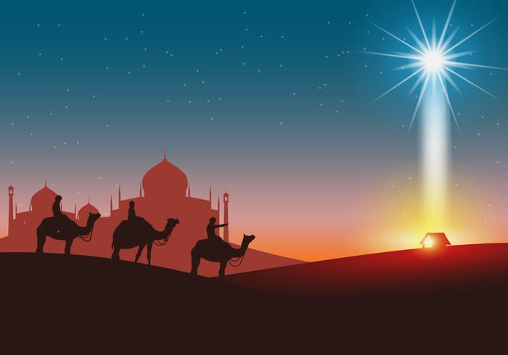
Review mind maps and create syllable poem on the theme of The Epiphany or The Journey of the Magi.
Create a Haiku, Tanka or Tetractys on the theme.

