Slide 1
Lesson One -
To know the location of Ancient Rome and explain why it was powerful
.

Slide 2
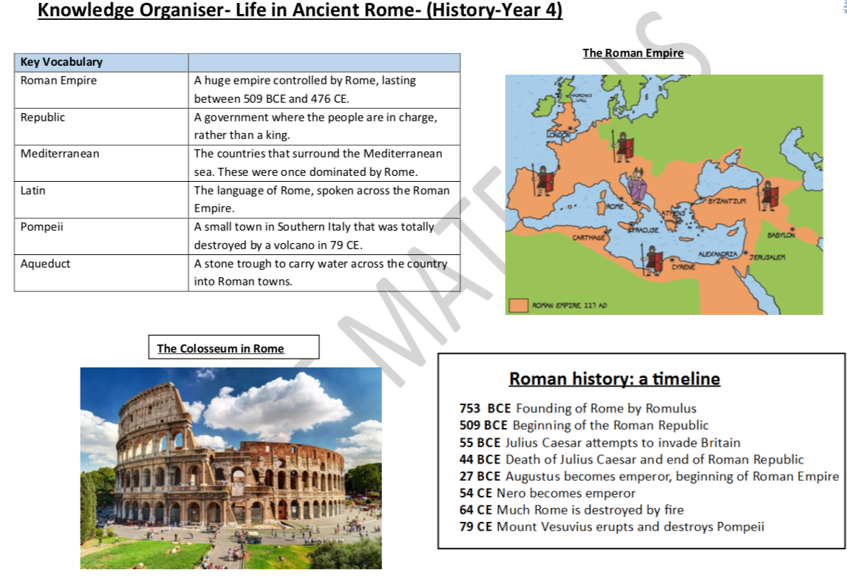

Slide 3
Quiz
Q - Why do we study Rome?
A – The Romans left us a legacy of many ideas and concepts that still important today. These include their architecture, laws, government and language
Q – What are the advantages of Rome’s location?
A – Being on the River Tiber, Rome had good farm and pasture land, the river was good for defence and trade.
Q – Which was not built by Romans?
A - Amphitheatres. Roads. Towns. Castles.
Q – Who lived in Britain before the Romans?
A – Anglo-Saxons; Normans; Celts; Vikings.

Slide 4
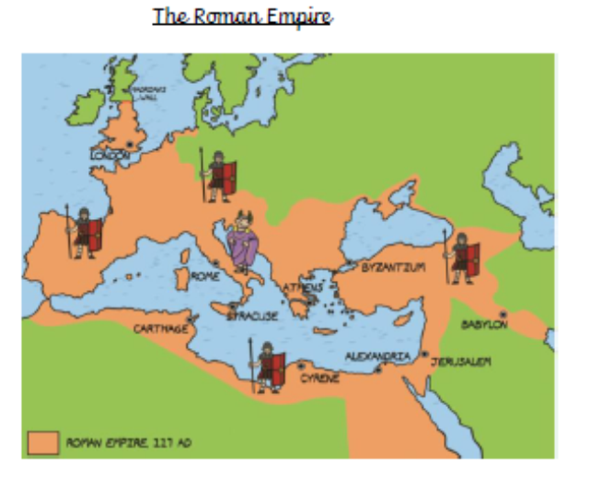
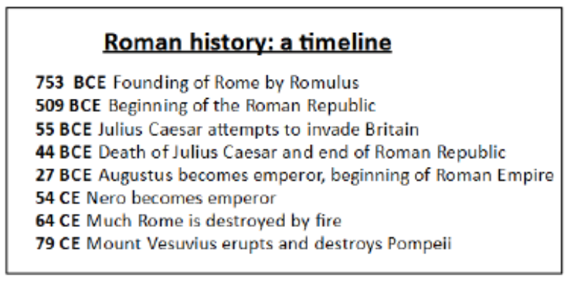
Key information

Slide 5
https://www.bbc.co.uk/programmes/p01lkwjz

Slide 6
Task: To locate Rome on a map
Success Criteria:
I can show what area was in the Roman Empire.
I can explain why Rome’s location helped it to become powerful.

Slide 7
Key Vocabulary
Rome
Romulus
Remus
Mediterranean
century

Slide 8
What do you know?
If you know something about the Romans already write it down on a spider diagram like the one below.
The Romans
Consider the name, ‘The Romans’. What can you deduce from this name?

Slide 9
The Rise of Rome
In 600 BC Rome was little more than a hilltop village in Italy but over the next 600 years, The Romans conquered much of Europe, large pieces of North Africa and built the greatest empire the world had ever seen.
Over a million people lived in Rome, it was a busy, bustling and noisy city. Rome had huge public buildings, lots of small shops, public baths, inns, cafes, parks and grand arenas where citizens would watch chariot races and gladiator battles.

Slide 10
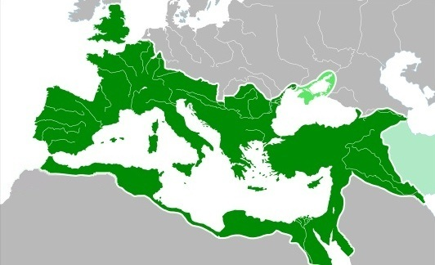
The Roman Empire
The Roman Empire (in green) by 117 AD.

Slide 11
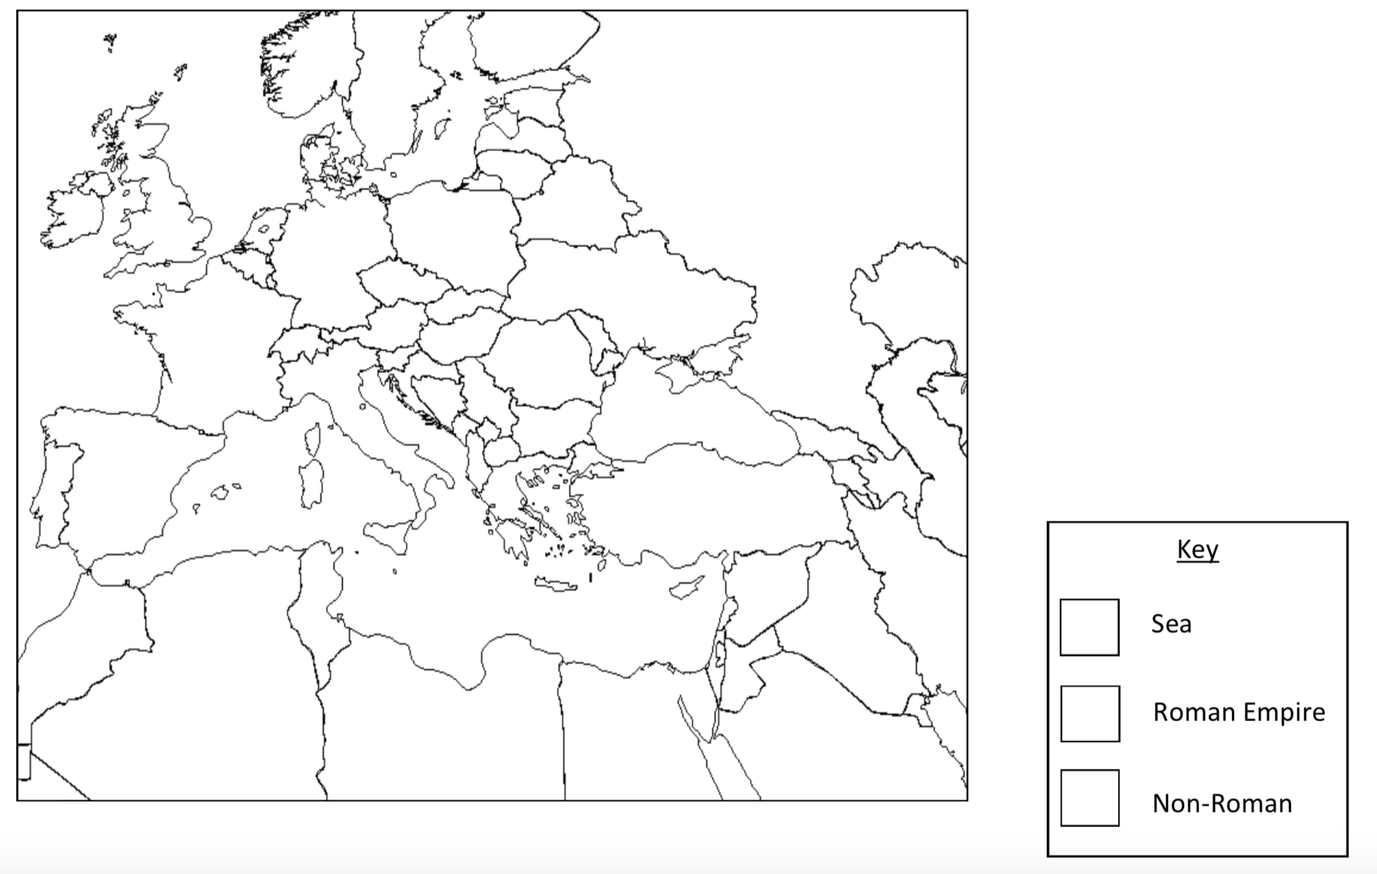
Your task – locate Rome on the map

Slide 12
Assessment Questions.
Where was Ancient Rome?
How far did the Roman Empire spread?
Between what dates did Ancient Rome exist?
Why was Ancient Rome so important?
What have you found most interesting today?
What puzzled you?
What questions do you have?
How can we find the answers?

