Slide 1
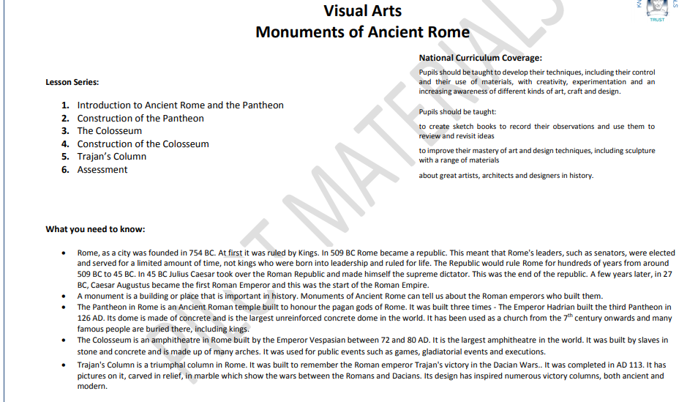

Slide 2
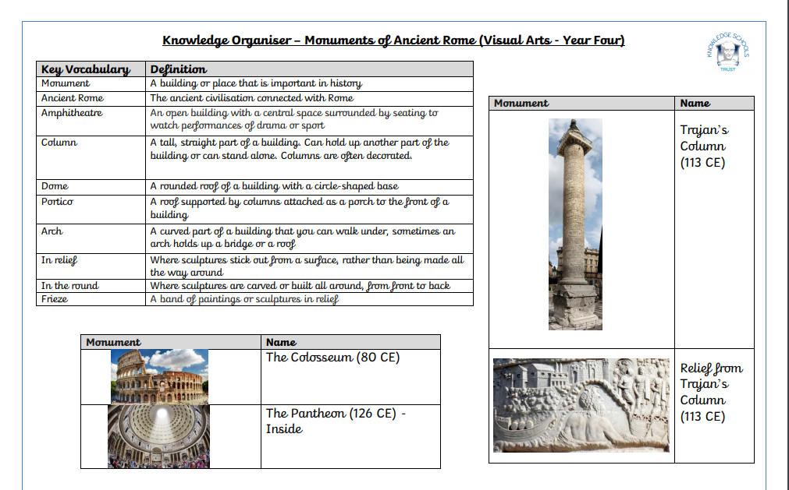

Slide 3

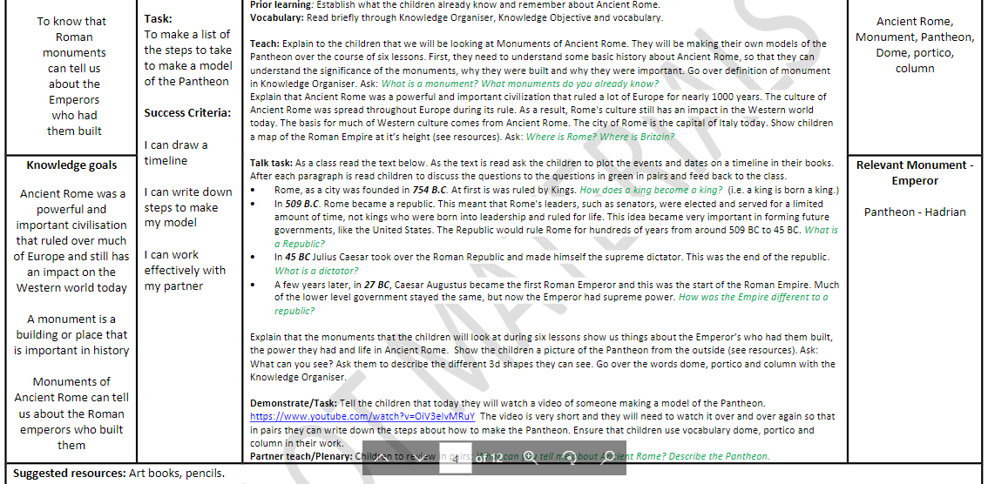

Slide 4
Suggested Resources
Art books
Pencils

Slide 5
Prior Learning
What do you remember about Ancient Rome?
What do you remember about the architecture?

Slide 6

Vocabulary
Ancient Rome
monument
Pantheon
dome
portico
column
Hadrian

Slide 7
Warm up task
What do you think a monument is?
Notes:
Explain that Ancient Rome was an important and powerful civilisation that rules for nearly 1000 years.
The culture of Ancient Rome was spread throughout Europe during it’s rule.
Rome’s culture still has an impact on the western world today.
Check your knowledge organiser for the definition of a monument.
Monument – a building or place that is important in history.

Slide 8
Talk Task
Read the text below and plot the events and dates on a timeline in your book.
Rome, as a city, was founded in 754BC. At first it was ruled by kings.
  How does a king become a king?
In 509BC Rome became a Republic. This meant that Rome’s leaders, such as consuls, were elected and served for a limited amount of time, not like kings who ruled for life. This idea became very important in forming future governments, like ours. The Republic would rule Rome for hundreds of years from around 509BC to 45BC.
  What is a Republic?
Notes:
How does a king become a king? – they are born a king.

Slide 9
Talk Task
In 45BC Julius Caesar took over the Roman Republic and made himself the supreme dictator. This was the end of the Republic.
  What is a dictator?
A few years later, in 27BC, Caesar Augustus became the first Roman Emperor and this was the start of the Roman Empire. Much of the lower level government stayed the same, but now the Emperor had supreme power.
  How was the Empire different to a Republic?

Slide 10
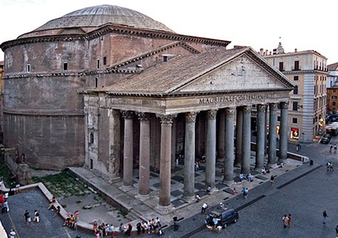
The Pantheon
dome
portico
Describe the 3D shapes that you can see.
What can you see?
column
Notes:
The monuments we are looking at in the next six lessons show us things about the Emperors who had them built, the power they had and life in Ancient Rome.
Ask the children to use their knowledge organiser to go over:
Dome
Portico
Column

Slide 11
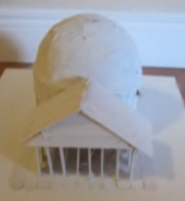
Main task
https://www.youtube.com/watch?v=OiV3eIvMRuY
Notes:
Short clip of someone making a model of the Pantheon
TASK:
In pairs children are to write down the steps of the task. Ensure children use the correct vocabulary of dome, portico and column.

Slide 12
Plenary
In a silent gallery, walk around the room looking at each other’s steps.
Have we used clear steps and the key vocabulary:
dome, portico and column?

