Slide 1
Week 14
OUTCOME: To publish and send a letter to Michael Morpurgo
To write as a shepherd at the nativity of Jesus

Slide 2
LO: To publish a letter.
Word of the day-nativity Sound of the day: ity What does the word mean?

Slide 3
Word of the day-nativity
What type of word is nativity?
Investigate the word of the day.
Is this word used in any other context?
Why do you think this might be?
Sound of the day: ity
Revise grammar and spelling last week.
Can you remember why some words ended -ty and others were -ity?
Does this rule apply here?
Think of anymore –ity words. Think of as many as you can.
e.g. responsibility, susceptibility…

Slide 4
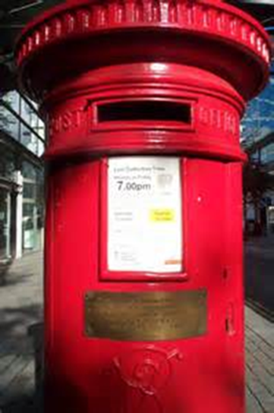
L.O. To write and send a letter to Michael Morpurgo.
Remember the letters we have written to Mr Morpurgo. If you do not have access to your edited draft, write another letter or Christmas card and send it.
Take care with your hand writing this is a final draft!!
Fan Mail Address:
Michael Morpurgo
David Higham Associates
7th Floor
Waverley House
7-12 Noel Street
London W1F 8GQ

Slide 5
Day 2
Word of the day-annunciation What does the word mean? Sound of the day :-tion This is another word to add to our –tion list. Use the word annunciation in 2 different sentences. Try beginning with the word.

Slide 6
Look at the route word announce.
What type of word is it?
How many suffixes and prefixes can you use to vary this word?
announced, renounce, pronounce, announcement, announcer, announcing, renounced…
What type of words have you created?
Use them in sentences.

Slide 7
L.O. to explore the words spoken by the angels in the bible See R.E. Blended Learning for this lesson. Look at the activity of the angels in: – The annunciation to Zechariah – The annunciation to Mary – The dream of Joseph – The shepherds in the field – The warning given to Joseph to go to Egypt.

Slide 8
Day 3
Word of the day-saviour Sound of the day:-our Can you write a sentence using the word of the day. What is the root word here? Think about other root words with a vowel ending e.g. behave How many can you think of?

Slide 9

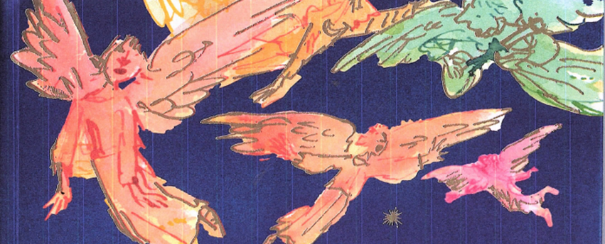
LO: to write the story of the annunciation to the shepherds
Revisit yesterday’s R.E.
Imagine you are one of the shepherds and write a personal account of what happened.
Describe the scene before the annunciation.
What did the angels look like?
How did you feel?
What did they say?

Slide 10
Day 4
Word of the day-symbol
Sound of the day: suffix-ing How many verbs with the suffix –ing can you think of? Use only words that have a connection to Christmas. Singing, playing, decorating, announcing….

Slide 11
LO: to write shape poems based upon the symbols of Christmas
Mind map words, images and ideas associated with the:
star
angel
tree
crib
holly
Christmas lights
Using alliteration and simile complete simple blank verse stanzas to write as shape poems on templates.

Slide 12
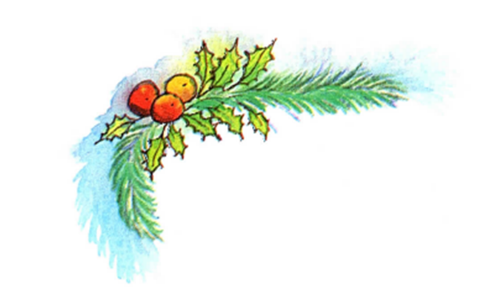
Day 5
Word of the day- Christmas
Happy Christmas Everybody!!

