Slide 1
Week 13
OUTCOME: To write a letter to Michael Morpurgo

Slide 2
LO: To write the opening of a letter
Word of the day- Gaudete -rejoice Word of the day-delight Sound of the day: igh What does the word mean?

Slide 3
Word of the day-delight
What type of word is delight? Explore the sentence- “I love above everything your delight in it all,”
Noun and verb use in sentences.
Explore other words that can be used in this way – dance, play…
Investigate the word of the day.
Look at some English words with a Latin route.
Sound of the day: igh
Think of as many words as you can with the igh sound in.

Slide 4
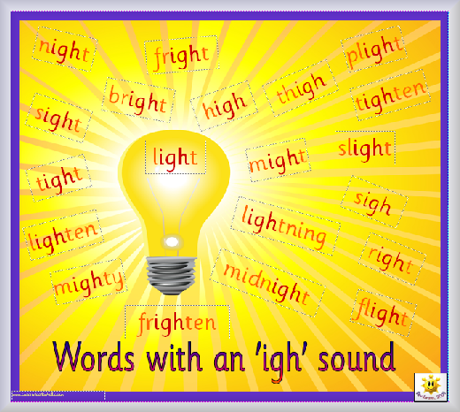
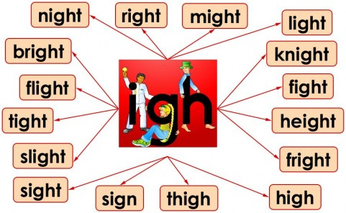
Write two sentences using as many of the words as possible.
It was very frightening when the bright flashes signalled the midnight lightening.

Slide 5


Slide 6
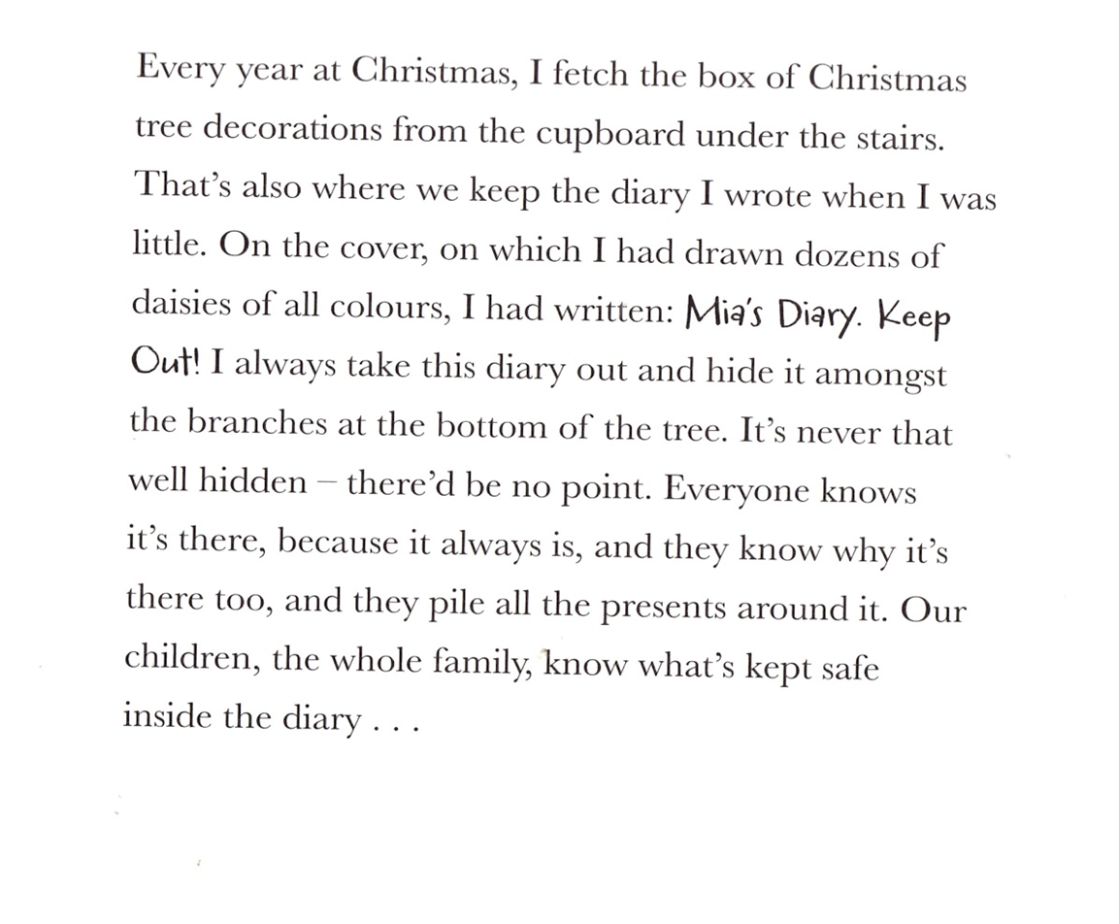

Slide 7
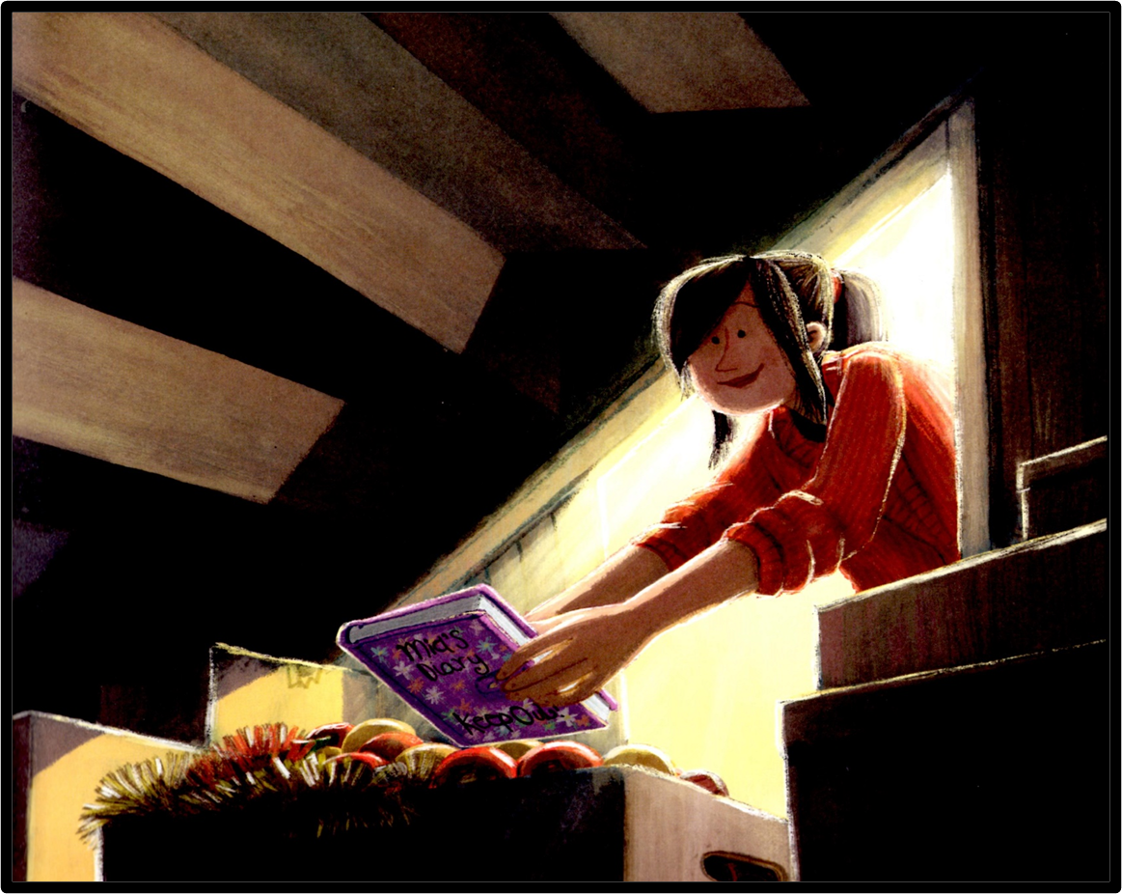

Slide 8
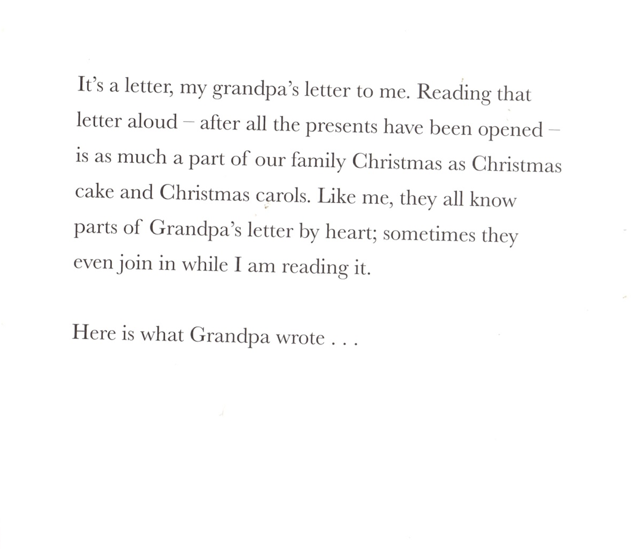

Slide 9
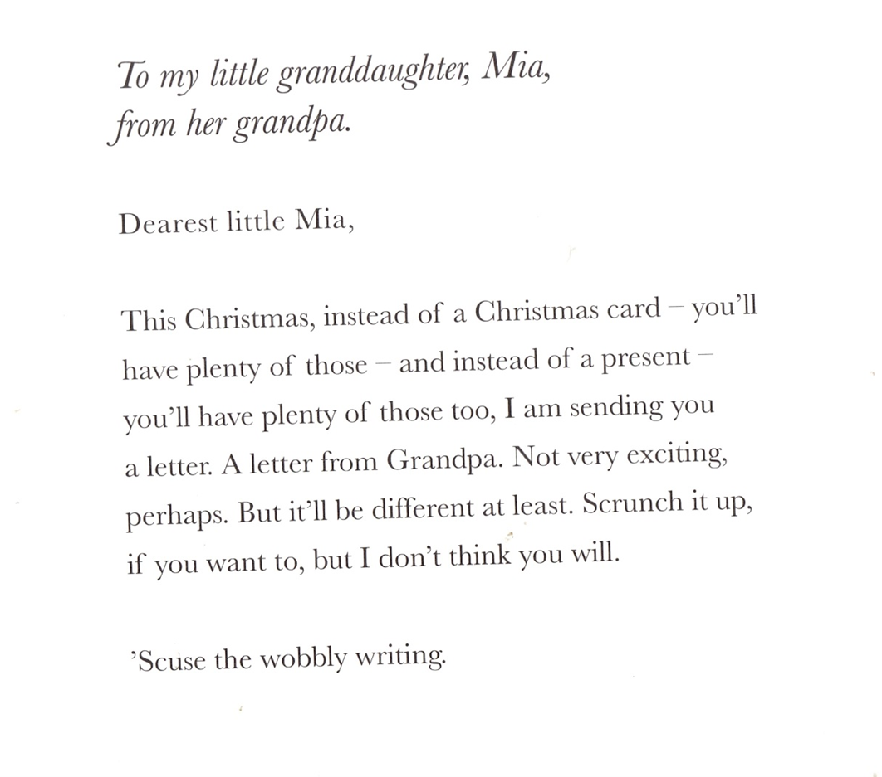

Slide 10
What is the purpose of the opening paragraph of a letter?
Model opening a letter to an author.
Dear Mr Morpurgo,
I am writing to let you know how much we enjoyed your book The Butterfly Lion. Year 4 read your book in our English classes and it enabled us to learn about Africa, World War 1 and express our views on performance animals.
I have found the book to be fascinating and stimulating at the same time.
Your book has broadened my understanding of many subjects; I had not thought much about the animals performing in the circus or on TV and how different their life is to their wild existence.
( Ask some questions)
We all enjoyed your book so much that we are now reading some of your short Christmas stories.
Wishing you a Happy Christmas,
Yours sincerely,
(Senders Name)

Slide 11
Day 2
Word of the day-infinity What does the word mean? Sound of the day : words ending in –ty or ity Write a compound sentence using the word infinity.

Slide 12
proper ty
securi ty
activi ty
majori ty
capaci ty
facili ty
minori ty
identi ty
priori ty
maturi ty
mobili ty
quanti ty
casual ty
humani ty
equali ty
warran ty
severi ty
affini ty
veloci ty
morali ty
fideli ty
immuni ty
locali ty
scarci ty
almigh ty
totali ty
legali ty
rigidi ty
divini ty
subtle ty
insani ty
tenaci ty
sereni ty
sancti ty
futili ty
feroci ty
solidi ty
veraci ty
atroci ty
traves ty
heredi ty
sobrie ty
Read the words. How many do you already know? Look up any unfamiliar words.

Slide 13
L.O. to create a mind map of problems in the world
Read on to and “we are her guardians too,” explore any new vocabulary - beacon, arid, lifeless etc.
Write the mind map in dark colours for negative images.
Read on to the end of the book: adding ideas of how we can improve the world using brighter colours.

Slide 14
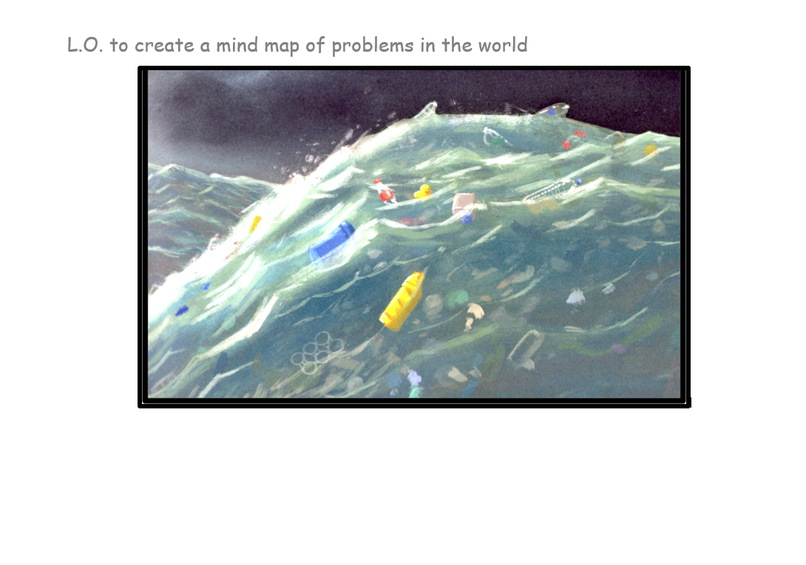
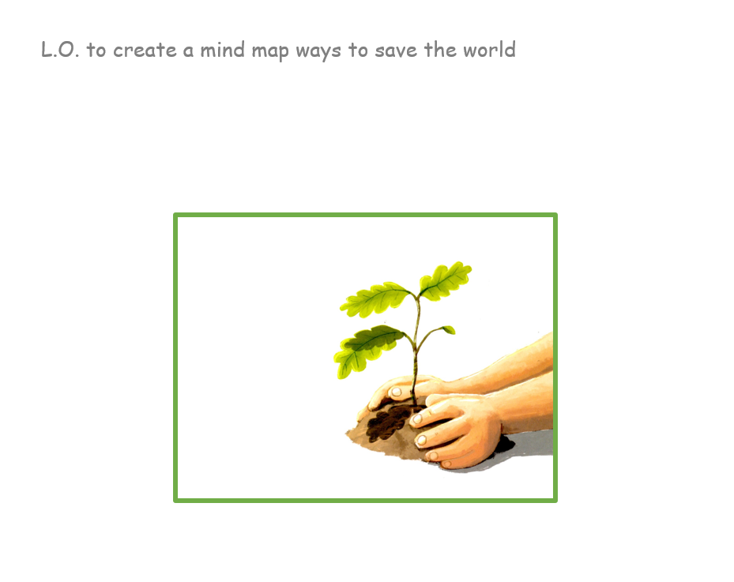
Plastic waste litter cutting trees

Slide 15
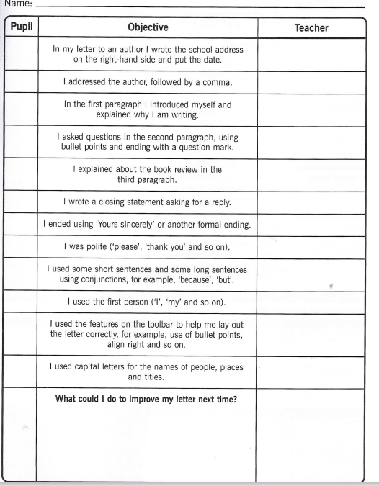
Continue the letter describing the Butterfly Lion.
Look at the marking ladder and make sure your letter contains all the necessary objectives.

Slide 16
Day 3
Word of the day-condition Sound of the day: tion Can you write a sentence using the word of the day.

Slide 17
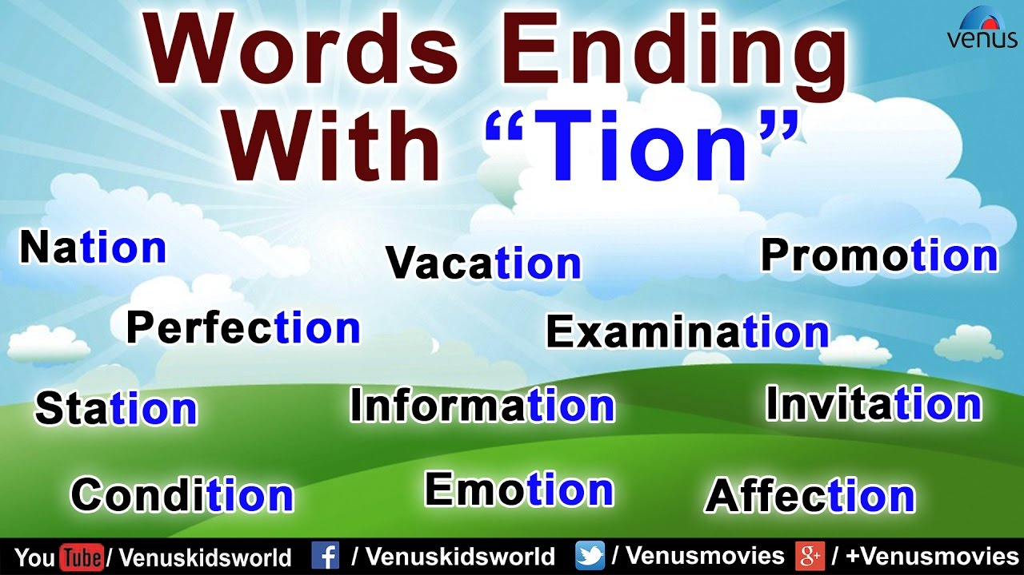
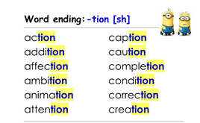

Slide 18
LO: to write two central paragraphs to a letter
Read The Best Christmas Present in the World to “dated at the top 26th December 1914” What do you think the letter will be about?
Think about the stories we have shared – Compare Butterfly Lion/Grandpa’s Christmas/The Promise. Which one is your favourite? Why? Draft the paragraph for the letter. Discussing the books include questions about the books or other stories.
Recap Michael’s autobiography and continue with a paragraph referring to his life and asking an additional question.
Finish by reading on and reaching; “I told the men ‘It’s a trick.’ But it wasn’t.”

Slide 19
Day 4
Word of the day- outstretched
Analyse the parts of the word – prefix – out suffix- ed
Sound of the day: ou

Slide 20



Slide 21
LO: to write a final paragraph and closing statement
Read to the end of the letter “Your loving Jim,”
Write a final paragraph and closing statement.

Slide 22
Day 5
Word of the day-intrusion
Sound of the day - tr

Slide 23
Explore the prefix ‘in’.
What other words can you think of that begin with this prefix?
in surance
in stitute
in fluence
in terview
in terface
in troduce
in tention
in tegrate
in flation
in tensive
in tegrity

Slide 24
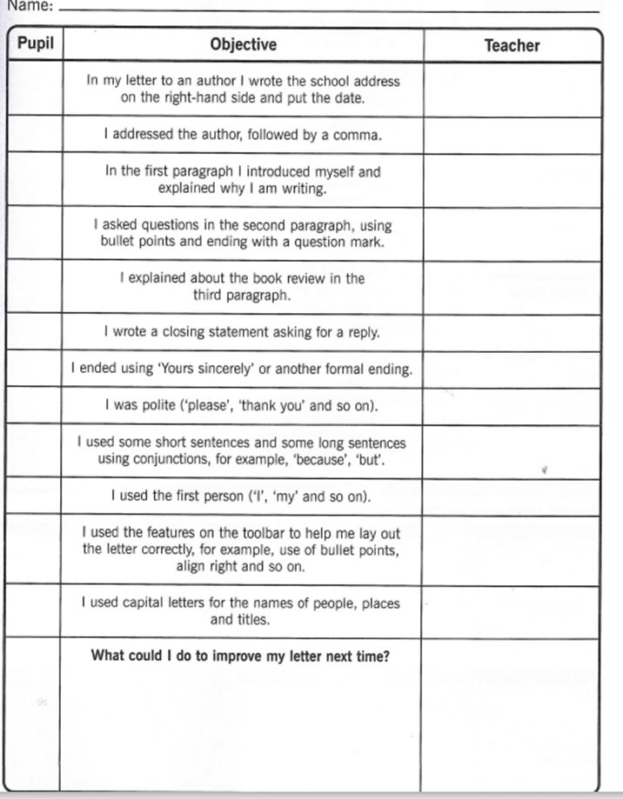
L. O. to read, edit and publish our letter
Finish reading the story
Edit the letters for accuracy and check against a marking ladder.

