Slide 1
Autumn term assessment gaps

Slide 2
LO: to write numbers in words

Slide 3
Write in digits
Twenty three
Forty six
One hundred and forty five

Slide 4
On whiteboards write in words the number
33

Slide 5
In your books;
Write the digits 0-10, next to them write the words:
0-zero
1-one…

Slide 6
12

Slide 7
12
twelve

Slide 8
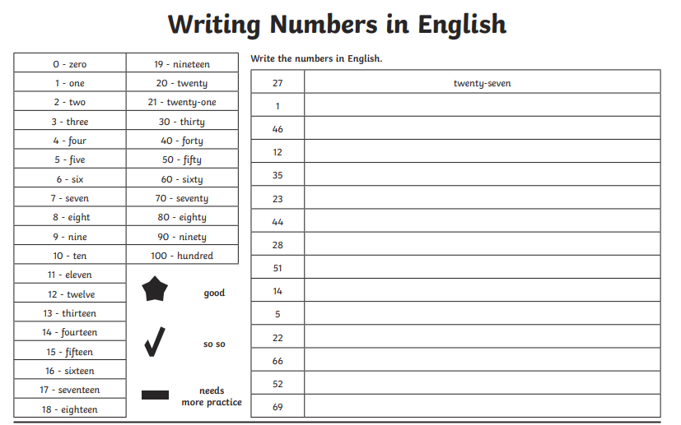

Slide 9
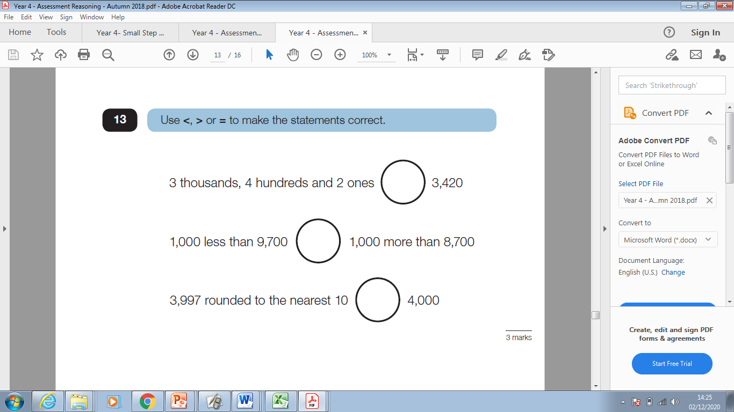

Slide 10
LO: to calculate division

Slide 11
8÷4
How can we solve this?
How could we illustrate this?

Slide 12
48÷4
How can we solve this?

Slide 13
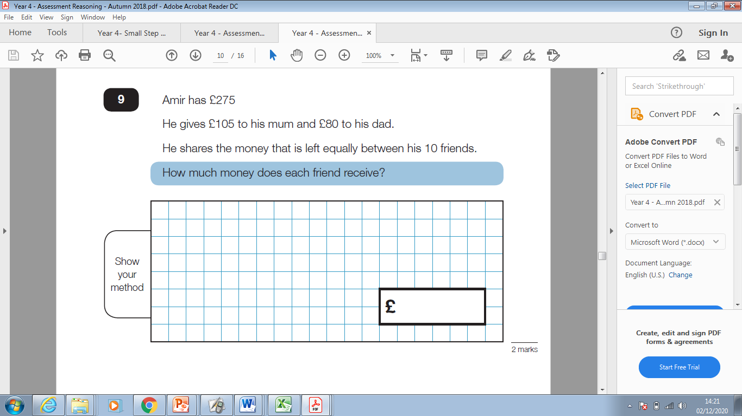

Slide 14
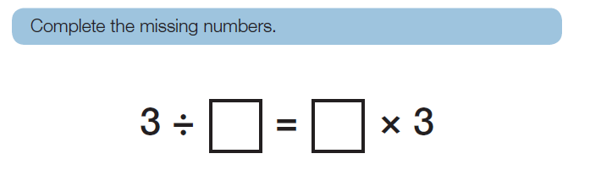

Slide 15
LO: to find addition and subtraction facts

Slide 16
What does this symbol mean?
₌

Slide 17
What does this symbol mean?
The = equals symbol is used to show that the values on either side of it are the same.
₌
It is most commonly used to show the result of a calculation, for example 2 + 2 = 4, or in equations, such as 2 + 3 = 10 − 5.

Slide 18
Create calculations that have answer of 5

Slide 19
Create calculations that have answer of 5
2x10=1x10
4x2+2=20-10
The values on either side are worth the same

Slide 20
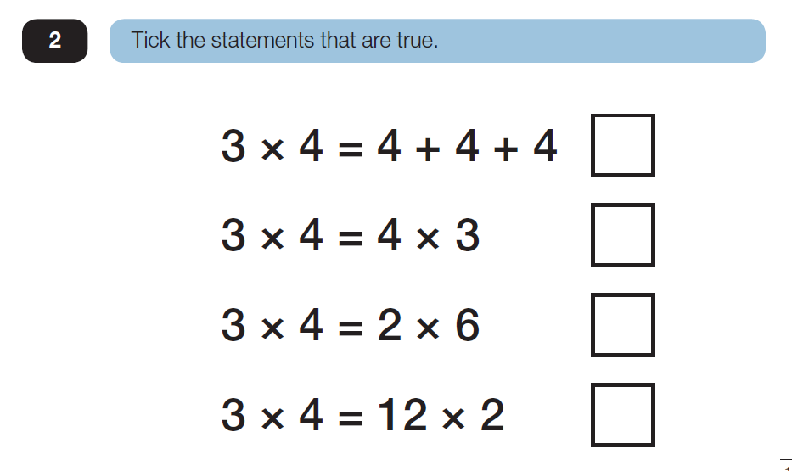
Have another go at this question

Slide 21
230+123=353
What other addition and subtraction facts can we find from this number sentence?

Slide 22
230+123=353
123+230=
353-230=
353-123=
353=230-
353= 123+

Slide 23
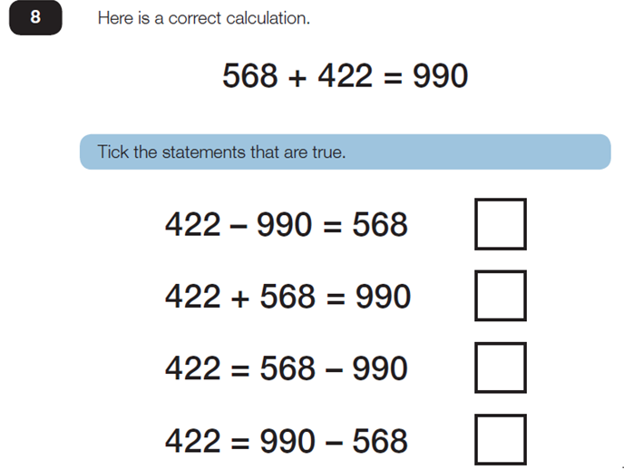
Have another go at this;

Slide 24
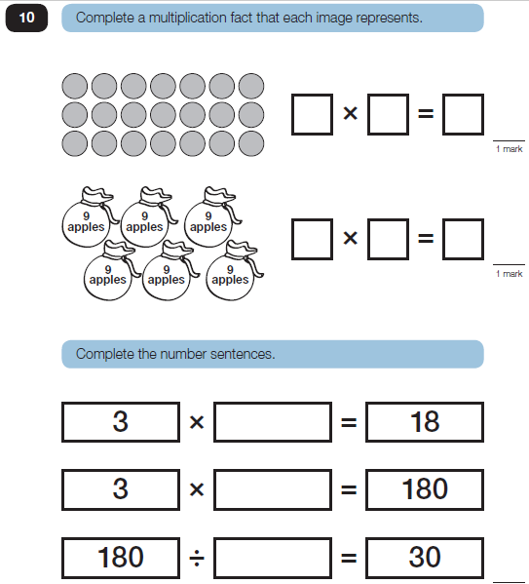

Slide 25
LO: to use number lines

Slide 26
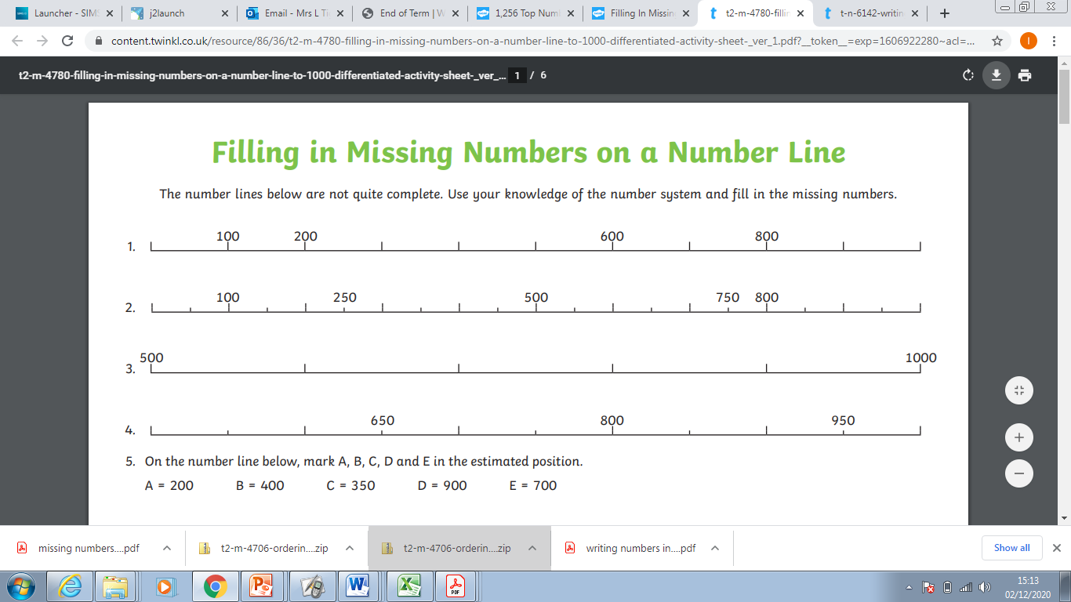

Slide 27
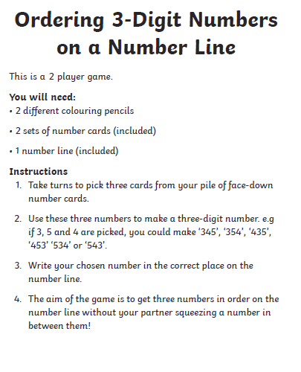

Slide 28
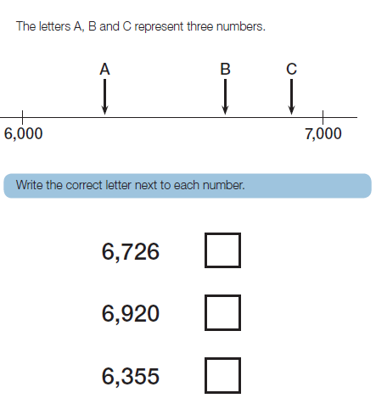

Slide 29
LO: to count in 6’s
Recite 6 times tables

Slide 30
36= 6x___
60= 6x___
4x6=___
7x6=____

Slide 31
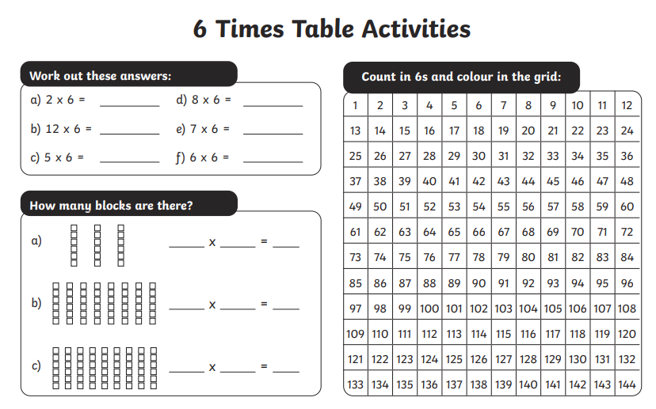

Slide 32
The school orders 12 boxes of A4 paper. Each box contains 6 reams, with each ream containing 500 sheets. How many sheets of paper are ordered?

Slide 33
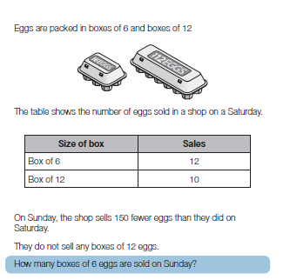

Slide 34


