Slide 1
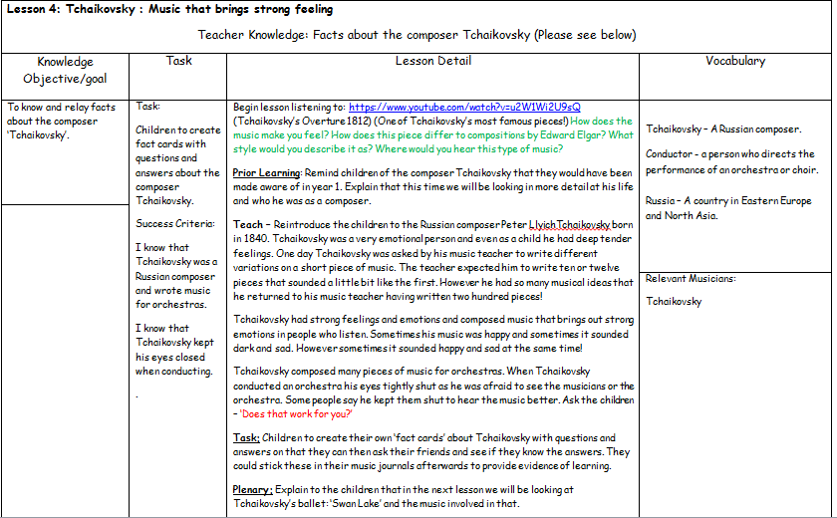
Lesson 4 - Tchaikovsky – Music That Brings Strong Feeling

Slide 2
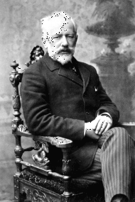
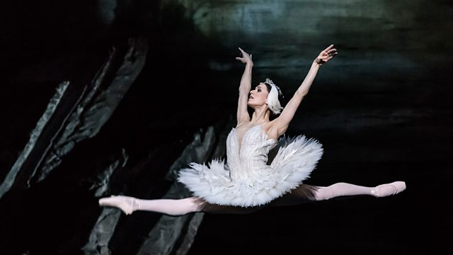

Year 4
Autumn 2
Lesson 4
Tchaikovsky: Music That Brings Strong Feeling

Slide 3

Let’s Listen -
https://www.youtube.com/watch?v=D2kWjAKjxoI
How does the music make you feel?
How does this piece differ to compositions by Edward Elgar?
What style would you describe it as?
Where would you hear this sort of music?
What instruments are used?

Slide 4
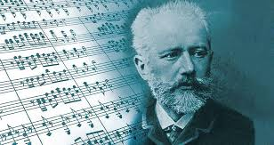
Prior Learning
In year 1 we looked at the composer ‘Tchaikovsky’ and now we are going to look in more detail at Tchaikovsky’s life and who he was as a composer.

Slide 5
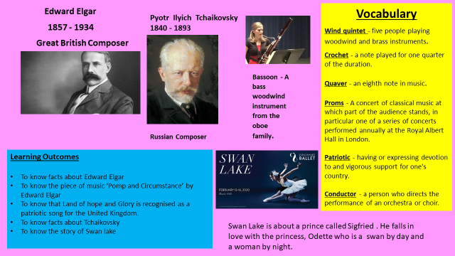
Our Knowledge Organiser

Slide 6
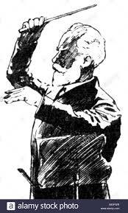
Key Vocabulary
Tchaikovsky – A Russian composer.
Conductor - A person who directs the performance of an orchestra or choir.
Russia – A country in Eastern Europe and North Asia.

Slide 7
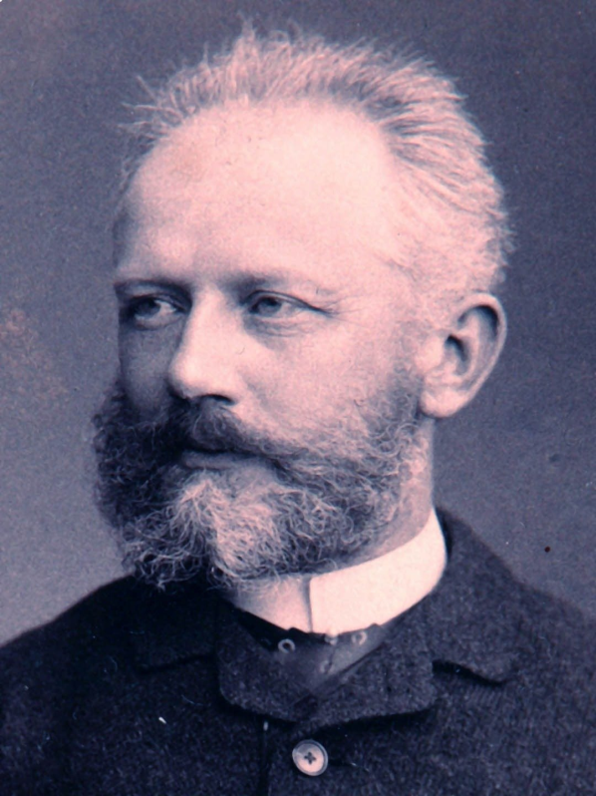
L.O: To know and relay facts about the composer ‘Tchaikovsky’.
Success Criteria: I know that Tchaikovsky was a Russian composer and wrote music for orchestras. I know that Tchaikovsky kept his eyes closed when conducting.
Here are today’s key words:
Tchaikovsky
Conductor
Russia

Slide 8
Teach
Peter Llyich Tchaikovsky was born in 1840. Tchaikovsky was a very emotional person and even as a child he had deep tender feelings. One day Tchaikovsky was asked by his music teacher to write different variations on a short piece of music. The teacher expected him to write ten or twelve pieces that sounded a little bit like the first. However he had so many musical ideas that he returned to his music teacher having written two hundred pieces!
Tchaikovsky had strong feelings and emotions and composed music that brings out strong emotions in people who listen. Sometimes his music was happy and sometimes it sounded dark and sad. However sometimes it sounded happy and sad at the same time!
Tchaikovsky composed many pieces of music for orchestras. When Tchaikovsky conducted an orchestra his eyes were tightly shut as he was afraid to see the musicians or the orchestra. Some people say he kept them shut to hear the music better. Does that work for you?

Slide 9

Task – Can you create some fact cards on Tchaikovsky?
Create some fact cards with questions and answers based on Tchaikovsky. When you have finished test them on your friend and see if they can answer the questions!

Slide 10
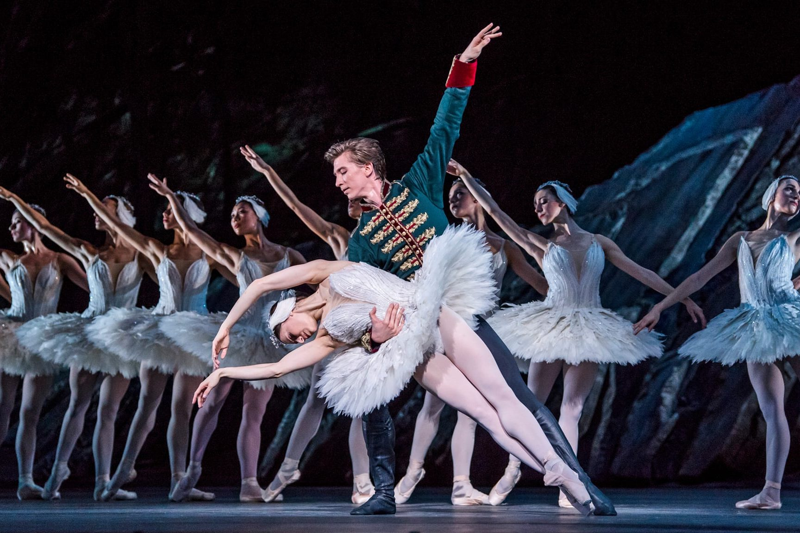
And finally…
In the next lesson we will be looking Tchaikovsky’s ballet; ‘Swan Lake’.

