Slide 1
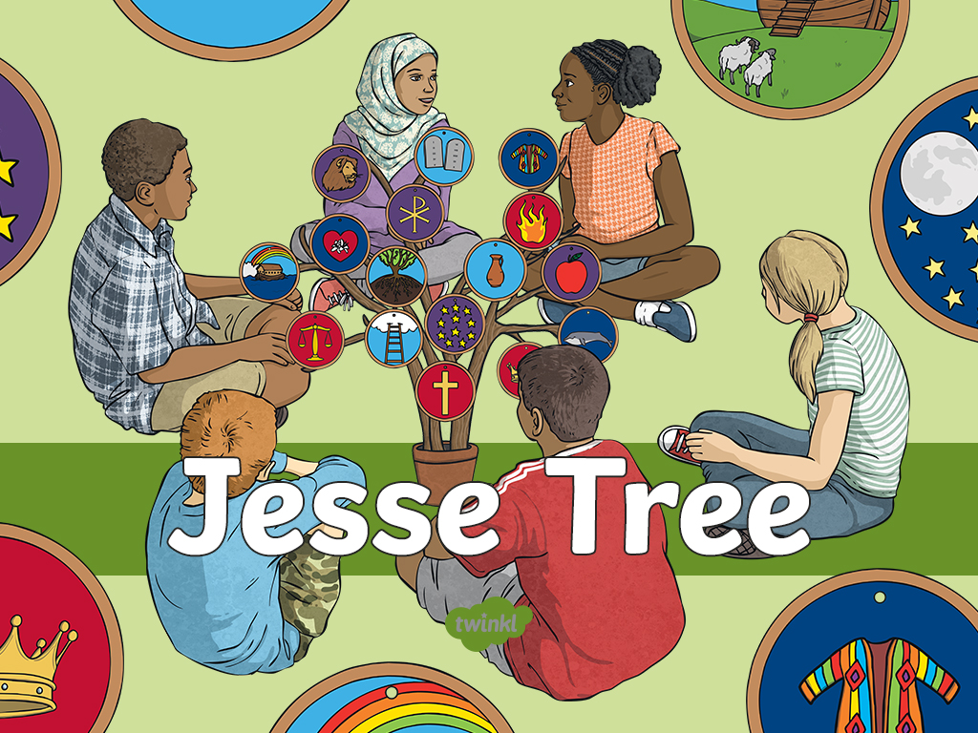

Slide 2
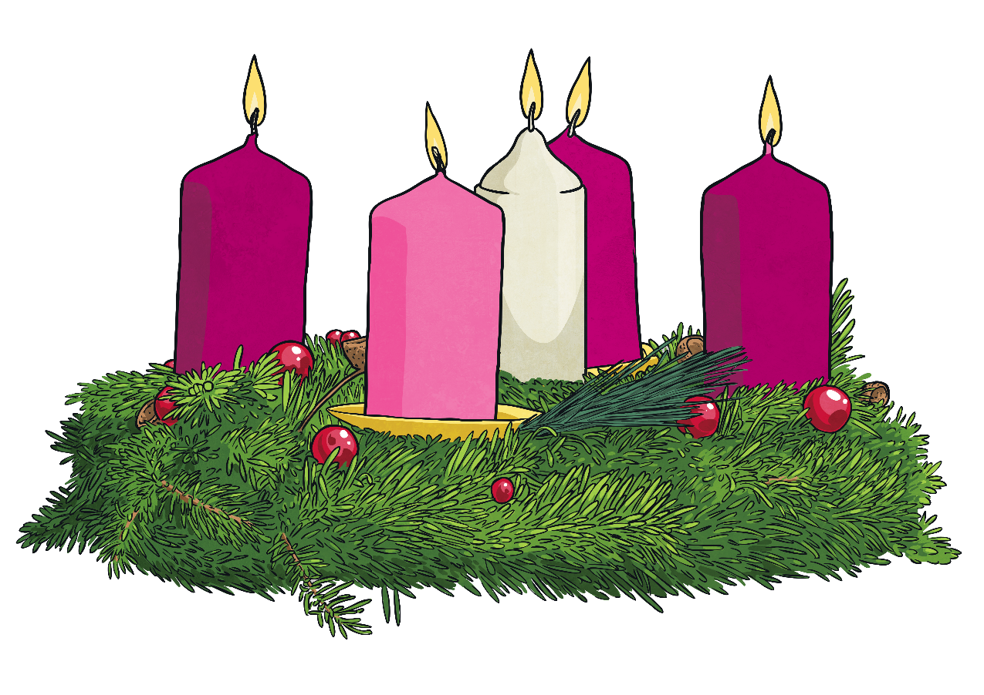
What is Advent?
Advent is the season of waiting and preparing for the celebration of the birth of Jesus.
The term advent is a version of a Latin word that means coming.
This is a time spent preparing and remembering the real meaning of Christmas. It is a time that begins with the Sunday nearest to the feat of St Andrew the Apostle (30th of November) and falls across 4 Sundays.

Slide 3

What are the Four Weeks of Advent?
There are four weeks of advent, with a traditional theme for the advent Sundays.
God’s people – The Candle of Hope. A time for celebrating the hope in Jesus Christ.
The old testament prophets – The Candle of Peace. A time for celebrating the peace found in Jesus Christ.
John the Baptist – The Candle of Love. A time to celebrate the love for Jesus Christ.
Mary the mother of Jesus – The Candle of Joy. A time to celebrate the joy found in Jesus Christ.

Slide 4
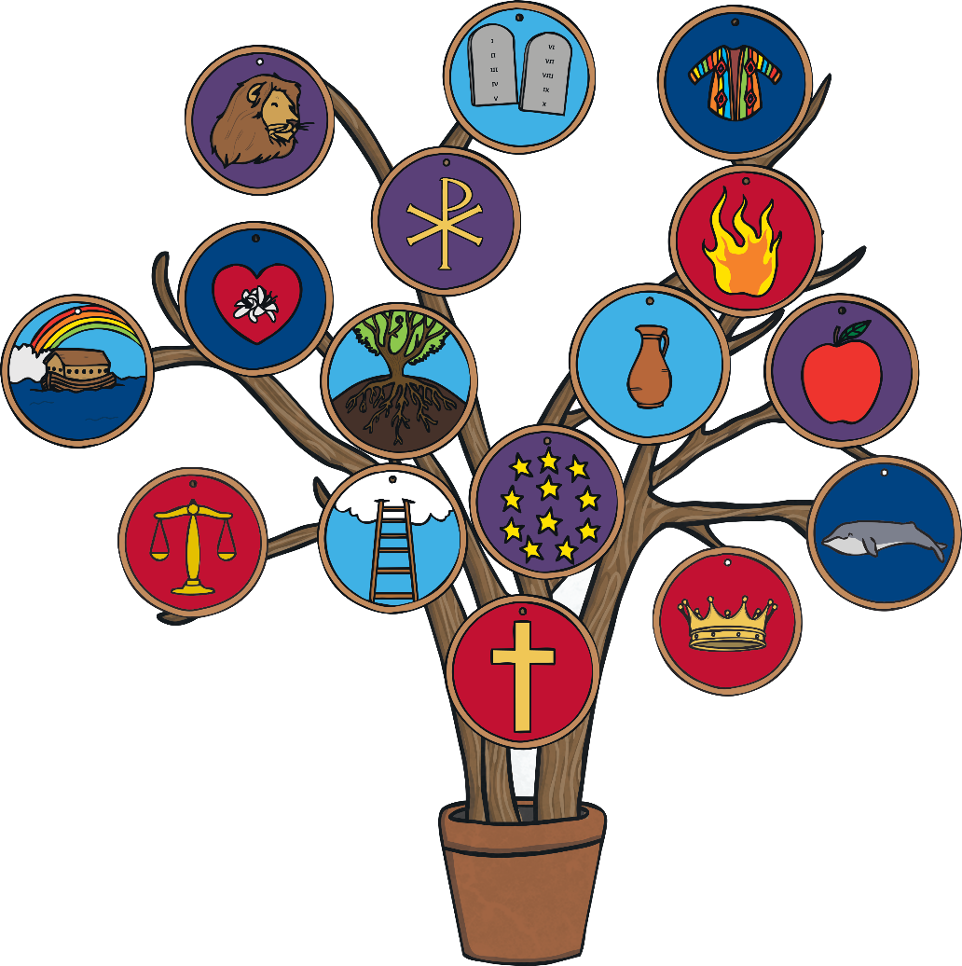
What is a Jesse Tree?
A Jesse Tree is a decorative tree that each day during Advent has an ornament hung on it that symbolizes the story of how God prepared for Jesus to be born.
The Jesse Tree is divided into 3 main parts.
A tree
Symbolic ornaments
Passages or scripture readings that go with the ornaments.

Slide 5

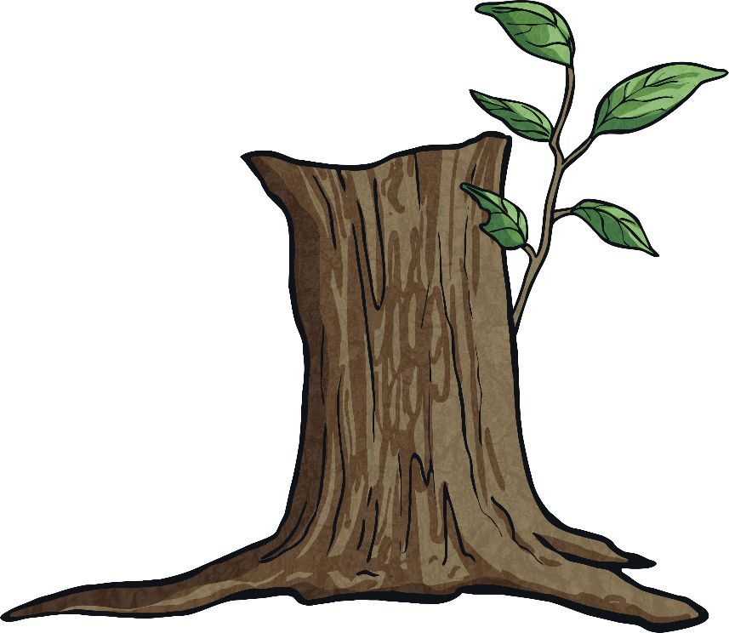
The Name
The name the Jesse Tree comes from Jesse, who was the Father of the King David.
Isaiah 11:1: “A shoot will spring forth from the stump of Jesse, and a branch out of his roots.”
A branch is a sign of new life and new beginnings, Jesus was a descendent of King David and Jesus is a new branch.

Slide 6
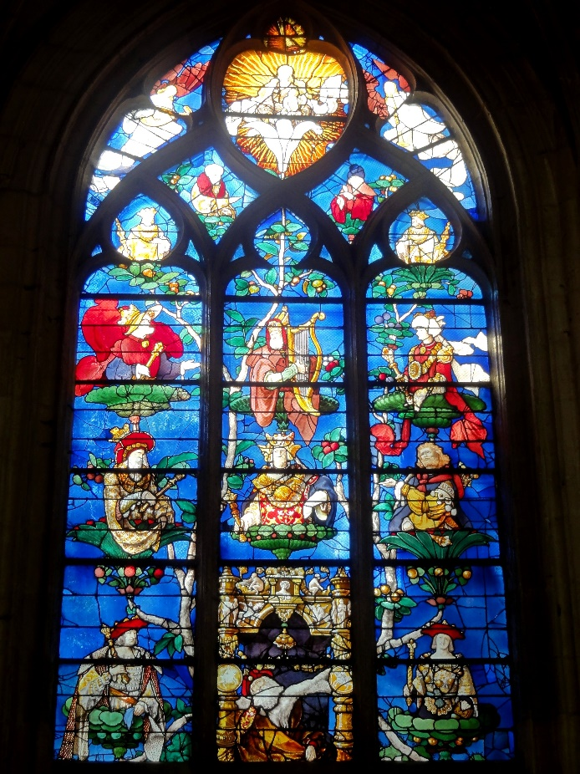
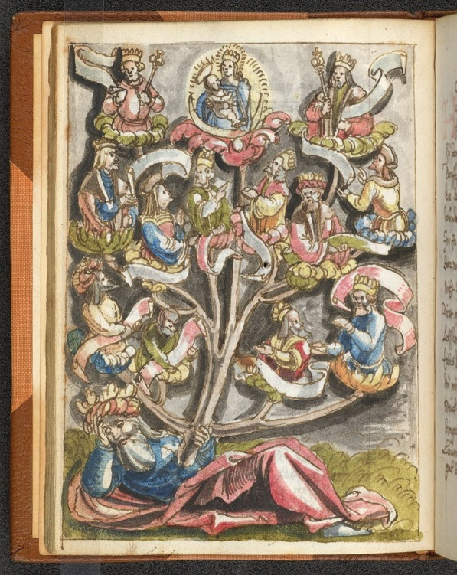
Growth of the Jesse Tree
The first Jesse Trees were put in churches in the form of large carvings, tapestries or stained glass windows. They were there to help illustrate the Bible for those who were unable to read or write.

Slide 7
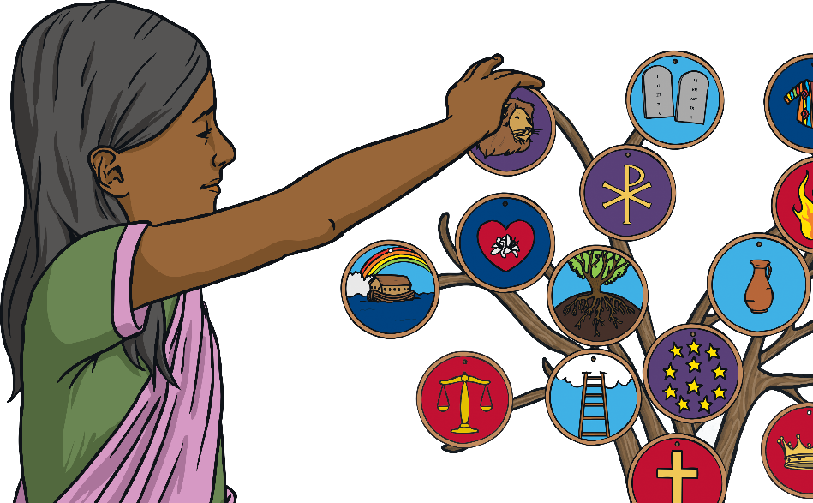
Growth of the Jesse Tree
These days the Jesse Tree is used in a similar way to an Advent Calendar. Each day through advent, or each Sunday through advent, a decoration or ornament that tells a story from the Bible is hung on one of the branches. By Christmas, the tree will be full of illustrations that represent people and events that record the promises of God from the Old Testament.
The Jesse Tree helps to connect the custom of decorating the Christmas trees to the creation and birth of Jesus and helps to connect the advent season with the 4000 year history of the faithfulness of God.

Slide 8
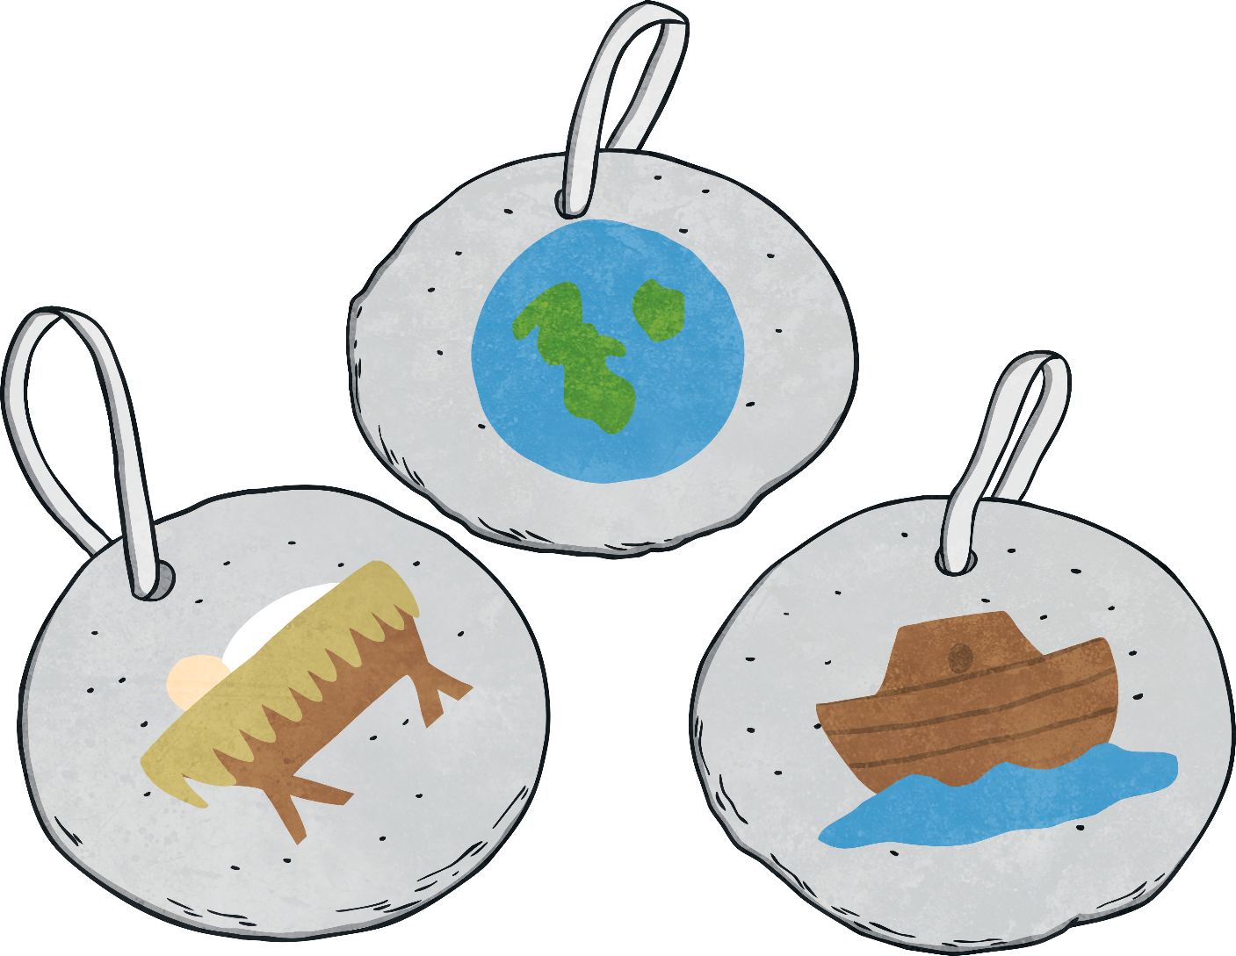
The Ornaments
As each ornament is added they are accompanied by an explanation of the symbols and a verse of Scripture from the story the ornament represented.

Slide 9
Reading
Isaiah 11:1-2
God has a plan for everything. Long before Jesus was born lived a man named Jesse. Jesse had seven sons; the youngest was named David. When David grew up, he became a great king of Israel. God had a plan for Jesse and for his son David, even before they were born.
Jesus was also part of Jesse and David's family tree, born many, many years after David. People waited a long time for the birth of the saviour. The season of Advent is a season of waiting for us, too. We wait for Christmas, the day we celebrate the birth of Jesus.
It is hard to be patient, especially when we are waiting for something wonderful like Christmas! But it is important to learn to be patient, and to trust that God has a plan for us, too.
Discuss what ornament could be made to represent this reading.

Slide 10
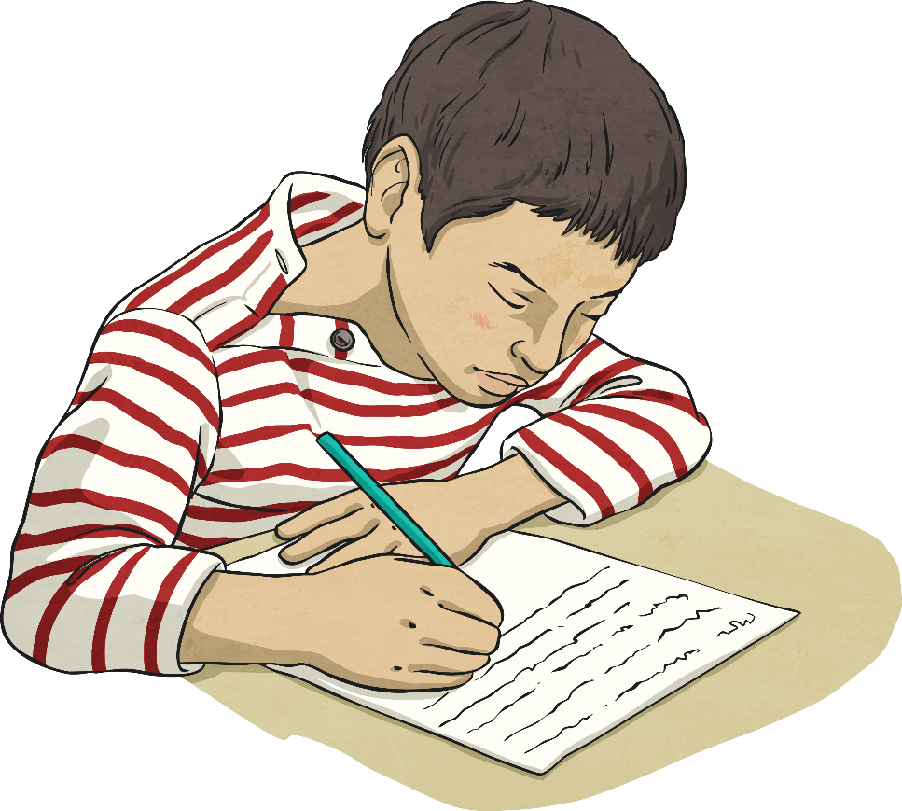
Your Turn
What are some other passages that you feel would be appropriate for using on the Jesse Tree?
Complete the worksheet and then work as a class to decide on the passages you would use for a class Jesse Tree.

Slide 11


