Slide 1
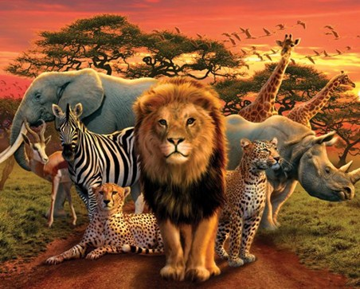
Africa
Insert Picture

Slide 2
Prior Learning
Who can describe any features of Africa?
What regions of Africa can we recall?

Slide 3
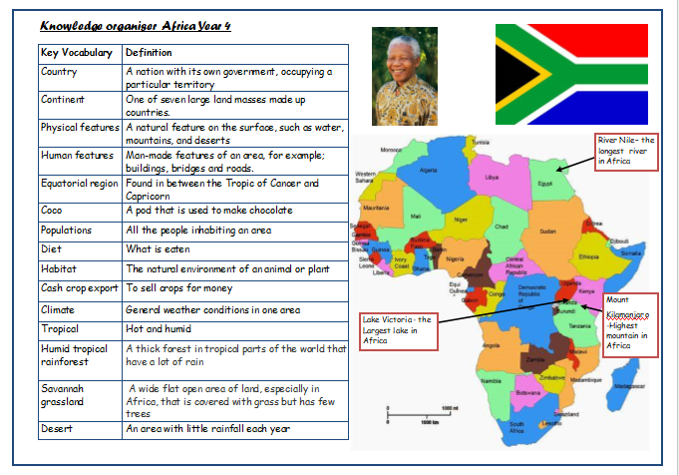
Our Knowledge Organiser

Slide 4
Key Vocabulary
Country
Landscape
Savannah
Tropical rainforest
Savannah grassland
Desert
Habitat
Diet
Appearance

Slide 5
L.O: to know some of the animals that are indigenous to Africa.
Success Criteria: I can name animals found in Africa. I can describe the habitat. I can share information about an African animal with my partner.
Here are today’s key words:
Indigenous
Habitat
Landscape
Diet
Appearance

Slide 6
Talk Task
What animals come from Africa?
What does indigenous mean?
https://www.youtube.com/watch?v=u0EN8itpQZo

Slide 7
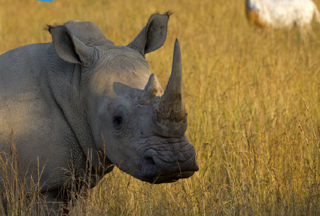
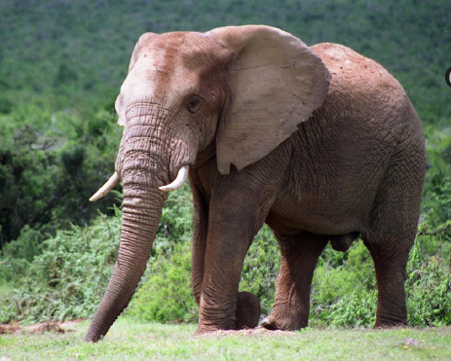
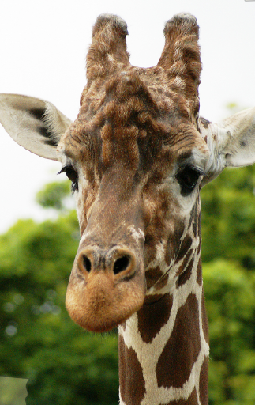
Teach
Where do they live?
What do they eat?
What do they look like?

Slide 8
Teach
Rhino’s can live in dense rainforests and swamps to grassy plains.
Elephants can live in grasslands, woodlands, rainforests, and even deserts.
Giraffes usually live in Savannahs, open woodlands and grasslands.

Slide 9
Teach
What types of landscape are there in Africa?
Where might a mountain gorillas live?
What would a camel eat?
What does a snake look like?
Where would termites be found?

Slide 10
Task
L.O: to know some of the animals that are indigenous to Africa.
Success Criteria: I can name animals found in Africa. I can describe the habitat. I can share information about an African animal with my partner.
To create an information sheet about an animal from Africa.
It should include:
habitat of the animal,
countries where this habitat/animal can be found,
appearance,
diet,
fascinating facts

Slide 11
Task
L.O: to know some of the animals that are indigenous to Africa.
Success Criteria: I can name animals found in Africa. I can describe the habitat. I can share information about an African animal with my partner.
http://www.africaguide.com/wildlife/index.htm
https://www.activityvillage.co.uk/african-animals
https://www.africaguide.com/wildlife/index.htm

Slide 12
And finally…
In preparation for next lesson please research holidays in Africa. This may include internet research or visiting a travel agent to get a brochure.

