Slide 1
Week 12
OUTCOME: To plot a narrative.

Slide 2
This week’s spellings
though
although
dough
through
breakthrough
thought
bought
brought
fought
ought

Slide 3
L.O: to write a diary entry in role as a character from a story
Word of the day – abandoned I planted in abandoned parks and gardens with broken glass. What does the word mean?

Slide 4
Investigate the word of the day.
I planted in abandoned parks and gardens with broken glass.
Write a sentence using the adjective abandoned.
Can you change the root into a verb and use that in a sentence?

Slide 5
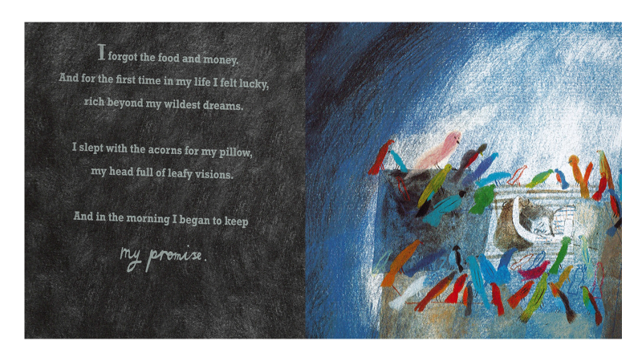

Slide 6
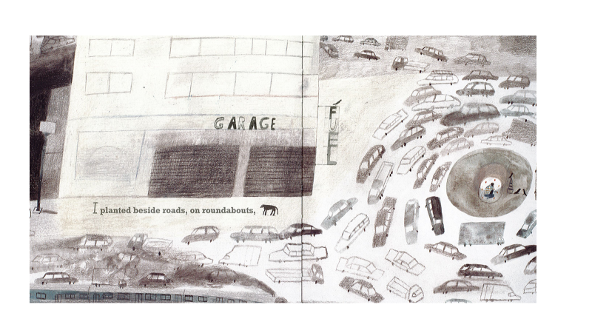
.

Slide 7
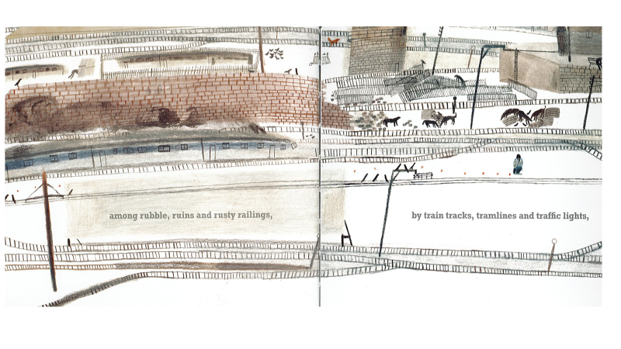

Slide 8
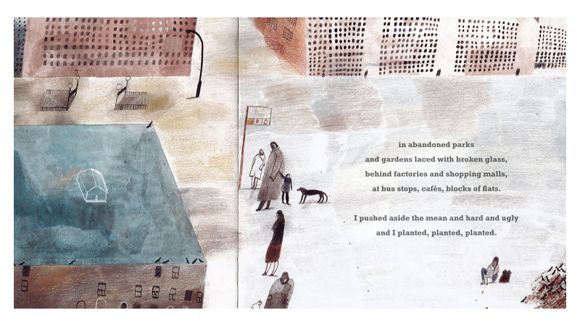

Slide 9

L.O: to write a diary entry in role as a character from a story
Write a diary entry.
Focus on capital letters and full stops and conjunctions to link ideas.
Think of different ways of starting sentences other than ‘I’.
Sentence openers:
• fronted adverbials,
• prepositions,
• a verb
Write in present/present tense except for when writing about the theft which will be past tense as it happened ‘last night’

Slide 10
Monday 30th November
Last night my life changed!
I know that it sounds dramatic but my encounter with an old lady and her handbag altered me. I am not used to frail elderly women hanging on to their possessions for dear life; she should have been an easy target! To and fro we pulled that bag and finally she made me promise to plant them. Can you imagine what I thought of that!
Later, when I opened the bag it was full of acorns. I don’t feel disappointed. I feel changed.
Keeping my promise is the most important thing. I have been planting all over the city, beside roads, on roundabouts, in parks and behind factories.

Slide 11
Day 2
Word of the day-parched What does the word mean? The gritty wind still scratched the parched, cracked streets. Can you make a simple sentence using the word? Explore synonyms for parched.

Slide 12
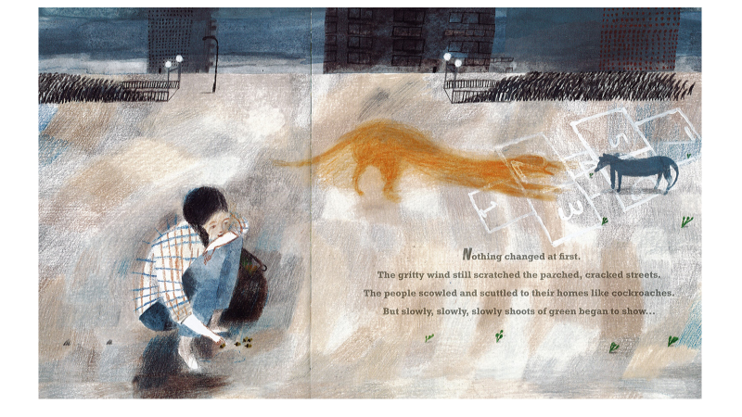

Slide 13
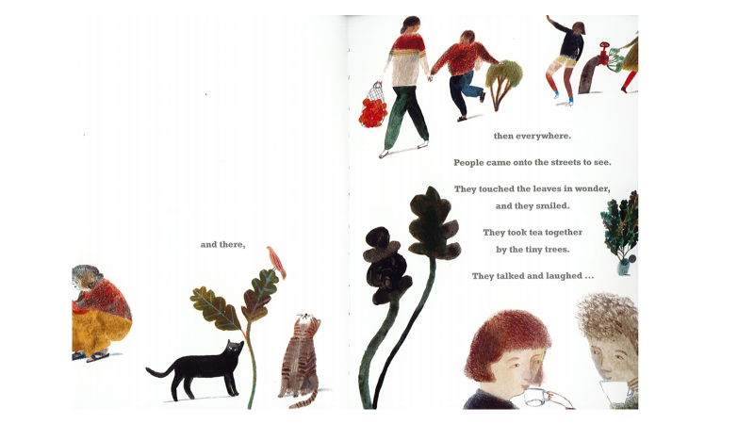

Slide 14
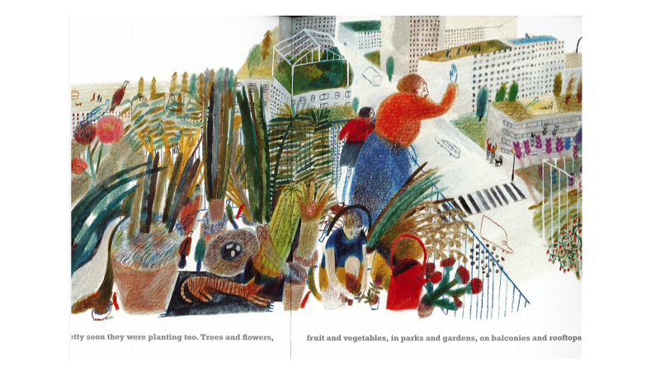

Slide 15
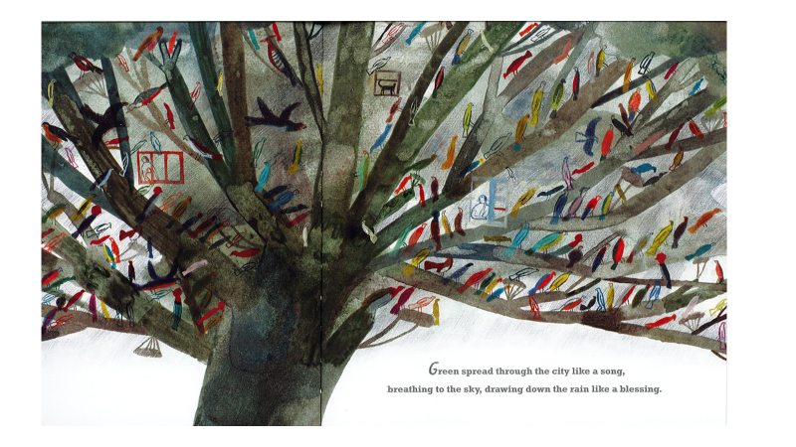

Slide 16
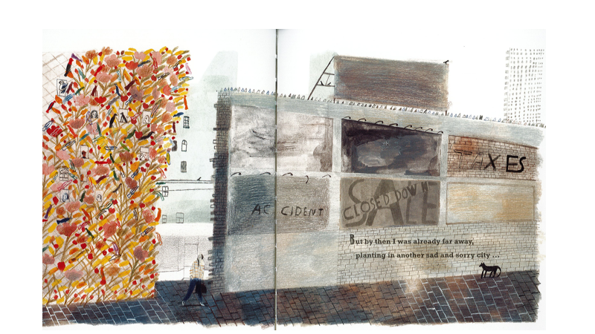

Slide 17
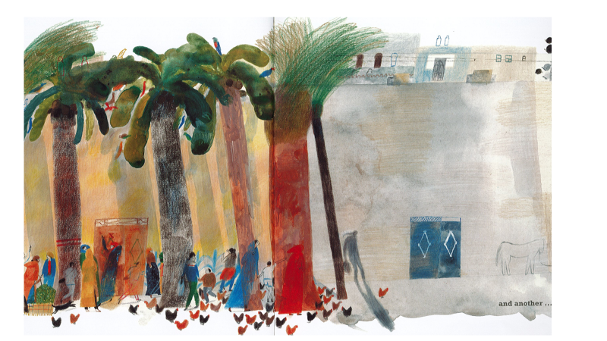

Slide 18
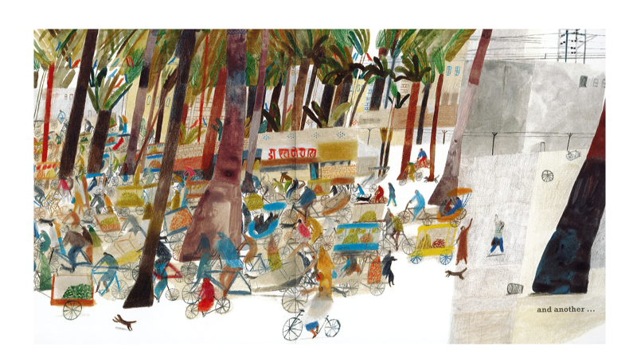

Slide 19
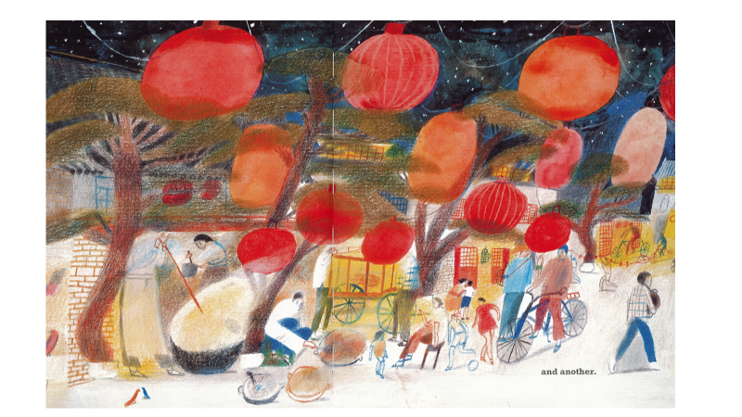

Slide 20
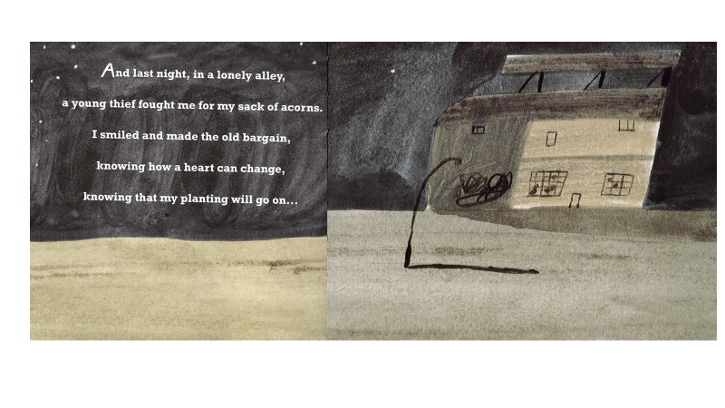

Slide 21
L.O. to plot the story.
Review the story. Quickly story map the sequence of events. How did the story open?
What is the problem?
How does that build up?
What is the most exciting bit/the climax?
How is the problem resolved?
How does the story end?
Write the plan on a Mountain story planner.

Slide 22
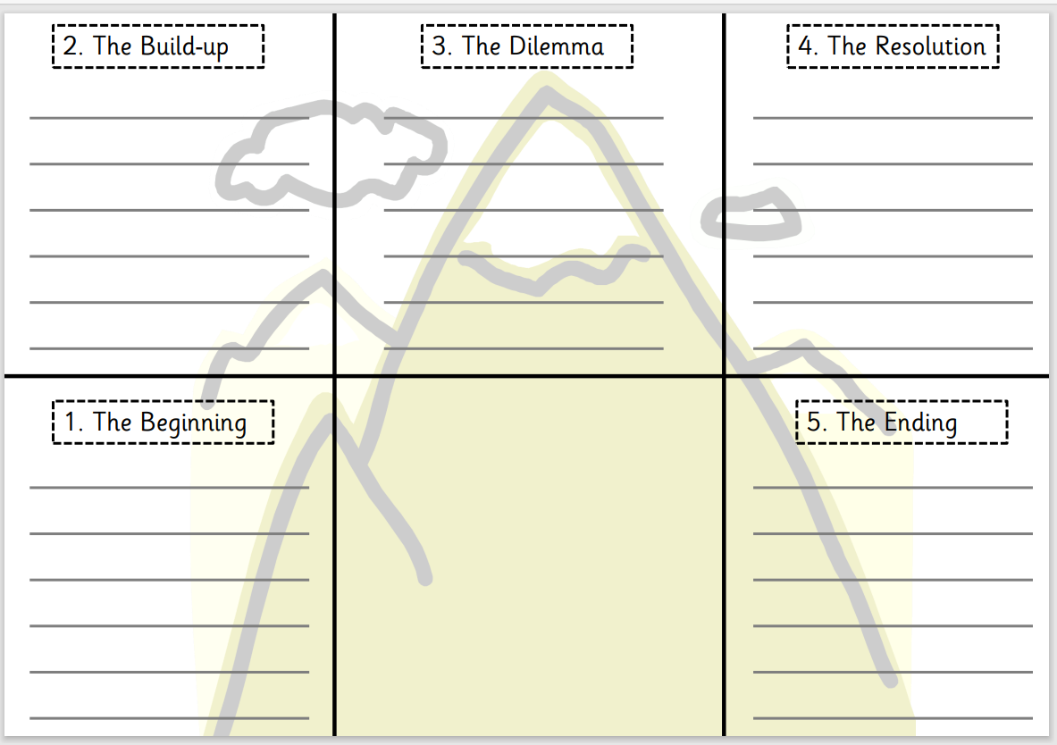
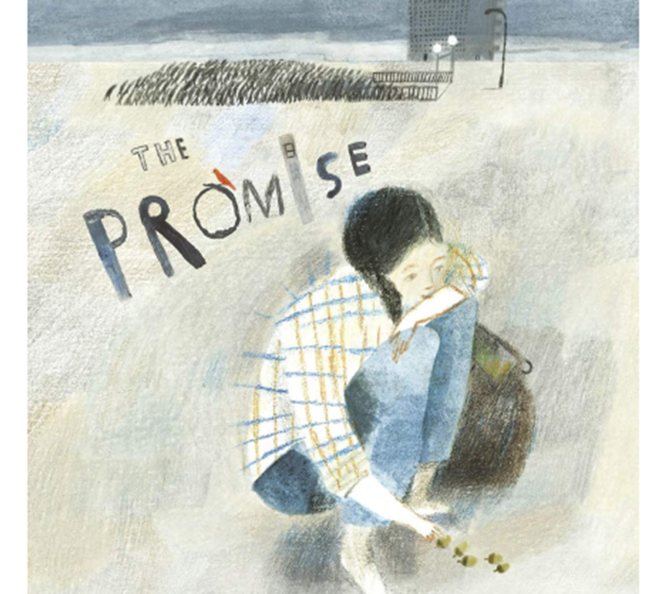

Slide 23
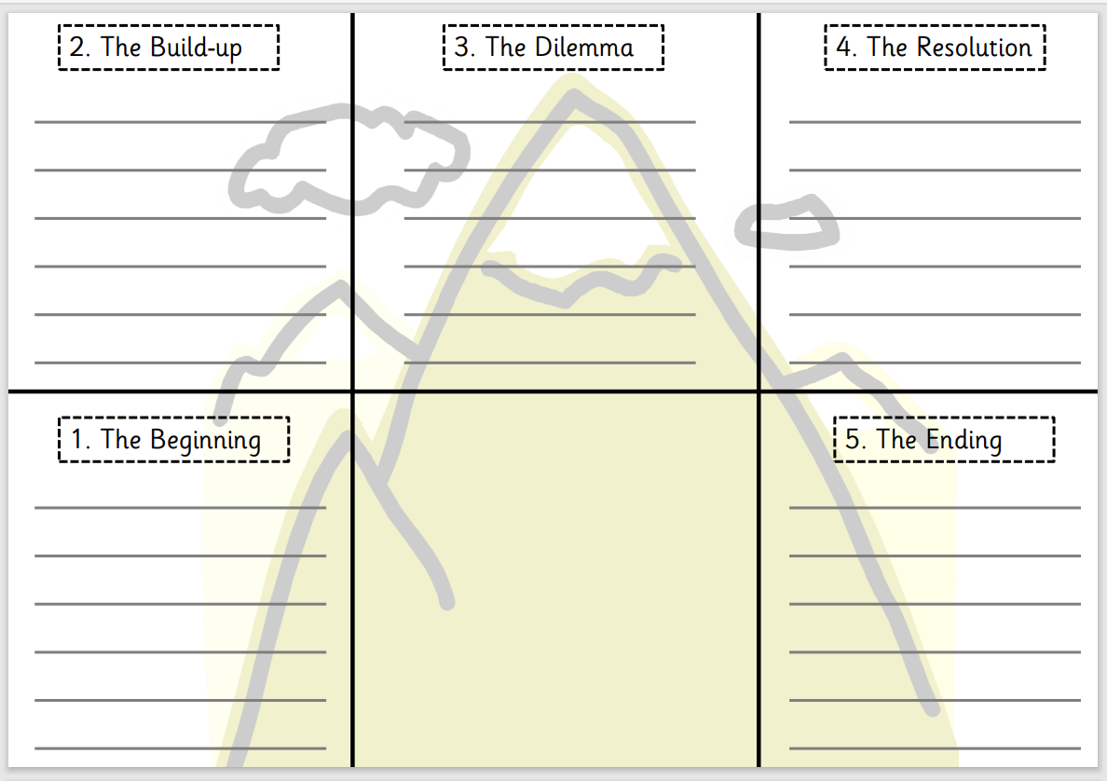
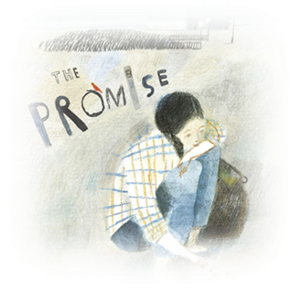
A young girl grew up alone in the city.
She had become as ugly and mean as the streets she lived on.
The girl stole to stay alive and didn’t care about her victims.

Slide 24
Day 3
Word of the day- visions “I slept with the acorns for my pillow, my head full of leafy visions.” Can you write a sentence using the word of the day.

Slide 25
LO: to write an opening and build up for a narrative.
Look at the opening structure.
Change the opening of the story; writing from the mysterious old woman’s viewpoint.
Build a kindly character living in a dark city.
Think about where the lady might live. How has the city changed?
Try using these sentence starters:
Each day…each night…Strangers snatch and steal. One day I was…
Why was the old lady out at night?
What do you think her home is like?
Does she know her neighbours?

Slide 26
Day 4
Word of the day- bargain “I smiled and made the old bargain, knowing how a heart can change, knowing that my planting will go on.”

Slide 27
Word of the day- bargain
What does bargain mean?
Can it be used in different ways?
This is a homophone. Can you think of any words which like this homophone are spelt the same way and have more than one meaning?

Slide 28
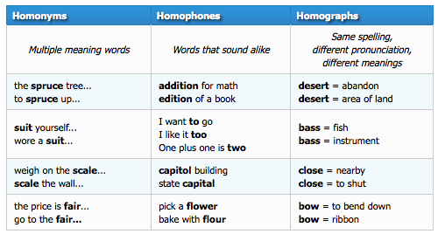
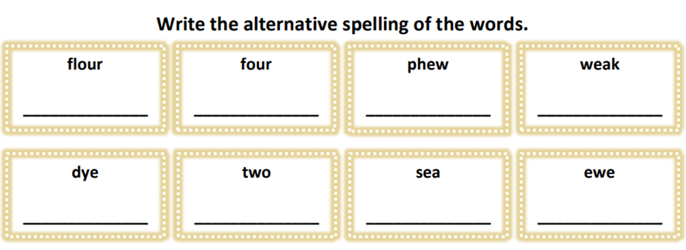
Homophones
Same spelling different meaning

Slide 29
LO: to plot and write the climax and resolution Describe your encounter with the young thief. Explore tension. Describe the new world of hope that the planting created. Include 3 adjectives describing colourful, charming, delightful, thoughtful, compassionate… A simile. A bright hopeful colour. 2 powerful verbs. What do you want to happen? Look back at the positive images in the book. Quickly mind map outcomes/changes we would like to see in the world. • A cared for environment. • Community and care for the elderly, frail, lonely. • A beautiful, happy, free world. • Fair sharing of resources – end to poverty and homelessness. • Kindness.

Slide 30
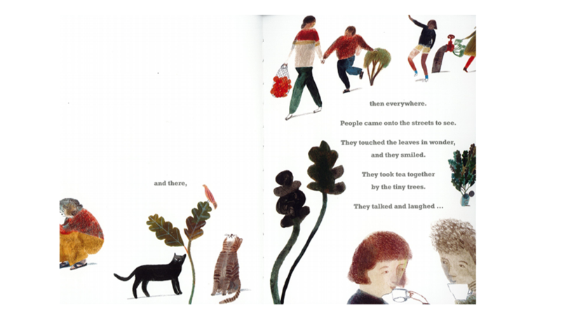
Write the end using the structure and sentence openers from the book:
At first… First here… then everywhere…But by then… And one night.

Slide 31
Day 5
Words of the day-transformation
What type of word is this?
Can it be changed into a verb?

Slide 32
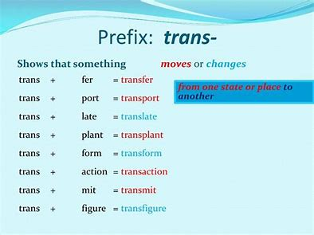
Spelling Task
Explore the prefix ‘trans’.
What is the route word?
What other words can you think of that begin with this prefix?

Slide 33
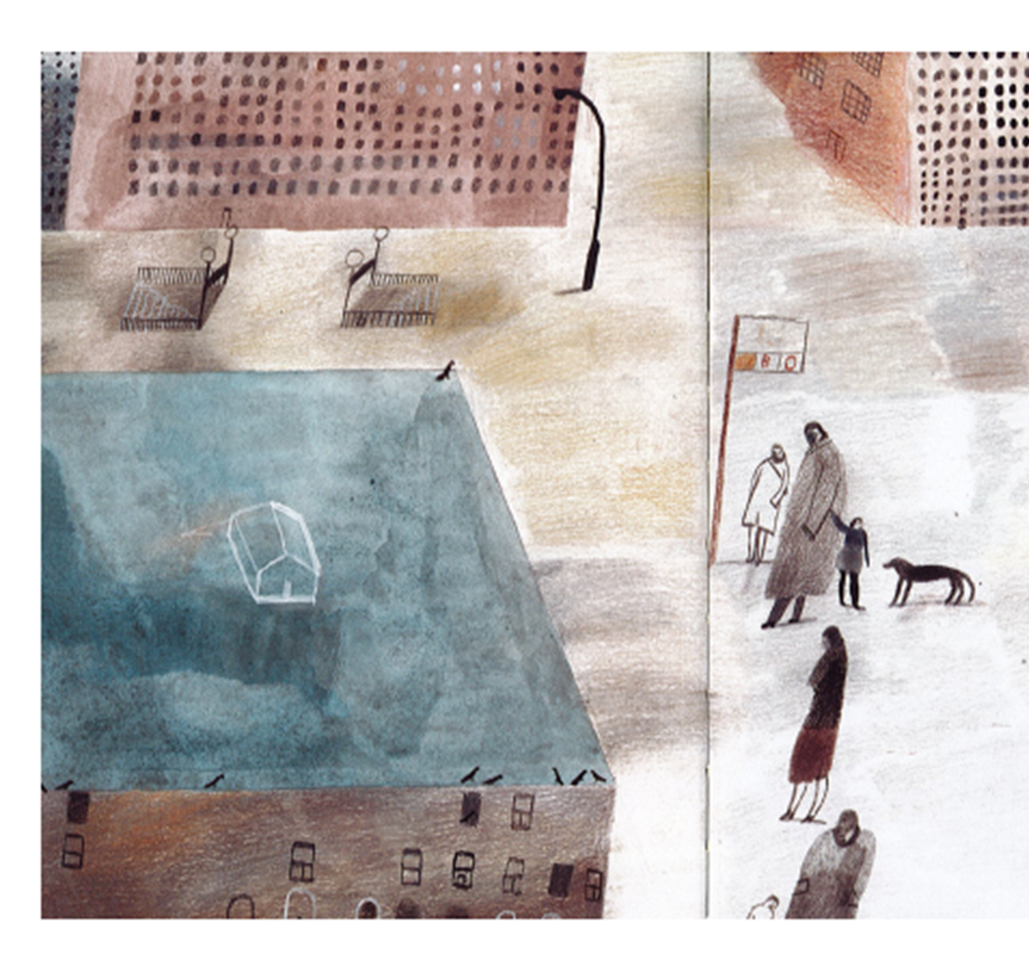
L. O. to read, edit and write a resolution
Finish with advice from your character. How can we care for our own environment and crucially the people within it?
Change the resolution “If we don’t change the way we live our world will become…”

