Slide 1
Spellings for week 23.1.2020
Group 1
musician
politician
electrician
magician
mathematician
dietician
statistician
technician
clinician
beautician

Slide 2
Week starting
23rd November 2020
OUTCOME: to write a description of a setting

Slide 3
L.O. to describe a setting using adventurous adjectives to describe a setting.
Word of the day – constantly A gritty, yellow wind blew constantly. What does the word mean? Can you think of an alternative adverb?

Slide 4
Adjectives changed to Adverbs A gritty, yellow wind blew constantly
constant -ly continuous-ly regular-ly repetitive-ly frequent-ly persistent-ly incessant-ly endless -ly ceaseless -ly
Changing adjectives to adverbs
Change the "-y" at the end of adjectives to an "-ily" in order to create an adverb. The change is made to accommodate the awkward "-y" at the end of the adjective. For example, "ready" would become "readily". Consider the new adverb before using it. You can change words like "hard" and "late" into adverbs "hardly" and "lately".

Slide 5
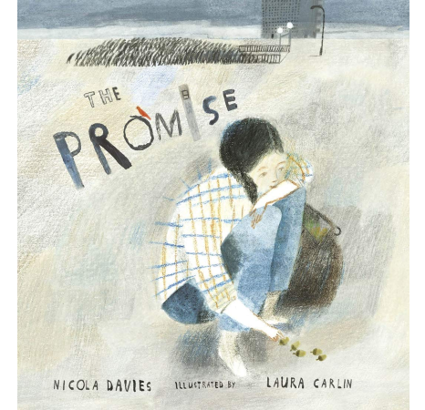
L.O. to describe a setting using adventurous adjectives to describe a setting.
Look at the front cover of
'The Promise’.
Make inferences/predictions based on the following questions:
What do you know about the story?
What clues in the picture tell you this?
What does the illustration tell you about the mood of the story?
Where is it set?
What do you think 'The Promise' might be? Who makes it and why?

Slide 6
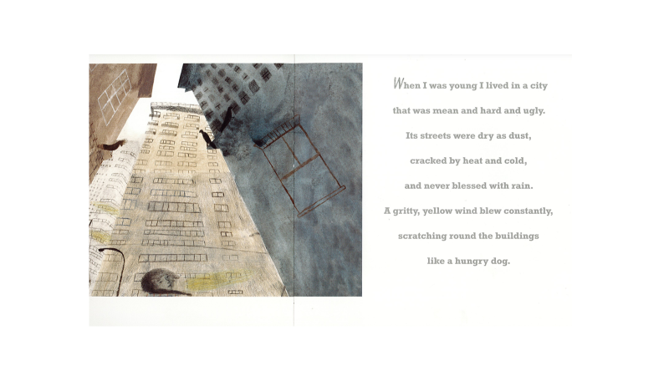

Slide 7
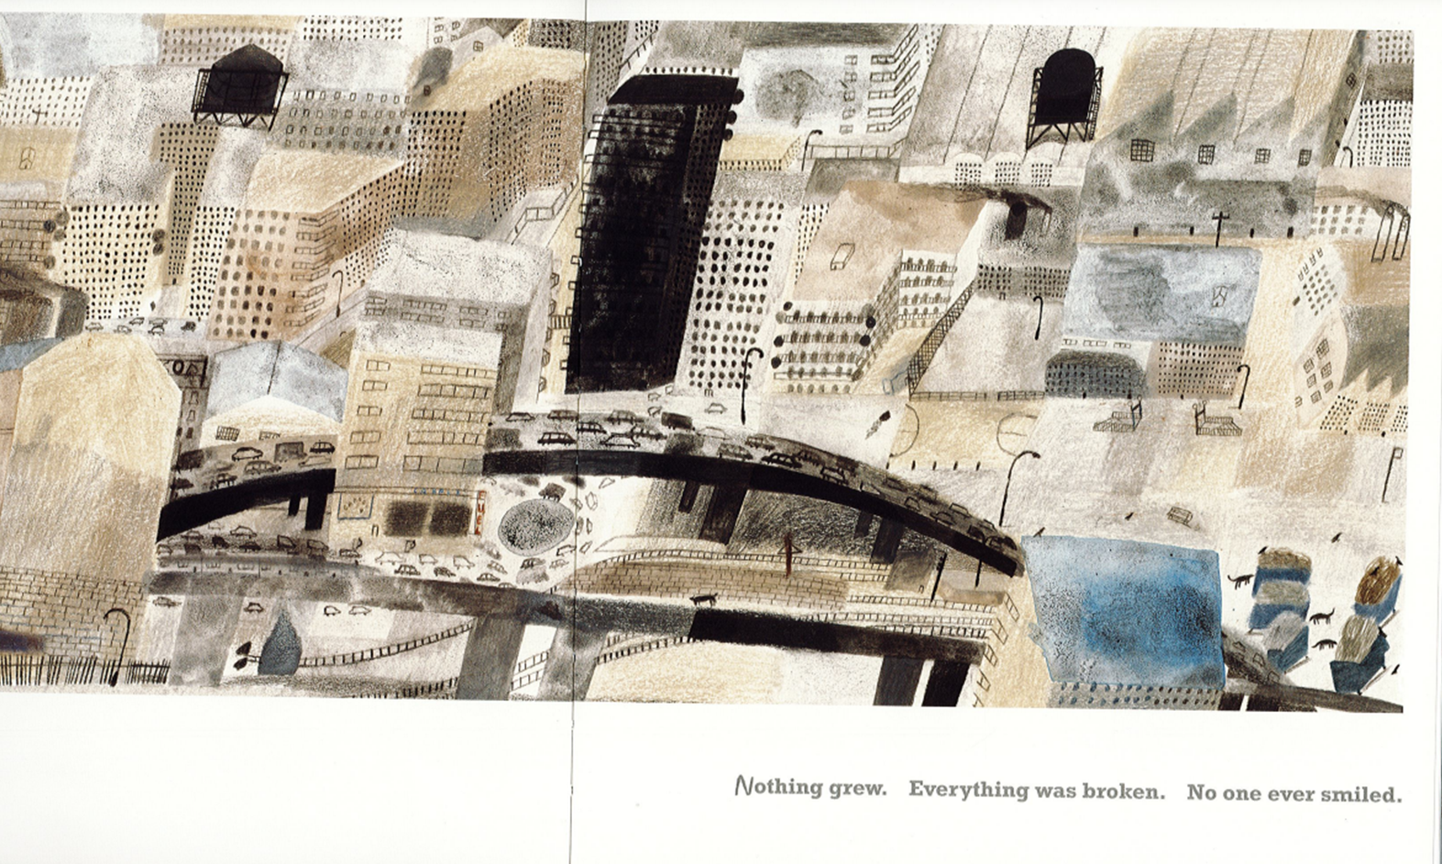

Slide 8
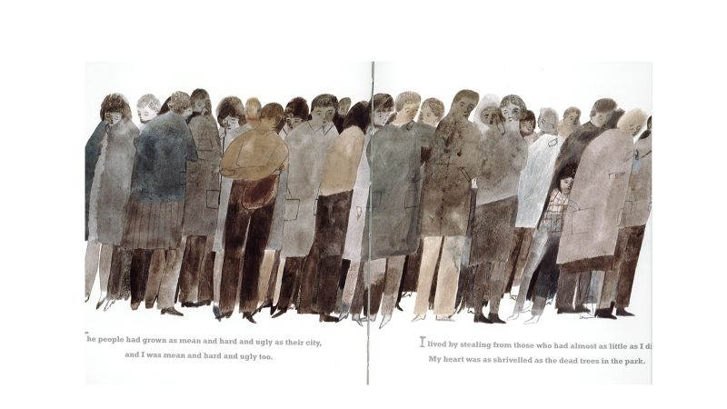

Slide 9
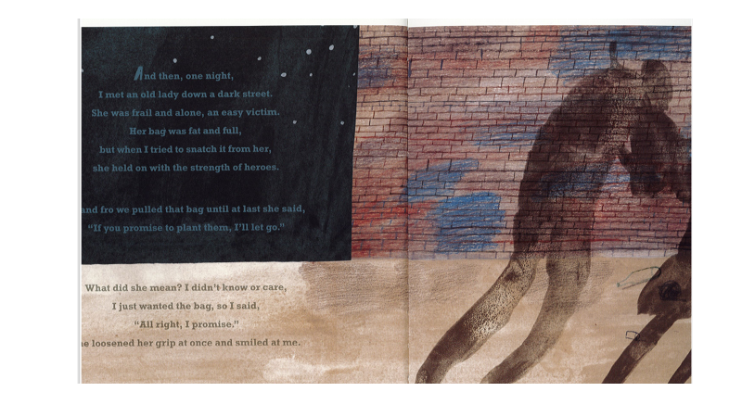
.

Slide 10
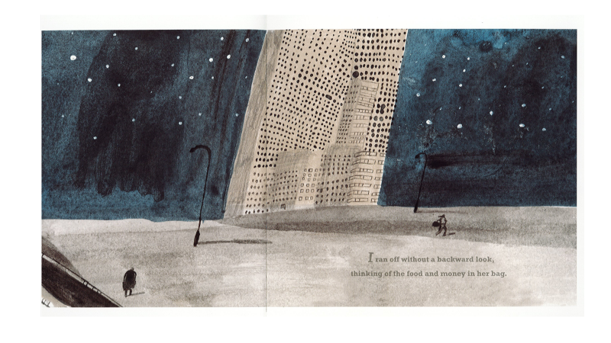

Slide 11
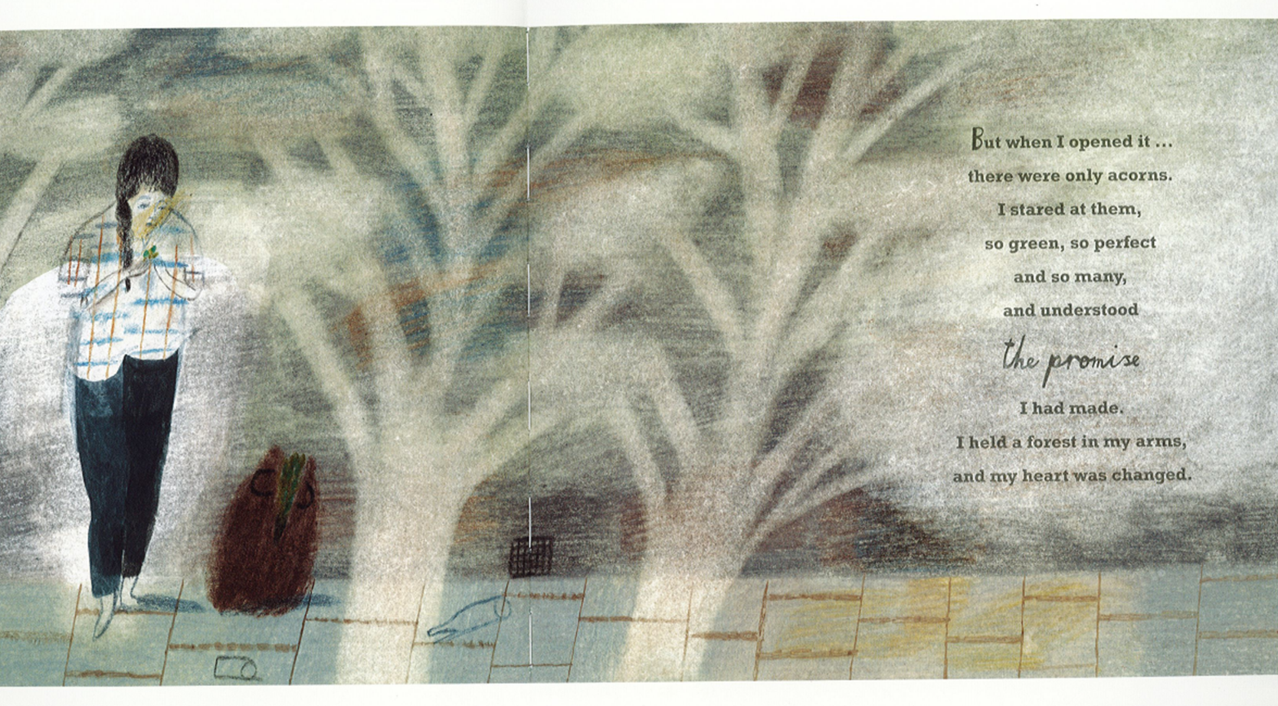

Slide 12
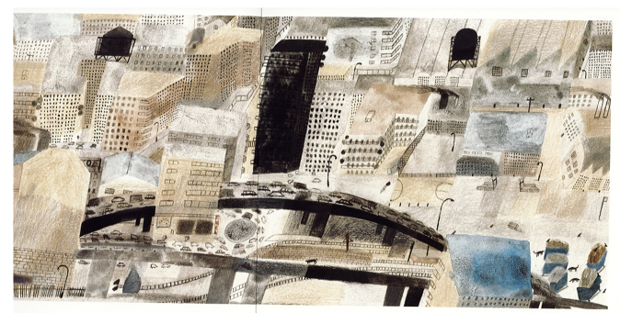
Setting of the city
Think about the setting. Would you like to live here? Why/Why not? What is the setting like? Pick out effective adjectives and similes the author has used to describe the setting.
mean
hard
ugly
dry
dusty
windy
“Scratching round buildings like a hungry dog.”
Now add some of your own adjectives and similes.

Slide 13
Day 2
Word of the day-shrivelled What does the word mean? My heart was as shrivelled as the dead trees in the park. Can you make a simple sentence using the word? Now try writing a complex sentence.

Slide 14
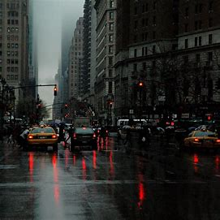
Review adjectives collected yesterday.
Use some of the adjectives and write similes.
“My heart was a shrivelled as the dead leaves in the park.”
horrible alarming awful unkind uncaring shabby miserable gloomy
As miserable as a broken heart.
The city was mean, and almost as gloomy, as a rainy day.

Slide 15
L.O. to write a free verse poem You are going to write a free verse poem to describe the setting. Use the similes, adjectives and adverbs to describe mean, hard ,ugly city.. I grew up in a city… The sky scrapper buildings cast dark shadows, Callous, unkind; miserably lonely, A tedious, arid landscape, desert of concrete, Gusty damp squall, blowing confusion.

Slide 16
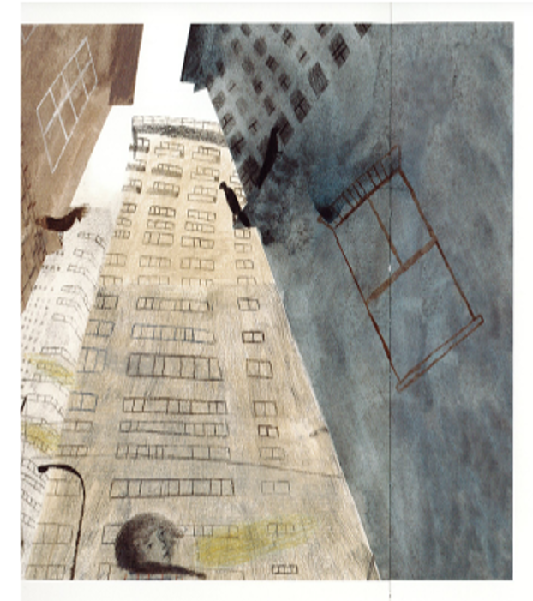
Disordered, confusion; in the ugly city
People march like ants on the pavement
Lonely, isolation; in the ugly city
Cranes like giant monsters hovering
Gusty, windswept storms; in the ugly city.

Slide 17
Day 3
Word of the day-frail She was frail and alone, an easy victim. Can you write a sentence using the word of the day.

Slide 18
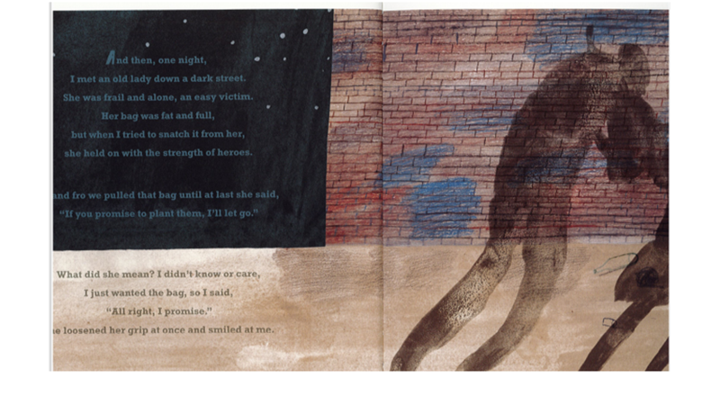

Slide 19
L.O to use fronted adverbials when describing a setting. We will be using all the descriptive vocabulary we have collected, to write a description of the setting. Remember the lessons we did using 'fronted adverbials' (which can include time connectives, adverbs and prepositions) in this case we will be using fronted adverbials to describe the setting. Write 5 sentences by inserting fronted adverbials. Remember to use a comma - we place a comma after the fronted adverbial because if you took that clause off the sentence would still make sense. e.g. 'All around the city, grime and dirt clung to the surfaces.’

Slide 20
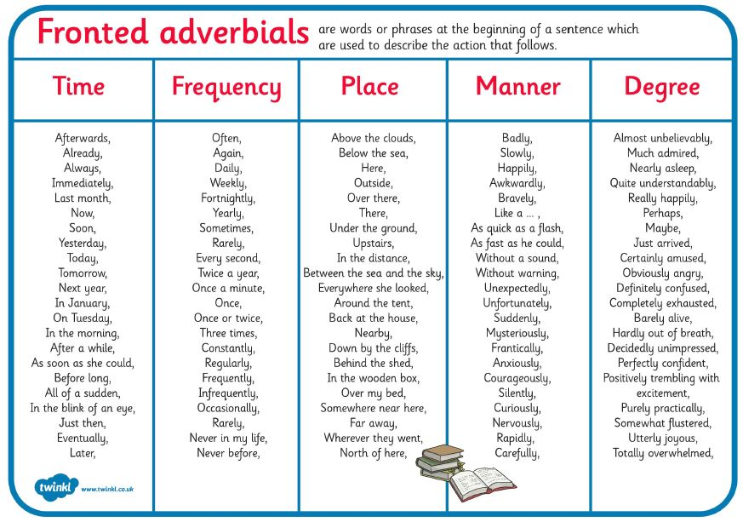

Slide 21
Day 4
Words of the day-victim
She was frail and alone, an easy victim.

Slide 22
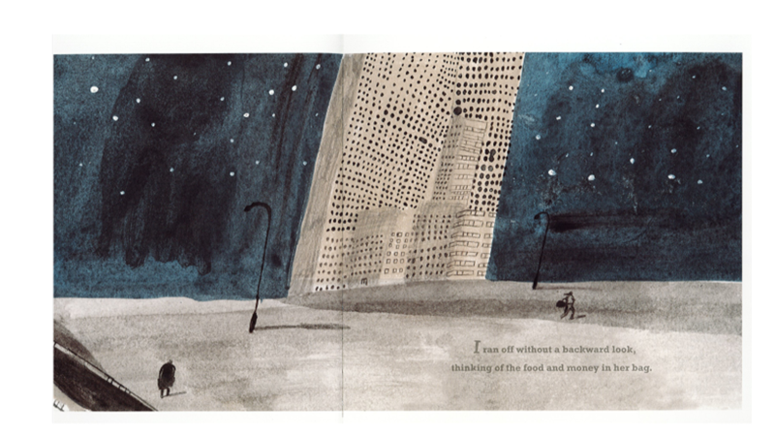

Slide 23
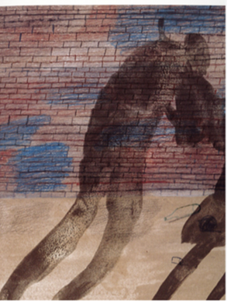
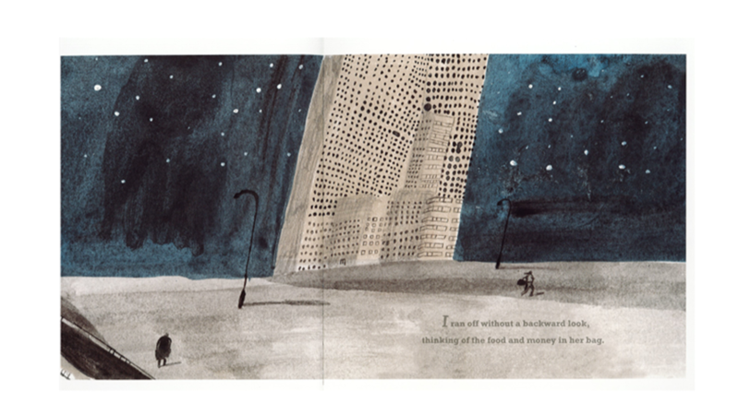
L.O. to focus on a character’s emotions
Look at the shadow image below.
What do you think is happening here? How can you tell? What clues in the picture make you think that?
Why do you think the girl is stealing from the lady?
What do we know about her life that might make someone behave in this way?

Slide 24
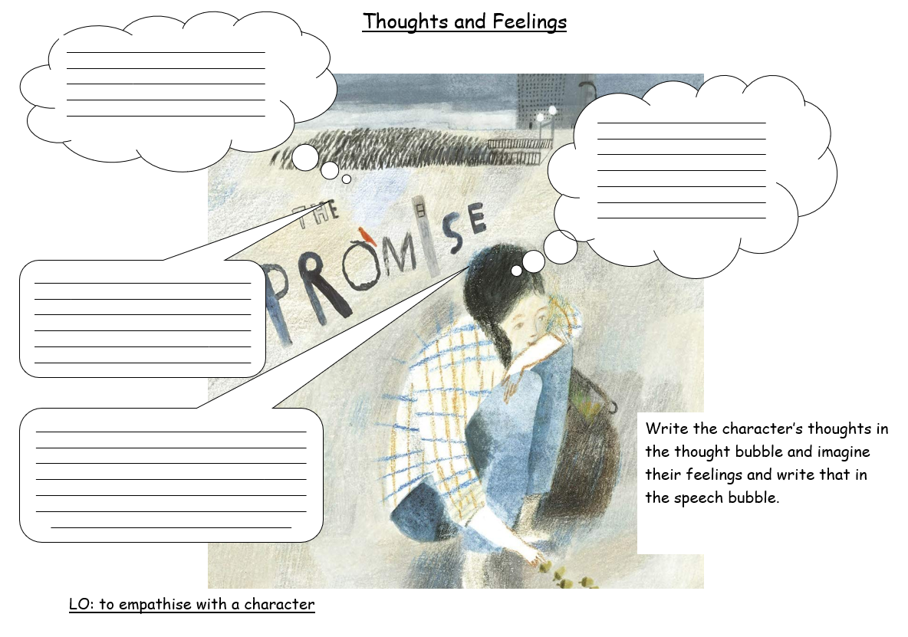
Re read the slides 5-10, up to ‘and my heart was changed’. Complete the reading and write the thoughts and feelings of the girl in the story.

Slide 25
Day 5
Reading Comprehension
Word of the day-heroes

Slide 26
Reducing Air Pollution in our Cities
The number of people now living in cities across the globe is as high as it has ever been. With the UN predicting this figure will rise from the current level of 55% to almost 70% in the coming decades.
Increased human density in these areas brings with it many potential environmental issues. With pollution being one of the most concerning.
This pollution comes in many forms, from plastic and other waste littering the streets, to toxic chemical substances entering waterways. But perhaps one of the most worrying (in terms of public health) is the issue of air pollution.
According to the World Health Organization (WHO) around 3.8 million premature deaths are attributed to air pollution.
So how can we reduce air pollution levels in our cities? What inventions and innovations are appearing to help reduce this big environmental issue?
One of the solutions is to green up our cities as shown in Nicola Davies book ‘The Promise.’ Where there is limited space this can be done vertically.
1) Vertical Forests
Vertical forests may look like the work of science fiction, but thanks to Italian architect Stefano Boeri the first vertical forest towers, the ‘Bosco Verticale’ were completed in Milan in 2014.

Slide 27
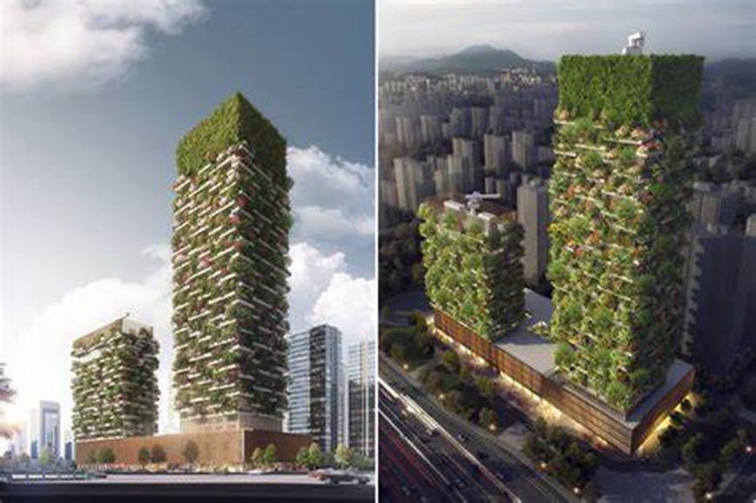
The two towers in Milan are residential flats but with a difference. They are covered in a total of 900 trees, 5,000 shrubs and over 11,000 other plants!
The vegetation can absorb carbon dioxide from the air, preventing the gas from causing further greenhouse warming in the atmosphere. But on top of this, plants and trees can act to filter airborne particles either by intercepting them or absorbing them through pores in the leaf surface.

