Slide 1
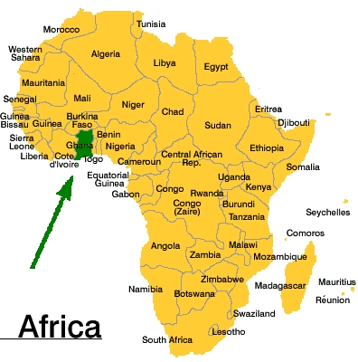
Africa
Insert Picture

Slide 2
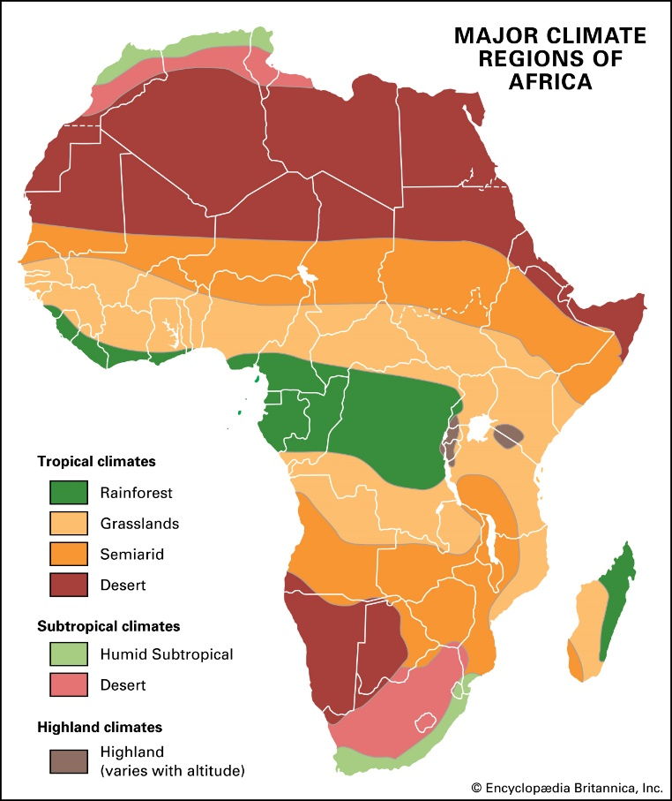
Prior Learning
What do you know about the climate of Africa?
Which areas of Africa are hot and wet?
How can we locate these areas using Lines of Latitude?

Slide 3
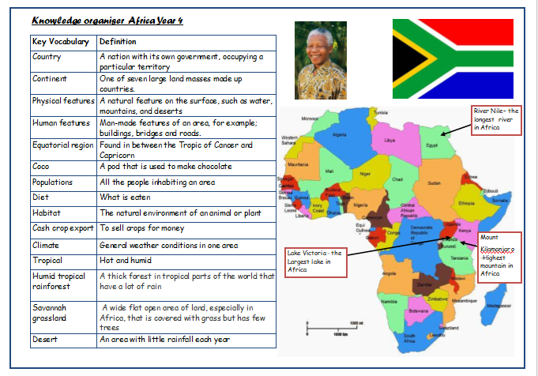
Our Knowledge Organiser

Slide 4
Key Vocabulary
Ghana
economy
cash crop
Fair trade
Equatorial
Tropic of Capricorn
Tropic of Cancer
Climate
Export
sustainable

Slide 5
L.O: to be able to describe the economy of the African country Ghana
Success Criteria: I can locate and explain the climate of Ghana I can name Ghana’s main export I can compare Ghana with other parts of Africa
Here are today’s key words:
export
Fair Trade
cocoa
rainforest
economy
cash crop
equatorial

Slide 6
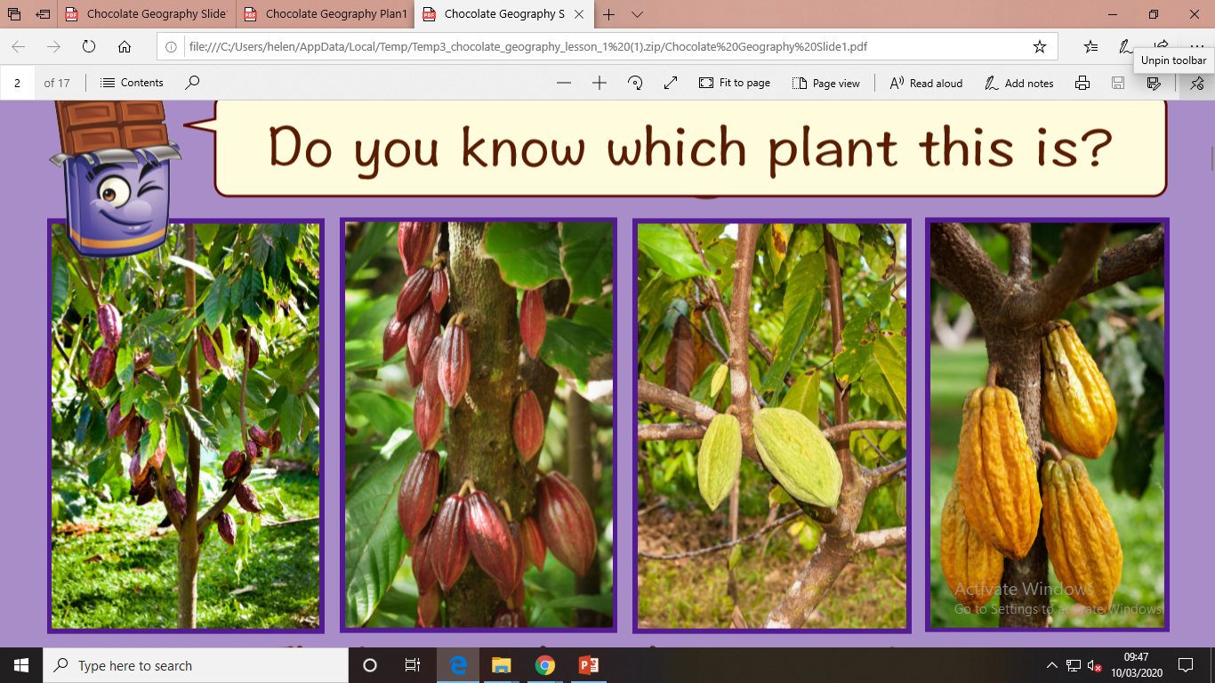
Talk Task

Slide 7
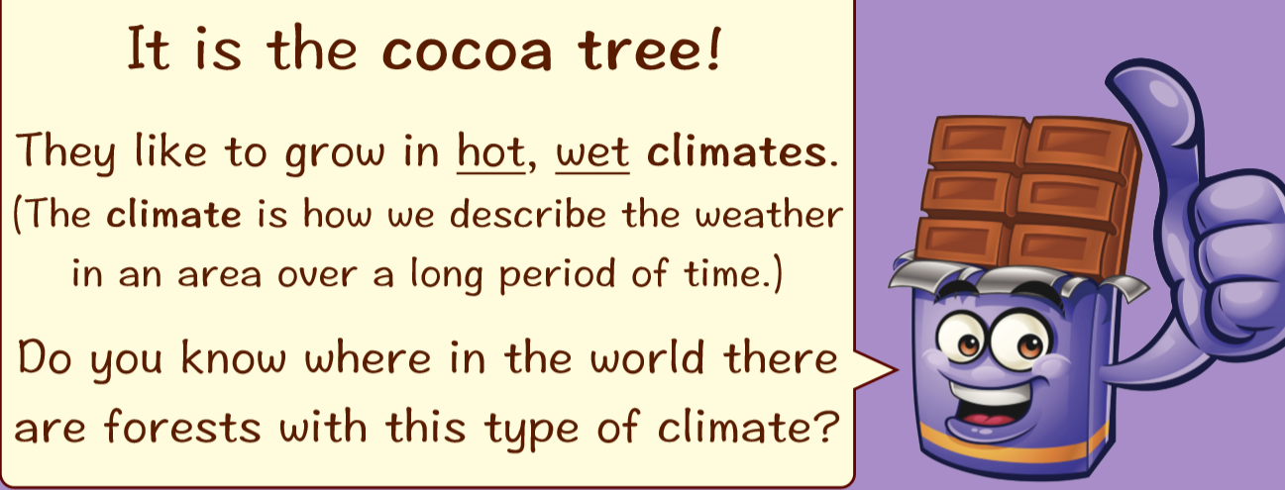
Teach
Text and pictures…
What other plants grow in this region?
What is the natural vegetation of the region?

Slide 8
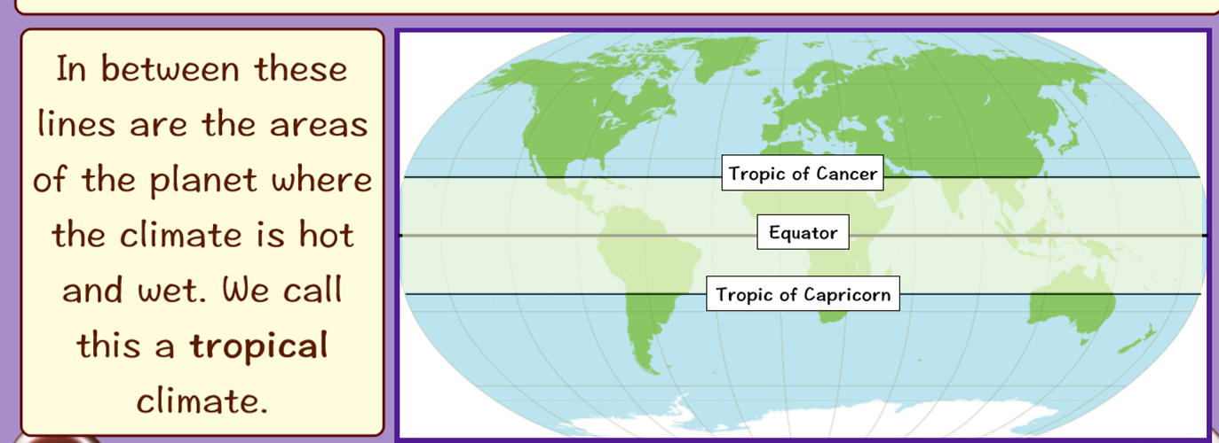
Teach
Text and pictures…
Look at your atlases which countries in Africa are equatorial?
Can you spot Ghana?

Slide 9
Teach
By West African standards, Ghana has a diverse and rich resource base. The country is mainly agricultural, however, with a majority of its workers engaged in farming.
Cash crops consist primarily of cocoa and cocoa products, which typically provide about two-thirds of export revenues.
Other exports include timber products, coconuts and other palm products, shea nuts which produce an edible fat, and coffee.
Ghana also has established a successful program of non-traditional agricultural products for export, including pineapples, cashews, and pepper.

Slide 10
Teach
How can farming in Ghana be made sustainable?
https://www.fairtrade.org.uk/Farmers-and-Workers/Cocoa
https://www.youtube.com/watch?v=eXBLDSxfgxc

Slide 11

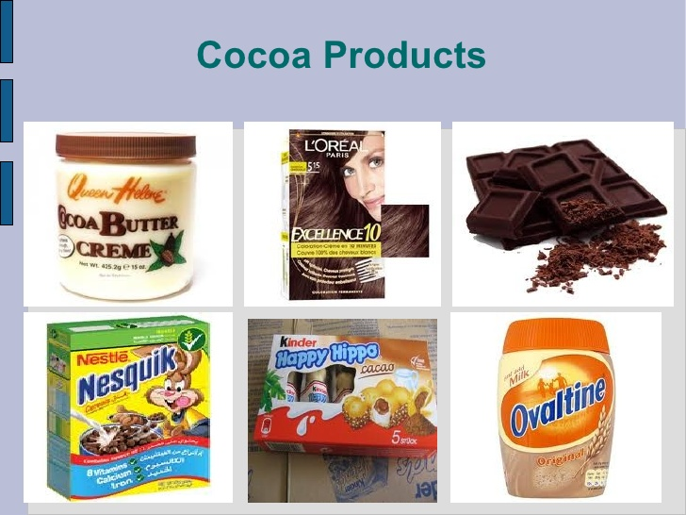


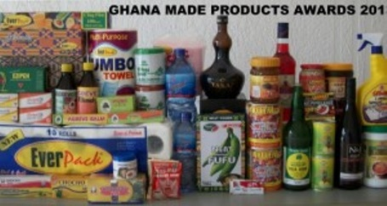

Slide 12
Task
L.O :to be able to describe the economy of Ghana
Success Criteria: I can locate and explain the climate of Ghana I can name Ghana’s main export I can compare Ghana with other parts of Africa
Use the food labels and information from the PowerPoint to make a poster promoting a sustainable fair trade economy for Ghana.

Slide 13
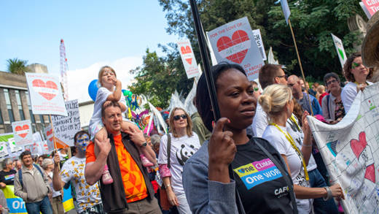
And finally…
How can we help support the people of Ghana?
How can we help reduce the loss of equatorial rainforests?
https://cafod.org.uk/About-us/Where-we-work/Africa

