Slide 1
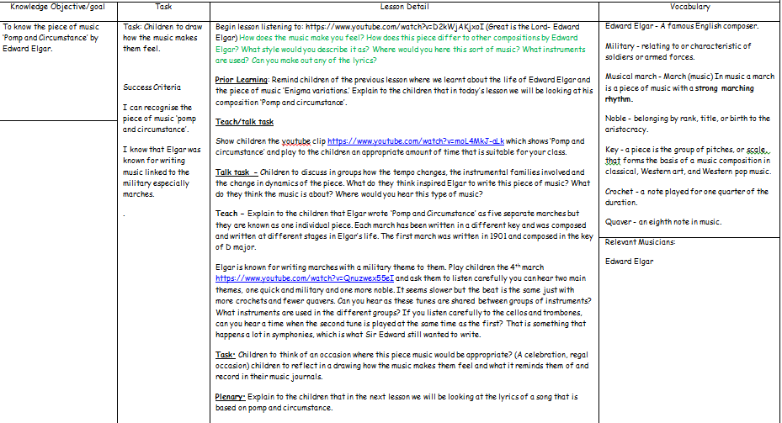
Lesson 2 - Edward Elgar

Slide 2
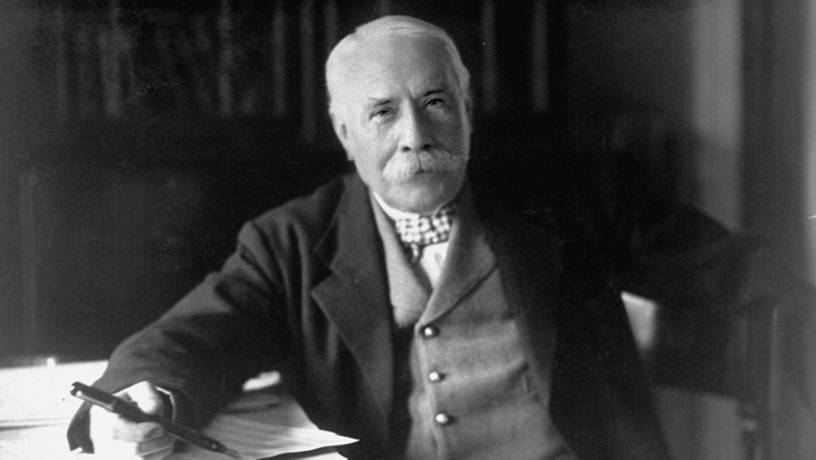

Year 4
Autumn 2
Lesson 2
Edward Elgar

Slide 3

Let’s Listen - https://www.youtube.com/watch?v=D2kWjAKjxoI
How does the music make you feel?
How does this piece differ to other compositions by Edward Elgar?
What style would you describe it as?
Where would you hear this sort of music?
What instruments are used?
Can you make out any of the lyrics?

Slide 4
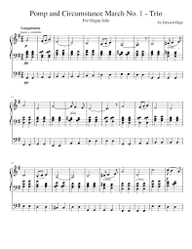
Prior Learning
In the last lesson we learnt about the life of the composer Edward Elgar and the piece of music ‘Enigma Variations.’
In today’s lesson we will be looking at Elgar’s composition ‘Pomp and circumstance’.

Slide 5
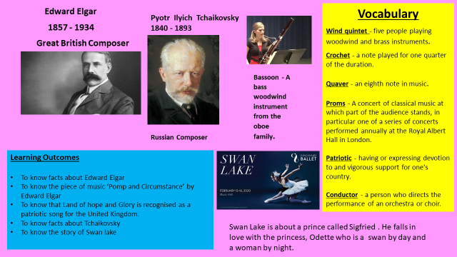
Our Knowledge Organiser

Slide 6
Key Vocabulary
Edward Elgar - A famous English composer.
Military - relating to or characteristic of soldiers or armed forces.
Musical march - March (music) In music a march is a piece of music with a strong marching rhythm.
Noble - belonging by rank, title, or birth to the aristocracy.
Key - a piece is the group of pitches, or scale, that forms the basis of a music composition in classical, Western art, and Western pop music.
Crochet - a note played for one quarter of the duration.
Quaver - an eighth note in music.

Slide 7
L.O: To know the piece of music ‘Pomp and Circumstance’ by Edward Elgar.
Success Criteria: To recognise the piece of music ‘pomp and circumstance’. To know that Elgar was known for writing music linked to the military especially marches.
Here are today’s key words:
Edward Elgar
Military
Musical march
Noble
Key
Crochet
Quaver

Slide 8
Talk Task
Discuss in groups how the tempo changes, the instrumental families involved and the change in dynamics of the piece. What do you think inspired Elgar to write this piece of music? What do you think the music is about? Where would you hear this type of music?

Slide 9
Teach
Elgar wrote ‘Pomp and Circumstance’ as five separate marches but they are known as one individual piece. Each march has been written in a different key and was composed and written at different stages in Elgar’s life. The first march was written in 1901 and composed in the key of D major.
Elgar is known for writing marches with a military theme to them. Have a look at the ‘4th March’ : https://www.youtube.com/watch?v=Qnuzwex55eI There are two main themes in this piece; one is quick and military and one more noble. It seems slower but the beat is the same just with more crochets and fewer quavers.
Can you hear as these tunes are shared between groups of instruments? What instruments are used in the different groups? If you listen carefully to the cellos and trombones, can you hear a time when the second tune is played at the same time as the first? That is something that happens a lot in symphonies, which is what Sir Edward still wanted to write.

Slide 10

Task – Draw how the music makes you feel?
Can you think of an occasion where this piece music would be appropriate? Can you reflect in a drawing how the music makes you feel and what it reminds you of and record in it in your music journals.

Slide 11
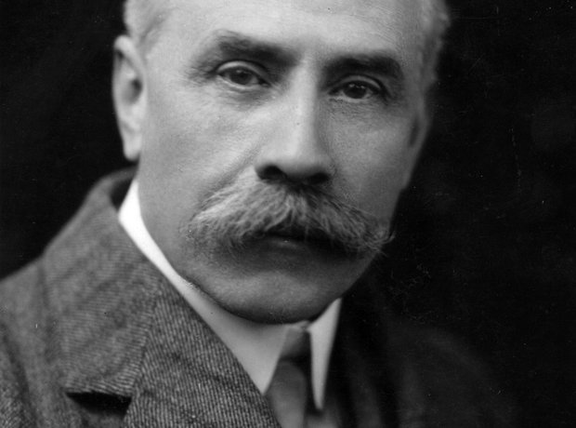
And finally…
In the next lesson we will be looking at the lyrics of a song by Edward Elgar that is based on Pomp and Circumstance.

