Slide 1
Week of 16th November 2020
OUTCOME: To review a novel and create questions for an author. Theme: letter writing, book review Audience: The author

Slide 2
LO: To learn more about the author
Word of the day- discernible What does the word mean? It was in French. Cirque Merlot, it read, and underneath: Le Prince Blanc – The White Prince! And just discernible, a picture of a lion roaring, a white lion.

Slide 3
The White Prince
They said I could take him out in his wheelchair every Sunday so long as I didn’t tire him, so long as he was back by supper. As Bertie said, it was just like our Sundays had been when we were little. There was only one place we could go to, a small village only a mile away. There wasn’t much left of the village, a few streets of battered houses, a church with its steeple broken off halfway up, and a cafe in the square, thankfully still intact. I would push him in his chair some of the way and he would hobble along with his stick when he felt strong enough. Mostly we would sit in the cafe and talk, or walk along the river and talk. We had so many years to catch up on.
He hadn’t written, he told me, because he’d thought that each day at the front might be his last, that he might be dead by sunset. So many of his friends were dead. Sooner or later, it had to be his turn. He wanted me to forget him, so that I wouldn’t know when he was killed, so that I wouldn’t be hurt. What you don’t know, you don’t grieve over, he said. He had never imagined that he would survive, that he would ever see me again.

Slide 4
It was on one of our Sunday outings that I noticed the poster across the street on the wall of what was left of the post office. The colours were faded and the bottom half had been torn away, but at the top the print was quite clear. It was in French. Cirque Merlot, it read, and underneath: Le Prince Blanc – The White Prince! And just discernible, a picture of a lion roaring, a white lion. Bertie had seen it too.
“It’s him!” he breathed. “It has to be him!” With no help from me, he was out of his wheelchair, stick in hand, limping across the street towards the cafe.
The café owner was wiping down the tables outside on the pavement. “The circus,” Bertie began, pointing back at the poster. He didn’t speak much French, so he shouted in English instead. “You know, lions, elephants, clowns!”
The man looked at him blankly and shrugged. So Bertie started roaring like a lion and clawing the air. I could see alarmed faces at the window of the cafe, and the man was backing away shaking his head. I ripped the poster off the wall and brought it over. My French was a little better than Bertie’s. The cafe owner understood at once.

Slide 5
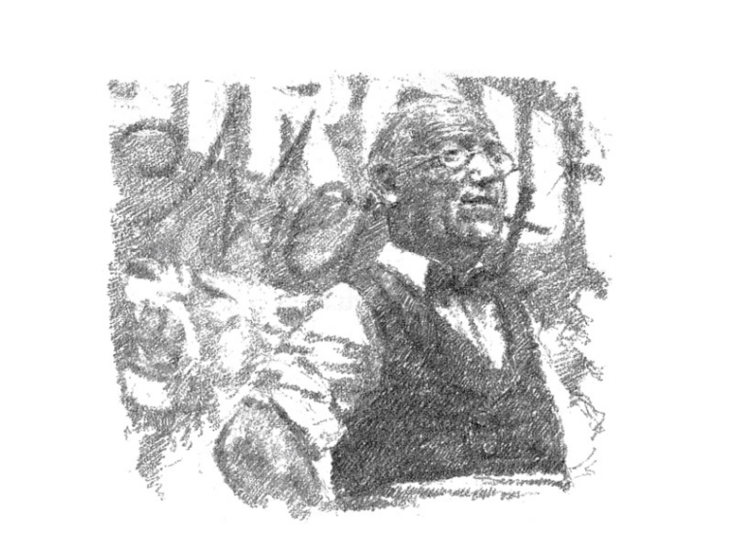
“Ah,” he said, smiling with relief. “Monsieur Merlot. Le cirque. C’est triste, très triste.” And he went on in broken English: “The circus. He is finished. Sad, very sad. The soldiers, you understand, they want beer and wine, and girls maybe. They do not want the circus. No one comes, and so Monsieur Merlot, he have to close the circus. But what can he do with all the animals? He keep them. He feed them. But the shells come, more and more they come, and his house – how you say it? – it is bombarded. Many animals are dead. But Monsieur Merlot, he stay. He keep only the elephants, the monkeys, and the lion, ‘The White Prince’. Everyone love The White Prince. The army, they take all the hay for the horses. There is no food for the animals. So Monsieur Merlot, he take his gun and he have to shoot them. No more circus. Finish. Triste, très triste.”

Slide 6
Much ado about... Me (a short autobiography)
I was born a really long time ago. 5th October 1943. In St Alban’s in Hertfordshire. My mother was there too, strangely enough, but my father was away at the war, in Baghdad. I had one older brother, Pieter. We both were evacuated to Northumberland when we were little, away from the bombs. After the war it was all change at home, not that I remember much of it. My mother wanted to be with a man she had met while my father was away in the army. He was called Jack Morpurgo. So my father came home to find there was no place for him. There was a divorce. Jack Morpurgo married my mother, and so became our stepfather. We lived in London then. We went to primary school at St Matthias in the Warwick Road, then were sent off to boarding school in Sussex – the Abbey, Ashhurst Wood. I was there for six years, hated being away from home, loved rugby and singing. Then I went off to a school in Canterbury, The King’s School, where I got more used to being away from home and still loved rugby and singing. We wore strange uniforms, wing collars, black jackets, boaters.
.

Slide 7
I went into the army, to Sandhurst, where officers are trained. Liked the uniforms and the good food and the friends I made, but hated being shouted at. Decided the army life was not for me. Met a girl called Clare who agreed with me and we got married, really young, because we loved one another. Had children really young, three of them. Went off to university at King’s College, London to start all over again. I got my degree, just, and decided to be a teacher. I had done a little bit before and liked it. So found myself in front of a class of children for the first time. Scary! But I loved reading stories to them. They seemed to like that too. We moved around a lot from school to school, which was quite unsettling for everyone, but finally ended up teaching in a little village primary school in Kent, at Wickhambreaux, where I ran out of other writers’ stories to read, so started making up some of my own.
Then Clare and I decided to start all over again, again! She was a teacher too by this time. We thought that what children needed most were wonderful and memorable experiences that would really help them find out about the world around them and find out more about themselves too. So we set up a charity called Farms for City Children, moved to Iddesleigh, bought a big house called Nethercott where the children could stay, made a partnership with a farming family we had got to know and invited our first city children down to the farm. The charity has been running now for forty years. Over 90,000 children have come to the three farms where the charity now runs, in Wales at Lower Treginnis Farm, in Gloucestershire at Wick Court, and of course where we started it all, at Nethercott in Devon.

Slide 8
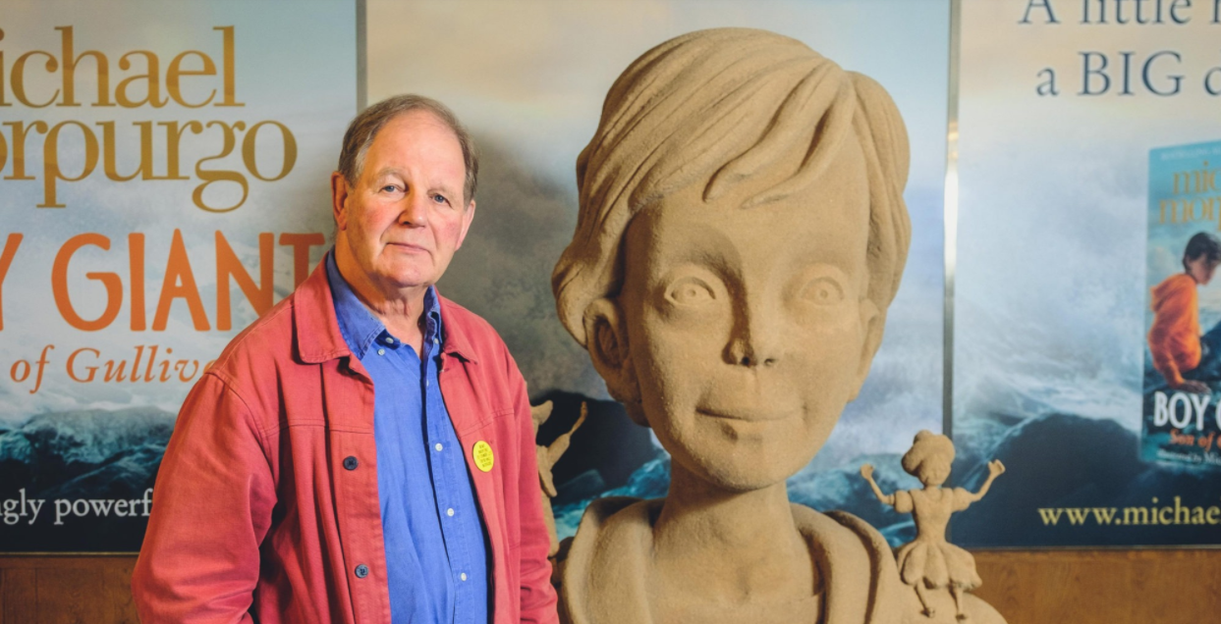
During all this time our children were growing up, of course. We now have eight grandchildren and a great-grandchild. And during all this time I was writing away, becoming a writer, a storyteller. Here in Devon I wrote nearly all my books, 130 I think, not that numbers count, War Horse, Private Peaceful, Why the Whales Came, The Butterfly Lion, Kensuke’s Kingdom. And with all of them, I was much helped in my writing by many friends and writers, but especially by Ted Hughes, the great poet, who lived nearby and fished on the river than runs through the farm. He became a good friend, and was a great inspiration to me to keep writing when I was finding it hard. And he and his wife Carol were always a source of great support to Farms for City Children.

Slide 9

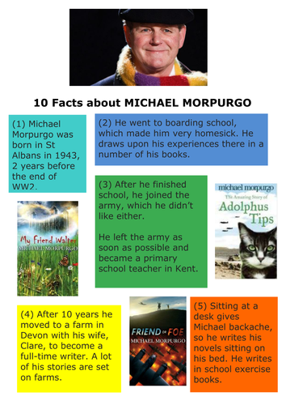
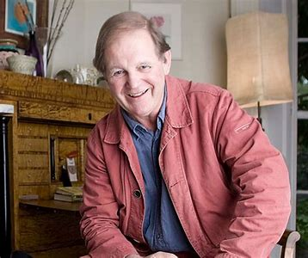
Tasks
Make notes about the author from the information on the slides.
What similarities can you find between Bertie and Michael Morpurgo?

Slide 10
Day 2
Word of the day – reluctant He was, as you can imagine, a little more reluctant when he saw the old man, and then Bertie, and still more when he saw a huge white lion. What does the word mean? Spot the verbs in the passage- which do you find most effective? Why?

Slide 11
“All of them?” cried Bertie. “He shot all of them?” “No,” said the man. “Not all. He keep The White Prince. He could not shoot The White Prince, never. Monsieur Merlot, he bring him from Africa many years ago. Most famous lion in all of France. He love the lion like a son. That lion, he make Monsieur Merlot a rich man. But he is not rich no more. He lose everything. Now he have nothing, just The White Prince. It is true. I think they die together. Maybe they die already. Who knows?” “This Monsieur Merlot,” Bertie said, “where does he live? Where can I find him?”
The man pointed out of the village. “Seven, maybe eight kilometres,” he said. “It is an old house by the river. Over the bridge and on the left. Not too far. But maybe Monsieur Merlot he is not there no more. Maybe the house is not there no more. Who knows?” And with a last shrug he turned and went indoors.
There were always army lorries rumbling through the village, so it was not at all difficult to hitch a ride. We left the wheelchair behind in the cafe. Bertie said it would only get in the way, that he could manage well enough with his stick. We found the house, a mill house, just over the bridge where the cafe owner had said it would be. There wasn’t much left of it. The barns all around were shell-blasted, the ruins blackened by fire. Only the main house still had a roof, but it too had not gone unscathed. One corner of the building had been holed and was partially covered by canvas that flapped in the wind. There was no sign of life.

Slide 12
Bertie knocked on the door several times, but there was no answer. The place frightened me. I wanted to leave at once, but Bertie would not hear of it. When he pushed gently at the door, it opened. Everything was dark inside. I did not want to go in, but Bertie took me firmly by the hand.
“He’s in here,” he whispered. “I can smell him.”
And it was true. There was a smell in the air, pungent and rank, and to me quite unfamiliar.
“Qui est là?” said a voice from the darkness of the room. “Qu’est-ce que vous voulez?” He spoke so quietly you could hardly hear him over the rush of the river outside. I could just make out a large bed under the window at the far end of the room. A man was lying there, propped up on a pile of cushions.
“Monsieur Merlot?” Bertie asked.
“Out?”
As we walked forward together, Bertie went on: “I am Bertie Andrews.

Slide 13
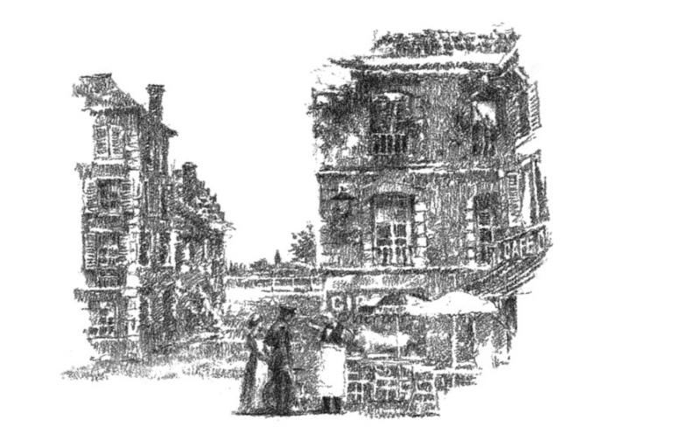
Many years ago you came to my farm in Africa, and you bought a white lion cub. Do you still have him?”
As if in answer the white blanket at the end of the bed became a lion, rose from the bed, sprang down and was padding towards us, a terrible rumble in his throat. I froze where I was as the lion came right up to us.
“It’s all right, Millie. He won’t hurt us,” said Bertie, putting an arm round me. “We’re old friends.” Moaning and yowling, the lion rubbed himself up against Bertie so hard that we had to hold on to each other to stop ourselves from falling over.

Slide 14
A Miracle, A Miracle!
The lion eyed Bertie for a few moments. The yowling stopped, and he began to grunt and groan with pleasure as Bertie smoothed his mane and scratched him between the eyes. “Remember me?” he said to the lion.
“Remember Africa?”
“You are the one? I am not dreaming this?” said Monsieur Merlot. “You are the boy in Africa, the one who tried to set him free?” “I’ve grown a bit,” said Bertie, “but it’s me.” Bertie and Monsieur Merlot shook hands warmly, while the lion turned his attention on me, licking my hand with his rough warm tongue. I just gritted my teeth and hoped he wouldn’t eat it.
“I did all I could,” Monsieur Merlot said, shaking his head. “But look at him now. Just skins and bones like me. All my animals they are gone, except Le Prince Blanc. He is all I have left. I had to shoot my elephants, you know that? I had to. What else could I do? There was no food to feed them. I could not let them starve, could I?”
Bertie sat down on the bed, put his arms around the lion’s neck and buried his head in his mane. The lion rubbed up against him, but he kept looking at me. I kept my distance, I can tell you. I just could not get it out of my head that lions do eat people, particularly if they are hungry lions. And this lion was very hungry indeed. You could see his ribs, and his hip bones too.
“Don’t worry, monsieur’ said Bertie. “I will find you food. I will find food enough for both of you. I promise.”

Slide 15
The driver of the ambulance I waved down thought at first that he was just giving a nurse a lift back to the village. He was, as you can imagine, a little more reluctant when he saw the old man, and then Bertie, and still more when he saw a huge white lion.
The driver swallowed a lot, said nothing all the way, and just nodded when Bertie asked him to let us out in the village square. And so there we were half an hour or so later, the four of us sitting outside the cafe in the sun, the lion at our feet gnawing a huge bone the butcher was only too pleased to sell us. Monsieur Merlot ate a plate of fried potatoes in complete silence and washed it down with a bottle of red wine. Around us gathered an astonished crowd of villagers, of French soldiers, of British soldiers – at a safe distance. All the while Bertie scratched the lion’s head right between his eyes.
“He always liked a good scratch just there,” Bertie said, smiling at me. “I told you I would find him, didn’t I?” he went on. “I was never sure you really believed me.”
“Well, I did,” I replied, and then I added: “After a while, anyway.” It was the truth. I suppose that may explain why I took all that happened that morning so much in my stride. It was amazing, surreal almost, but it was no surprise. A prophecy come true, like a wish come true – and this was both – can never be entirely surprising.
.

Slide 16
As we walked the lion down the village street, Bertie leaning on the lion, me pushing Monsieur Merlot in the wheelchair, the crowd parted in front of us and backed away. Then they began to follow us, at a discreet distance, of course, up the road towards Bertie’s hospital. Someone must have gone on ahead to warn them, because we could now see a huddle of doctors and nurses gathered on the front steps, and there were people peering out of every window. As we came up to the hospital, an officer stepped forward, a colonel it was.
Bertie saluted. “Sir,” he began, “Monsieur Merlot here is a very old friend of mine. He will need a bed in the hospital. He’s in need of rest, sir, and a lot of good food. The same goes for the lion. So I wondered, sir, if you’d mind if we used the walled garden behind the hospital. There’s a shed in there where the lion could sleep. He’d be quite safe, and so would we. I know him. He doesn’t eat people. Monsieur Merlot here has said that if I can feed the lion and take care of him, then I can take him back to England with me.” “The brass cheek of it!” the colonel spluttered as he came down the steps. “Who the devil do you think you are anyway?” he said. And that was when he recognised Bertie. “You’re the fellow that won the VC, aren’t you?” he said, suddenly a lot more polite. “Andrews, isn’t it?”

Slide 17
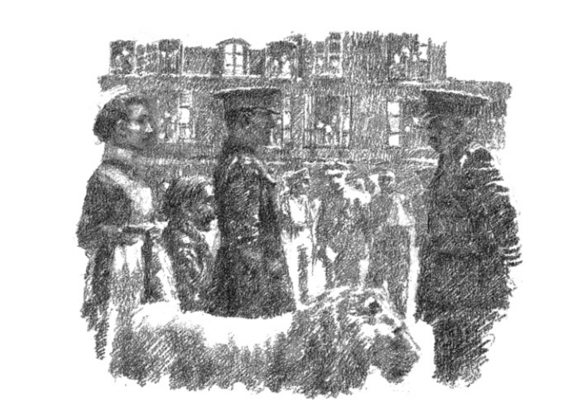
As we sat there outside the cafe sipping our wine, the three of us decided what should be done about The White Prince. Monsieur Merlot kept crying and saying it was all “un miracle, un miracle”; and then he would wipe the tears from his eyes again, and drink down another glass of wine. He liked his wine.
The whole plan was entirely Bertie’s idea. To be honest, I didn’t see how it could possibly be done. I should have known better. I should have known that once Bertie had set his heart on something, he would see it through.
“Yes, sir, and I want to take the lion back to England when I go. We’ve got somewhere in mind for him to live,” and he turned to me. “Haven’t we?” he said. “Yes,” I said.
It wasn’t at all easy persuading the colonel to agree. He began to soften only when we told him that if we didn’t look after the white lion, no one else would, and then he would have to be taken away and shot. A lion, the symbol of Britain, shot! Not at all good for morale, Bertie argued. And the colonel listened.

Slide 18
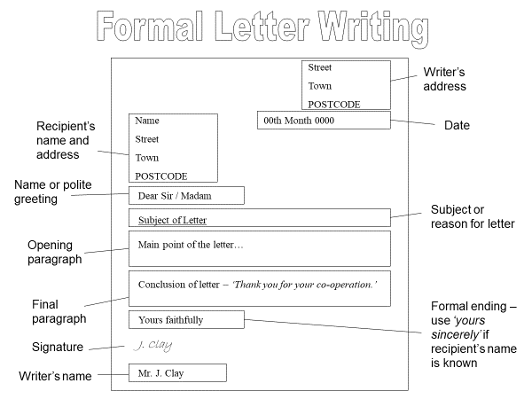
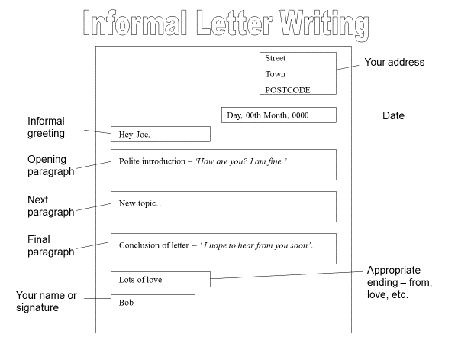
LO: to investigate the organisational and language features of a formal letter

Slide 19
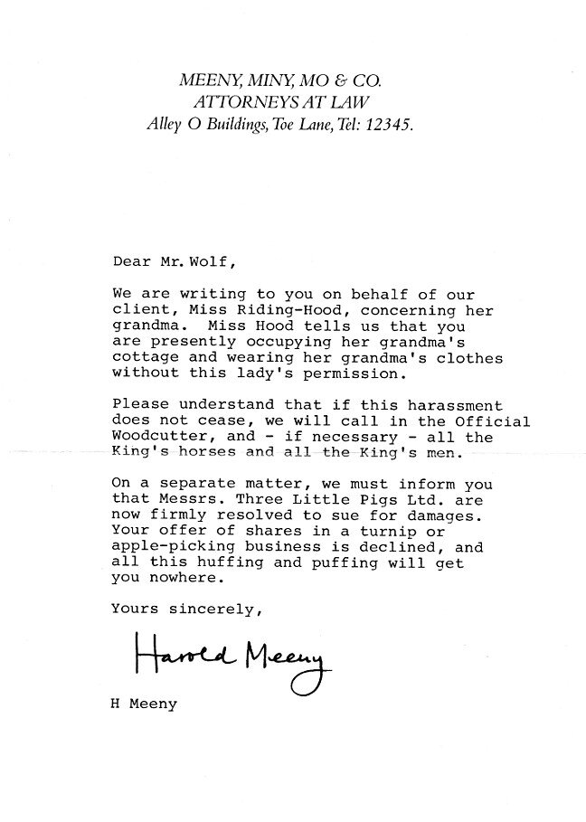
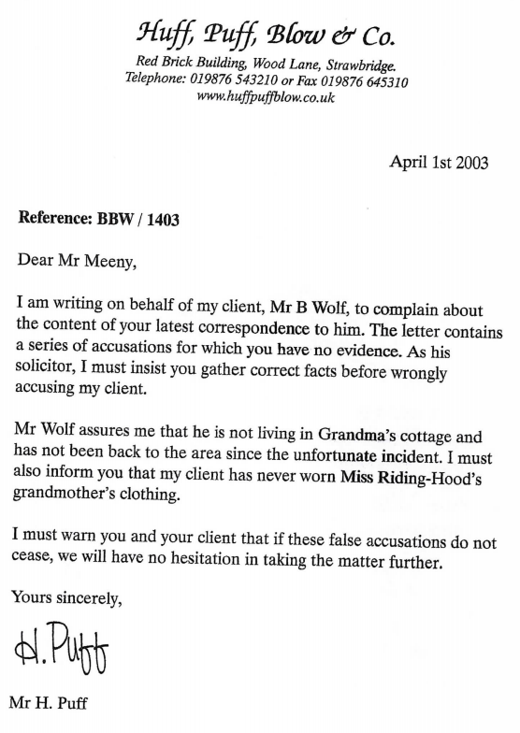
Look at the two letters and identify the features of formal letters.

Slide 20
Day 3
Word of the day - console There was nothing I could do to cheer him or even console him.

Slide 21
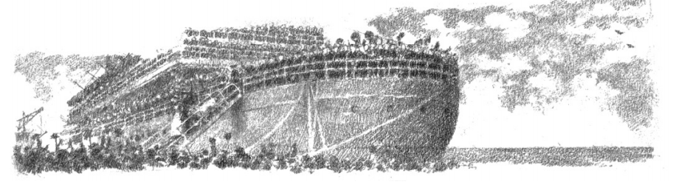
It wasn’t any easier persuading the powers that be in England to allow the lion to come back home when the war was over, but somehow Bertie managed it. He just wouldn’t take no for an answer. Bertie always said afterwards that it was the medal that did it, that without the prestige of the Victoria Cross behind him he’d never have got away with it, and The White Prince would never have come home.
When we docked at Dover, the band was playing and the bunting was out, and there were photographers and newspaper reporters everywhere. The White Prince walked off the ship at Bertie’s side to a hero’s welcome. “The British Lion Comes Home” roared the newspapers the next day.
So we came back here to Strawbridge, Bertie, The White Prince and me. I married Bertie in the village church. I remember, Bertie had a bit of a disagreement with the vicar because he wouldn’t allow the lion inside the church for the wedding. I was very glad he didn’t – but I never told Bertie that. Nanny Mason adored both Bertie and The White Prince, but she insisted on washing him often, because he smelt – the lion, not Bertie. Nanny Mason stayed on with the three of us – “her three children”, she called us – until she retired to the seaside in Devon.

Slide 22
The Butterfly Lion
We never had children of our own – just The White Prince – and I can tell you, he was enough of a family for anyone. He roamed free in the park just as we had planned he would, and chased the deer and the rabbits whenever he felt like it; but he never did learn how to kill for himself. You can’t teach old lions new tricks. He lived well, on venison mostly, and slept on a sofa on the landing – I wouldn’t have him inside our bedroom, no matter how often Bertie asked. You have to draw the line somewhere.
Bertie’s leg never recovered completely. When it was bad, he often needed a stick, or me, or the lion to lean on. It pained him a lot, particularly when the weather was cold and damp, and he never slept well. On Sundays the three of us would wander the park together, and he would sit on the top of Wood Hill with his arm around his old friend’s neck and I would fly kites. As you know, I’ve always loved kites; and so, it turned out, did the lion, who pounced on several of them as they landed, savaged them and ripped them to pieces.
The lion never showed any interest in escaping, and even if he’d wanted to, the park wall was too high for an old lion to jump. Wherever Bertie went he wanted to go too. And if ever Bertie went out in the car, then he’d sit by me near the stove in the kitchen, and watch me with those great amber eyes, listening all the while for the sound of Bertie’s car coming up the gravel to the front of the house.

Slide 23
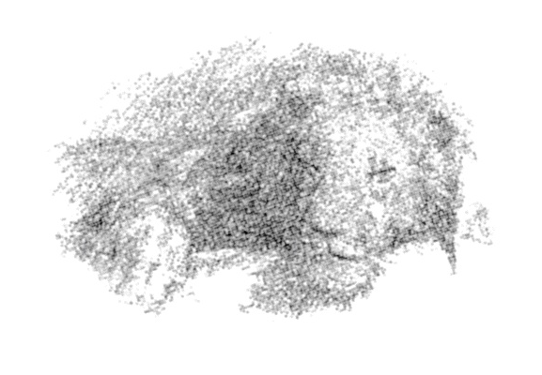
The old lion lived on into a ripe old age. But he became stiff in his legs and could see very little towards the end. He spent his last days stretched out asleep at Bertie’s feet, right where you’re sitting now. When he died, we buried him at the bottom of the hill out there. Bertie wanted it that way so he could always see the spot from the kitchen window. I suggested we plant a tree in case we forgot where he was. “I’ll never forget,” he said fiercely. “Never. And besides, he deserves a lot more than a tree.”
Bertie grieved on for weeks, months after the lion died. There was nothing I could do to cheer him or even console him. He would sit for hours in his room, or go off on long walks all on his own. He seemed so shut away inside himself, so distant. Try as I did, I could not reach him.

Slide 24
LO: to respond to the text and justify my opinion
Using an outline of the lion write what you think of the book. What did you most enjoy? How did the book make you feel? Saddest moment? Happiest moment? Funniest moment? Favourite character? What have you learned from the book? About Africa? About World War I?

Slide 25
Day 4
Words of the day- dignified
What does the word mean?

Slide 26
Then one day I was in the kitchen here, when I saw him hurrying down the hill, waving his stick and shouting for me.
“I’ve got it,” he cried, as he came in, “I’ve got it at last.” He showed me the end of his stick. It was white. “See that, Millie? Chalk! It’s chalk underneath, isn’t it?”
“So?” I said.
“You know the famous White Horse on the hillside at Uffington, the one they carved out of the chalk a thousand years ago? That horse never died, did it? It’s still alive, isn’t it? Well, that’s what we’re going to do, so he’ll never be forgotten. We’ll carve The White Prince out on the hillside – he’ll be there for ever, and he’ll be white for ever too.”
“It’ll take a bit of time, won’t it?” I said.
“We’ve got plenty, haven’t we?” he replied, with the same smile he had smiled at me when he was a ten-year-old boy asking me if he could come back and mend my kite for me.

Slide 27
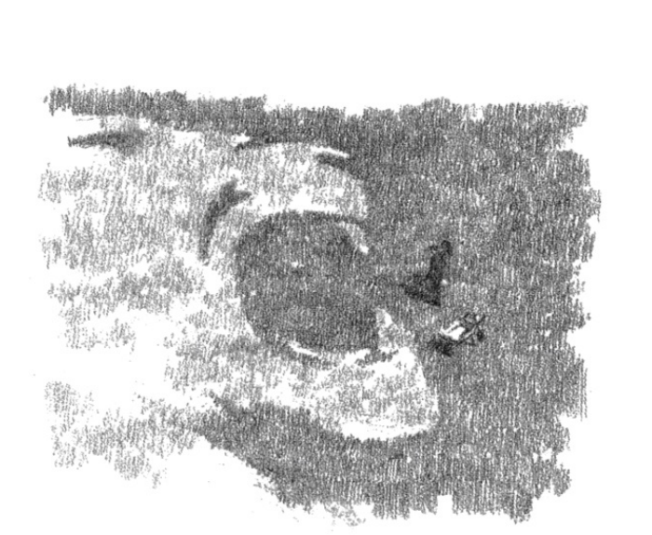
It took the next twenty years to do it. Every spare hour we had, we were up there scraping away with spades and trowels; and we had buckets and wheelbarrows to carry away the turf and the earth. It was hard, back-breaking work, but it was a labour of love. We did it, Bertie and I, we did it together – paws, claws, tail, mane, until he was whole and perfect in every detail.
It was just after we’d finished that the butterflies first came. We noticed
that when the sun comes out after the rain in the summer, the butterflies –
Adonis Blues, they are, I looked them up – come out to drink on the chalk
face. Then The White Prince becomes a butterfly lion, and breathes again like
a living creature.
So now you know how Bertie’s white lion became The White Prince and
how The White Prince became our butterfly lion.

Slide 28
And the Lion Shall Lie Down with the Lamb
The old lady turned to me and smiled. “There,” she said. “That’s my story.” “And what about Bertie?” I knew as I asked that I shouldn’t have. But I had to know.
He’s dead, dear,” the old lady replied. “It’s what happens when you get old. It’s nothing to worry about. It’s lonely, though. That’s why I’ve got Jack. And Bertie, like his lion, lived on to a good age. He’s buried out there under the hill beside The White Prince.” She looked back at the hill for a moment. “And that’s where I belong too,” she said.
She tapped the table with her fingers. “Come on. Time to go. Back to school with you before they miss you and you get yourself into trouble. We wouldn’t want that, would we?” She laughed. “Do you know, that’s just what I told Bertie all those years ago when he ran away from school. You remember?” She was on her feet now. “Come on, I’ll drive you. And don’t look so worried. I’ll make sure no one sees you. It’ll be like you’ve never been gone.”
“Can I come again?” I asked.
“’Course you can,” she said. “I may not always be easy to find, but I’ll be here. I’ll just tidy away the tea things, and then we’ll go, shall we?” It was a very old-fashioned car, black and upright and dignified, with a leathery smell and a whiny engine. She dropped me at the bottom of the school park, by the fence.

Slide 29
“Take care, dear,” she said. “And be sure you come again soon, won’t you?
I’ll be expecting you.” “I will,” I replied. I climbed the fence before I turned to wave; but by that time the car had gone.
To my huge relief no one had missed me. And best of all, Basher Beaumont was in the sickroom. He’d gone down with measles. I just hoped his measles would last a long time, a very long time.
All through supper I could think of nothing but Bertie Andrews and his white lion. Stew and dumplings and then semolina pudding with raspberry jam – again! It was as I was picking my way through my slimy semolina that I remembered Bertie Andrews had been at this school. Maybe, I thought, maybe he’d had to sit here and eat slimy semolina just as we did now. I looked up at the honours boards around the dining hall, at the names of all the boys who had won scholarships over the years.
I looked for Bertie Andrews. He wasn’t there. But then, I thought, why should he be? Maybe, like me, he wasn’t brilliant at his school work. Not everyone wins scholarships.
Cookie – Mr Cook, my history teacher – was sitting beside me at the end
of my table. “Who were you looking for, Morpurgo?” he asked suddenly.
“Andrews, sir,” I said. “Bertie Andrews.”

Slide 30
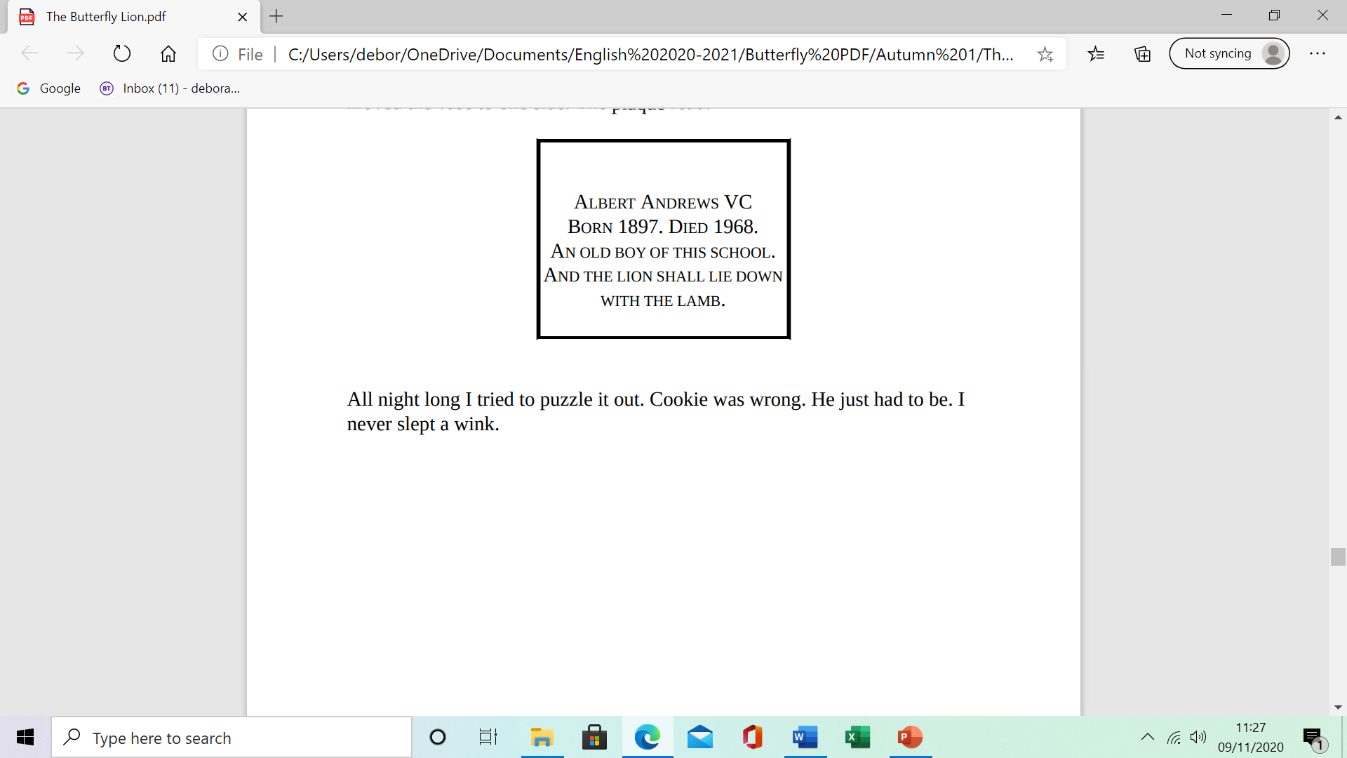
“Andrews? Andrews? There’s an Albert Andrews who won the Victoria Cross in the First World War. You mean him?” Cookie scraped his bowl clean and licked the back of his spoon. “I love raspberry jam. You’ll find his name in the chapel, under the East Window, under the War memorial. But he wasn’t killed in the war, you know. He lived down at Strawbridge, that place with the lion on the gateway, just across the main road. He died, maybe ten, twelve years ago, soon after I came to teach here. The only old boy ever to win the VC. That’s why they put up a memorial plaque to him in the chapel after he died. I remember the day his wife came to unveil it – his widow, I should say. Poor dear, just herself and her dog in that great big place. She died only a few months later. Broken heart, they say. You can, you know. You can die of a broken heart. That house has been empty ever since. No family to take it on.
No one wants it. Too big, you see. Shame.”
I said I wanted to be excused, to go to the toilet. I hurtled down the passage, out across the courtyard and into the chapel. The small brass plaque was exactly where Cookie had said it was, but hidden by a vase of flowers. I moved the vase to one side. The plaque read:
All night long I tried to puzzle it out. Cookie was wrong. He just had to be. I never slept a wink.

Slide 31
Adonis Blues
The next afternoon after games were over, I went over the fence at the bottom of the park, hared up through Innocents Breach, across the road, along the wall and slipped through the iron gateway with the stone lion roaring above me. It was raining a light summer rain.
I tried knocking at the front door. No one came. No dog barked. I went round to the back and peered in through the kitchen window. The box kite was still there on the kitchen table, but there was no sign of the old lady anywhere. I rattled the kitchen door, and knocked louder, again and again. I called out: “Hello! Hello!” There was no reply. I banged on the window. “Are you there? Are you there?”
“We all are,” came a voice from behind me. I turned. There was no one there. I was alone, alone with the white lion on the hillside. I had imagined it.
I climbed the hill and went to sit in the grass above the white of the lion’s mane. I looked down at the great house beneath me. Jackdaws cawed overhead. There was bracken and grass growing out of the gutters and around the chimney pots. Some of the windows were boarded up. Drainpipes hung loose and rusting. The place was empty, quite empty.
The rain suddenly stopped and the sun warmed the back of my neck. The first butterfly landed on my arm. It was blue. “Adonis Blues, Adonis Blues,” came the voice again, like an echo in my head. Then the sky around me was filled with butterflies, and they were settling to drink on the chalk.

Slide 32
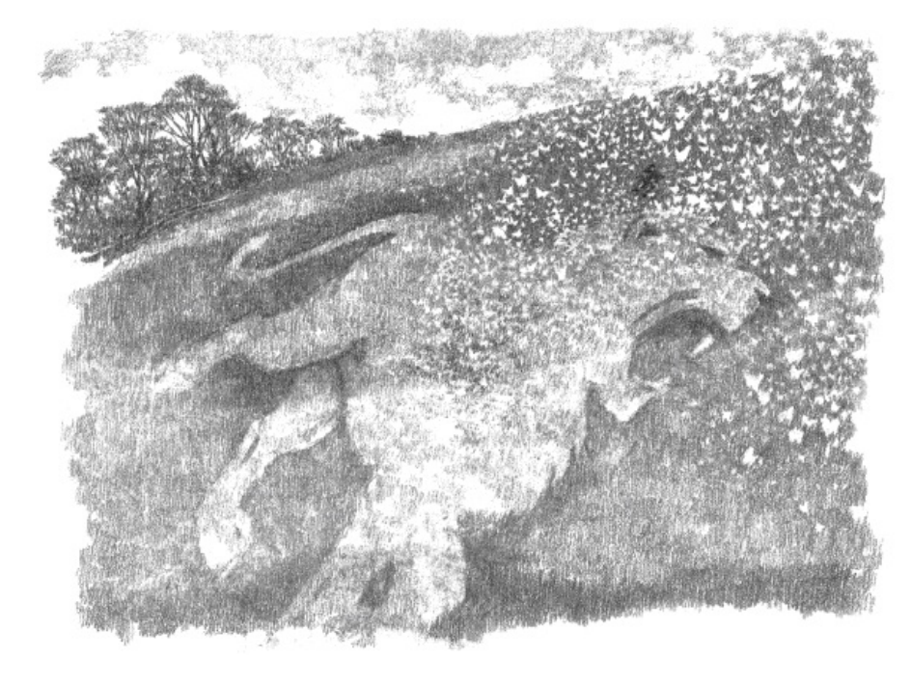
“Adonis Blues, remember?” The same voice, a real voice, her voice. And this time I knew it was not in my head. “Keep him white for us, there’s a dear. We don’t want him forgotten, you see. And think of us sometimes, won’t you?”
“I will,” I cried. “I will.”
And I swear I felt the earth tremble beneath me with the roar of a distant lion.

Slide 33
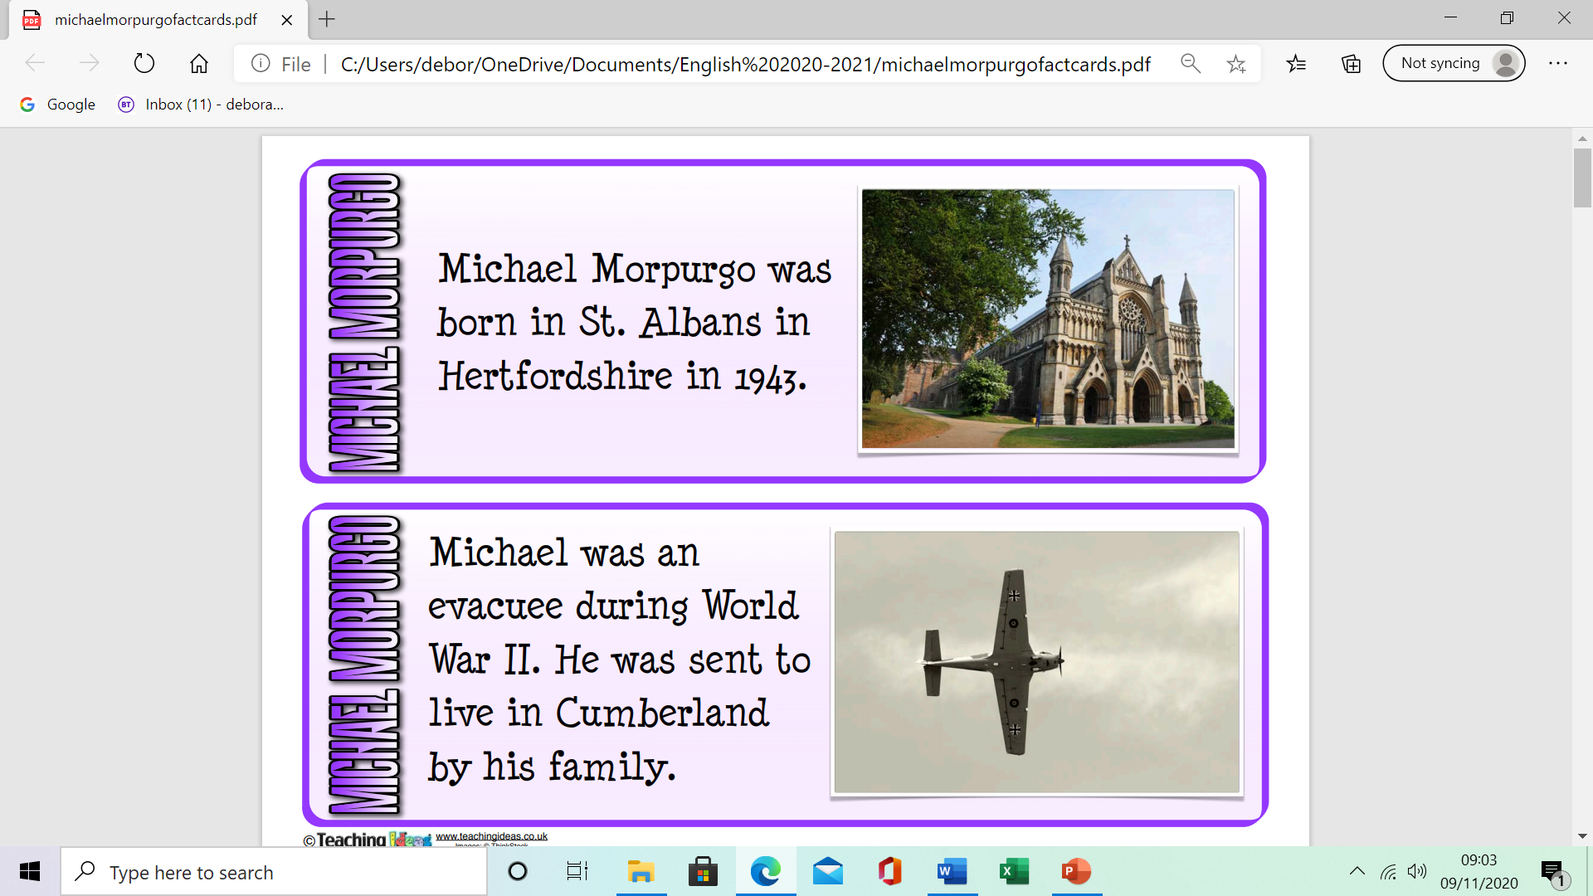
LO: to create questions and analyse a review Review what you already know and think of Michael Morpurgo. What would you like to know? Create 5 questions to ask the author. Use the fact cards to help you frame your question. See English Lesson 4 - Michael Morpurgo Fact Cards attached. Where and when were you born? Did your experience in World War II encourage you to set some of your books in war time?

Slide 34
Day 5
A True Story
Some years ago, two friends were in a big department store in London, when they saw a lion cub for sale. The store was keen to get rid of the cub, because it had already escaped once and ripped to shreds a heap of expensive rugs. John and Ace bought the cub and took him home. They called him Christian. Christian lived in their London flat for a year, but by then he weighed more than a full-grown man. It was time to introduce him back into the wild and they took him to Kenya where he was soon living with a pride of lions. John and Ace were delighted, but also sad. They missed him. In the end they decided to go back to Kenya to see him one last time. Everyone said this was impossible. Christian might not even be alive any more. But John and Ace went to where they had last seen Christian—and to their amazement, there he was. It was just as if he had known they were coming. Slowly, he padded up to them and put his paws on their shoulders, licking them as he had done when he was a little cub. They spent several days with him but in the end they had to go home. After they left, Christian was never seen again.

Slide 35
Lion and Mouse Story
Once when a lion, the king of the jungle, was asleep, a little mouse began running up and down on him. This soon awakened the lion, who placed his huge paw on the mouse, and opened his big jaws to swallow him.
"Pardon, O King!" cried the little mouse. "Forgive me this time. I shall never repeat it and I shall never forget your kindness. And who knows, I may be able to do you a good turn one of these days!”
The lion was so tickled by the idea of the mouse being able to help him that he lifted his paw and let him go.
Sometime later, a few hunters captured the lion, and tied him to a tree. After that they went in search of a wagon, to take him to the zoo.

Slide 36
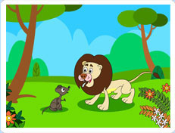
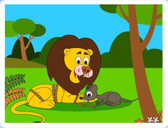
Just then the little mouse happened to pass by. On seeing the lion’s plight, he ran up to him and gnawed away the ropes that bound him, the king of the jungle.
"Was I not right?" said the little mouse, very happy to help the lion.
MORAL: Small acts of kindness will be rewarded greatly

