Slide 1
Week 9
OUTCOME: to write a description of life on the battlefields of World War I. Theme: Historical Novel World War I

Slide 2
L.O: to summarise and give opinions
Word of the day-flamboyant What does the word mean? All the kites I had seen had been more colourful, more flamboyant.

Slide 3
A Lot of Old Codswallop
The dog was whining at the kitchen door. “Let Jack out for me, will you?” said the old lady. “There’s a dear. I’ll tell you what, I’ll fetch down the kite Bertie made for me, shall I? You’d like to see it, wouldn’t you?” And she went out.
I was only too happy to let the dog out and shut the door on him. She was back sooner than I expected. “There,” she said, setting the kite down on the table in front of me. “What do you think of it then?” It was huge, much bigger than I had expected, and covered in dust. It was made of brown canvas stretched over a wooden frame. All the kites I had seen had been more colourful, more flamboyant. I think the disappointment must have shown in my face.

Slide 4
“She still flies, you know,” she said, blowing the dust off. “You should see how she goes. You should see her.” She sat down in her chair and I waited for her to begin again. “Now then, where was I?” she asked. “I’m so forgetful these days.”
“Bertie’s last letter,” I said. “He was just going off to the war. But what about the white lion, ‘The White Prince’? What happened to him?” I could hear the dog barking wildly outside. She smiled at me. “Everything comes to he who waits,” she said. “Why don’t you have a look out of the window?”
I looked. The lion on the hillside was blue no more. It was white now, and the dog was bounding across the hillside, chasing away a cloud of blue butterflies that rose all around him.

Slide 5
Task: to summarise the novel and give your opinion.
Review the novel so far. Who are the characters?
Have you got a favourite character? Why?
What has happened?
What have you found most exciting? Most poignant? Most intriguing?
Would you recommend this novel? Why?

Slide 6
The Butterfly Lion by Michael Morpurgo
A lyrical and moving tale of a young boy growing up in Africa, and his lifelong friendship with a white lion. “All my life I’ll think of you, I promise I will. I won’t ever forget you.” Bertie rescues an orphaned white lion cub from the African veld. They are inseparable until Bertie is sent to boarding school far away in England and the lion is sold to a circus. Bertie swears that one day they will see one another again, but it is the butterfly lion which ensures that their friendship will never be forgotten.
My favourite character is Millie because she is kind, giving and polite; in the story she puts Bertie before herself. I also liked Bertie because he goes through a lot, yet is really resilient.
Guardian Children’s Book Club
Jenny commented: ‘the story kept me guessing as it had a lot of chapters ending on cliff-hangers so it was fun to guess what would happen next. It kept you on the edge of your seat!’. She also explained, ‘My favourite part of the book was when Bertie was reunited with the lion because it was heart-warming and touching’.
Overall, we really enjoyed this book and would recommend it to children aged between 9 and 11, who like to be able to read to themselves. We also liked reading a Michael Morpurgo book as some of us hadn’t read his work before.
.

Slide 7
Day 2
Word of the day -huddled What does the word mean? Within a few months he was sitting huddled at the bottom of a muddy trench, hands over his head, head between his knees, curling himself into himself as tight as he would go, sick with terror as the shells and whizzbangs blew the world apart around him. Spot the verbs in the passage- which do you find most effective? Why?

Slide 8
“He chases everything that moves,” she said. “But don’t worry. He won’t catch a single one. He never catches anything.” “Not that lion,” I said. “I meant the lion in the story. What happened to him?”
“Don’t you see? They’re the same. The lion out there on the hillside and the lion in the story. They’re the same.”
“I don’t understand,” I said.
“You soon will,” she replied. “You soon will.” She took a deep breath before she began again.
For many years Bertie never spoke about the fighting in the trenches. He always said it was a nightmare best forgotten, best kept to himself. But later on when he’d had time to reflect, when time had done its healing perhaps, then he told me something of how it had been.
At seventeen, he’d found himself marching with his regiment along the straight roads of northern France up to the front line, heads and hearts high with hope and expectation. Within a few months he was sitting huddled at the bottom of a muddy trench, hands over his head, head between his knees, curling himself into himself as tight as he would go, sick with terror as the shells and whizzbangs blew the world apart around him. Then the whistle would blow and they’d be out and over the top into No Man’s Land, bayonets fixed and walking towards the German trenches into the ratatat of machinegun fire. To the left of him and to the right of him his friends would fall, and he would walk on, waiting for the bullet with his name on which he knew could cut him down at any moment.

Slide 9
At dawn they always had to come out of their dugouts and “stand to” in the trenches, just in case there was an attack. The Germans often attacked at dawn. That’s how it was on the morning of his twentieth birthday. They came swarming over No Man’s Land out of the early morning sun, but they were soon spotted and mown down like so much ripe corn. Then they were turning and running. The whistle went, and Bertie led his men over the top to counterattack. But as always the Germans were expecting them, and the usual slaughter began. Bertie was hit in the leg and fell into a shellhole. He thought of waiting there all day and then crawling back under cover of darkness, but his wound was bleeding badly and he could not staunch it. He decided he had to try to crawl back to the trenches whilst he still had the strength to do it.

Slide 10

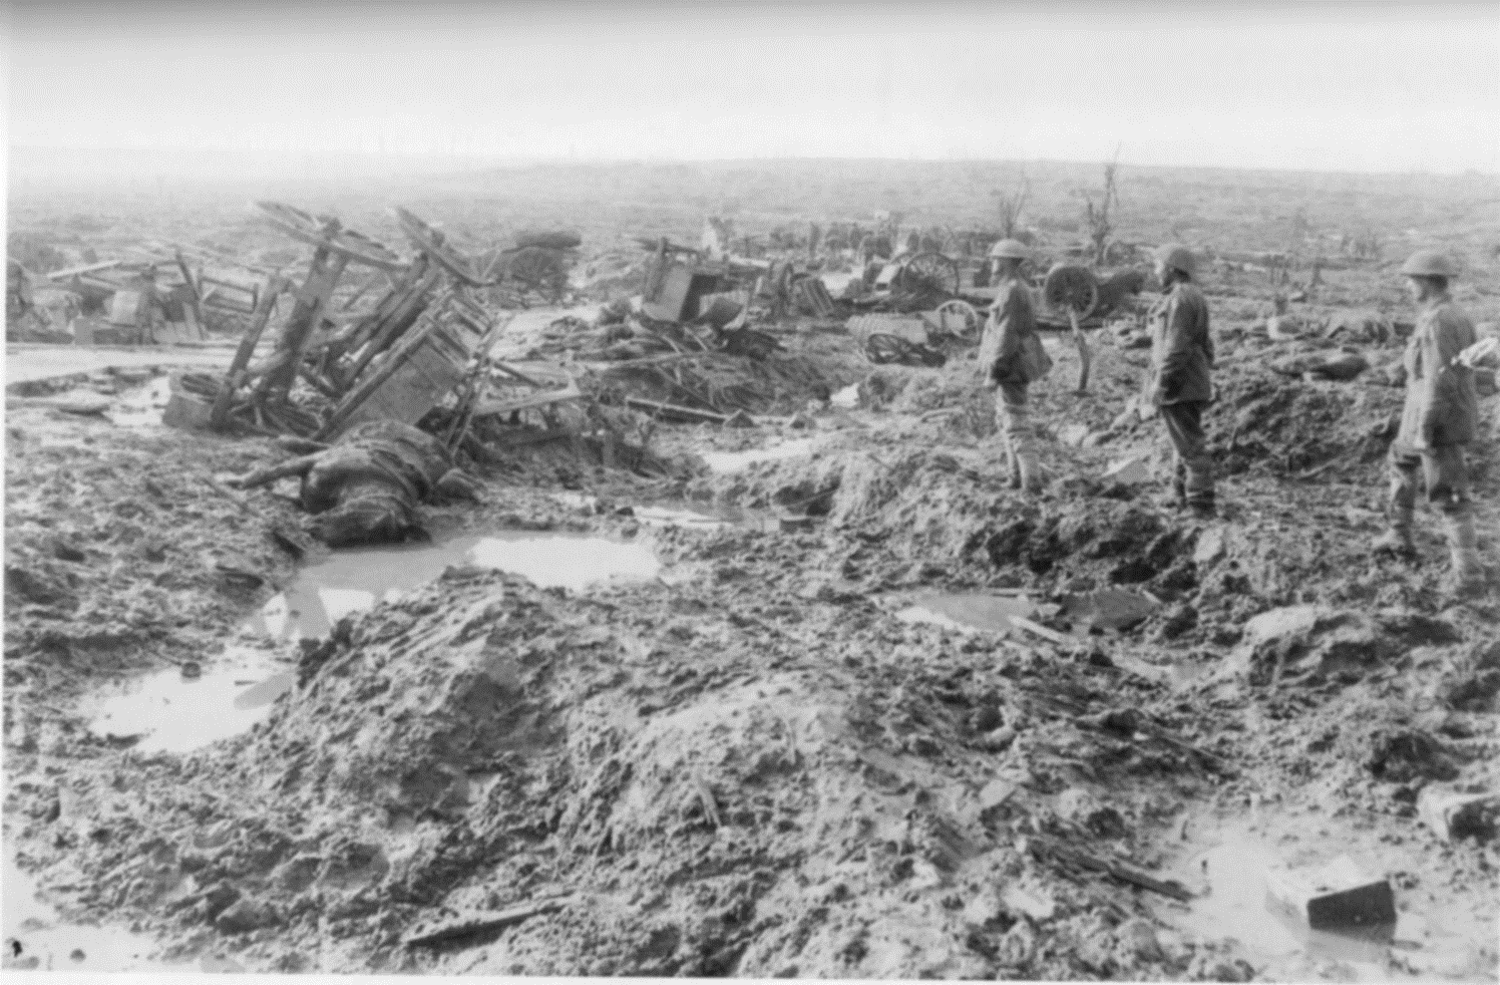
LO: to use senses to describe.
Go through the passage and explore trench warfare.
Using photographs and pictures to help understand how the trenches and the battlefield looked, felt and smelt.
Use the senses to mind map to explore the battlefield.

Slide 11

Life in the Trenches WW1

Slide 12
LO: to use senses to describe. Go through the passage and explore trench warfare. On the Western Front, the war was fought by soldiers in trenches. Trenches were long, narrow ditches dug into the ground where soldiers lived. They were very muddy, uncomfortable and the toilets overflowed. These conditions caused some soldiers to develop medical problems such as trench foot. There were many lines of German trenches on one side and many lines of Allied trenches on the other. In the middle was no man's land, which soldiers crossed to attack the other side. https://www.bbc.co.uk/bitesize/topics/zqhyb9q/articles/z8sssbk
.

Slide 13
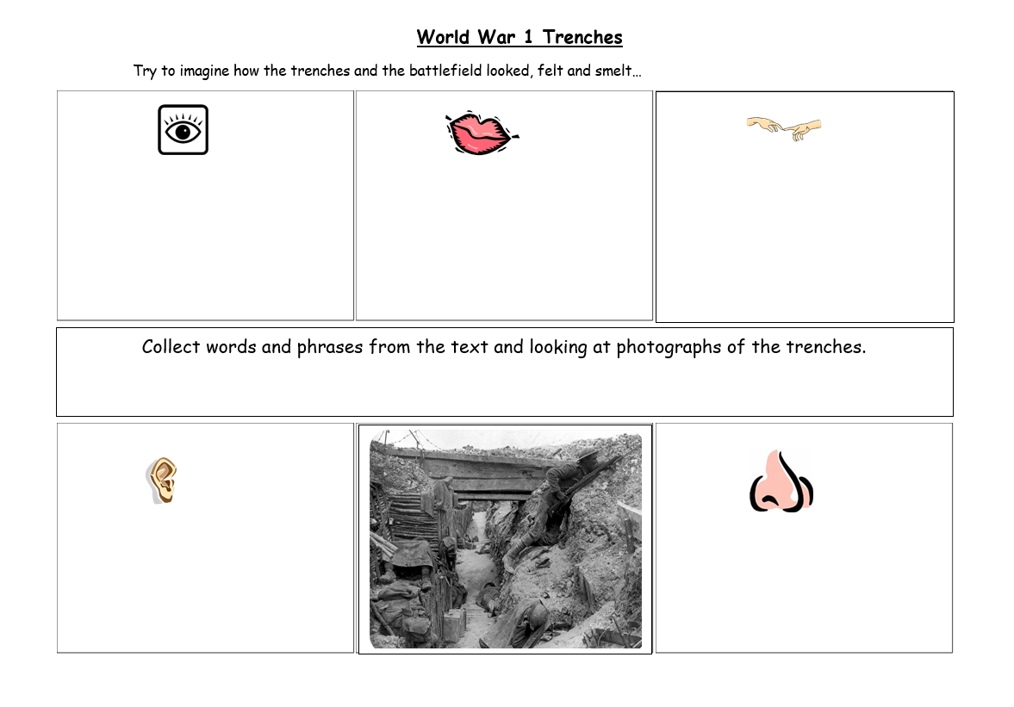

Slide 14
Day 3
Word of the day - staggered . The man was heavy and Bertie fell several times under his weight, but he got himself to his feet again and staggered on, until they tumbled together down into the trench.

Slide 15
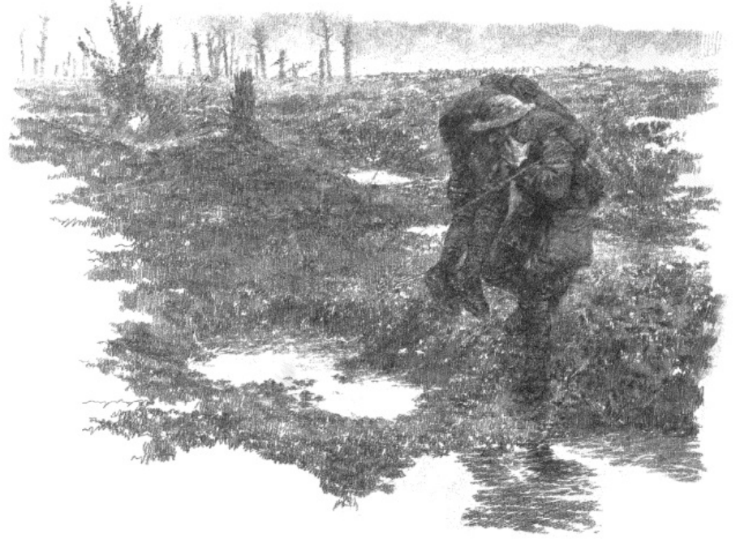
Hugging the ground, he was almost at the wire, almost back to safety, when he heard someone crying out in No Man’s Land. It was a cry he could not ignore. He found two of his men lying side by side, and so badly wounded that they could not move.
One of them was already unconscious. He hoisted him onto his shoulders and made for the trenches, the bullets whipping and whining around him. The man was heavy and Bertie fell several times under his weight, but he got himself to his feet again and staggered on, until they tumbled together down into the trench. The stretcher-bearers tried to take Bertie away. He’d bleed to death, they said. But he would not listen. One of his own men was still lying wounded out there in No Man’s Land, and he was going to bring him in, no matter what.

Slide 16
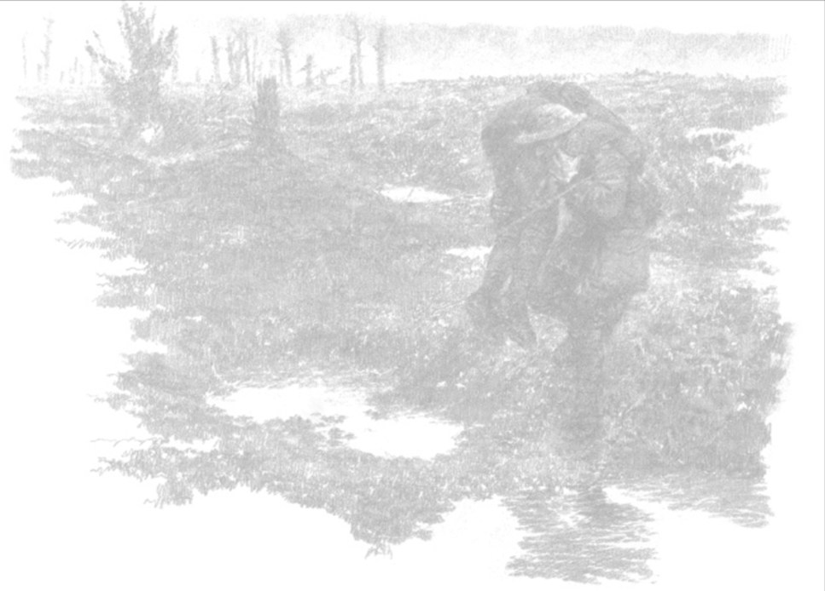
Spot the verbs in the passage- which do you find most effective?
Think about the repetition of ‘crawl’ echoing ‘walking’ the previous day.
Note whipping and whining- alliteration and onomatopoeia.

Slide 17
LO: to use senses to describe.
Go through the passage and explore trench warfare.
Using the verbs from the passage and additional language support. Write sentences using effective verbs. Mud squelched beneath my feet. Yellow tinged smoke lay over the battlefield. etc. Include two verbs in a sentence, alliterative examples etc.

Slide 18
Day 4
Word of the day- scarcely
The firing stopped almost at once. He was so weak himself by now that he could scarcely walk, but he managed to reach the wounded man and drag him back.
What does the word mean?

Slide 19
Waving his hands above his head, Bertie climbed out of the trench and walked forward. The firing stopped almost at once. He was so weak himself by now that he could scarcely walk, but he managed to reach the wounded man and drag him back. They say that in the end both sides, German and British, were up on the parapets and cheering him on as he stumbled back towards his lines. Then other men were running out to help him and after that he didn’t know any more.
When he woke up he found himself in hospital lying in a bed, with the two friends he had rescued on either side. He was still there some weeks later when he was told that he was to be awarded the Victoria Cross for his bravery under fire. He was the hero of the hour, the pride of his regiment.

Slide 20
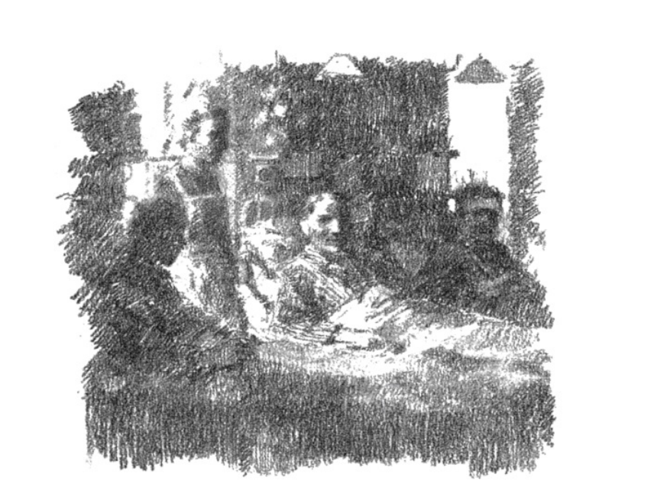
Afterwards Bertie always called it a “lot of old codswallop”. To be really brave, he said, you have to overcome fear. You have to be frightened in the first place, and he hadn’t been. There wasn’t time to be frightened. He did what he did without thinking, just as he had saved the white lion cub all those years before when he was a boy in Africa. Of course, they made a great fuss of him in the hospital, and he loved all that, but his leg did not heal as well as it should have. He was still there in the hospital when I found him.

Slide 21

LO: to write a description of life on the battlefields of World War I. Theme: Historical Novel World War I SC: I can use powerful verbs to describe. I can use varied sentence structure for impact. I can use fronted adverbial phrases.

Slide 22
“I experienced the close bond and trust between the officer and his men, I felt the cold, endless rain and horrific mud, I heard the endless noise of shelling and gunfire, realising very quickly why the life expectancy of these men was so short."
"On the Somme, not so bad for New Year's Day. Attached to the 49th Siege Battery. What a place. I wouldn’t have told anyone about this place. I hope we are not here long,"
Grimshaw's first entry on Jan. 1, 1917.
"This is what they call the Somme… Up to the neck in mud and water. Shells flying everywhere," Grimshaw continues on Jan. 2.
"The call was short, the blow severe/ I little knew that death was near. Only those that have lost are able to tell/ The pain that I felt at not saying farewell. Endy, Somewhere in France,“

Slide 23
1st July 1916, written on the western front
It is July 1st, 1916, the start of the Battle of the Somme, we had to go out of the trenches and walk into No-Man's-Land. I can't believe I've survived! The aim of this battle is to draw German forces away from Battle of Verdun, where the French forces are suffering severe losses. We are going to get out of the trenches and charge to the enemies, just like our commanders ordered us to do. We can't do anything about it. It's their orders and I bet they wouldn't care if I died. They've got plenty of soldiers. In fact 60 000 died today. How can they just forget and think like nothing has happened?
There is the constant smell of death. The constant feeling of getting bombed. It was a really horrible sight, seeing so many men die in just a few seconds. I remember praying that I would survive just before going over the top. I should've prayed for my friends.
One of my friends is a signaller. Most old soldiers will know what
this is. Bayonet drills, bombing practice, in short, all those exercises which were supposed to make an efficient soldier. He began to regret this. I can understand how he must've felt.
I can't believe I'm saying this but I wish I never joined the army. Those posters were nothing but lies. I wish I was back home to my family and not in this ghastly place. I can feel it will get much more worse. This is only the first day anyway.

Slide 24
Day 5
Word of the day-midst
In the midst of the suffering all around us, we needed some joy, believe me.

Slide 25
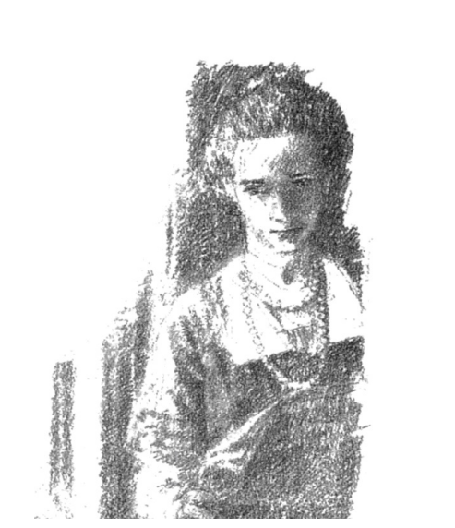
It was not entirely by accident that I found him. For over three years now there had been no letter, no word from him at all. He had warned me, I know, but the long silence was hard to bear. Every time the postman came, I hoped, and the pang of disappointment was sharper each time there was no letter from him. I told all to Nanny Mason who dried my tears and told me to pray, and that she would too. She was sure there’d be a letter soon.
Without Nanny I don’t know how I would have gone on living. I was so miserable. I had seen the wounded men coming back from France, blinded, gassed, crippled, and always dreaded seeing Bertie’s face amongst them. I had seen the long lists in the newspapers of all the men who had been killed or who were “missing”. I looked each day for his name and thanked God every time I did not find it. But still he never wrote, and I had to know why. I thought maybe he had been so badly wounded that he could not write, that he was lying in some hospital alone and unloved. So I determined I would become a nurse. I would go to France, and heal and comfort as best I could, and just hope that somehow I might find him. But I soon discovered that amongst so many men in uniform it would be hopeless to go looking for him. I did not even know his regiment, nor his rank. I had no idea where to begin.

Slide 26
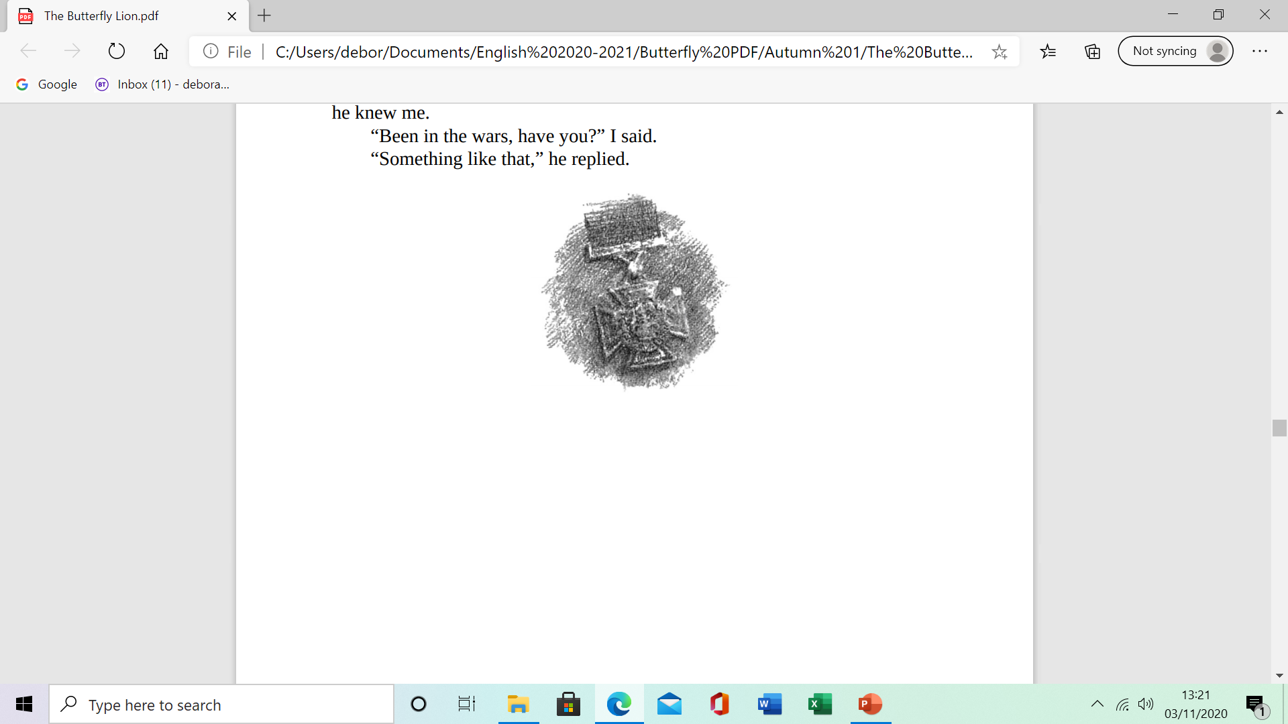
I was sent to a hospital some fifty miles behind the lines, not too far from Amiens. The hospital was a converted chateau with turrets and great wide staircases, and chandeliers in the wards. But it was so cold in winter that many of the men died as much from the cold as from their wounds. We did all we could for them, but we were short of doctors and short of medicines. There were always so many men coming in, and their wounds were terrible, so terrible. Each time we saved one it was such a joy to us. In the midst of the suffering all around us, we needed some joy, believe me.
I was at breakfast one morning – it was June of 1918. I was reading a magazine, the Illustrated London News, I remember, when I turned the page and saw a face I knew at once. He was older, thinner in the face and unsmiling, but I was sure it was Bertie. His eyes were deep-set and gentle, just as I remembered them. And there was his name: “Captain Albert Andrews VC”. There was a whole article underneath about what he had done, and how he was still recovering from his wounds in a hospital, a hospital that turned out to be little more than ten miles away. Wild horses would not have kept me from him. The next Sunday I cycled over. He was sleeping when I saw him first, propped up on his pillows, one hand behind his head. “Hello,” I said. He opened his eyes and frowned at me. It was a moment or two before he knew me. “Been in the wars, have you?” I said. “Something like that,” he replied.

Slide 27
Where does the old lady go?
What is different about the lion on the hillside when the boy looks outside?
What does the old lady say about the lion on the hillside and the one in the story?
What stopped Bertie from speaking about the fighting in the trenches for many years?
What did the soldiers do when the whistle blew?
What was No Man’s Land?
How was Bertie injured?
Why did the firing stop when Bertie went into No Man’s Land?
What honour was Bertie awarded?
Why was it hopeless for Millie to go looking for Bertie?
Where was Millie sent to?
What did Millie discover in the Illustrated London News?

