Slide 1
LO: to know the story of the visit of Jesus to Martha and Mary.
SC: I understand that this story teaches me the importance of prayer.
I can talk about the different choices made by Mary and Martha.

Slide 2
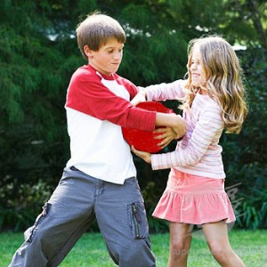
When did you last argue with a brother, sister or friend?
From time to time, disagreements happen.
Not everyone is the same.
Sometimes an argument arises over a task that needs to be done.

Slide 3
Our Bible story is about two sisters. They shared the same home (with their brother Lazarus), but had very different personalities.
Which of the sisters are you most like?

Slide 4
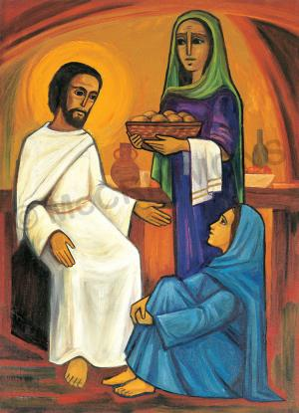
A tale of two sisters

Slide 5
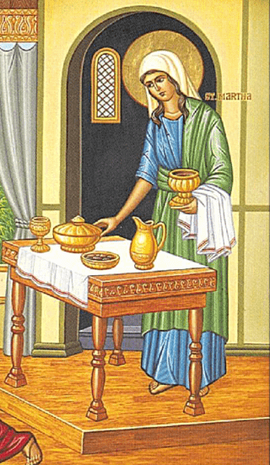
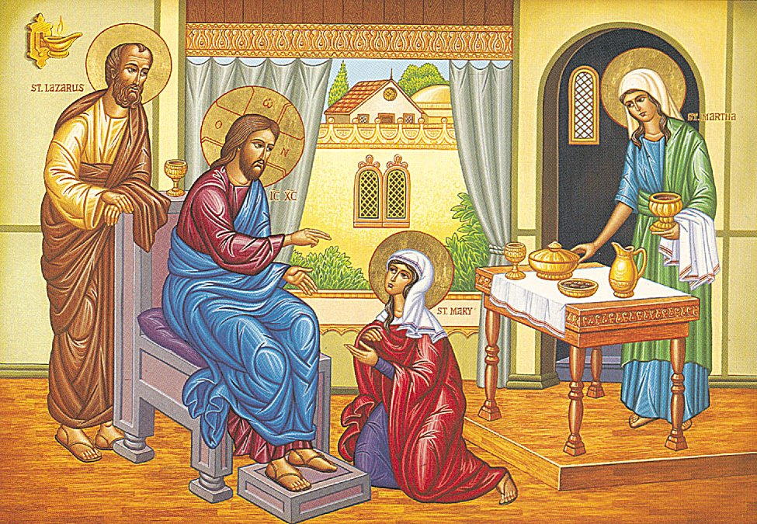
Martha loved to keep busy.
Martha could be very impatient.
Martha loved cooking.
Mary loved to think.
Mary was very calm.
Mary didn’t!

Slide 6
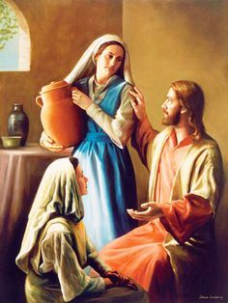
So, when Martha and Mary invited Jesus to their home this happened.

Slide 7

Martha laid the table.
Martha watched the oven
Martha cooked the dinner.
Mary sat on the floor.
Mary listened to Jesus.
Mary didn’t!

Slide 8
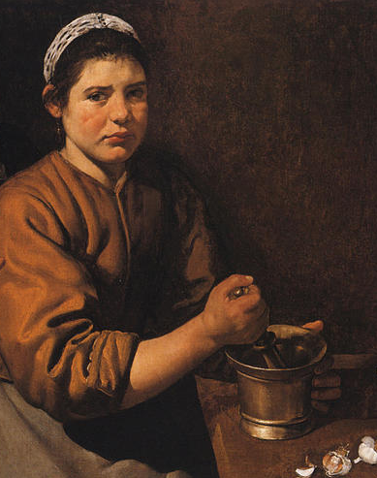
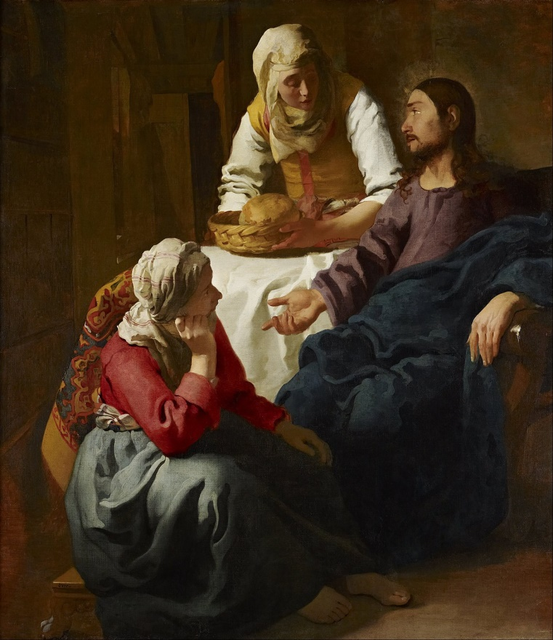
Martha was hot in the kitchen.
A pot boiled over.
Mary stayed in the cool.
Mary didn’t realise.

Slide 9
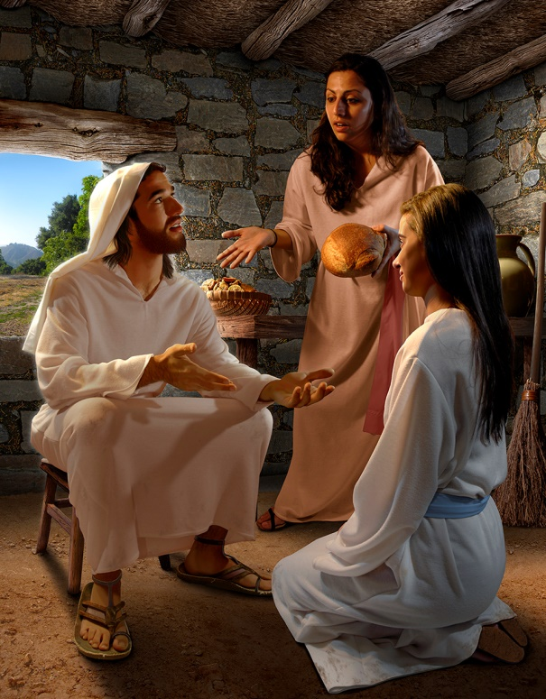
Finally, Martha’s anger boiled over too! ‘Mary, what kind of sister are you? Jesus, tell her to come and help me!’
‘Martha,’ Jesus replied, ‘I know you’re upset, but Mary is enjoying a special time that she’ll always remember.
Listening to me, Mary has chosen the better part.’

Slide 10
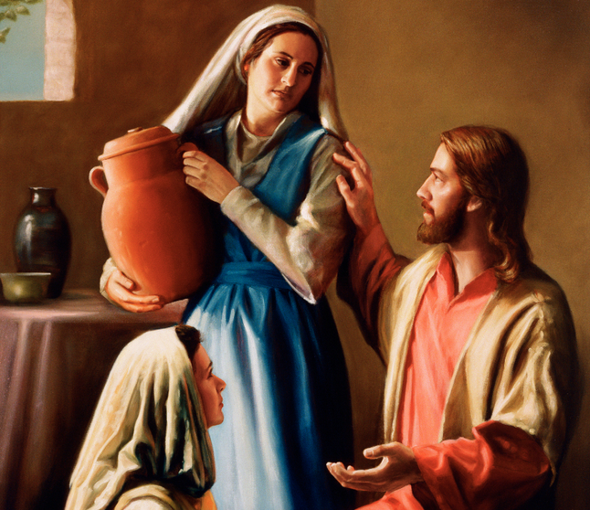
Why was Mary’s ‘the better part.’?
Think about:
What advice would they offer to Martha and Mary?
Did Mary eventually help Martha to serve her special meal and to clear up afterwards?
Was her sister’s plea for help ignored?

Slide 11
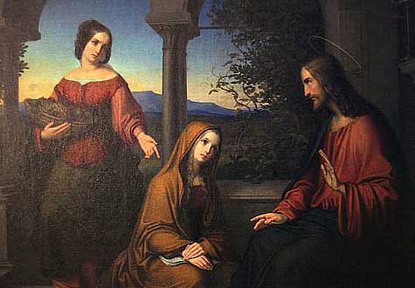
Mary sat in silence and listened to Jesus.

Slide 12
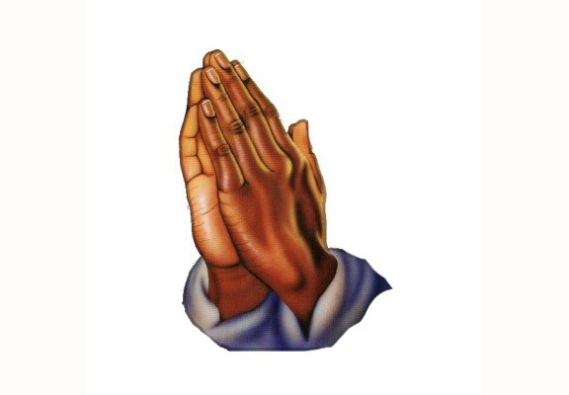
How does St Mary’s example help us as we pray?
Find some time to pray in silence and listen to Jesus.

